Slide 1


Concur Training
Travel Office
Contact: Traveloffice@csusm.edu

Slide 2
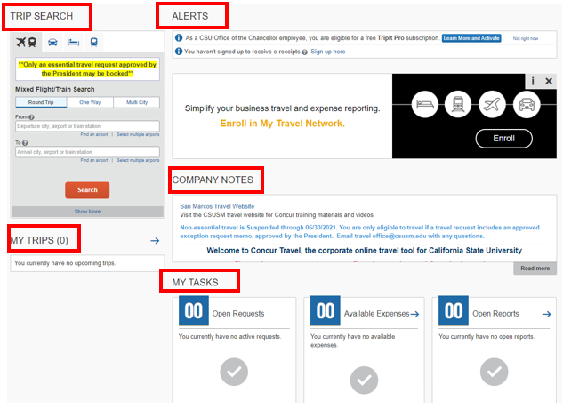

Concur Home Page

Slide 3
Concur
Home Page
Section | Description
Trip Search | This section provides the tools you need to book a trip with any or all of these: Flight: Use to book a flight. You can also book hotel and reserve a car at the same time. Car, Hotel, or Rail: Use to book hotels, reserve rental cars, etc. if not including them while booking a flight (Flight tab).
Alerts | This section displays informational alerts about Travel features.
Company Notes | Content is provided by Travel Office
My Trips | This section lists your upcoming trips.
My Tasks | This section lists Open Requests, Available Expenses, Open Reports and Required Approvals.

Slide 4
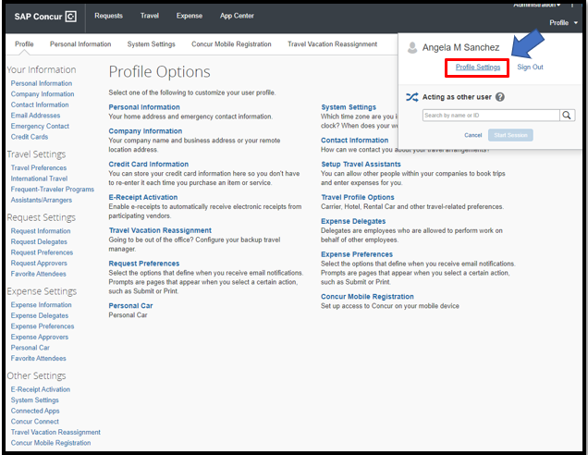

Review and Update Profile
Use the profile options to set or change your personal preferences.
To access your profile information:
Click Profile > Profile Settings. The Profile Options page appears.
Click the appropriate option from the left-side menu under Expense Settings.

Slide 5
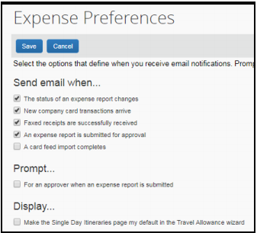
Expense Preferences
On the Expenses Preferences screen, you can select the options that define when you receive the following:
Email notifications
Prompts

Slide 6
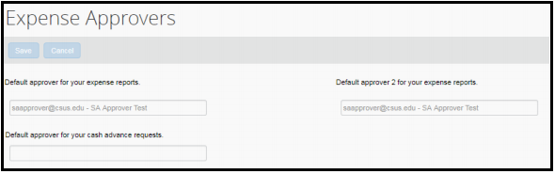
Expense Approvers
On the Expense Approvers screen, you can view your approver.

Slide 7
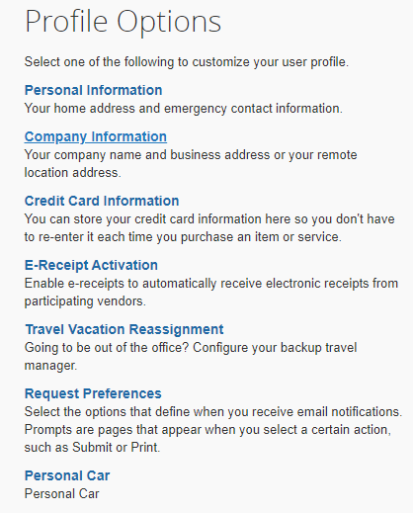
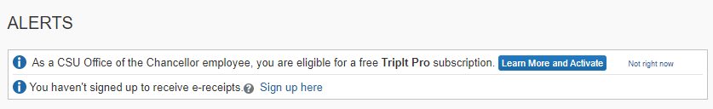
Enabling
E-Receipts
To sign up for e-receipts:
A message will appear on the home screen in the Alerts section, prompting you to sign up. On the home page, click Sign up here, and the E-Receipt Activation page will appear.
Click Profile > Profile Settings > E-Receipts Activation (in the Other Settings section of the left-side menu).

Slide 8
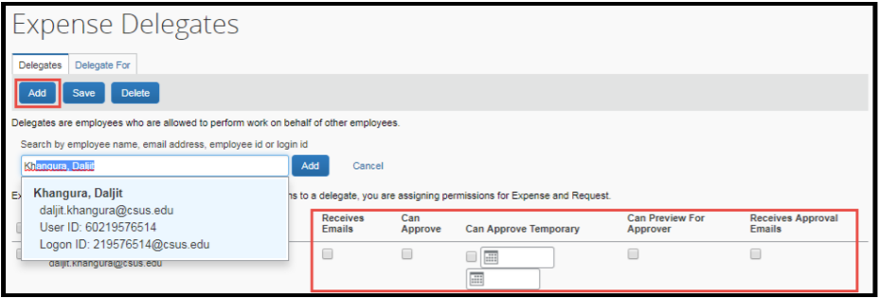
Adding Expense Delegates

Slide 9
Adding Expense Delegates
Action | Description
Can prepare | If selected, the delegate can create expense reports and requests on your behalf.
Option | If selected, the delegate can view receipt images on your behalf.
Receives Emails | If selected, the delegate receives a copy of each Expense related email that you receive, except for approval emails.
Can Approve | If selected, the delegate can approve expense reports, and requests on your behalf, without date constraints.
Can Approve Temporary | If selected, the delegate can approve expense reports and requests on your behalf but only for the specified period. If you select this option, you must also select beginning and ending date.
Delegate can preview for approver | If selected, the delegate can preview expense reports and requests on behalf of another employee.
Receives Approval Emails | If selected, the delegate receives a copy of each Expense approval-related email that you receive.

Slide 10
Submit a Travel Request
State employees using state funds should submit a travel request via concur.
The Travel Request should be submitted and approved prior to booking any travel.
Note: Per CSU Travel Procedures, Section IX.A "Travel Expense Claim must be submitted to the campus Travel Reimbursement office within 60 days of the end of a trip unless there is recurrent local travel, in which case Claims may be aggregated and submitted monthly." Please be aware Approved Travel Requests will automatically close 60 days after the travel end date

Slide 11
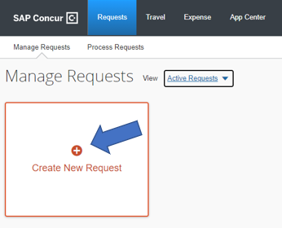
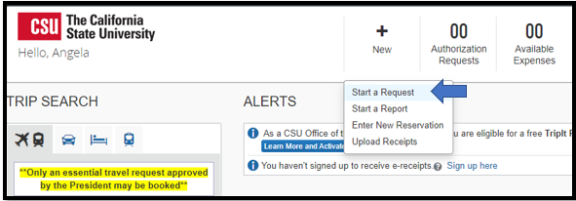
Submit a Travel Request
Click Request on the header toolbar, and then select New Request on the request page.
-or-
From the home page, click new, then start a request.

Slide 12
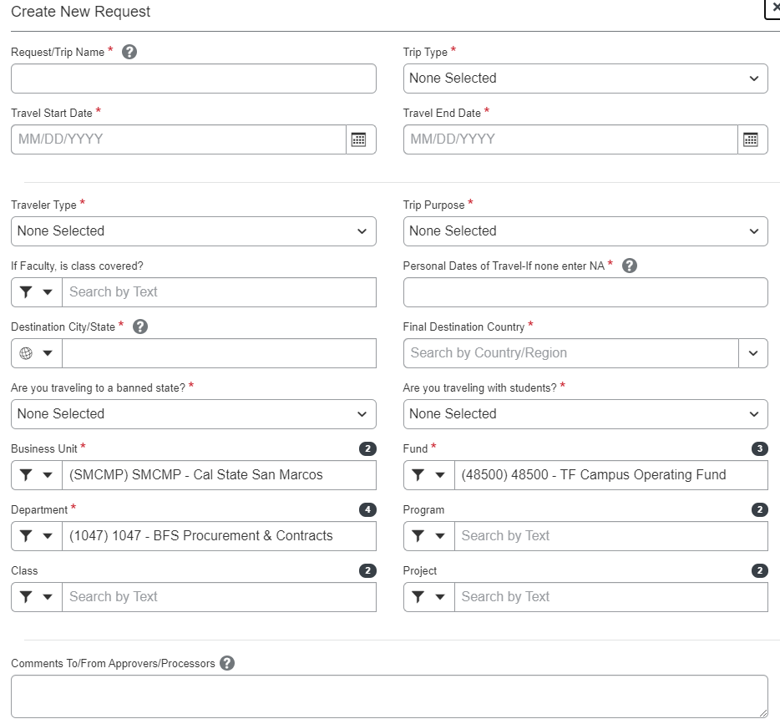
Submit a Travel Request
The Request Header tab appears. Complete all required fields with asterisk.

Slide 13
Submit a Travel Request
Field Name | Description
Request/Trip Name | Enter a meaningful trip name, similar to a name given to a travel expense report. Your department may implement a standard naming protocol. Suggested naming convention Destination City, State and dates of Travel (ex. Long Beach, CA 5/18-5/21)
Trip Type | Select from the drop-down list
How will you book you Trip? | 1 - Book via Concur Travel - Use the online booking travel wizard. 2 - Book Outside of Concur Travel - Book over phone with CBT or if arrangements will be made/paid for by another source other than CSUS.
Travel Start Date | Date business expenses start. If personal days precede business dates, please set travel start date to the date you leave for the trip.
Travel End Date | Date business expenses end. If personal days are after business dates please set travel end date to the date you return from trip.
Traveler Type | Select from the drop-down list
Trip Purpose | Select from the drop-down list
If Faculty, is class covered? | Only Required for Faculty. Select from the drop down list
Personal Date of Travel | Enter all dates which are personal. If none, place NA in field
Destination City/State | If you anticipate travelling to more than one city and/or country, enter where you plan to spend the majority of your travel time.
Final Destination Country | The country will pre-populate based on the destination city selected.
Are you traveling to a banned state? | Select from the drop-down list
Chart String | Chart field String will pre-populate based on your dept. If necessary, changes can be made by traveler or approver.

Slide 14
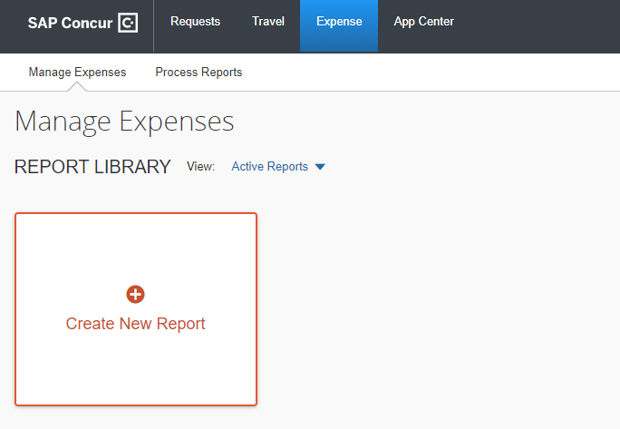
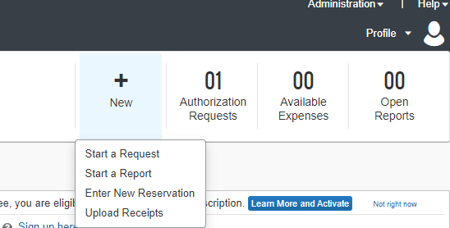
Creating a New Expense Report
To create a report:
On the home page, on the Quick Task Bar, place your mouse pointer over New, and then click Start a Report.
or –
Click Request on the header toolbar, and then select Expense under the Action column of the approved Request.

