Slide 1


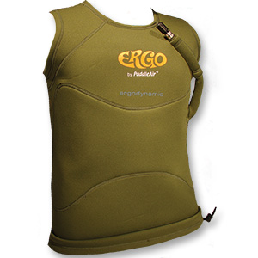
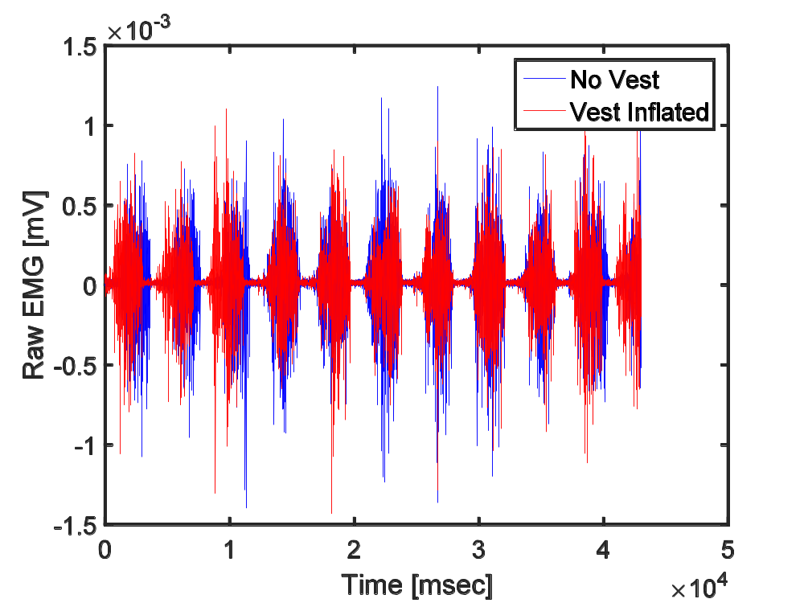
WEARING AN INFLATABLE VEST ALTERS TRUNK ANGLE AND MUSCLE ACTIVATION WHILE PADDLING A SURFBOARD
Jeff A. Nessler, Thomas Hastings, Kevin Greer, Sean C. Newcomer
¹Dept. of Kinesiology, California State University, San Marcos, CA 92096
ABSTRACT
RESULTS
BACKGROUND
METHODS
RESULTS
Low back pain is a commonly reported problem among recreational surfers. Some individuals report that wearing a vest with an inflatable bladder that alters trunk angle may help to alleviate pain. The purpose of this study was to determine whether such a vest has an effect on muscle activation and extension of the lower back while paddling a surfboard. Methods: Twelve recreational surfers completed 12 paddling trials at 1.1 m/s in a fresh water swim flume on both a shortboard and a longboard on two separate days. Three conditions of no vest, vest uninflated, and vest inflated were presented to participants in random order on each day. Surface EMG and trunk angle were acquired via wireless sensors placed over the right erector spinae, mid-trapezius, upper trapezius, and latissimus dorsi. Results: Wearing the inflated vest affected muscle activation: erector spinae and mid-trapezius demonstrated a significant decrease in activation relative to wearing no vest (12 and 18% decrease respectively, p<0.05). Trunk extension was also significantly reduced during the inflated vest condition (10-12% reduction, p<0.05). Results were similar for both the short and longboard, though this effect was greater while paddling the larger board. Conclusion: Wearing a vest with a properly inflated bladder between the surfer’s sternum and surfboard deck can alter trunk extension and muscle activity while paddling. These results may have implications for reducing low back pain in surfers.
Equipment
Ergo Vest (PaddleairTM) (Fig 1)
Wireless EMG with integrated, 3 axis accelerometer (Delsys Trigno) (Fig 2)
Modified swim flume with controllable water speed/temperature (Endless Pools) (Fig 2)
Figure 4 - Muscle activation while paddling a shortboard (top) and longboard (bottom) at a relative velocity of 1.1 m/s. Bars represent standard error of the mean. Superscript ª denotes statistically significant decrease relative to the no vest condition (p<.05) and ^{b} denotes statistically significant decrease relative to the vest no inflate condition.
Figure 1 The Ergo Vest by PaddleairTM.
Figure 2 Instrumented subject paddling a shortboard in the swim flume without a vest.
BACKGROUND
Procedures
Figure 5 - Measures of trunk extension angle while paddling a shortboard or longboard in a swim flume at 1.1 m/s. Trunk angle was calculated from the acceleration data acquired from the EMG sensor placed over the mid-trapezius. Bars represent standard error of the mean. Superscript ª denotes statistically significant decrease relative to the no vest condition (p<.05).
Surfing is increasing in popularity. There are approximately 10-20 million people participating in surfing worldwide more more than 2.1 million surfers in the United States alone.¹
Participation in the sport of surfing is a beneficial form of exercise. Participants often generate physical activity levels consistent with recommendations by ACSM and the CDC.²⁻⁴
Research into the optimization of equipment design for surfing is sparse. Low back pain is a common problem among recreational surfers that might be address through strategic design of surfing equipment.⁵
The Ergo Vest (PaddleairTM) was developed with the goal of reducing low back pain. This vest supports the trunk with an inflatable bladder located on the anterior aspect of the mid torso, directly over the surfer’s sternum (Fig 1).
If pain and discomfort can be reduced by using this device, the athlete may be able to surf longer and realize more of the benefits of physical activity.
Participants performed 12 paddling trials (1 minute each) over 2 separate days: 6 trials with shortboard, 6 trials with longboard. Each day, 2 trials were performed under each of the 3 vest conditions, presented in random order.
Vest conditions: 1) no vest, 2) vest worn but not inflated, 3) vest worn and inflated
Water velocity was set to a constant speed of 1.1 m/s, water temperature maintained between 18 and 21C.
Surface EMG was used to record activity from erector spinae (lumbar region), mid trapezius, upper trapezius, and upper latissimus dorsi of the right side (Fig 2).
Waterproof bandages were placed over each sensor to avoid water damage.
EMG sensors were removed and replaced between data collection on separate days.
Accelerometer data from the mid trapezius sensor was used as an estimate of trunk extension for comparison across vest conditions.
Raw EMG and accelerations were rectified and filtered (4th order butterworth, 25 Hz cutoff).
Muscle activation and tilt angle were compared across vest conditions using repeated measures ANOVA + paired t-test.
CONCLUSIONS
Back extensor muscle activation and trunk extension angle are altered in a prone surfer while wearing a vest with a small inflated bladder between their sternum and the deck of the surfboard.
No differences in muscle activation were noted between the no vest and uninflated vest conditions, suggesting that changes in muscle activity are primarily due to bladder inflation rather than mechanical compression.
This effect was similar for both the shortboard and longboard.
The purpose of this study was to determine whether wearing the Ergo Vest alters trunk extension and the activation of four back and/or shoulder muscles while paddling both a small and large surfboard.
RESULTS
REFERENCES
METHODS
International Surfing Association.
LaLanne, C.L., Cannady, M.S., Moon, J.F., Taylor, D.L., Nessler, J.A., Crocker G.H., Newcomer, S.C. (in press).Characterization of activity and cardiovascular response during surfing in recreational male surfers between the ages of 18-75 years old. J Aging and Physical Activity.
Bravo, M., Nessler, J.A., Cummins, K., Newcomer, S.C. (2015). Heart rate responses of high school students participating in surfing physical education. J Strength and Conditioning Research.
Mendez-Villanueva, A., Perez-Landaluce, J., Bishop, D., Fernandez-Garcia, B., Ortolano, R., Leibar, X., & Terrados, N. (2005). Upper body aerobic fitness comparison between two groups of competitive surfboard riders. J. Sci Med Sport, 8(1), 43-51.
Furness, J., Hing, W.A., Abbot, A. Walsh, J., Sheppard, J.M., & Climstein, M. (2014). Retrospective analysis of chronic injuries in recreational and competitive surfers: injury location, type, and mechanism. Int J Aquatics Res Ed, 8(3), 277-287.
Table 1 Subject Characteristics
Figure 3 – Raw EMG activity of Latissimus Dorsi under two different vest conditions for a representative subject.
Age [yrs] | Height [m] | Mass [kg]
25.3±6.1 | 1.8±0.1 | 74.7±5.4
12 recreational surfers performed a series of paddling tests. Surfers were at least 18 years of age and indicated that they engaged in surfing for at least 4 hours per week.

