Slide 1


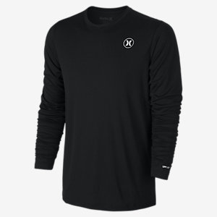
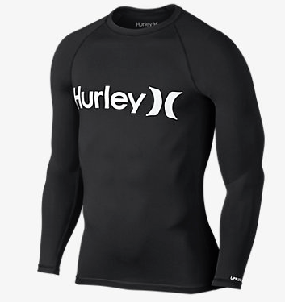
THERMOREGULATORY EFFECTS OF SHIRT VARIATION WHILE SURFING IN TROPICAL ENVIRONMENTS
Knudson, Keith, Bernath, Christopher, Homan, Jeffrey, Smetanka, Robert, Nessler, Jeff A., Newcomer, Sean C.
Department of Kinesiology, California State University, San Marcos, CA, 92096
Abstract
Subject characteristics
Purpose: In hot environments, loose clothing is often utilized to protect from the sun and to aid in the cooling process. This has lead surf apparel companies to create a loose fitting surf shirt as a substitute for the traditional rash guard, primarily for use in tropical areas. The effectiveness of these shirts in the thermoregulation process while surfing, however, is unknown. The purpose of this study was to investigate the thermoregulatory effects of wearing a surf shirt instead of a traditionally worn rash guard or no shirt while surfing in a tropical environment. We hypothesized that skin temperature while surfing would be lower while wearing a surf shirt compared to a rash guard or no shirt. Methods: 16 surfers (13 males, 3 females, mean age 23.3+/-8.8 years) completed 3 randomized surfing trials in Costa Rica. Each trial consisted of a 20-minute surfing session wearing either a surf shirt, rash guard, or no shirt. Skin temperatures were measured during each trial at 1-minute intervals using thermistors (iButton Thermochrons) placed on the skin at two locations. Skin temperatures were taken prior to and after each surf session on the right hand using a Fluker Foodpro Plus Infrared Thermometer to account for potential differences in starting skin temperatures between trials. Average heart rate (HR) was measured during each trial using a HR monitor (Polar F21) to examine whether surfing intensity was consistent between trials. Results: No significant differences were observed in mean HR (P=.48) and mean starting skin temperatures (P=.46) between the surf shirt, rash guard, and no shirt trials. Further, no significant differences were observed in skin temperatures between the three trials on either the back (P=.12) or the chest (P=.06). Conclusion: These data suggest that shirt type does not significantly affect the body's thermoregulatory process while surfing.
.
Table 1: All Values are recorded as mean ± SD
 | Age (yrs) | Height (in) | Weight (lbs) | Experience (yrs) | Board Height (in) | Water Temp (C) | Air Temp (C)
Mean | 28.3±8.8 | 69.7±2.4 | 159.1±22.2 | 15.3±13.1 | 69.9±1.8 | 28.5±1.1 | 29.4±1.4
.
Hurley Dri-Fit long sleeve men's surf shirt. UVB and UVA protection of covered areas(50spf), made of 100% polyester.
Hurley One and Only Men’s rash guard. UVB and UVA protection of covered areas(50spf), made of 88% nylon and 12% spandex.
Subject Preferences
Results
Table 2: Values are recorded as mean ± SD
 | Surf Shirt | Rash Guard | None
Average Rating | 1.9±0.9 | 1.8±0.7 | 2.2±0.9
Total Top Preference Votes | 6.0 | 5.0 | 5.0
Background
Recent trends have shown that surfers in tropical climates have been wearing regular cotton shirts to provide protection from the sun and serve as barrier between the board and the surfers chest. This has lead surf apparel companies to create a loose fitting surf shirt that possess the beneficial properties of both a rash guard and a cotton shirt. Research has shown that specialized attire can provide thermoregulatory benefits during running (Filingeri et Al., 2015), however no studies have been conducted in surfing. This protocol explored the thermoregulatory properties of Hurley’s Surf Shirt among surfers in Costa Rica.
Conclusions
There were no significant differences in skin temperature between surf shirt and rash guard (p=0.52 and p=0.93 for front and back, respectively), however, a nonsignificant trend revealed that wearing a rash guard or surf shirt may have a cooling effect as opposed to wearing no shirt (p=0.06 and p=0.07 for rash guard vs no shirt, front and back, respectively, and p=0.07 and p=0.20 for surf shirt vs no shirt, front and back, respectively.)
No significant differences in mean heart rate or mean starting temperature were observed (p=0.48 and p=0.46, respectively), indicating that the results were not influenced by differences in baseline skin temperatures and exercise intensities.
These data indicate that wearing some type of shirt while surfing in a hot and humid environments may have a positive thermoregulatory effect. The type of shirt worn, however, does not appear to have further thermoregulatory benefits. Surf apparel companies such as Hurley may therefore manufacture products based on aesthetic profiles, rather than physiological responses in skin temperature.
Further research should be conducted on preference, as rash guards had the top average rating, while surf shirt had the most number one votes in regards to preference.
Purpose
To test the hypothesis that skin temperature while surfing would be lower while wearing a surf shirt compared to a rash guard or no shirt.
Methods
Figure 1: Mean skin temperature over time. All values are reported as mean ± SD. * p<.05
Figure 2. Mean skin temperature between shirt types. All values are reported as mean ± SD. * p<.05
SUBJECTS
Subjects were male and female surfers ages 20-45 years, with at least one year of surfing experience.
PROTOCOL
Data was collected at Playa Guiones in Nosara, Costa Rica.
Informed written consent was obtained for each subject prior to participation.
Subjects completed a surfing questionnaire that consisted of questions related to age, height, weight, years surfed, board height and fin set up.
A heart rate transmitter (Polar T31-Coded) was attached to each subject under their sternum using an elastic chest strap.
A heart rate receiver watch (Polar F21) was attached to the subject’s wrist.
A thermistor (iButton Thermochron) was attached to the skin superficial to the upper right pectoralis major and another on the skin superficial to the right upper trapezius using Nexcare Tegaderm dressings.
Order of the interventions were randomized for each subject (rash guard, surf shirt, no shirt).
Following instrumentation, each subject participated in three 20 minute, self paced surf sessions.
Thermistors recorded chest and back temperature at one minute intervals.
Upon completion subjects were asked to rate each shirt based on preference.
STATISTICAL ANALYSIS
VassarStats was used to run RMANOVA on the data. Further t-tests were performed using Microsoft Excel. Statistical significance was set at alpha=.05.
All data is presented as mean ± standard deviation.
References
Filingeri, D., Fournet, D., Hodder, S., & Havenith, G. (2015). Mild evaporative cooling applied to the torso provides thermoregulatory benefits during running in the heat. Scandinavian Journal of Medicine & Science in Sports, 25, 200-210. doi:10.1111/sms.12322
Figure 3: Mean heart rate between shirt types. Values are reported as mean ± SD. * p<.05
Figure 4: Mean starting temperature between shirt types. Values are reported as mean ± SD. * p<.05
Acknowledgements
We would like to acknowledge Haley Villanueva, Will Clark, Marco Lopez, and Katie Harris for assisting with this study. Additionally, we would like to thanks the subjects who took time to participate in this study and Hurley for product donatation.

