Slide 1

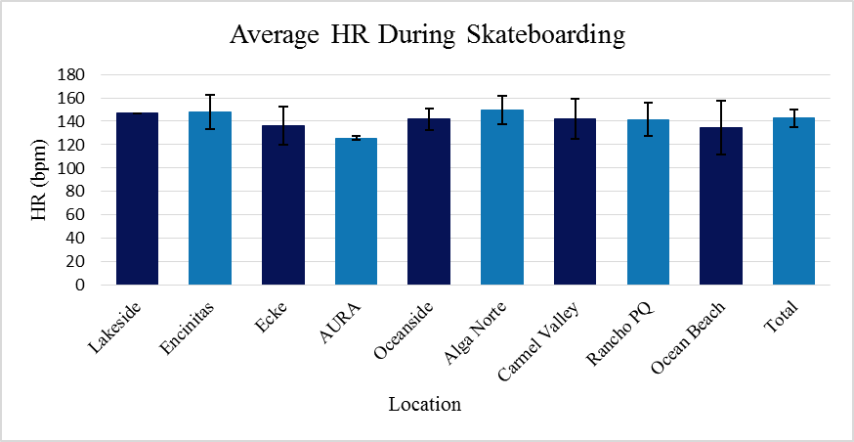
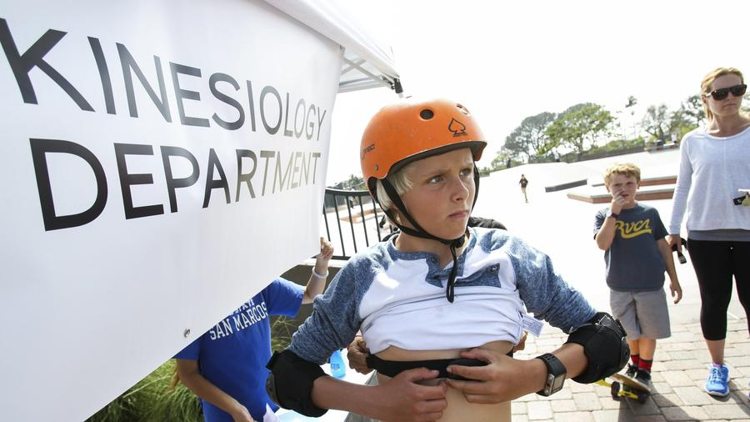
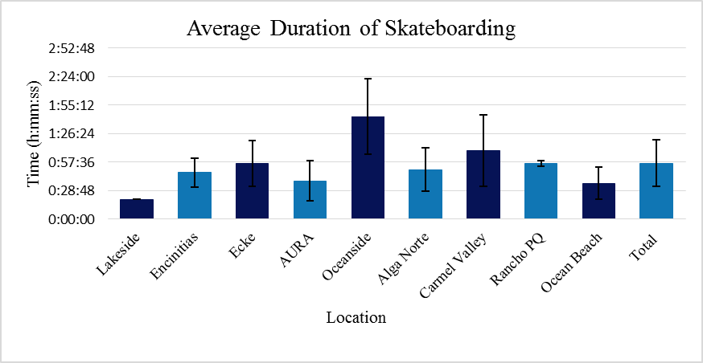
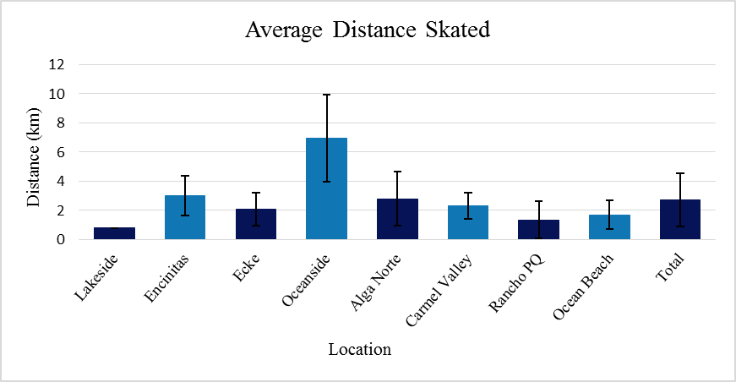
CARDIOVASCULAR RESPONSES TO RECREATIONAL SKATEBOARDING IN YOUTH
Furr, Heather N., Palma, Gavin M., Wosk, Moses E., Nessler, Jeff A., Newcomer, Sean C.
Department of Kinesiology, California State University San Marcos, CA
Abstract
Results
Subject Characteristics
Background: Recreational skateboarding continues to gain popularity in youth within the United States and abroad. Surprisingly there is a paucity of research regarding the cardiovascular responses of youth participating in recreational skateboarding.
Purpose: Therefore, the purpose of this study was to test the hypothesis that skateboarding would elicit heart rates and durations consistent with the American College of Sports Medicine (ACSM) recommendations for cardiovascular fitness in youth.
Methods: Seventy-three recreational skateboarders (Male: 65, Female: 8) between the ages of 6 and 17 years old participated in this study. Data were acquired at nine skate parks in the local community. Following parental consent, participants completed a questionnaire and were instrumented with a heart rate monitor (Polar V800 GPS Sports Watch), which recorded heart rate, duration, and distance at one second intervals. Prior to their session, participants were instructed to engage in typical skateboarding activities, with the duration and intensity of activity determined by the individual.
Results: Participants were 10.6±2.9 years old and had participated in skateboarding for 3.1±2.4 years. Subjects skateboarded on average 56±24 minutes, at a heart rate of 142.8±7.6 bpm, and covered a distance of 2.7±1.8 km.
Conclusion: Results from this study suggest that youth participating in recreational skateboarding at community skate parks attain exercise intensities and durations that are comparable with the ACSM’s exercise recommendations for cardiovascular fitness in youth. These findings may hold implications for city planners considering the impact of community skateparks on physical activity in youth and overall public health.
Figure 1: Average heart rate during skateboarding at each individual skate park and as a total group.
Table 1: Subject Characteristics expressed in Mean ± SD
Background
Subject | Height (in.) | Weight (lbs) | Age (Years) | Experience (Years) | Sample Size
Average | 56.3±27.4 | 82.8±27.8 | 10.6±2.9 | 3.1±2.4 | 73
Skateboarding participants report seeing the activity as a lifestyle rather than a sport (Wheaton, 2004).
In 2012, a petition stating that skateboarding was not considered a sport was signed by skateboarders themselves, preventing the activity from making its first debut in the 2012 Olympics (Thorpe, 2011).
The number of youth skateboarding participants between 6 and 17 years of age in the United States has decreased from 8.75 million in 2006, to 3.9 million in 2014 (Statista, 2015).
Parents play a major role in enabling their children to participate in physical activities and sports (Allender, 2006).
The way adults view skateboarding may contribute to the decline in skating among the youth population, because it is unclear if skateboarding provides any health benefits to their children (Bairner, 2009).
Only one research study has investigated the cardiovascular demands of street skateboarding in adults, which provides limited insight into the cardiovascular demands of youth participating in recreational skateboarding at community skate parks.
Results
Participant’s heart rate averaged 142.8±7.6 bpm, which represents approximately 70% of age predicted maximal heart rate (Figure 1).
Average duration of participating in skateboarding was 56±24 minutes (Figure 2).
Skateboarding distance averaged 2.7±1.8 km per skate session (Figure 3).
Purpose
Conclusion
Figure 2: Average duration of skateboarding at each individual skate park and as a total group.
In conclusion, this study suggests that skateboarding does meet the ACSM’s recommendations for cardiovascular fitness and health in youth between the ages of 6-17.
Children that show interest in skateboarding should be motivated by adults to participate in an activity that provides cardiovascular fitness and health benefits.
The purpose of this study was to test the hypothesis that skateboarding in community skate parks would elicit heart rates and durations consistent with the American College of Sports Medicine (ACSM) recommendations for cardiovascular fitness in youth.
.
Average Distance Traveled per Skateboarding Session
References
Methods
Subjects:
N=73, 65 males and 8 females
Ages 6-17 years old
A minimum of 1 year skateboarding experience
Parents and subjects signed informed consent and answered a one page questionnaire prior to participation
Measurements / Equipment:
Heart rate, distance, and duration were collected at 1 second intervals using a H7 heart rate transmitter and Polar V800 receiver (Polar Electro Inc.)
Subjects used their own skateboards and protective gear
Data was collected at nine separate San Diego community skate parks (Lakeside, Encinitas, Ecke, AURA, Oceanside, Alga Norte, Carmel Valley, Rancho Peñasquitos, and Ocean Beach)
Protocol:
Subjects were instrumented with a H7 heart rate transmitter and Polar V800 receiver.
Subjects were asked to wear sweatband over the Polar V800 receiver to protect against damages during a fall and to blind the subjects from heart rate responses during skateboarding.
Subjects were asked to perform typical skateboarding activities at self determined durations and intensities.
Statistics:
Means and standard deviations for heart rate, duration, and distance were calculated using Microsoft Excel
American College of Sports Medicine. (n.d.). Retrieved October 08, 2016, from http://acsm.org/
Allender, S., Cowburn, G., & Foster, C. (2006). Understanding participation in sport and physical activity among children and adults: A review of qualitative studies. Health Education Research, 21(6), 826-835. doi:10.1093/her/cyl063
Bairner A (2009) Book review: Olympic Industry Resistance: Challenging Olympic Power and Propaganda. Canadian Journal of Sociology 34(3): 969–71.
Thorpe, H., & Wheaton, B. (2011). 'Generation X Games', Action Sports and the Olympic Movement: Understanding the Cultural Politics of Incorporation. Sociology, 45(5), 830-847. doi:10.1177/0038038511413427
Wheaton B (2004) Introduction: Mapping the lifestyle sport-scape. In: Wheaton B (ed.) Understanding Lifestyle Sports: Consumption, Identity and Difference. London: Routledge.
Acknowledgements
Figure 3: Average distance traveled per skateboarding session at each individual skate park and as a total group.
Acknowledgements
We would like to acknowledge and thank the participants and their parents for being a part of this study, the Spring 2016 Kinesiology 326 Exercise Physiology class, and all student interns who the helped collect data for this study.
Notes:
1

