Slide 1


Teacher
Credential Application Guide
Fall 2025

Slide 2

A Message for Future Cougars
The School of Education is here to help you in your educational journey. From helping with filling out the application to providing guidance on helpful resources and understanding each requirement. We are excited as you have chosen a path that will empower you to empower others through knowledge. We look forward to helping you achieve your goals!

Slide 3



To start visit
Select Fall 2025 for the Term to Apply For
Click Apply
Once Redirected to the Sign In page, Select Create an Account
Fill in:
  Your Legal Name
  Contact Information
    The Email Address you use will be used across all Cal State Apply Applications!
  Text and Phone Authorization (optional)
  Username and Password
  Terms and conditions
  European Union Data Protection
Once complete you will be asked to fill out an Extended Profile
Fill In:
  Degree Goal
  Returning Question
  US Military Status
  International Applicant Question
Once your account has been created, you will be redirected to Add Programs to your application. This is where you will select the credential program that you interested in applying to.

Slide 4
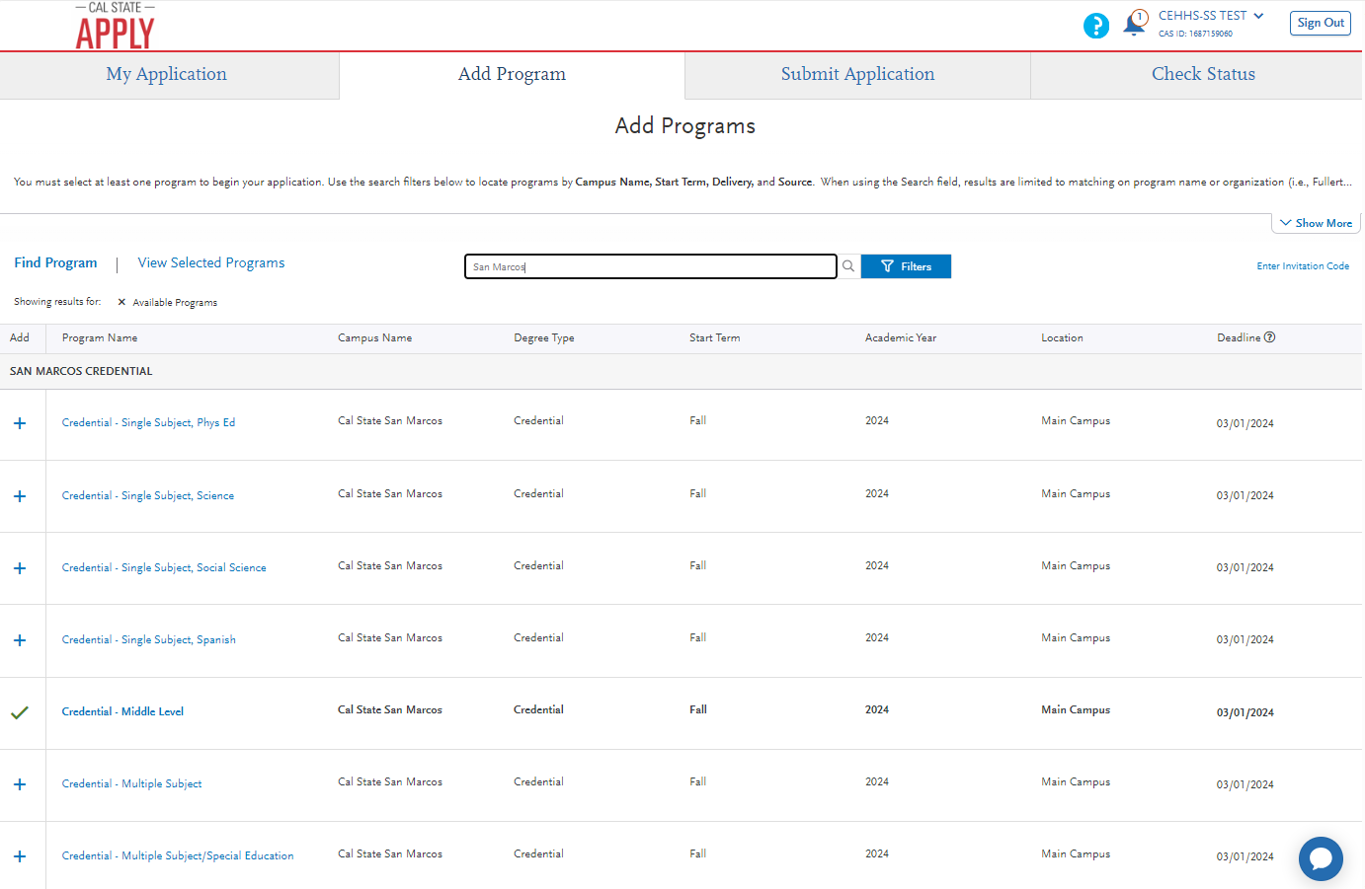





Using the Filter, search for San Marcos.
Once filtered, you should see San Marcos Credential under Program Name.
Click the + sign to add the program you wish to apply for to your application (a green check will appear once selected).
Reminder: For this application, only one program may be selected for each term per campus!
After selecting a Program, select Continue below. You will be asked to review your Program Selections.

Slide 5
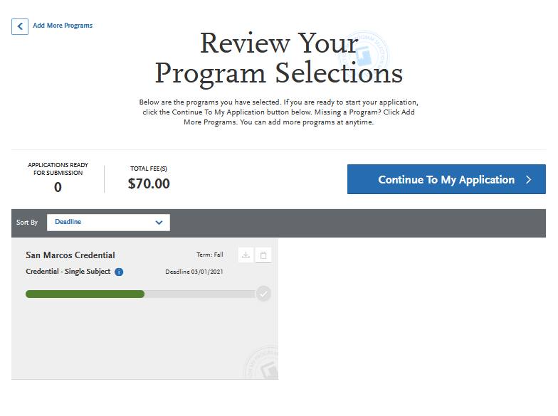



Applying through Cal State Apply will cost $70. You will not pay this fee now. You will be required to pay once you submit your completed application.
Verify that the program selection matches the one that you choose.
After verifying that the program looks correct, select Continue To My Application, which will take you to the My Application homepage.

Slide 6
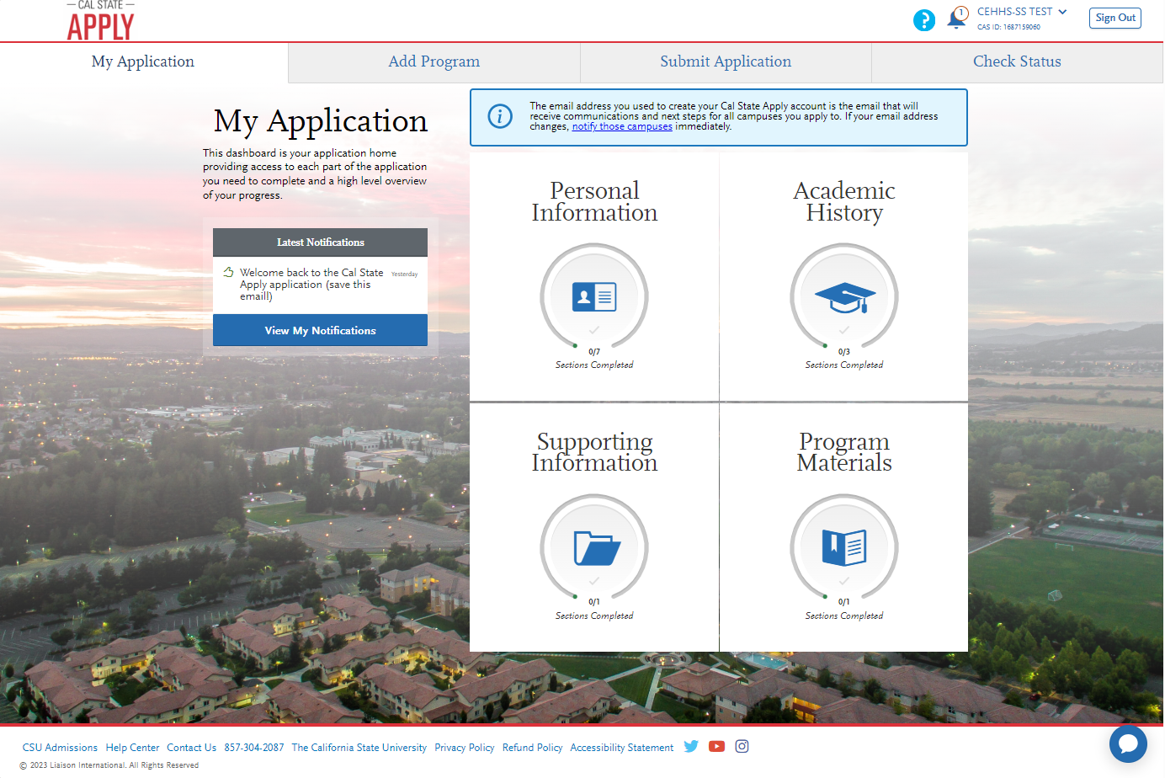
1
2
On the My Application homepage, there are four main sections to the application:
  Personal Information
  Academic History
  Supporting Information
  Program Materials
3
4
Each of the main sections have additional subsections, which are outlined on the next page.
It can also be helpful to fill out the application in order, starting with Personal Information.

Slide 7
Release Statement
Colleges Attended
Experiences
Credential – Credential Specific
Biographic Information
GPA Entries
Contact Information
Standardized Tests
Citizenship/Residency Information
Race & Ethnicity
Each section has multiple sub-sections that need to be filled out prior to submitting the application. The next few pages of this guide will provide additional information for sections that may require additional context to complete.
Other Information
Financial and Parental Information

Slide 8
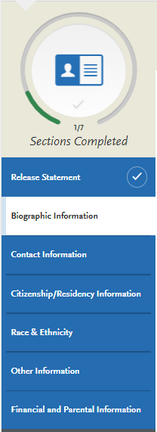


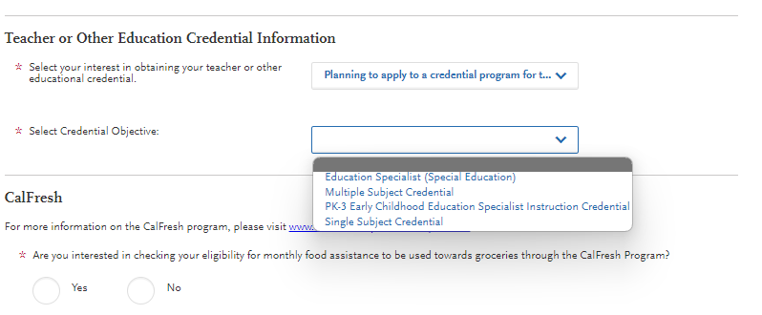
Begin filling out the Personal Information Section of your application, starting with the Release Statement subsection.
Once you have completed a subsection a check mark will appear next the subsections heading.
Release Statement
Biographic Information
Contact Information
Citizenship/Residency Information
Race & Ethnicity
Other Information
Financial and Parental Information
The Teacher or other Education Credential Question, does not have an impact on admissions decision. If you are pursuing a Middle Level Program, select either Single Subject or Multiple Subject Credential.

Slide 9
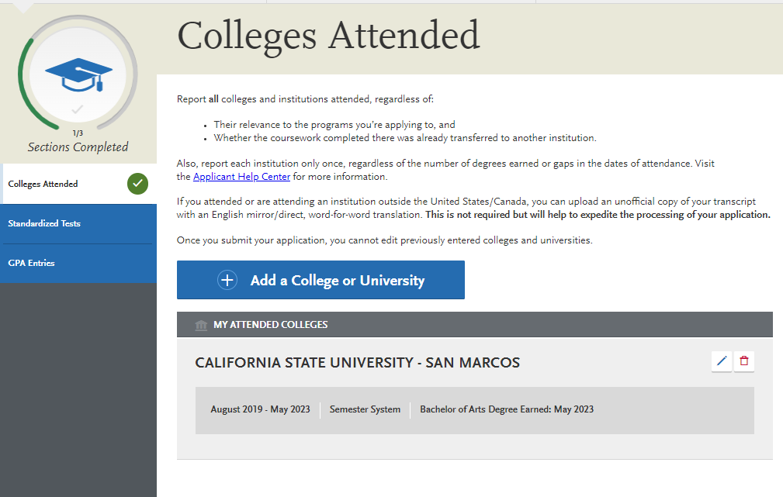
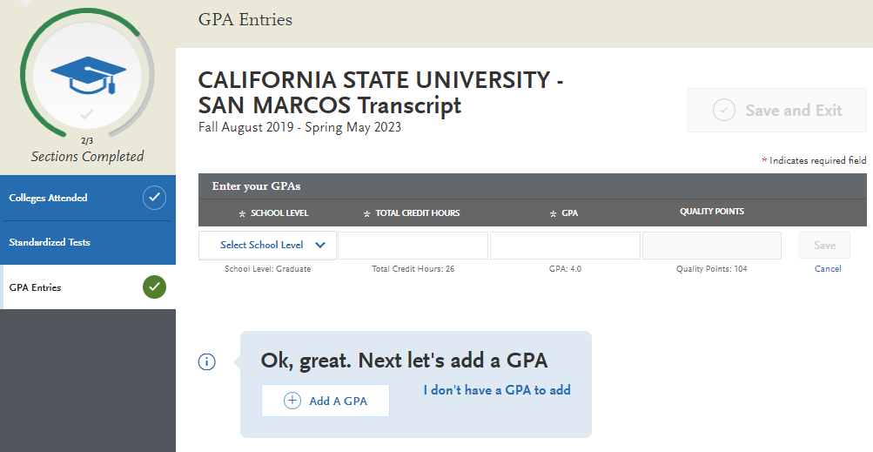
Be sure to include all higher education institutions that you have attended.
Colleges Attended
GPA Entries
Standardized Tests
Enter your Total Credit Hours and cumulative GPA for each higher education institution that you have attended.

Slide 10
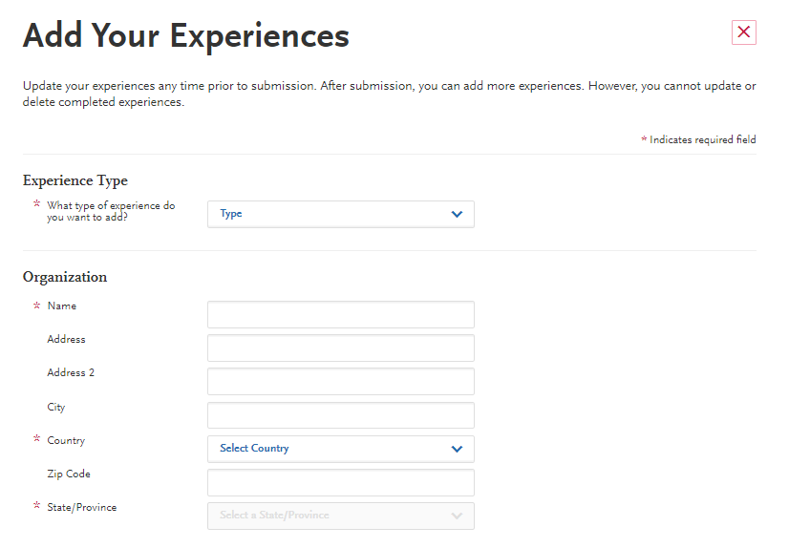
Experiences
Highlight any relevant experience that you would like to include with your application!
This information helps to provide additional context for the admissions committee as to why you are interested in a teaching credential program. If you do not have any relevant experiences – no problem! Simply select I do not wish to add any experiences.

Slide 11
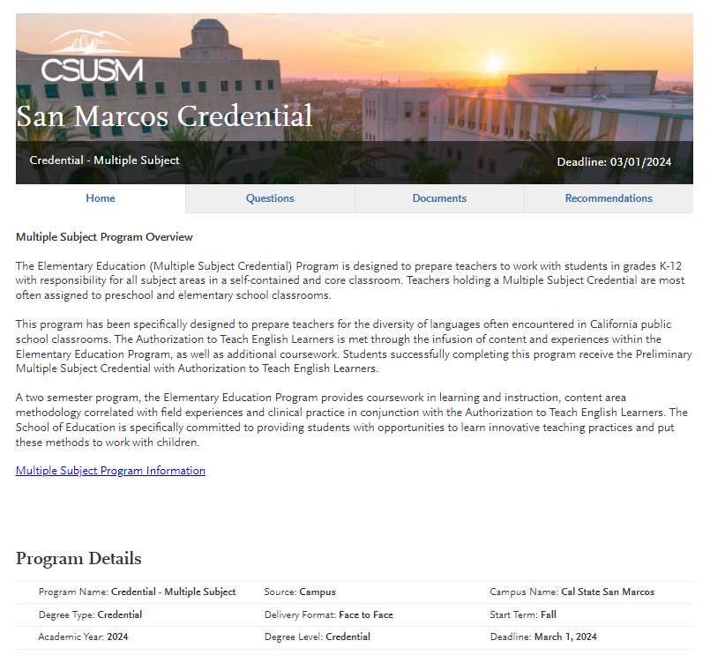


Credential – Credential Specific
Before beginning, verify that you are applying to the correct program using the information listed under Program Details.
If the information is correct, proceed by clicking the Questions tab above.

Slide 12
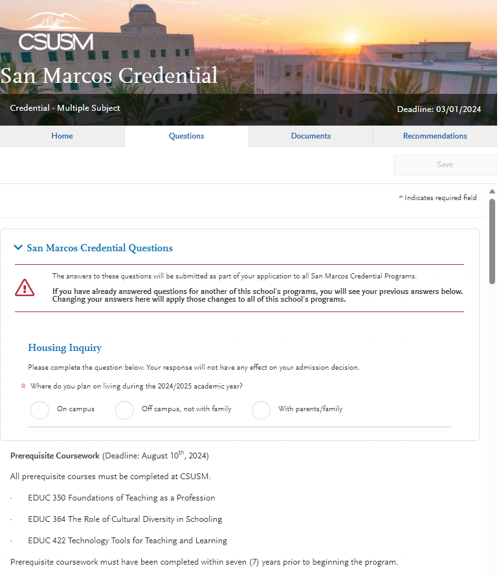
The first set of San Marcos Credential Questions starts with a Housing Inquiry and then provides a list of all requirements that must be completed in order for admission into the program.
Credential – Credential Specific

Slide 13
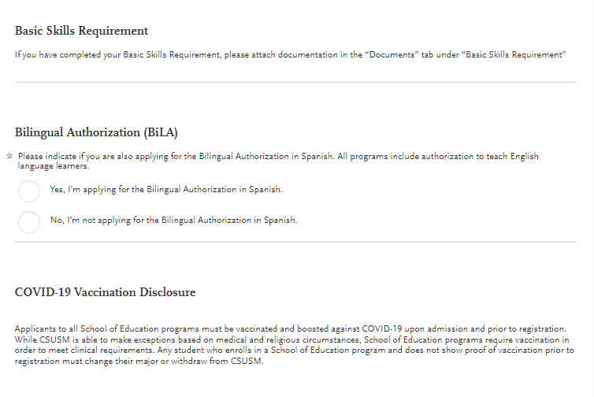
As you continue with the Questions section, you will be prompted to answer a Bilingual Authorization (BiLA)
Credential – Credential Specific
If you are interested in teaching in both Spanish and English select, Yes, I am applying for the Bilingual Authorization in Spanish.

Slide 14
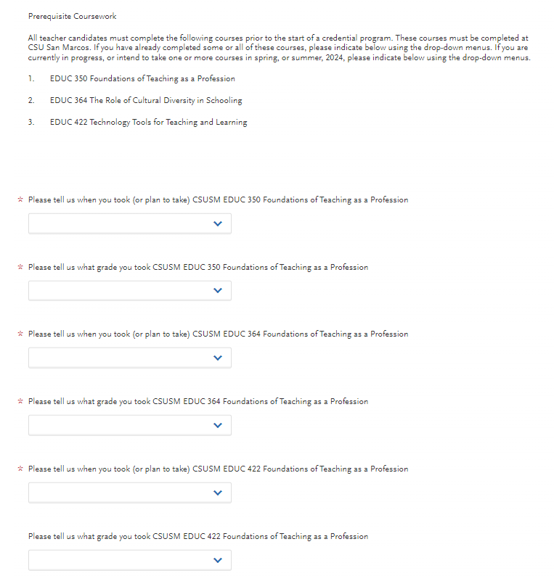



As you continue you will find related to the 3 prerequisite courses required for admission
Credential – Credential Specific
Select the term in which you have taken or plan to take a corresponding pre-requisite course.
Select the grade that you received in the corresponding pre-requisite. If you are currently taking the course or plan to take the course in the future, select In-Progress.
As a reminder, students must receive a C+ or better in each pre-requisite course. Pre-requisite courses must be completed by the end of the Summer 2024 term.

Slide 15
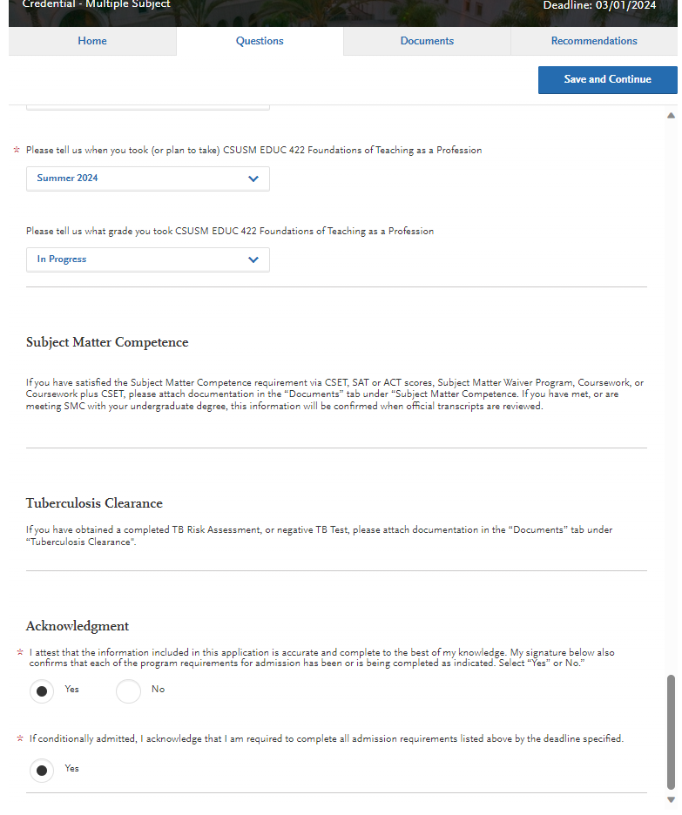


The final question is an acknowledgement. Please read both questions carefully. Once all questions have been answered, a blue Save and Continue button will appear in the top right corner.
Credential – Credential Specific
Please click Save and Continue. Once the document has saved, move on to the next section by clicking the Documents tab.

Slide 16
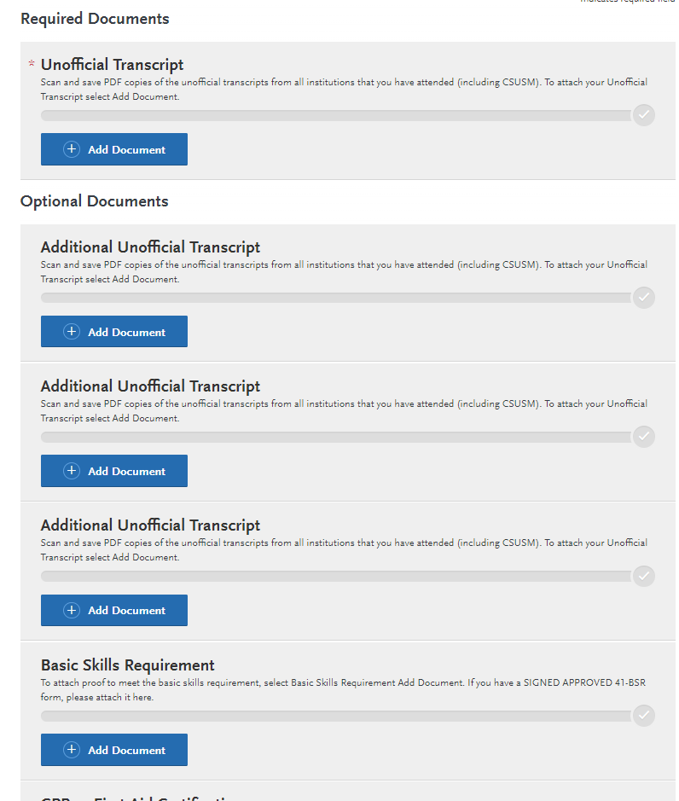
Within the Documents tab there are two main sections: Required Documents & Optional Documents
For Required Documents, please upload your most recent Unofficial Transcript from the most current Higher Education Institution attended.
Credential – Credential Specific
For Optional Documents, please upload each corresponding document if available. If not available, you will be required to submit the documentation by the respective due date by emailing the document to cehhs-ss@csusm.edu
Once all documents are uploaded, select the Save and Continue button in the top right corner. Then select the Recommendations tab.

Slide 17
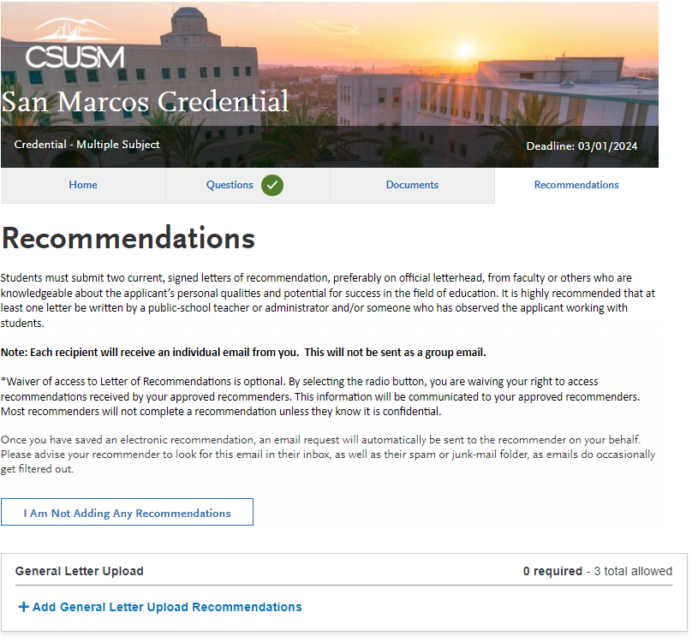



All applicants are required to submit two current, signed letters of recommendation from faculty or other who are knowledgeable about the applicant's personal qualities and potential for success in the field of education.
IMPORTANT: If you have copies of letters of recommendation with you, they can be uploaded by returning to the Documents tab. Attach the Letters of Recommendation using the Supplemental Materials tag. Be sure to click Save and Continue after uploading!
Credential – Credential Specific
If you do not have letters of recommendations, then Select +Add General Letter Upload Recommendations.

Slide 18
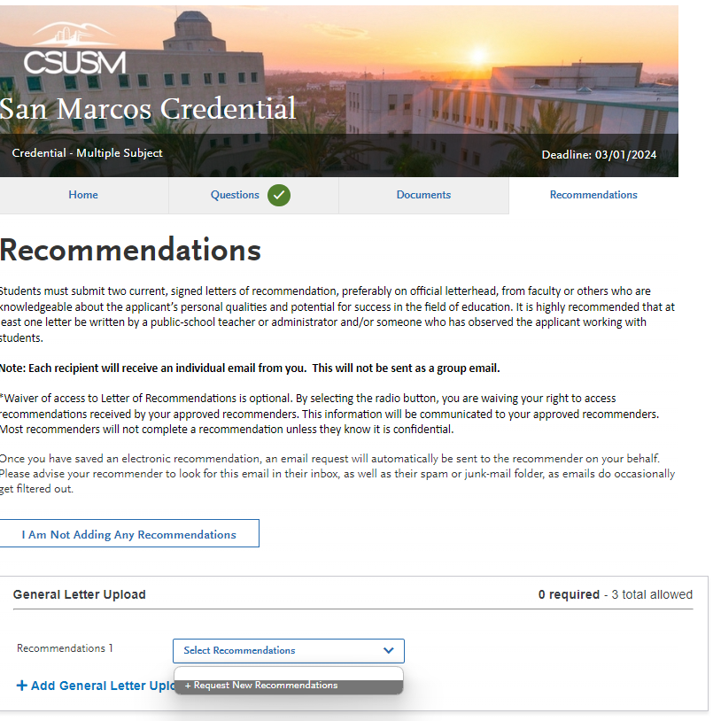

Credential – Credential Specific
Select +Request New Recommendations in the drop-down menu.

Slide 19
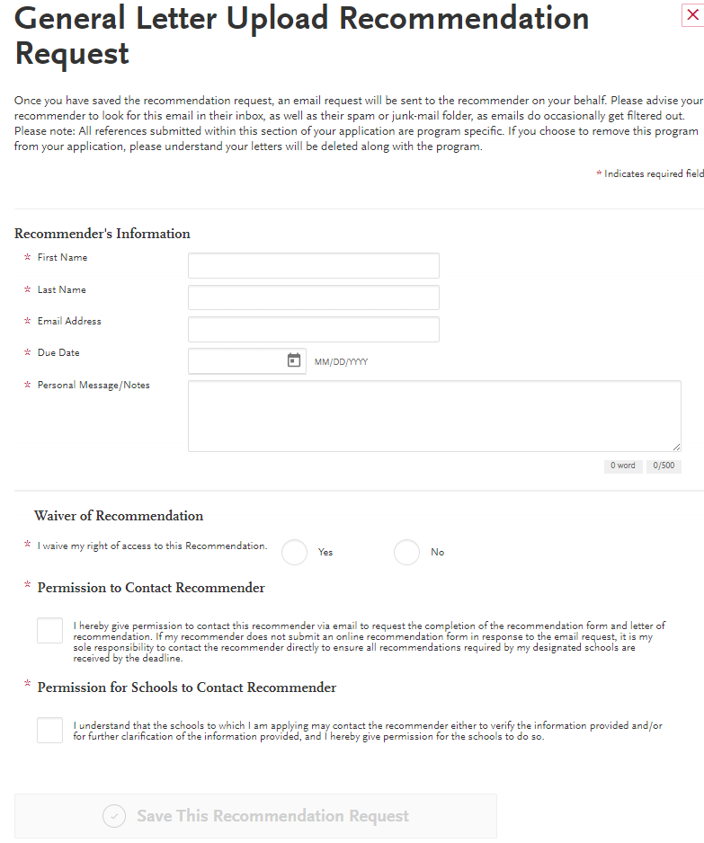
Enter recommender information.
Credential – Credential Specific
Due Date: We recommend to select a date one week before you plan on submitting your application, in case your recommender submits the recommendation late.
Submit this information early to provide your recommender enough time to write a strong letter for you.
Once completed select Save this Recommendation Request. An email will be sent to the recommender on your behalf.

Slide 20
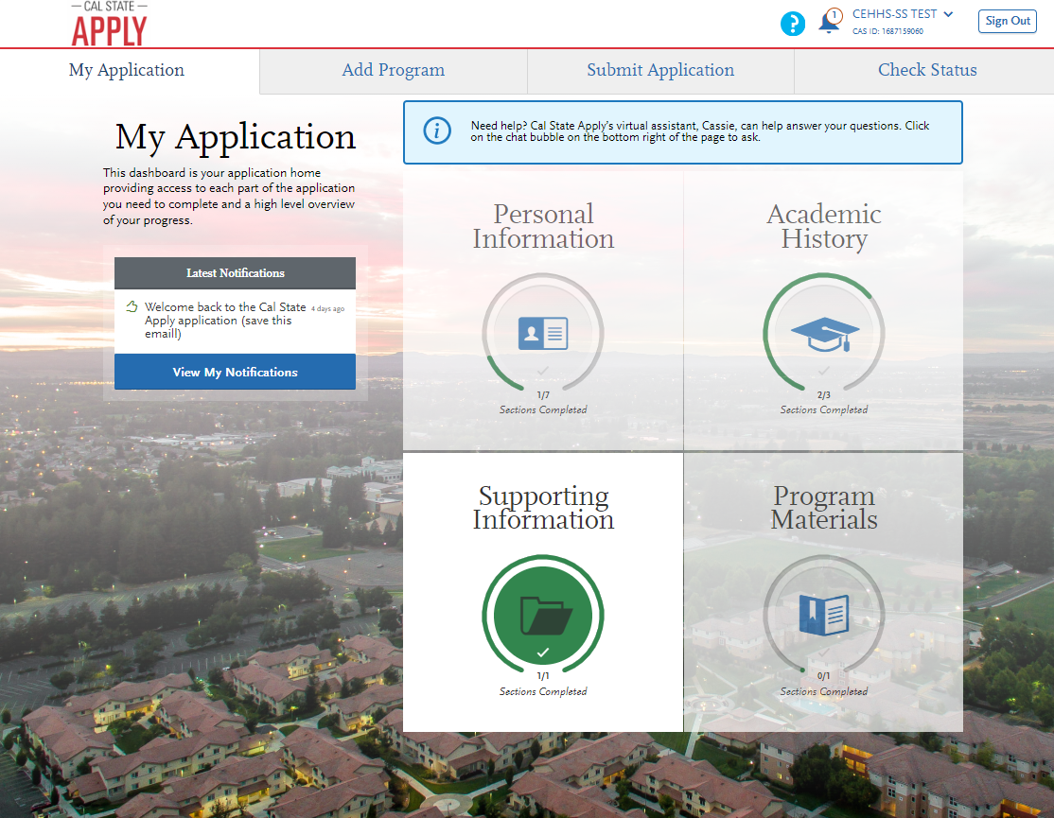

Once all sections have been completed, they should all show as green. With everything completed you can then select Submit Application in the tab above. At this point you will be required to pay the $70 application fee.

Slide 21
Questions
We are here to support your during your educational journey!
For additional questions please contact the College of Education, Health & Human Services staff via email at: cehhs-ss@csusm.edu

