Slide 1

The content of these slides was presented at The Hands that Feed Us event on 3/18/26.
Research completed by program leads Sarah Ziegler and Allison Reyes.

Slide 2
Farm Workers

Slide 3
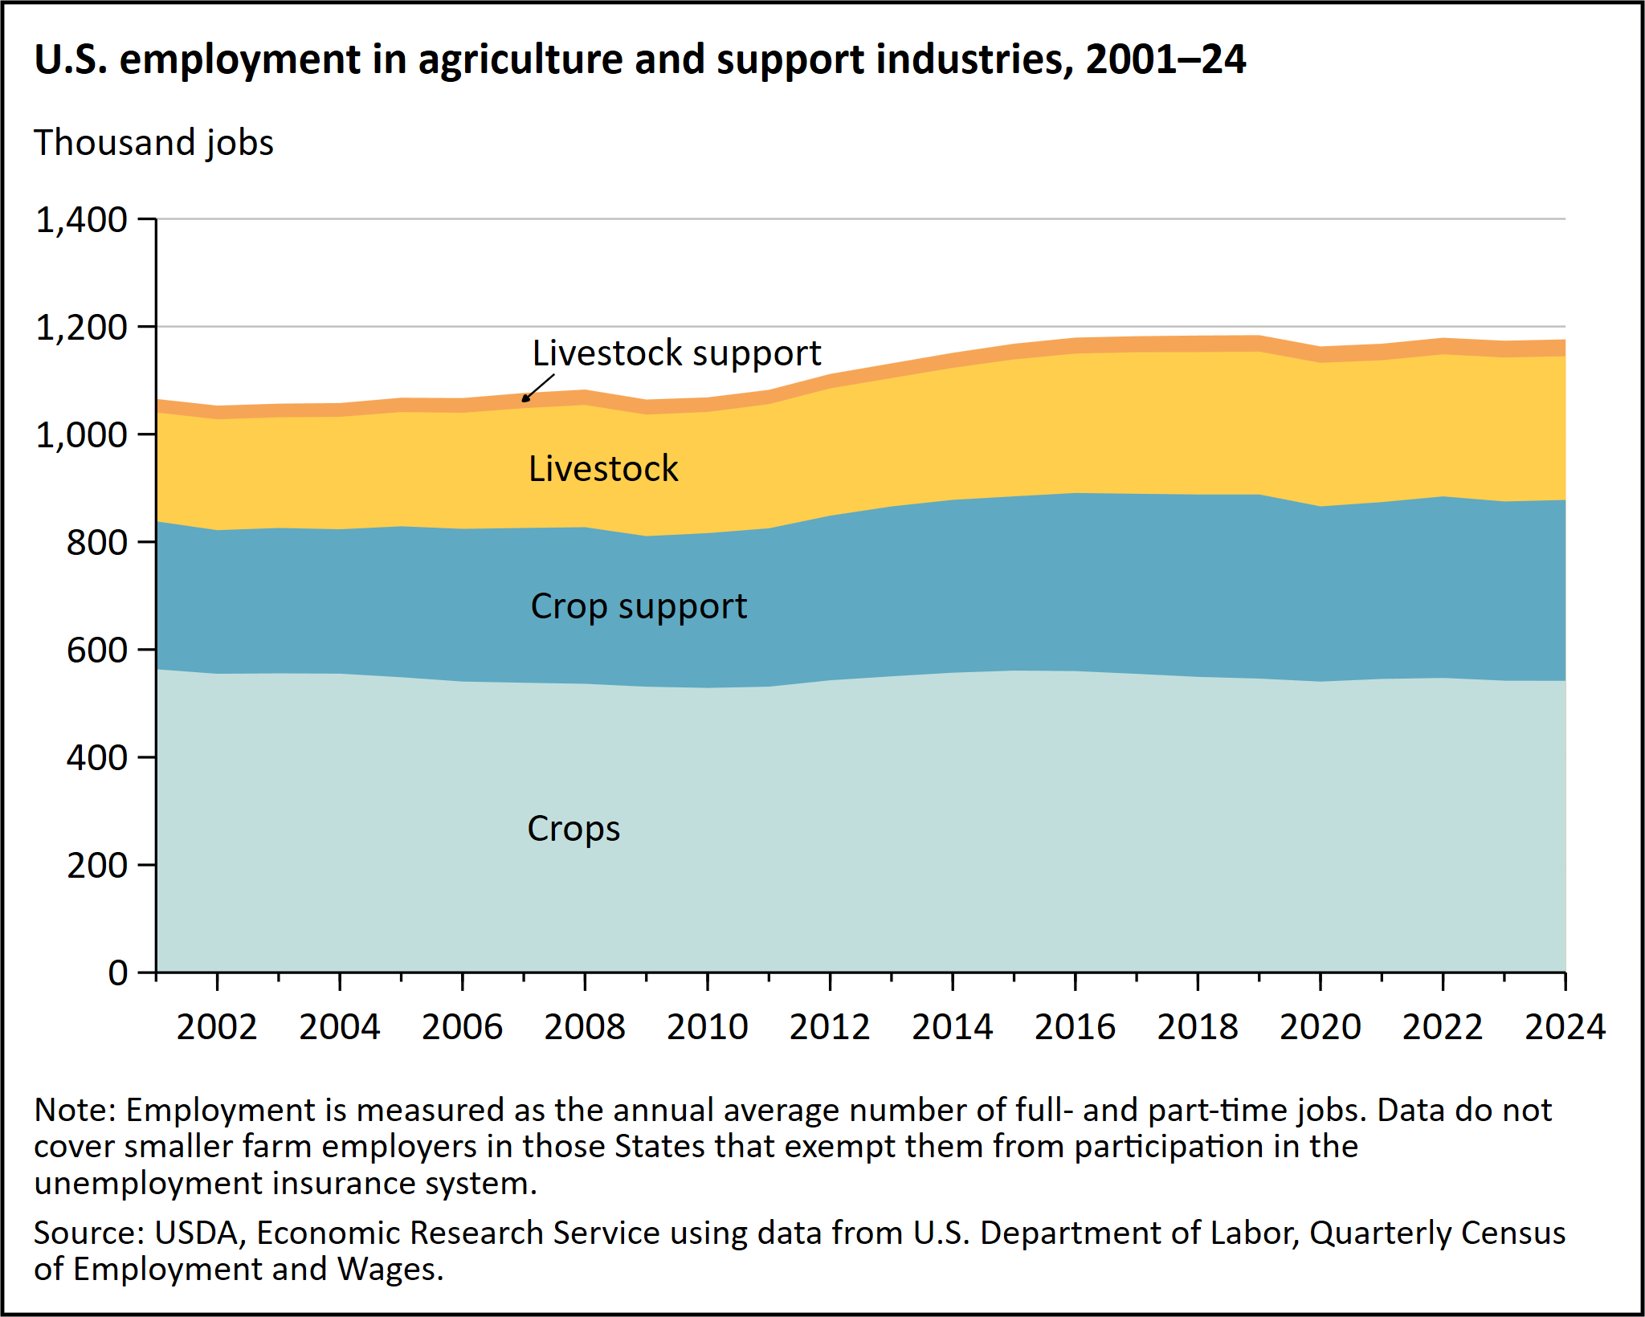

Slide 4
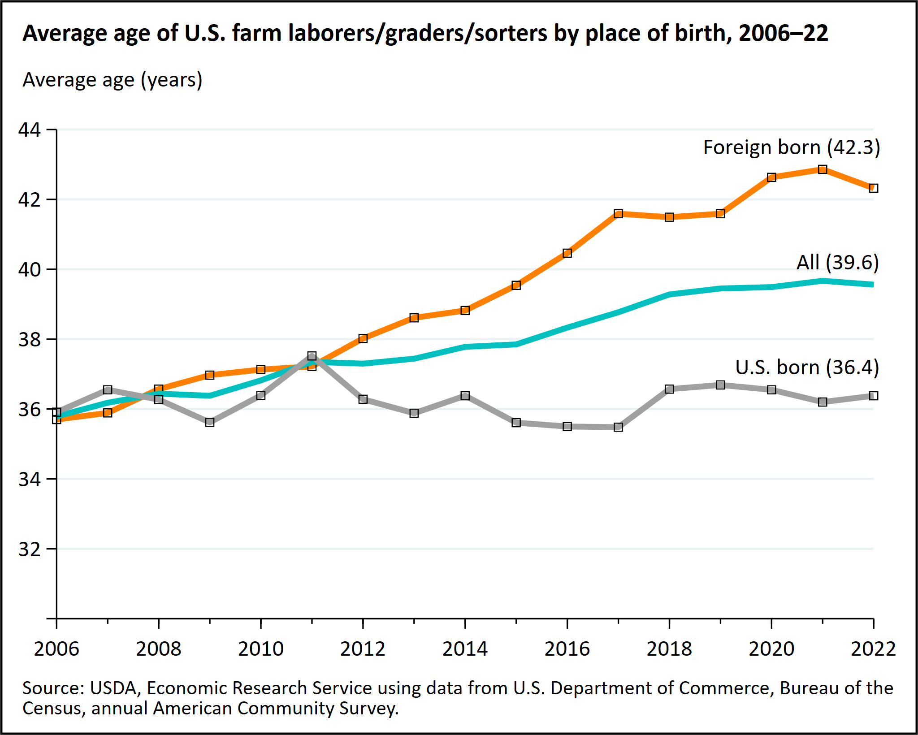

Slide 5
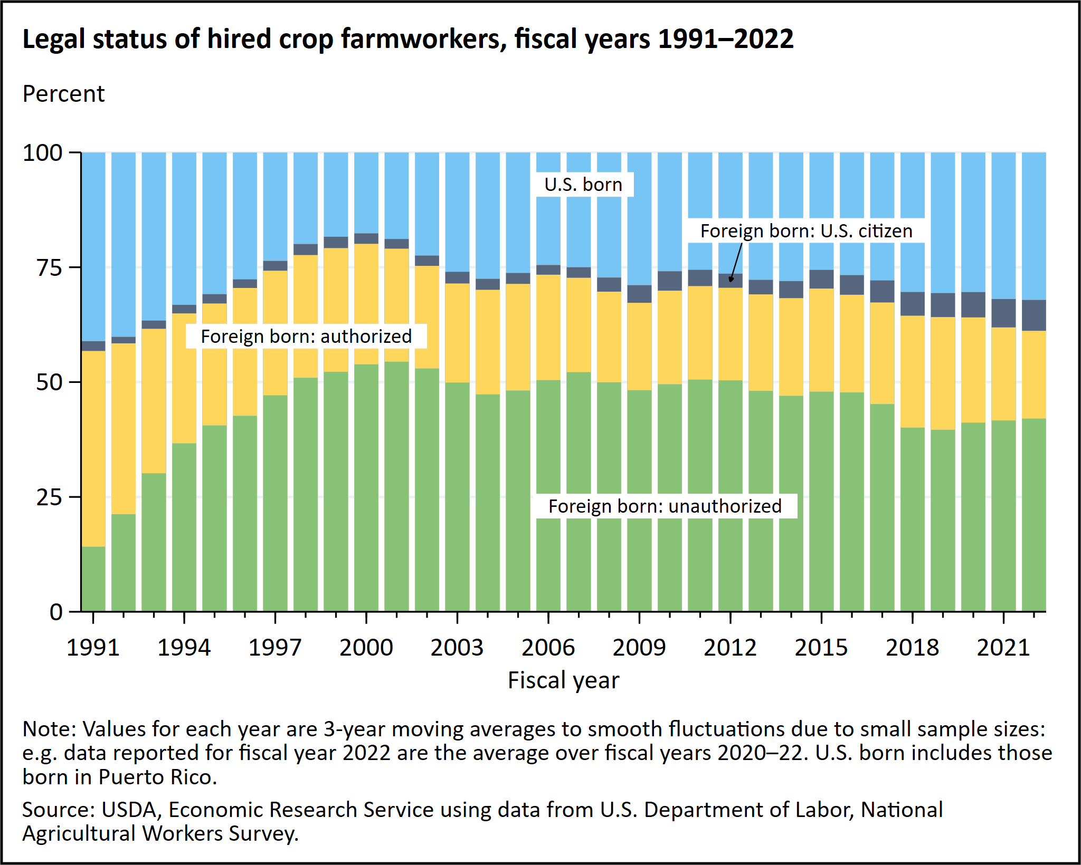

Slide 6
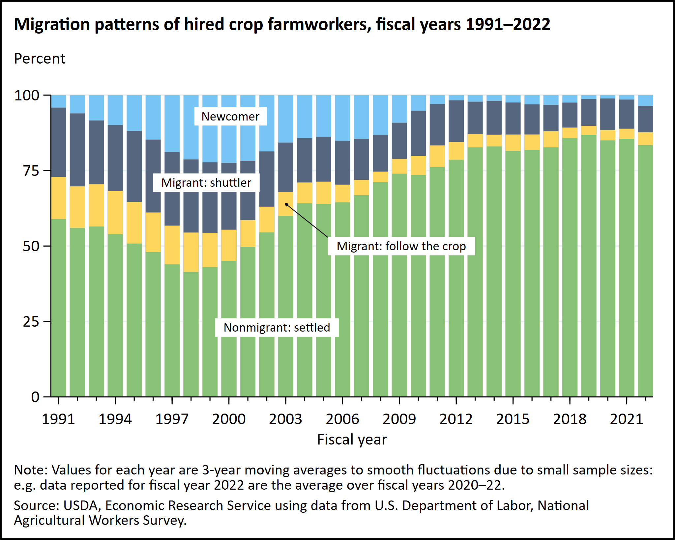

Slide 7
For more information: https://www.ers.usda.gov/topics/farm-economy/farm-labor

Slide 8
Data Literacy:
Which charts/statistics stand out to you?
What does this data tell us?

Slide 9
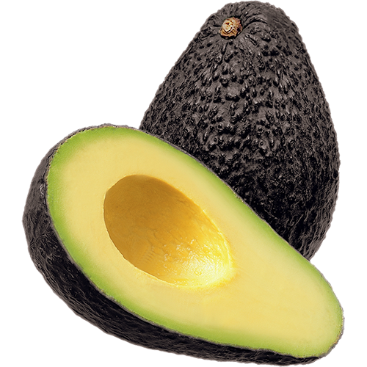
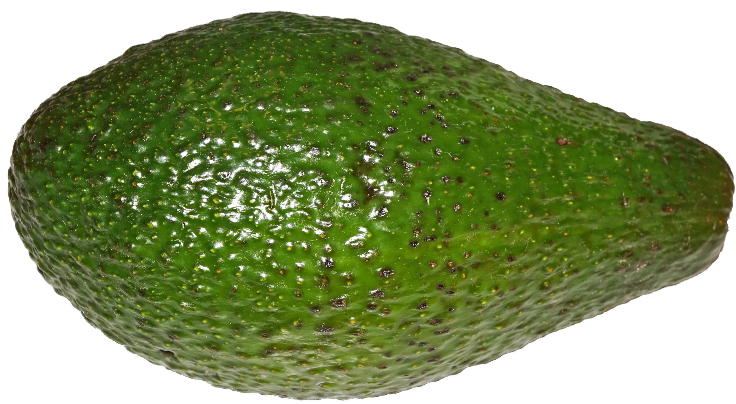
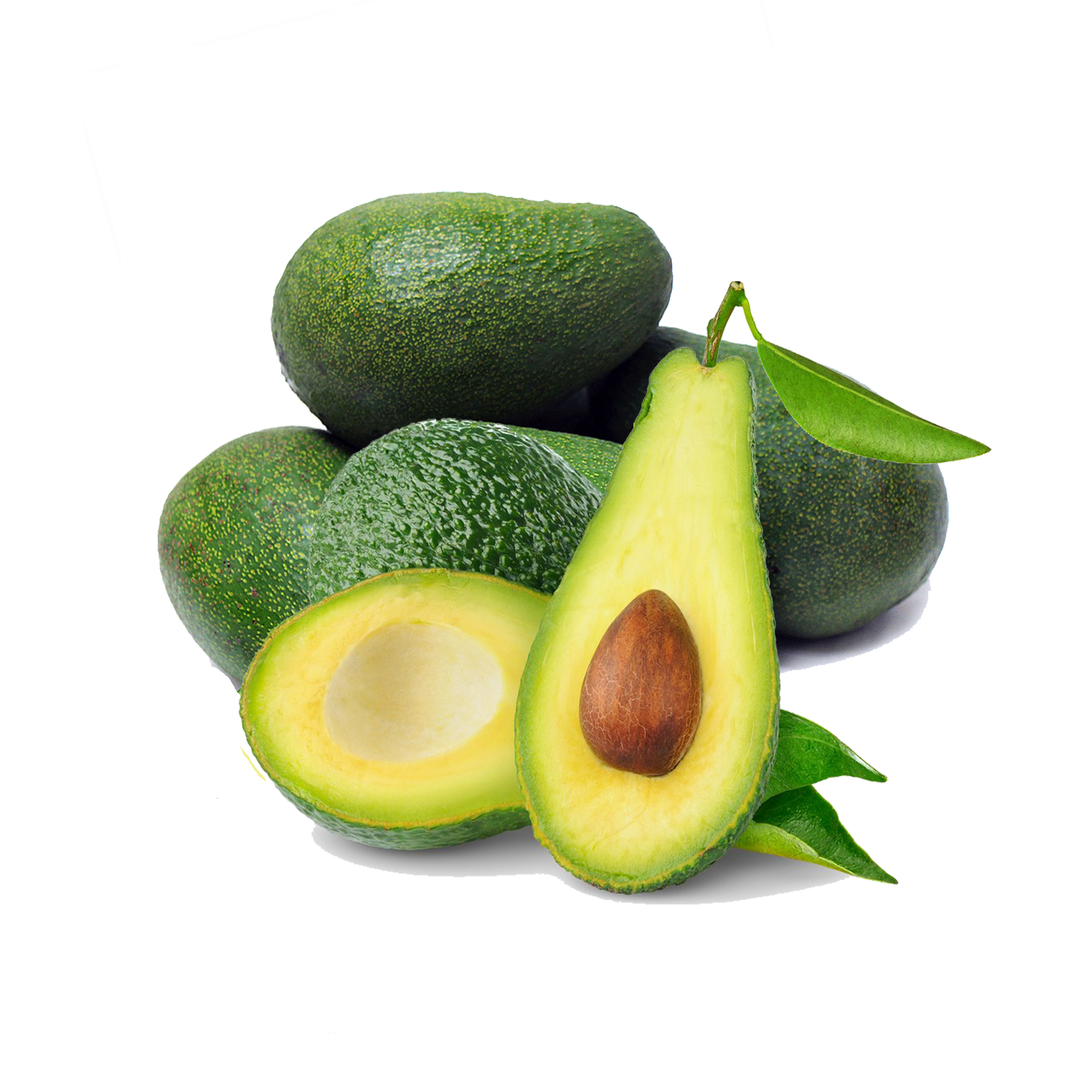
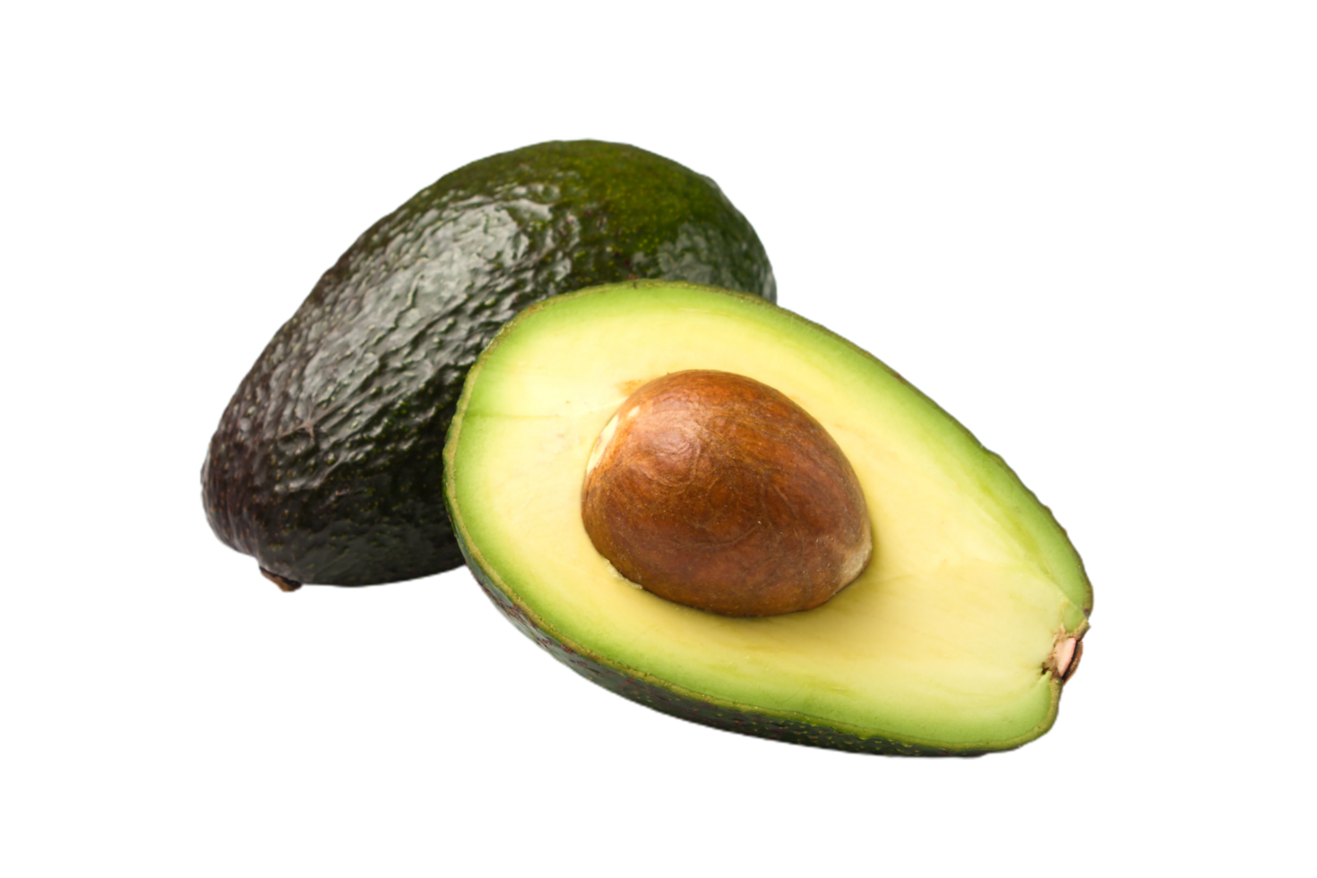
Avocados

Slide 10
“California stands alone as a state that requires agricultural workers be paid the local or federal minimum wage, whichever is higher, and also be paid overtime. California’s state minimum wage is currently
$16.90 per hour, which is more than double the current federal minimum wage rate of $7.25.
California agricultural workers are better paid and additionally protected by the state requirement that workers be paid overtime after ten hours of work in a day or for the first eight hours on the seventh consecutive day of work in a workweek. California is also unique in requiring that agricultural employees be paid double time for all hours of work in excess of eight on the seventh day of work in a workweek.”
-California Avocado Commission

Slide 11
“The use of farm labor contractors is governed by both federal and state regulation. California has stringent requirements around hiring to prevent conditions such as indentured labor, fee-for-work, or illegal payroll deductions for costs such as uniforms, damaged safety equipment or losses resulting from an employee’s work. These laws exceed federal requirements.”
-California Avocado Commission

Slide 12
A single avocado takes
14 – 18 months to grow.
-California Avocado Commission

Slide 13
California Avocado Commission. (2024, September 24). What Makes California Avocados Ethically Sourced?. California Avocados. https://californiaavocado.com/sustainability/ethically-sourced/

Slide 14
Reminder: Consider the Source
How might the goals of the
California Avocado Commission influence the information they choose to share on their website, and the manner in which they do so?

Slide 15
Critical Thinking: Read Between the Lines
Why did the California Avocado Commission feel the need to share this information on their website?

Slide 16
Avocados are known as oro verde or green gold due to how lucrative it is.
-Food Empowerment Project

Slide 17
“On one hand, growing avocados is so profitable that a farmer with even a few acres of avocado trees earns enough to send his children to college or to buy a new pickup truck, which is something that no other crop has been able to offer...”
-Food Empowerment Project

Slide 18
“On the other hand, the economic success of avocado production—valued at $3 billion annually...has attracted the attention of the country’s cartels.”
-Food Empowerment Project

Slide 19
Examples of tactics used by cartels:
Seizing plantations
Cutting down forests to start orchards
Demanding farmers pay "protection fees"
Theft of avocados in transit
Farmers forced to work without pay
Violence or threat of violence
-Food Empowerment Project

Slide 20
Food Empowerment Project. (n.d.). The Problem with Avocados. Food Empowerment Project. Retrieved March 17, 2026, from https://foodispower.org/our-food-choices/the-problem-with-avocados/

Slide 21
Reminder: Consider the Source
How might the reliability of an article posted to a non-profit's website compare with that of a peer-reviewed journal article?

Slide 22
Critical Thinking: Conscious Consumerism
Given this information, what should you do now?
If you stopped eating avocados, would that help farmers and farm workers, or harm them?

Slide 23
The state of Michoacán, Mexico supplies
> 80% of U.S. avocados.
-Avocado Institute of Mexico

Slide 24
Avocados bloom at different times of the year depending on the elevation. Every year there are four blooms in Michoacán.
-Avocado Institute of Mexico

Slide 25
"No matter the season, consumers will have access to an abundance of high-quality, lush avocados, and the 35,000 growers and 90 packing houses have plenty of work year-round."
-Avocado Institute of Mexico

Slide 26
Ambrosi, A. (2020, September 4). The Magic of Michoacán’s Four Blooms. Avocado Institute of Mexico. https://avocadoinstitute.org/avo-journey/magic-of-michoacan/magic-of-the-four-blooms/

Slide 27
Reminder: Consider the Source
What criteria would the
Avocado Institute of Mexico use when deciding what statistics to include on their website?

Slide 28
Critical Thinking: All Voices
What perspective is missing from this information?

Slide 29
Strawberries

Slide 30

Where Do They Come From?
California produces 85-90% of US Strawberries
  Major counties: Ventura, Santa Barbra, Monterey
Florida is second
California produces over 1.8 billion pounds annually.
Harvest is nearly year-round in CA due to climate.
Production value exceeds $2 billion annually
(Weber et al., 2025)(Noncitrus Fruits and Nuts, 2025)

Slide 31
Major Companies
Driscoll’s
  Largest berry distributor in the U.S.
  Privately owned
  Contracts with growers in CA, Mexico, Peru, Morocco
    Important structural detail: Driscoll’s does not own all farms. They operate under a contract system. Growers supply berries under strict quality and branding agreements. This can diffuse responsibility for labor conditions.
    (The Driscoll’s Way, 2026)

Slide 32
Naturipe Farms
  Large berry marketer
  Works with growers in North America and South America
Dole
  Major produce distributor
  Involved in berry distribution
(Our Produce, 2026)(What We Grow, n.d.)

Slide 33
Transportation & Perishability
Berries rely on refrigerated trucking, centralized distribution, national grocery chains
Shipped within 24–48 hours of harvest
Intense coordination at every stage due to spoilage risk
(Weber et al., 2025)

Slide 34
Labor & Working Conditions
Labor-intensive:
  Hand-picked, 8–12 hour shifts
Paid piece-rate per box
  incentives for faster work, skipped breaks
Worker demographics:
  ~73% foreign-born, majority from Mexico, many below poverty line, limited health insurance
Common violations:
  overtime exclusions, piece-rate underpayment, lack of rest breaks
Pesticide exposure:
  respiratory, skin, neurological risks
(National Agricultural Workers Survey, n.d)(Programs: Environmental Health, 2025)

Slide 35
Processing & Supply Chain
Stages:
Hand harvest → Field sorting → Clamshell packaging → Rapid cooling → Refrigerated trucking → Distribution warehouse → Grocery stocking
Labor involved:
  pickers, supervisors, irrigation, pest control, packers, inspectors, drivers, warehouse, grocery clerks
Peak California harvest:
  30,000+ seasonal workers
(State Agricultural Trade by Country of Origin and Destination, n.d.)
(Occupational Employment and Wage Statistics, n.d.)

Slide 36
Global Supply & Transnational System
Mexico dominates US berry imports:
  raspberries 90%, blackberries 95%, growing share of strawberries
Companies use contract farming:
  Driscoll’s, Naturipe, Mission Produce, Dole
U.S. corporate control:
  pricing, packaging, distribution; profit centralized; labor responsibility diffused
Community effects in CA:
  labor shortages, temporary migrant housing, isolated camps
Perishability increases labor pressure:
  narrow harvest windows, just-in-time, piece-rate pay, cold chain logistics, retail expectations
  (United States-Mexico-Canada Agreement, n.d.)

Slide 37
Works Cited Strawberries
National Agricultural Workers Survey. (n.d). U.S. Department of Labor. https://www.dol.gov/agencies/eta/national-agricultural-workers-survey
Noncitrus Fruits and Nuts. (2025). USDA. https://esmis.nal.usda.gov/publication/noncitrus-fruits-and-nuts
Our Produce. (2026). Dole. https://www.dole.com/
Occupational Employment and Wage Statistics (n.d.) U.S Bureau of Labor Statistics. https://www.bls.gov/oes/tables.htm
Programs: Environmental Health. (2025). Farmworker Justice. https://farmworkerjustice.org/en/programs/environmental-safety
State Agricultural Trade by Country of Origin and Destination (n.d.) USDA. https://www.ers.usda.gov/
The Driscoll’s Way (2026). Driscoll’s. https://www.driscolls.com/about
United States-Mexico-Canada Agreement. (n.d.) Office of the United States Trade Representative. https://ustr.gov/trade-agreements/free-trade-agreements/united-states-mexico-canada-agreement
Weber, C., Wechsler, S.J., & Wakefield, H. (2025). Fruits and Tree Nuts. USDA. https://www.ers.usda.gov/topics/crops/fruit-and-tree-nuts
What We Grow. (n.d.) Naturipe Farmed Fresh. https://www.naturipefarms.com/

Slide 38
Livestock

Slide 39

Ranch Workers (Cow-Calf Operations)
Responsible for raising cattle from birth until they are sold to feedlots
Daily tasks include:
  Herding and monitoring cattle across large areas
  Assisting with calving (birth of calves)
  Vaccinating and treating sick animals
  Maintaining fences, water systems, and equipment
Work is year-round and requires both physical labor and technical knowledge
Often performed in remote, rural environments
(Knight, 2025)

Slide 40
Ranch Working Conditions
Workdays often last 8–12+ hours, depending on season and workload
Workers are exposed to extreme environmental conditions:
  High heat in summer
  Cold and storms in winter
Remote locations lead to:
  Limited access to healthcare services
  Transportation challenges
Many workers live on ranch property, increasing isolation
Limited oversight compared to urban workplaces
(Castillo et al., 2025)

Slide 41
Ranch Labor System
Ranches increasingly rely on immigrant labor due to labor shortages
The H-2A visa program allows temporary agricultural workers to work legally in the U.S.
Workers are often tied to a single employer, limiting mobility
Fear of job loss can discourage reporting unsafe conditions
Migrant labor plays a key role in sustaining livestock production
(Foreign labor performance data, n.d.)

Slide 42
Feedlot Workers
Work in large-scale operations where cattle are fattened before slaughter
Feedlots may contain thousands to tens of thousands of animals
Responsibilities include:
  Feeding cattle using automated systems
  Monitoring growth and health
  Administering medications or supplements
  Operating tractors and heavy machinery
Work is continuous and often year-round
(Knight, 2025)

Slide 43
Feedlot Working Conditions
Workers are exposed to environmental hazards:
  Dust and airborne particles
  Ammonia and methane gases from waste
Health risks include:
  Respiratory illness
  Eye and skin irritation
Physical risks:
  Injury from large animals
  Machinery accidents
Work is repetitive and physically demanding
(Agriculture Worker Safety and Health, 2024)

Slide 44
Slaughterhouse Workers
Represent the largest labor force in livestock production
Workforce includes many immigrant and refugee workers
Job roles include:
  Stunning animals before slaughter
  Cutting and trimming meat
  Packaging and labeling products
  Cleaning and sanitation
Work takes place on fast-moving production lines
(Castillo et al., 2025)

Slide 45
Processing Plant Conditions
Meatpacking is one of the most dangerous industries in the U.S.
Common injuries:
  Deep cuts and lacerations
  Repetitive motion injuries
  Musculoskeletal disorders
Workers handle sharp tools and heavy materials
Exposure to strong cleaning chemicals used for sanitation
(Meatpacking, n.d.) (Injuries, Illnesses, and Fatalities, n.d.)

Slide 46
Line Speed & Labor Pressure
Processing plants operate at very high speeds to maximize production
Workers must keep up with machines and conveyor systems
Tasks are repeated thousands of times per shift
Limited breaks increase fatigue and risk of injury
Faster line speeds are linked to higher accident rates
(Workplace Safety and Health: Better Outreach, Collaboration, and Information Needed to Help Protect Workers at Meat and Poultry Plants, 2017)

Slide 47
Labor Vulnerability
Many workers depend on their employer for wages, housing, and legal status
Fear of retaliation or deportation limits reporting of unsafe conditions
Language barriers can prevent understanding of safety protocols
Agricultural workers often have fewer legal protections than other workers
Limited access to legal resources and support
(Agricultural Employment, n.d.)

Slide 48
Wages & Economic Pressure
Wages are often low relative to the physical risk and intensity of the work
Many workers rely on overtime to earn sufficient income
Some workers send money to family members (remittances)
Limited opportunities for advancement or higher-paying positions
Economic pressure can force workers to stay in unsafe jobs
(Occupational Employment and Wage Statistics, n.d.)

Slide 49
Farmworker Communities
Livestock production creates “meatpacking towns” in rural areas
Communities often depend on one large employer (processing plant)
Population includes many immigrant and multilingual families
These workers support both local economies and national food supply
(MacDonald & McBride, 2009)

Slide 50
Community Challenges
Rapid population growth can strain local infrastructure
Housing shortages lead to overcrowded living conditions
Schools must adapt to language and cultural diversity
Limited healthcare access in rural areas
Transportation barriers affect daily life and job access
(A nation of immigrants: A portrait of the 40 million, including 11 million unauthorized, 2013)

Slide 51
Scale of Labor in Livestock
Large meatpacking plants employ 1,000–3,000 workers each
The livestock system employs hundreds of thousands nationwide
Labor spans:
  Ranches
  Feedlots
  Processing plants
  Transportation and distribution
This workforce is essential to maintaining a stable food supply
(Occupational Employment And Wage Statistics, n.d.)

Slide 52
Works Cited Livestock
A nation of immigrants: A portrait of the 40 million, including 11 million unauthorized. (2013). Pew Research Center.
https://www.pewresearch.org/hispanic/2013/04/04/a-nation-of-immigrants/
Agriculture Worker Safety and Health. (2024). CDC. https://www.cdc.gov/niosh/agriculture/about/?CDC_AAref_Val=https://www.cdc.gov/niosh/topics/aginjury/
Agricultural Employment. (n.d.). U.S Department of Labor. https://www.dol.gov/agencies/whd/agriculture
Castillo, M., Simnitt, S., Zahniser, S. (2025). Farm Labor. USDA. https://www.ers.usda.gov/topics/farm-economy/farm-labor
Foreign labor performance data. (n.d.). U.S. Department of Labor.
https://www.dol.gov/agencies/eta/foreign-labor/performance
Injuries, Illnesses, and Fatalities. (n.d.). U.S Bureau of Labor Statistics. https://www.bls.gov/iif/
Knight, R. (2025). Cattle & Beef. USDA. https://www.ers.usda.gov/topics/animal-products/cattle-beef
MacDonald, J., & McBride, W. (2009). The transformation of U.S. livestock agriculture: Scale, efficiency, and risks. U.S. Department of Agriculture. https://www.ers.usda.gov/webdocs/publications/44150/11008_eib43_1_.pdf
Meatpacking. (n.d.) OSHA US. Department of Labor. https://www.osha.gov/meatpacking
Occupational Employment and Wage Statistics (n.d.) U.S Bureau of Labor Statistics. https://www.bls.gov/oes/
Rural Economy & Population (n.d.). USDA. https://www.ers.usda.gov/topics/rural-economy-population
Workplace Safety and Health: Better Outreach, Collaboration, and Information Needed to Help Protect Workers at Meat and Poultry Plants. (2017). U.S. Government Accountability Office. https://www.gao.gov/products/gao-18-12

Slide 53
Discussion Questions:
What is one thing you learned from this event?
What surprised you the most?
How will this event impact the way you think about who was involved in the food you eat moving forward?

