Slide 1

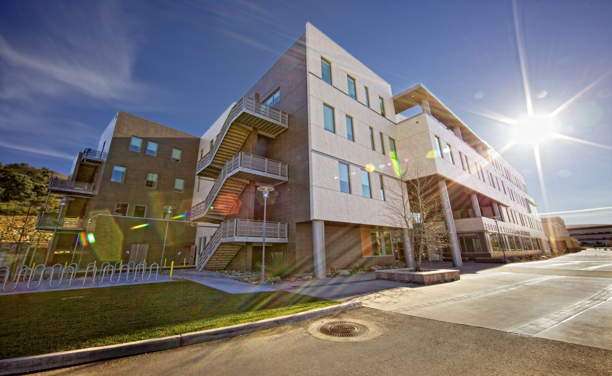

Data Warehouse
Navigation
Functionality
Setting up Reports
Verifying Balances
Exporting Data to Excel
University Budget Office

Slide 2
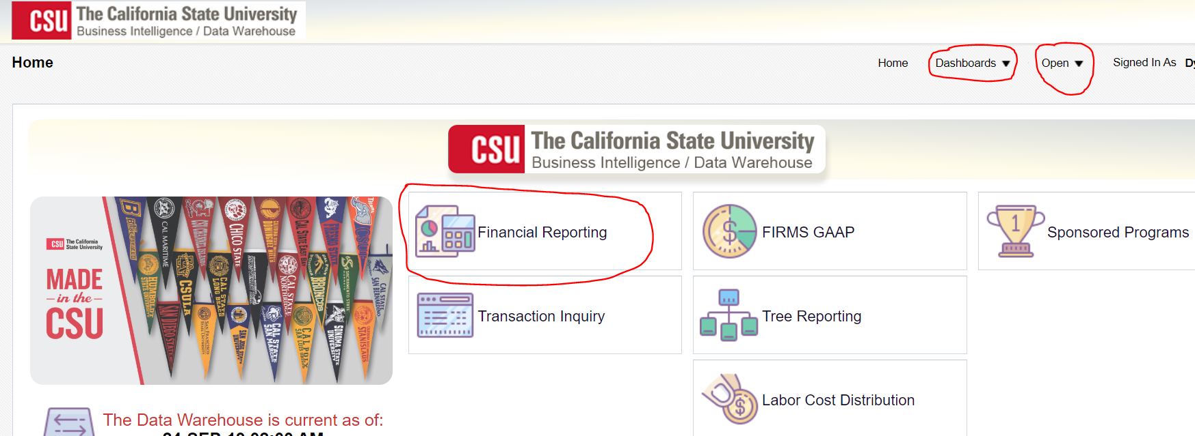
Home Page

Slide 3
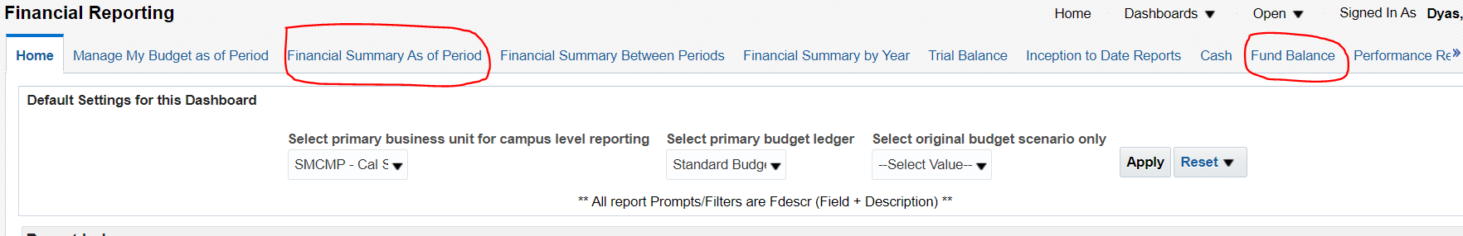
Most Popular Reports
  Financial Summary As of Period
  Fund Balance Report

Slide 4
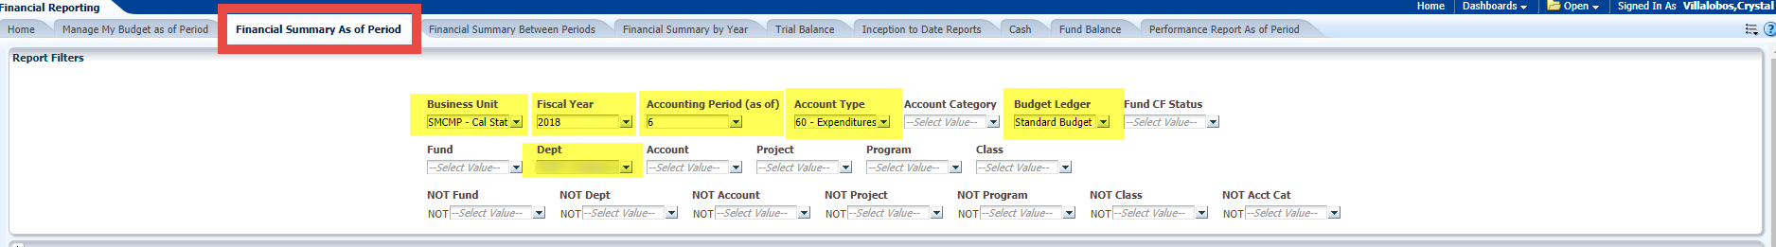
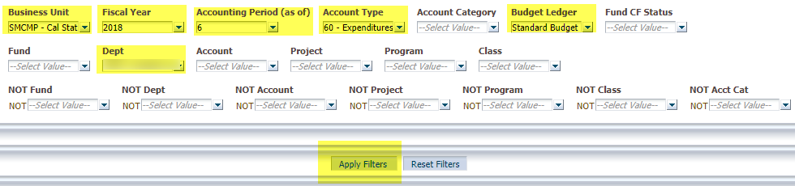
Navigation- Run Reports
Business Unit: SMCMP
Fiscal Year: 2018
Accounting Period: 6 (December)
Account Type: 60- Expenditures
Budget Ledger: Standard Budget
Dept: Your Department
Click “Apply Filters”

Slide 5
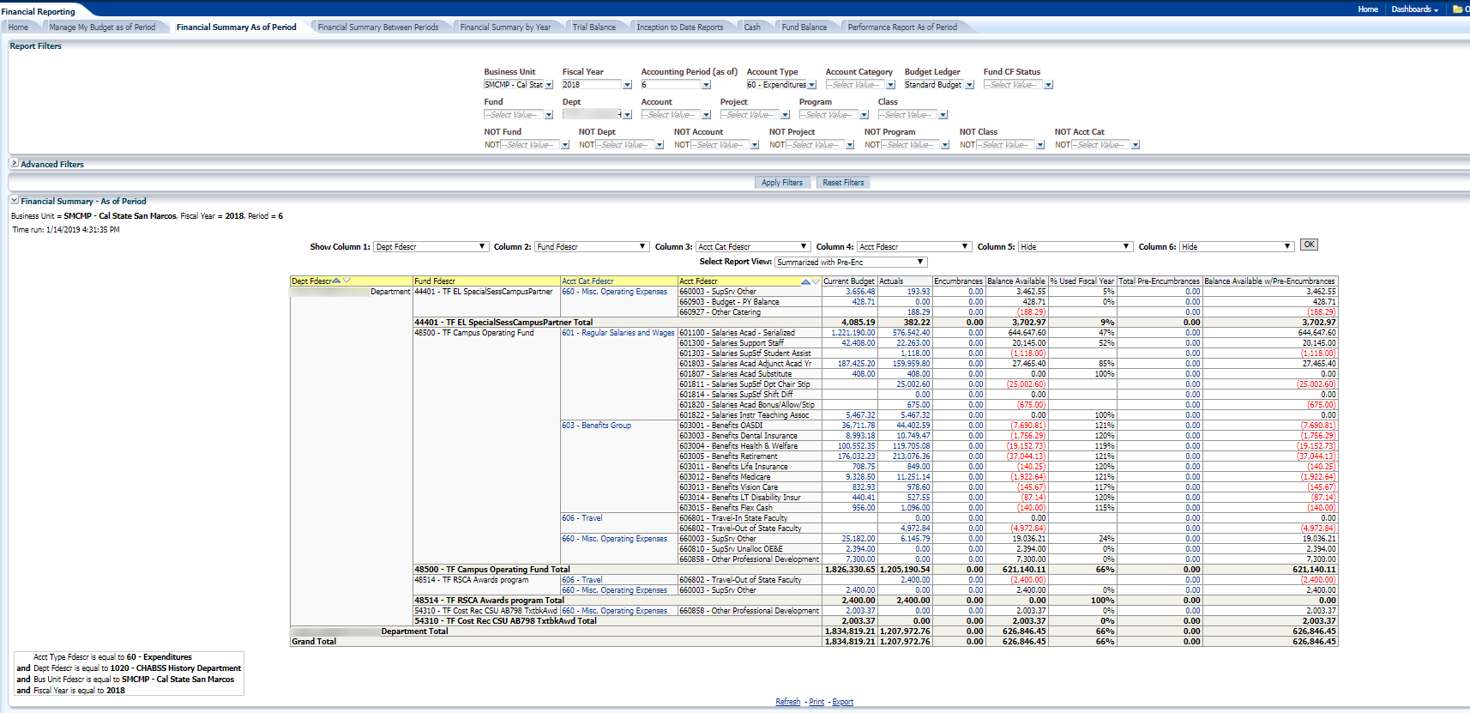
Navigation- Run Reports

Slide 6
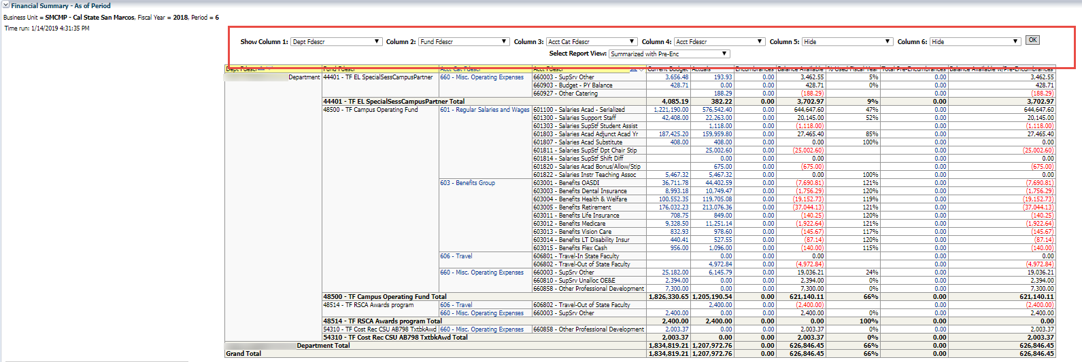
Navigation- Run Reports
Column 1: Dept Fdescr
Column 2: Fund Fdescr
Column 3: Acct Cat Fdescr
Column 4: Acct Fdescr
Select Report View:
Summarized with Pre-Enc
Click “OK”

Slide 7
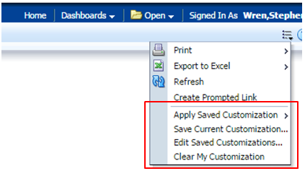
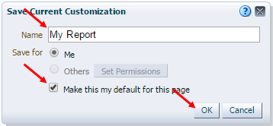
Navigation – Saving Reports
Saved reports and defaults are called “customizations”
Can save or utilize (apply) saved reports using the bullet point icon in upper right

Slide 8
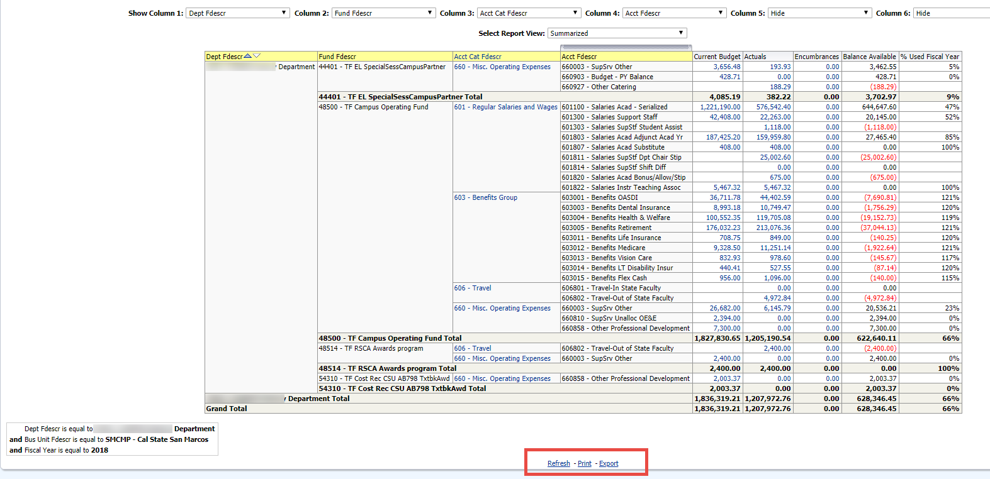
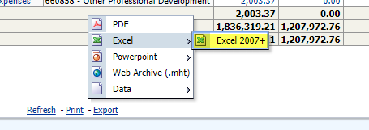
Navigation- Download Report

Slide 9
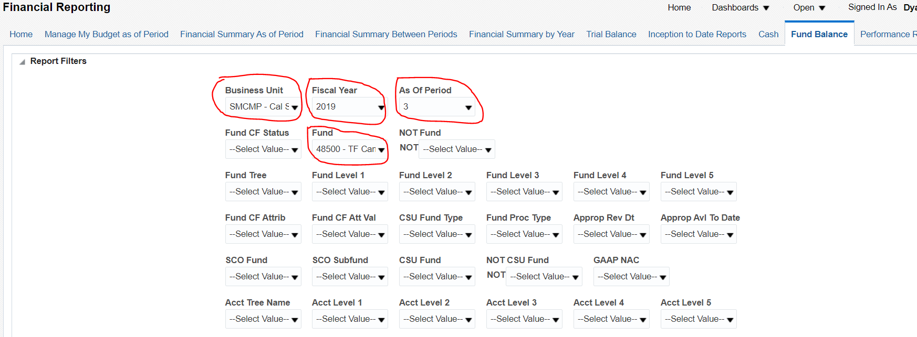
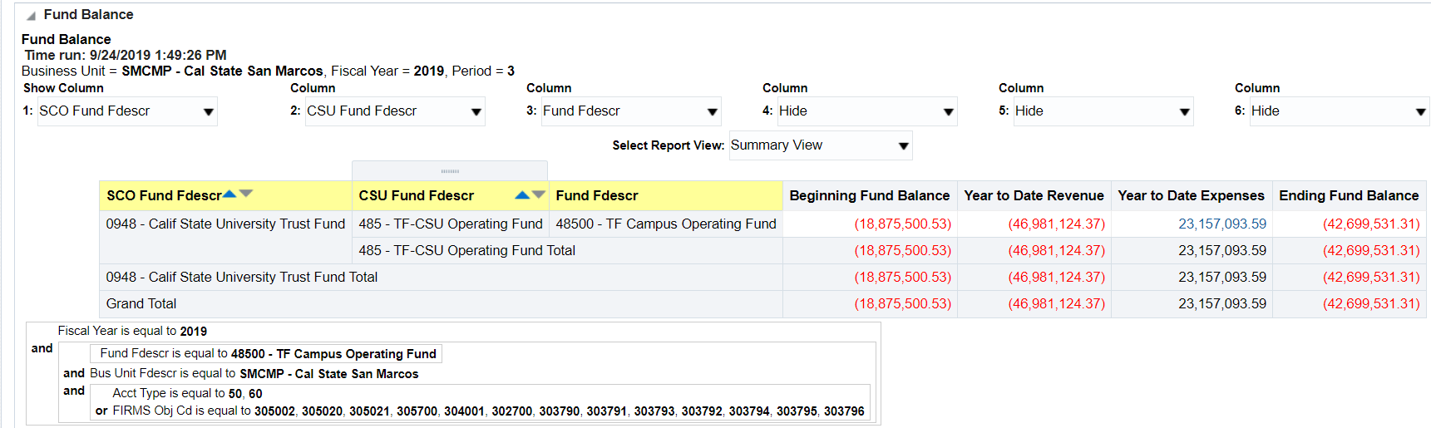
Navigation – Fund Balance Report
  Fund Summary Only

Slide 10
Pivot Table Instructions
Questions?

