Slide 1

Budget Tracking & Reconciliation with PIVOT TABLES
THE SHADOW BUDGET OVERVIEW
By CSU San Marcos

Slide 2


We will have a quiz at the end of the Power Point
Join with the Kahoot! app or at kahoot.it (no app needed)

Slide 3
What is the ‘Shadow’ Budget
  It’s a BUDGET MANAGEMENT SYSTEM using an Excel Workbook
      CSUSM nicknamed it the ‘Shadow’ budget because it shadows our financial software system.
      Similar to Quicken or other budget management tools but with Excel’s flexibility and customization.
  The sample workbook we will share with you starts with one data entry spreadsheet
      Formatted as a table (much like a checkbook ledger).
      Pivots are then created on additional worksheets to analyze the data.
      You can easily add as many pivots as you want in order to analyze in multiple ways.
  We use similar Excel workbooks for other sources of data as well.
      Pivots can be used to analyze any data set such as enrollment schedules, csv data downloads, HR actuals, etc.
  Pivot tables are a powerful Excel tool that makes analysis more efficient and accurate.
      Pivot tables are like filters on steroids!

Slide 4
Why do we use a ‘SHADOW’ Budget?
  shadow budget?
    RECONCILING - Reconcile revenue and expenses monthly against “the bank” in our case, Data Warehouse, with EASE!
    TRACKING – Manage multiple fund sources, professional development funds, faculty funds, O&E, salaries, with EASE!
    FORECASTING – Projecting & revising monthly, mid-year and fiscal year end by fund, department, account, category, tags, with EASE!
    No more multiple spreadsheets and workbooks to manage and analyze, keep everything in one workbook. Use one set of data to analyze in multiple ways, create reports, comparisons, historical analysis, again, with EASE!

Slide 5
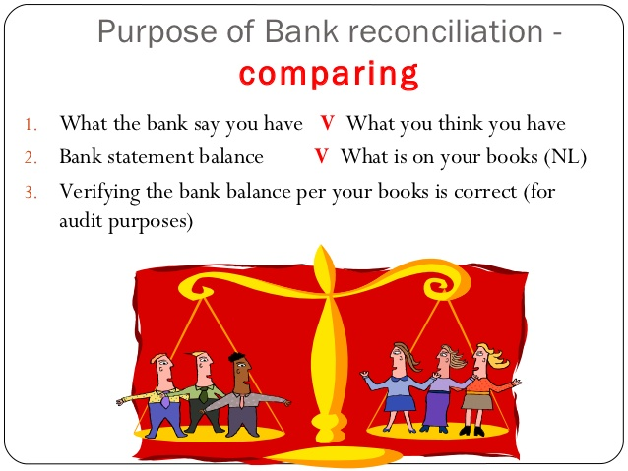
Why is it Important to RECONCILE?
  Know current financial status is in ‘real’ time
  Protects the resources of the University by being good stewards
  Catch errors such as transposing numbers and charging incorrect departments
  Confirm budget and expenses have been recorded and are correct

Slide 6

Why is it important to FORECAST?
Forecasting is a projection of the total revenues and expenses through the end of the fiscal year.
  Confirm funds will end the fiscal year “on target” and in good financial health.
  Project multiple fund sources, professional development funds, salaries, O&E, etc. Know exactly what has been spent and what is available to spend quickly and accurately.
  Easy monthly, mid-year, and annual reporting.

Slide 7

Advantages of using this shadow budget:
  CUSTOMIZABLE – add columns as needed for additional analysis
  ACCESSIBLE – no licensing fees, most people have access to Excel, Excel 16 and PC use
  SHAREABLE – Use in shared files or SharePoint
  Increase accuracy & efficiency – quick and easy analysis in multiple ways
  Increases Excel skills overall – more than just budget
  Reduces multiple data entry spreadsheets

Slide 8

Excel tools to get to know:
  FORMAT AS A TABLE
  QUICK ACCESS TOOLBAR
  REFRESH
  VALIDATION TABLES
  CONDITIONAL FORMATTING
  PIVOT TABLES & PIVOT TABLE TOOLS
  SLICERS & FILTERS

Slide 9
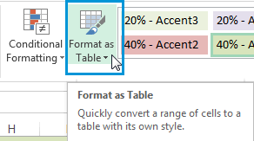
Format as a Table
  Using the table format in your Excel spreadsheet eliminates the need to insert lines.
  Filter to your fund or department and just add a new line on the bottom by entering data.
  Totals at the top include only what is filtered or everything if you unfilter.
  It’s like having multiple spreadsheets in one place.

Slide 10
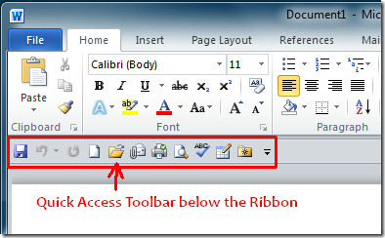
Quick Access Toolbar
For convenience add the following to your toolbar (below the ribbon for easy access):
  Save
  Refresh All
  Filter
  Clear Filter
  Email
  Insert Pivot Table

Slide 11
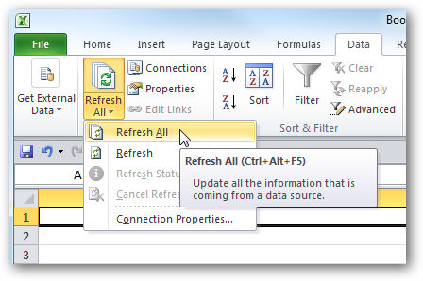
Refresh
Most important tool to keep pivots up to date!
Use refresh whenever you edit the data so all pivots will be updated.

Slide 12
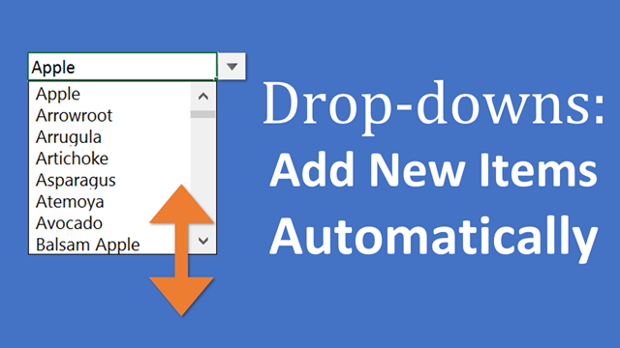
Validation Tables
at are they?
  A MUST FOR ACCURATE DATA & ANALYSIS!
  A set of data that restricts the values allowed in a cell
which reduces data entry errors
  Creates ‘drop down’ boxes to choose
from rather than manual data entry

Slide 13
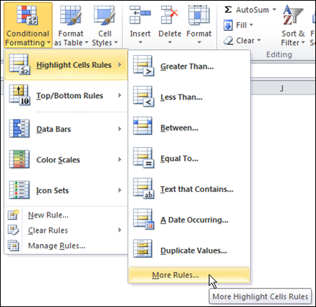
Conditional Formatting
We use conditional formatting in the template to color code funds and scenarios for easy visualization of your funds. It’s a great tool to know!

Slide 14
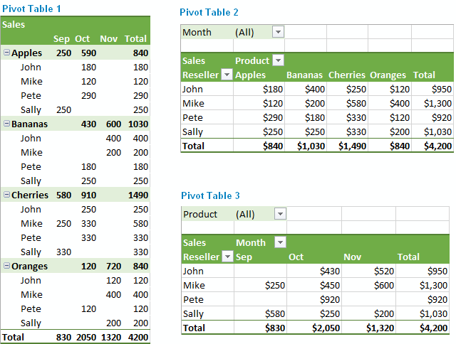
Pivot Tables and Pivot Tools
Pivot tables are a preset query of the data (filter on steroids).
All analysis of the data is done with pivot tables from one spreadsheet.
Make as many pivot tables as you need
  By Account to reconcile
  By Category to review with supervisor
  By Employee to track salaries
Pivot table tools include Design and Analyze
  Design is cosmetic for visual clarity
  Analyze includes changing data source, adding
  slicers (filters on steroids)

Slide 15
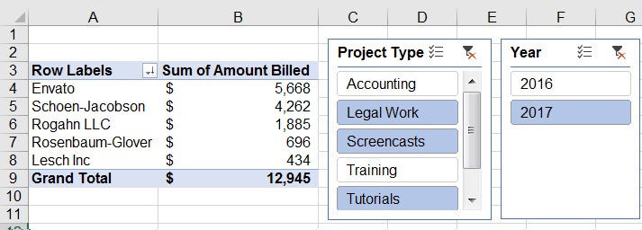
Slicers and Filters
Use in data entry ledger or pivot tables to filter and analyze data

Slide 16
Excel and Pivot Table Training available
TIP for maximum functionality of the Excel shadow budget: Use the most up to date Excel version (Excel 16) Use a PC not a MAC, not all Excel tools are available in a MAC
SEMINARS & WEBINARS
FREE ONLINE
ON CAMPUS TRAINING
Pryor Seminars
https://www.pryor.com/
SkillPath
http://www.skillpath.com
onlc Training Centers
https://www.onlc.com
You Tube:
  MyOnlineTrainingHub.com
  Myexcelonline.com
CSU Campus Online Learning/Skillport
Use knowledgeable staff on campus for workshops
Hire Professional Excel Trainers for your group
Request Budget Office Support

Slide 17
Time for the Kahoot! Quiz…go to Kahoot.it
And then to the shadow budget samples…
Power Point and Shadow Budget Samples are available at:
https://www.csusm.edu/par/budgettrackingandreconciliation.html\
Presentation by CSU San Marcos
at the Academic Resources Conference (ARC) May 30, 2019
Amy Armstrong, Kim Kamrath, Robin Martens, Janet Morris, Maria Rasimas

