Slide 1
Welcome to
Budget Orientation
Maria Rasimas
Academic Affairs Director, Resources & Operations
October 12, 2022

Slide 2
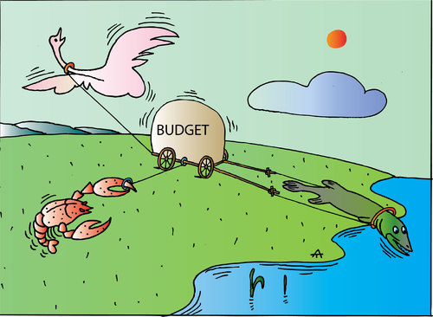
Welcome to
Budget Orientation
Who is this for? ALL EMPLOYEES THAT MANAGE A BUDGET
New hires
Current employees
New and current supervisors of budget

Slide 3
Agenda: Funds and Processes
Budget Process
Terminology and Types of Funds
Budget Cycle and Timeline
Uses of Funds: Procard and Purchasing
Uses of Funds: Professional Development
Monthly Budget Reconciliation
Budget transfers and IFTs
Assigned Time and Reimbursed Time
Support, Guidance and Resources
Tips from the Auditors

Slide 4
Budget Process
What is a budget?
Budget is not another word for cash.
noun: an estimate, often itemized, of expected income (or allotment) available for spending that is based on a plan for how it will be spent for a given period of time.
A budget provides a vehicle for managing financial resource plans.
The budget runs on a fiscal year calendar from July 1 through June 30.

Slide 5
What is the difference between accounting, budgeting, and finance?
FINANCE = Resource Flow
Accounting: THE PAST
Budgeting: THE FUTURE
Recording
Reporting
Analysis
Audits
Information Gathering
Modeling
Discussions
Decisions

Slide 6
State Budget Allocation Process
State of California
Governor’s January Budget → May Revise → Final June Budget
Higher Education
California State University
CSU San Marcos

Slide 7
Campus Budget Allocation Process
The Budget Office notifies the Divisions of allocation funds available.
The Divisions determine the budget allocations for their areas.
Divisions collect and send all budget submissions from each area to the Budget office.
The Budget Office uploads/posts budget allocations to Data Warehouse.

Slide 8
Terminology: Two Parts to Every Budget
Revenue
Expenditures (aka Actuals)
State Appropriation
Student tuition and fees
Self-generated revenue in auxiliary units or self-supported designated funds such as Extended Learning
Lottery, Trust & Grants
Salaries
Operating expenses
Travel
Hospitality
Special Consultants

Slide 9
Terminology:
Budget “Scenarios”
  BASE funds
  New permanent base allocation
  Continuing permanent base allocation to cover expenses that recur annually
  Most common scenarios for budget uploads and transfers:
  BBB Base Budget (allocation/base upload)
  BBS Base AE&SS Fees (allocation/base upload)
  BBT Base Budget Transfer (during fiscal year as needed)
  ONE-TIME funds
  One-time allocations for special projects or expenses beyond the scope of base funding
  Expenses that are not recurring
  Most common scenarios for budget uploads and transfers:
  OTB One-time Budget (allocation/base upload)
  OSS One-time Salary Savings(allocation/base upload)
  OBR One-time Budget Restoration(allocation/base upload)
  ORT One-time Reimbursement(allocation/base upload)
  OBT One-time Budget Transfer (during fiscal year as needed)

Slide 10
Terminology:
Transaction Types
Budget
  Spending Authority
  Allowance/ Income
Actual (aka Expenditure)
  Actual expense (Check has been cut and vendor has been paid)
Encumbrance
  Open purchase orders
Balance (BBA = Budget Balance Available)
  Budget less actuals and encumbrances.

Slide 11
Terminology: STATE Fund Sources
EACH FUND HAS ITS OWN GUIDELINES AND REGULATIONS
General or Operating Funds 485xxx: the predominant fund for financing state operations.
  Must spend to zero or funds will be swept by the division June 30 (48500 only). Must request carry forward approval from Academic Affairs for 48500 funds, this should be rare with the exception of mandatory carry forwards.
  STUDENT FEES: Academic Excellence & Student Success Fee (AE&SS), Non-Discretionary or Course Fees, student fees reserved for specific purposes (generated on campus from fees paid by students)
    Must be spent in compliance with Executive Orders (EO), may only be used as they were approved or request formal revision. Must be reviewed for compliance periodically. Submit annual forms with budget request. Annual training available.
  Trust/Special Projects 44xxx, 46xxx, 49xxx (Extended Learning): state self support funds, revenue generating activities such as campus newspaper, athletics, cultural programs, Extended Learning, etc.
    Carried forward to the next fiscal year automatically if not spent, request is not necessary. Submit annual forms with budget request. Annual training available.
  Lottery Funds 481xx: restricted by law to projects and programs directly related to the educational process.
    Lottery funds should be spent out in year allocated or risk loss of funding.
    Must formally request ‘restoration’ if not spent (no more than 80% of allocation) from the Budget Office (form on their website) and notify your Resource Analyst.

Slide 12
Terminology: AUXILIARY Fund Sources
EACH FUND HAS ITS OWN GUIDELINES AND REGULATIONS
CSUSM Corporation (Fund 92xxx)
  Campus Programs - Internal Grants: Indirect Costs (IDC), Campus & Community Relations Funds (CCR), Grant Proposal Seed Money (GPSM)
  Sponsored Projects - External Grants: NIH, NSF
  Foundation (Fund 96xxx)
    Donations, Endowments

Slide 13
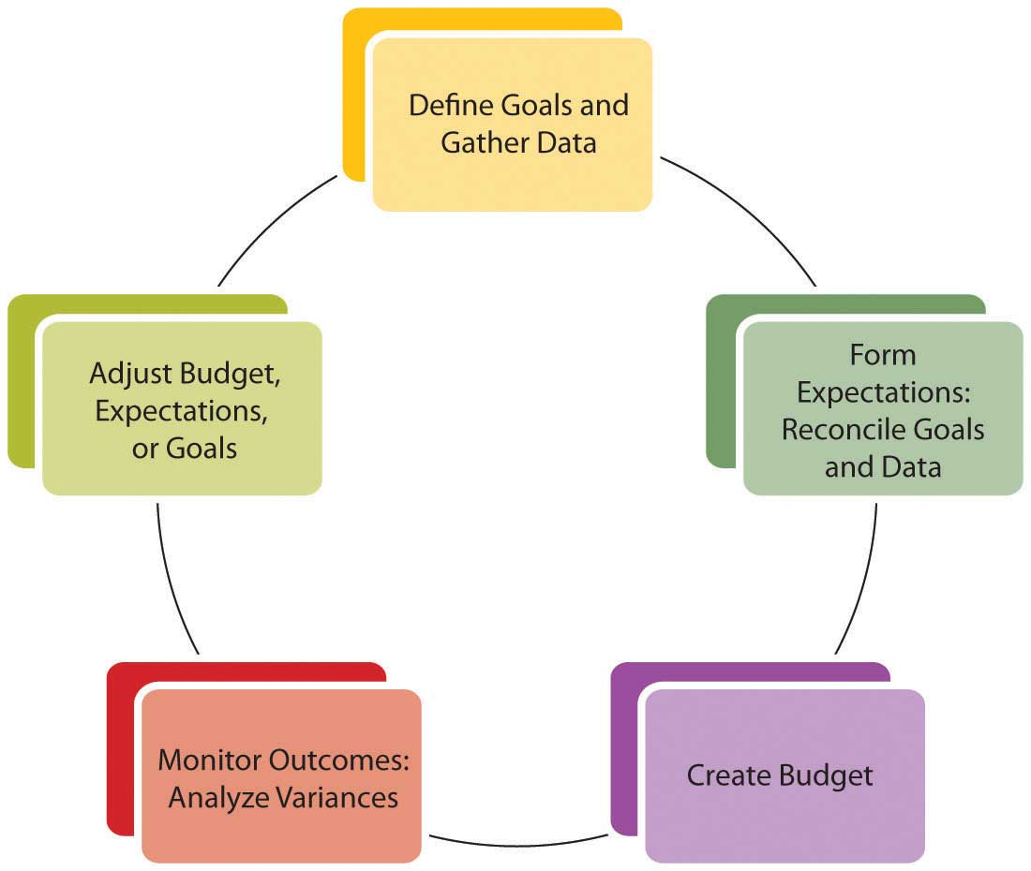
Budget Cycle
Training, support, and resources are available through your unit Budget Analyst
  DEFINE GOALS Administrators
  Unit PreBBR Analysis of budget needs and review with Vice Provost
5. ADJUST Staff & Supervisor (Unit or Dept Level)
Mid-Year Report
Carry Forward Request
Fiscal Year Close
2. FORM EXPECTATIONS Administrator with support from Unit Analyst as needed
Fiscal Year budget request
4. MONITOR & ANALYZE BUDGET
Budget Staff & Supervisor (Unit or Dept Level)
Create new FY Shadow Budget
3. CREATE BUDGET Administrator & Unit Analyst
Base Budget Review (BBR) submitted for upload with allocation
Cash Trust submission
Non-Discretionary Student/Course Fees submission

Slide 14
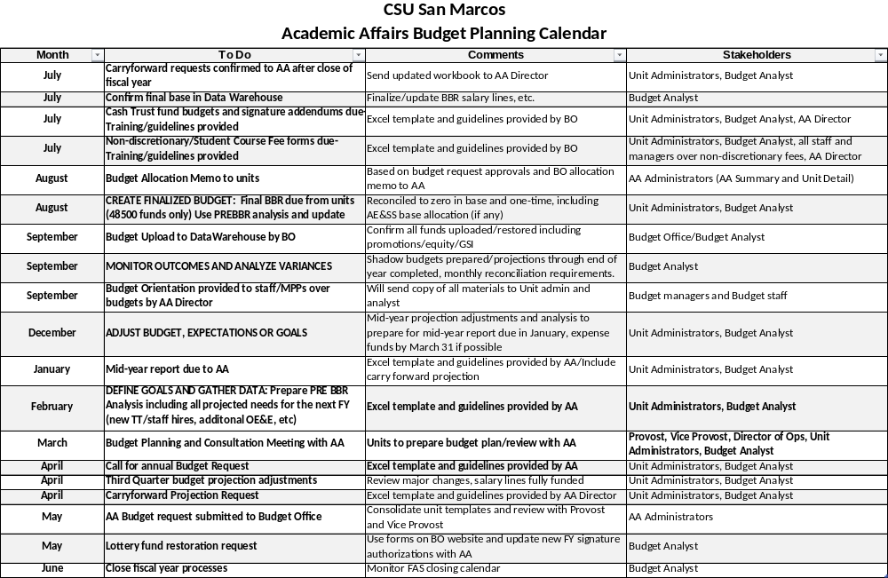

Slide 15
Uses of Funds: PROCARD and Purchasing
Using university purchasing processes (e.g. ProCard; Purchase Order) is strongly encouraged and preferred over personal reimbursement (Direct Pay).
Both ProCards and the entire department/unit budgets are reconciled and audited monthly, signed by owner and supervisor
Best practices:
  Code expenses to the correct account code
  Confirm invoice is attached
  Accurate description of purpose (e.g. recipient name for Professional Development)
  Professional Development funds must be spent in the year received, they are not eligible to carry forward into the next fiscal year unless specifically authorized. The Provost will review and authorize exceptions on a case by case basis for funds received too late in the year to be used.
  Hospitality expense must have ​signed hospitality ​form attached
  Please expense funds by March 31 as much as possible to meet all University fiscal year-end calendar deadlines. Work with your Lead Analyst for exceptions.

Slide 16
Uses of Funds: Professional Development
Regardless of College or Department, Faculty spending requests should be reviewed with consistent standards. Faculty should fairly be expected to explain the following (however briefly) for spending requests:
How will this purchase further your professional development?
How does this purchase align with the College’s mission and/or strategic goals?
PROFESSIONAL DEVELOPMENT: Professional Development is defined as pursuit of knowledge or skill through study, research and/or creative activities, professional travel, conferences, workshops or courses that directly support and develop a person’s professional growth in their discipline or career. Appropriate expenditure may include supplies, equipment, books, professional memberships or subscriptions, and other costs related to professional development. Hiring students to assist with research, scholarly and/or creative activities is permissible. All purchases must follow CSUSM procurement policies.
https://www.csusm.edu/par/resource_operations/professionaldevelopment.html

Slide 17
Definitions & Requirements from Academic Affairs:
Any items purchased with University funds are intended for University business, and all spending requests must be focused on that expectation.
Any items purchased with professional development funds are the property of CSUSM and must be returned to CSUSM for proper decommissioning, disposal or reuse per applicable policies.
Professional development funds must cover the entire cost of the item(s). Co-mingling of funds is not allowed; e.g., items cannot be purchased with 50% professional development funds and 50% personal funds.
University Procurement processes must be followed, and any personal reimbursements must comply with the Direct Pay Guidelines.
Technology purchases and COVID-related purchases require approval from the Dean/Supervisor BEFORE purchasing and/or requesting from IITS.
Professional memberships or subscriptions are allowable if directly related to professional development; Supervisor or Department Chair approval is required.
This document addresses purchases; Faculty wishing to use professional development funds for payments (e.g., gift cards, cash payment for research) will need additional approvals. Note that Institutional Review Board (IRB) approvals are separate from and do not guarantee spending approvals.

Slide 18
Monthly Budget Reconciliation
Budget reconciliation is the process of reviewing transactions, supporting documentation, and resolving any discrepancies that are discovered after the Data Warehouse general ledger closes each month.
Reconcile and Forecast every month – this is the foundation for internal control and ensures protection of the University’s resources and helps determine if your funds will end the fiscal year “on target”.
Professional Development/Faculty Funds should also be reconciled monthly by name and reviewed for accuracy and balances provided to faculty regularly.
Division of ACADEMIC AFFAIRS: Monthly reconciliation required by all budget staff and reviewed and signed by budget manager, see Vice Provost memo for full requirements. Biggest change in 22/23 is we will now store them in the AA Portal unit folders.
Adjust budget & projections as needed to meet goals. Expense funds as much as possible by March 31 to avoid last minute issues (there are exceptions, but they should be rare). ENSURE STRATEGIC SPENDING RATHER THAN LAST MINUTE SPENDING!

Slide 19
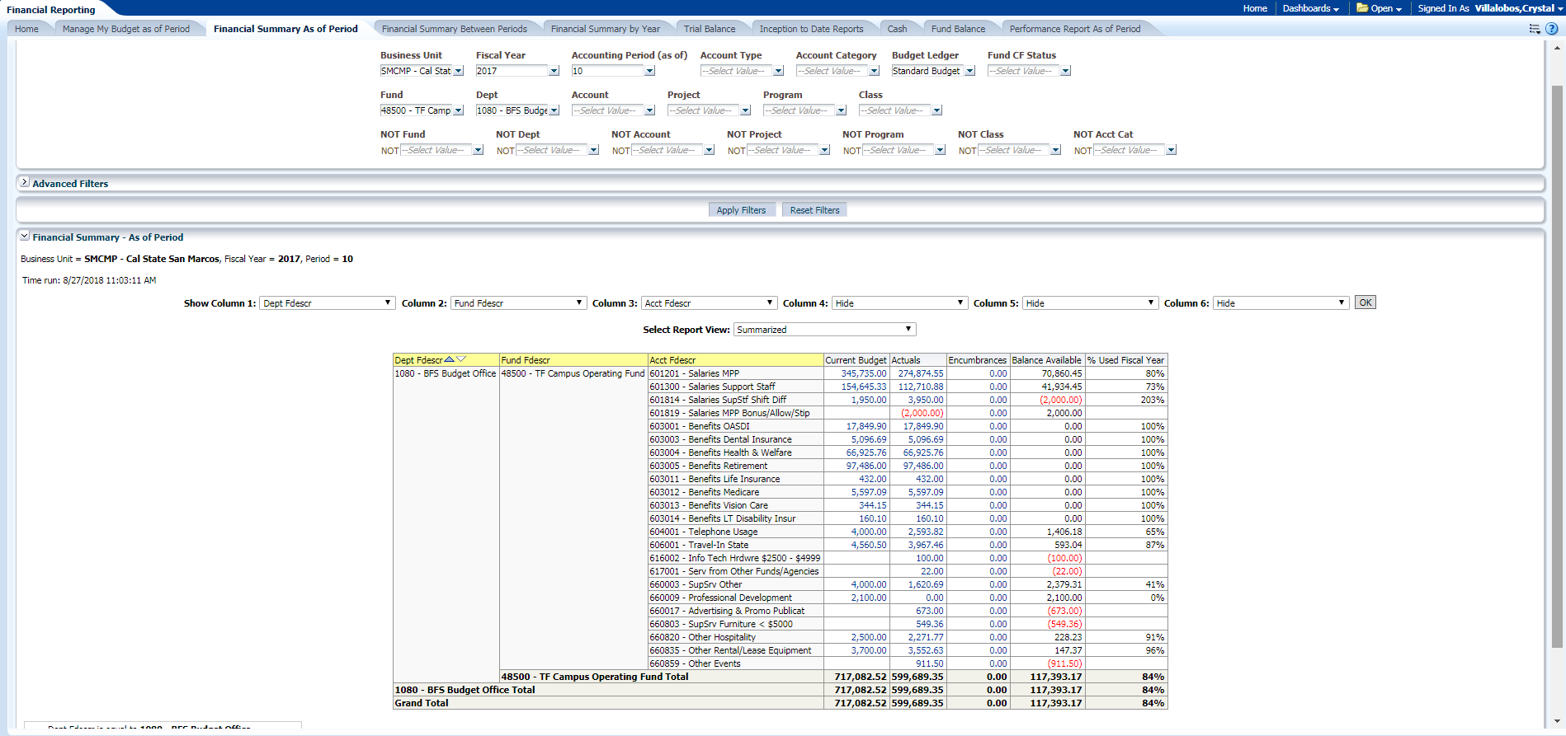
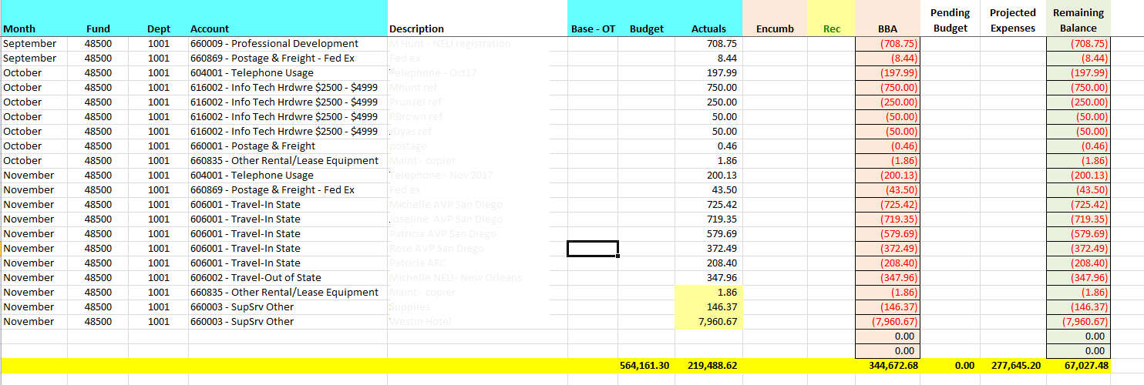
Managing Your Department Budget: Reconciliation
Utilize Data Warehouse (DW) to gather your data for the specific time period.
Download the data from DW to Excel to reconcile.
Work with your Division/Unit Analyst to determine your divisions reconciliation process.

Slide 20
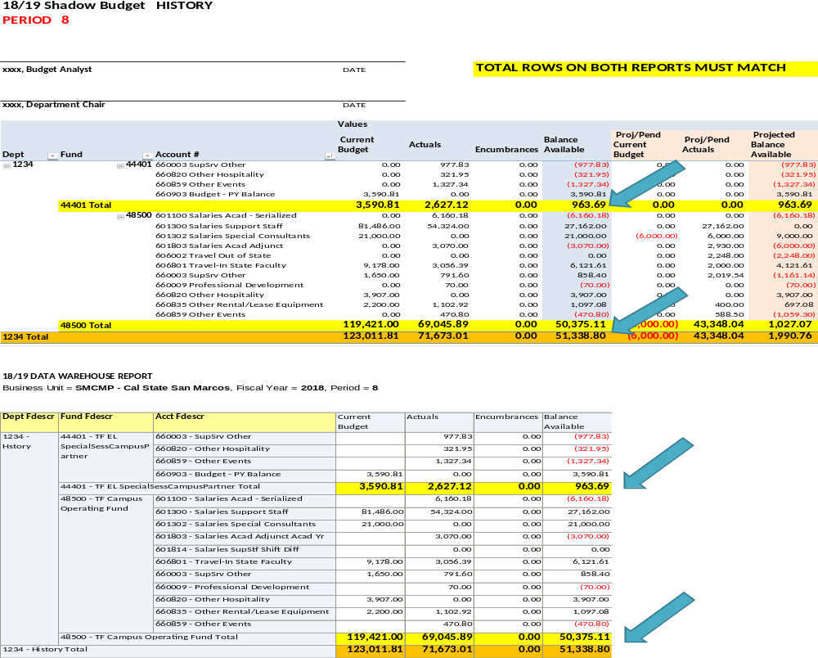
Sample of monthly budget reconciliation reports

Slide 21
Reconciling – Why is it Important?
Maintain Internal Control
Protects the resources of the University by being good stewards
Confirms financial statements are accurate and reliable
Helps determine whether or not your funds will end the fiscal year “on target” and in good financial health
Find and correct any financial discrepancies/variances
Division of ACADEMIC AFFAIRS: Monthly reconciliation required, see Vice Provost memo

Slide 22
Reconciling – What Do I Look For?
Confirm transactions are posted for the correct amount and match your submitted transactions and that you have back up documentation in case of an audit.
Confirm transactions are recorded in the correct department, fund, and account (chart field).
All transactions that should be recorded are recorded.
The balance in the shadow budget matches the balance on the Data Warehouse budget report in three columns: Budget, Actuals and BBA (balance) as well as each account code.

Slide 23

What Should I Do if I Find an Error?
RESEARCH and get it corrected preferably by the next reconciliation, do not wait. You risk losing funds if errors are not caught and corrected WITHIN the quarter.
For questions regarding the payment of an invoice, contact Accounts Payable
For payroll questions, contact Payroll Services
For budget help, contact your unit lead Budget Analyst
Corrections may include submitting the following:
  Budget Transfer
  Salary Adjustment
  Financial Transfer
  Billing Invoice

Slide 24
Budget and Transfers – BEST PRACTICES
MULTIPLE BUDGET TRANSFERS:
If you are transferring funds to more than one department, please post on one transaction, eliminate multiple transactions as much as possible.
BUDGET TRANSFERS WITHIN A DEPT ID:
Please avoid transferring funds between accounts in the same department. By submitting these transfers, it creates non-value added work for the Budget Office.
Keeping budget as it was originally posted will help your unit forecast and budget for the next fiscal year.
EXPENSING FUNDS OUT OF A DIFFERENT ACCOUNT THAN BUDGETED TO:
Accounts are considered ‘green’, it’s ok to be negative in one account if budget was posted to another in the same DEPT ID.
For instance, posting budget to Professional Development funds for faculty and expensing to travel, supplies, or events is correct. Track it with tags/categories in your shadow budget. Please request help from your lead analyst, if needed.
Regardless of the account of the budget, you MUST use the correct account to expense, please review the account list for the most appropriate account.
FULLY FUNDED SALARY LINES:
The original budget (BBR) for salary lines should fully fund the new fiscal year. If IRPs or Reclassification occur, submit a budget transfer to fully fund the salary line with BASE funds (using BBT scenario).
This will assure all salary lines are fully funded at year end. This is the only time you are allowed to budget transfer within a department.

Slide 25
What is a IFT (previously CPO)? Interagency Financial Transaction
  An IFT is the tool used to move cash between our campus and other CSU campuses or between our campus and the Chancellor’s Office (CO).
  IFT payments are made electronically by the CO – they are not invoiced or paid with checks.
  The Budget Office collaborates with Accounting to ensure entries required by the Budget Office are accurately processed on a monthly basis.
  Often stateside grants come as IFT’s, examples include COAST, CSUPerb, etc. or we make payments such as CSU ARC registrations to another campus.
  Access in the CSYOU & CSU CFS Login portal, IFT guidelines are provided.

Slide 26
Assigned Time and Reimbursed Time
(Course Release, Grant Buyout)
Provide an outline of every faculty member’s expected non-course related work and funding sources as soon as possible for the academic year (during schedule build, if possible).
  Track all tenure track faculty work assigned to non-instruction
  E.g., faculty serving on Academic Senate, grant funded research buyout, etc.
  Must track so that college is reimbursed for the time faculty spend working elsewhere
  Share with College Budget Analyst for support with processing for timely reimbursement

Slide 27
Reviewing Budget Basics
A Budget is not cash. It is an estimated plan of income for a set period of time which provides a vehicle for managing financial resource plans.
Reconcile and Forecast your records monthly – this is the foundation for internal control and ensures protection of the University’s resources, and helps determine whether or not your funds will end the fiscal year “on target”.
Review, Research and Resolve any discrepancies and variances and contact your Resource Analyst for help.

Slide 28
Support, Guidance and Resources
Remember, the unit Lead Analyst will be the best support for managing and training on the unit budgets, always check with them first before calling the Budget Office or AA Director for support. This helps us with consistency of training and information across the division. The Lead Analyst will reach out to me if they need additional support.
Annual Budget Orientation/Refresher is provided each fall for all new and current budget managers, analysts, and coordinators.
The FY Budget Orientation Power Point, Guidelines, and Reconciliation memo are also posted on the PAR website for review at any time, along with sample department and college shadow budgets (excel workbooks to manage your budget).
  https://www.csusm.edu/par/budgettrackingandreconciliation.html

Slide 29
Academic Affairs RESOURCES
Planning and Resources (PAR)Website review:
https://www.csusm.edu/par/resource_operations/index.html
Includes AA budget training & resources, onboarding resources, and other important links.
Information on AA Business Operations (AABO) meetings including monthly Roundtable Discussions/Meetings
AA Approval Requirements MATRIX and Provost Signature guidelines
PLEASE TAKE ADVANTAGE OF THESE HELPFUL RESOURCES

Slide 30
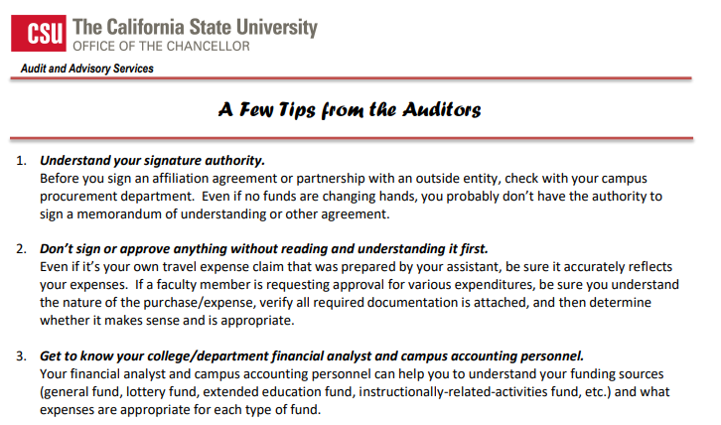

Slide 31
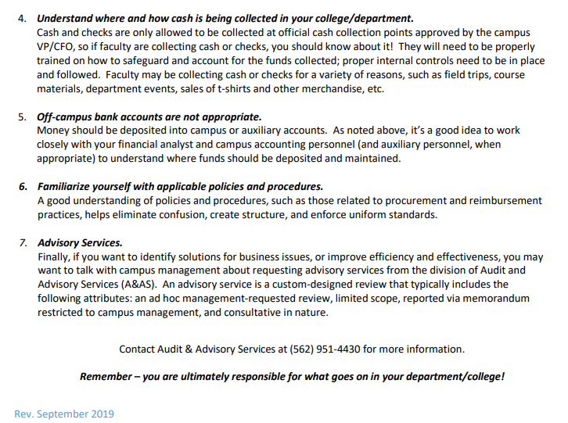

Slide 32
QUESTIONS?

