Slide 1
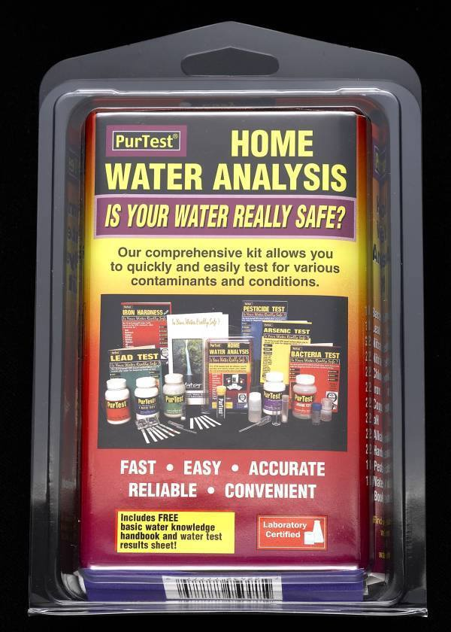

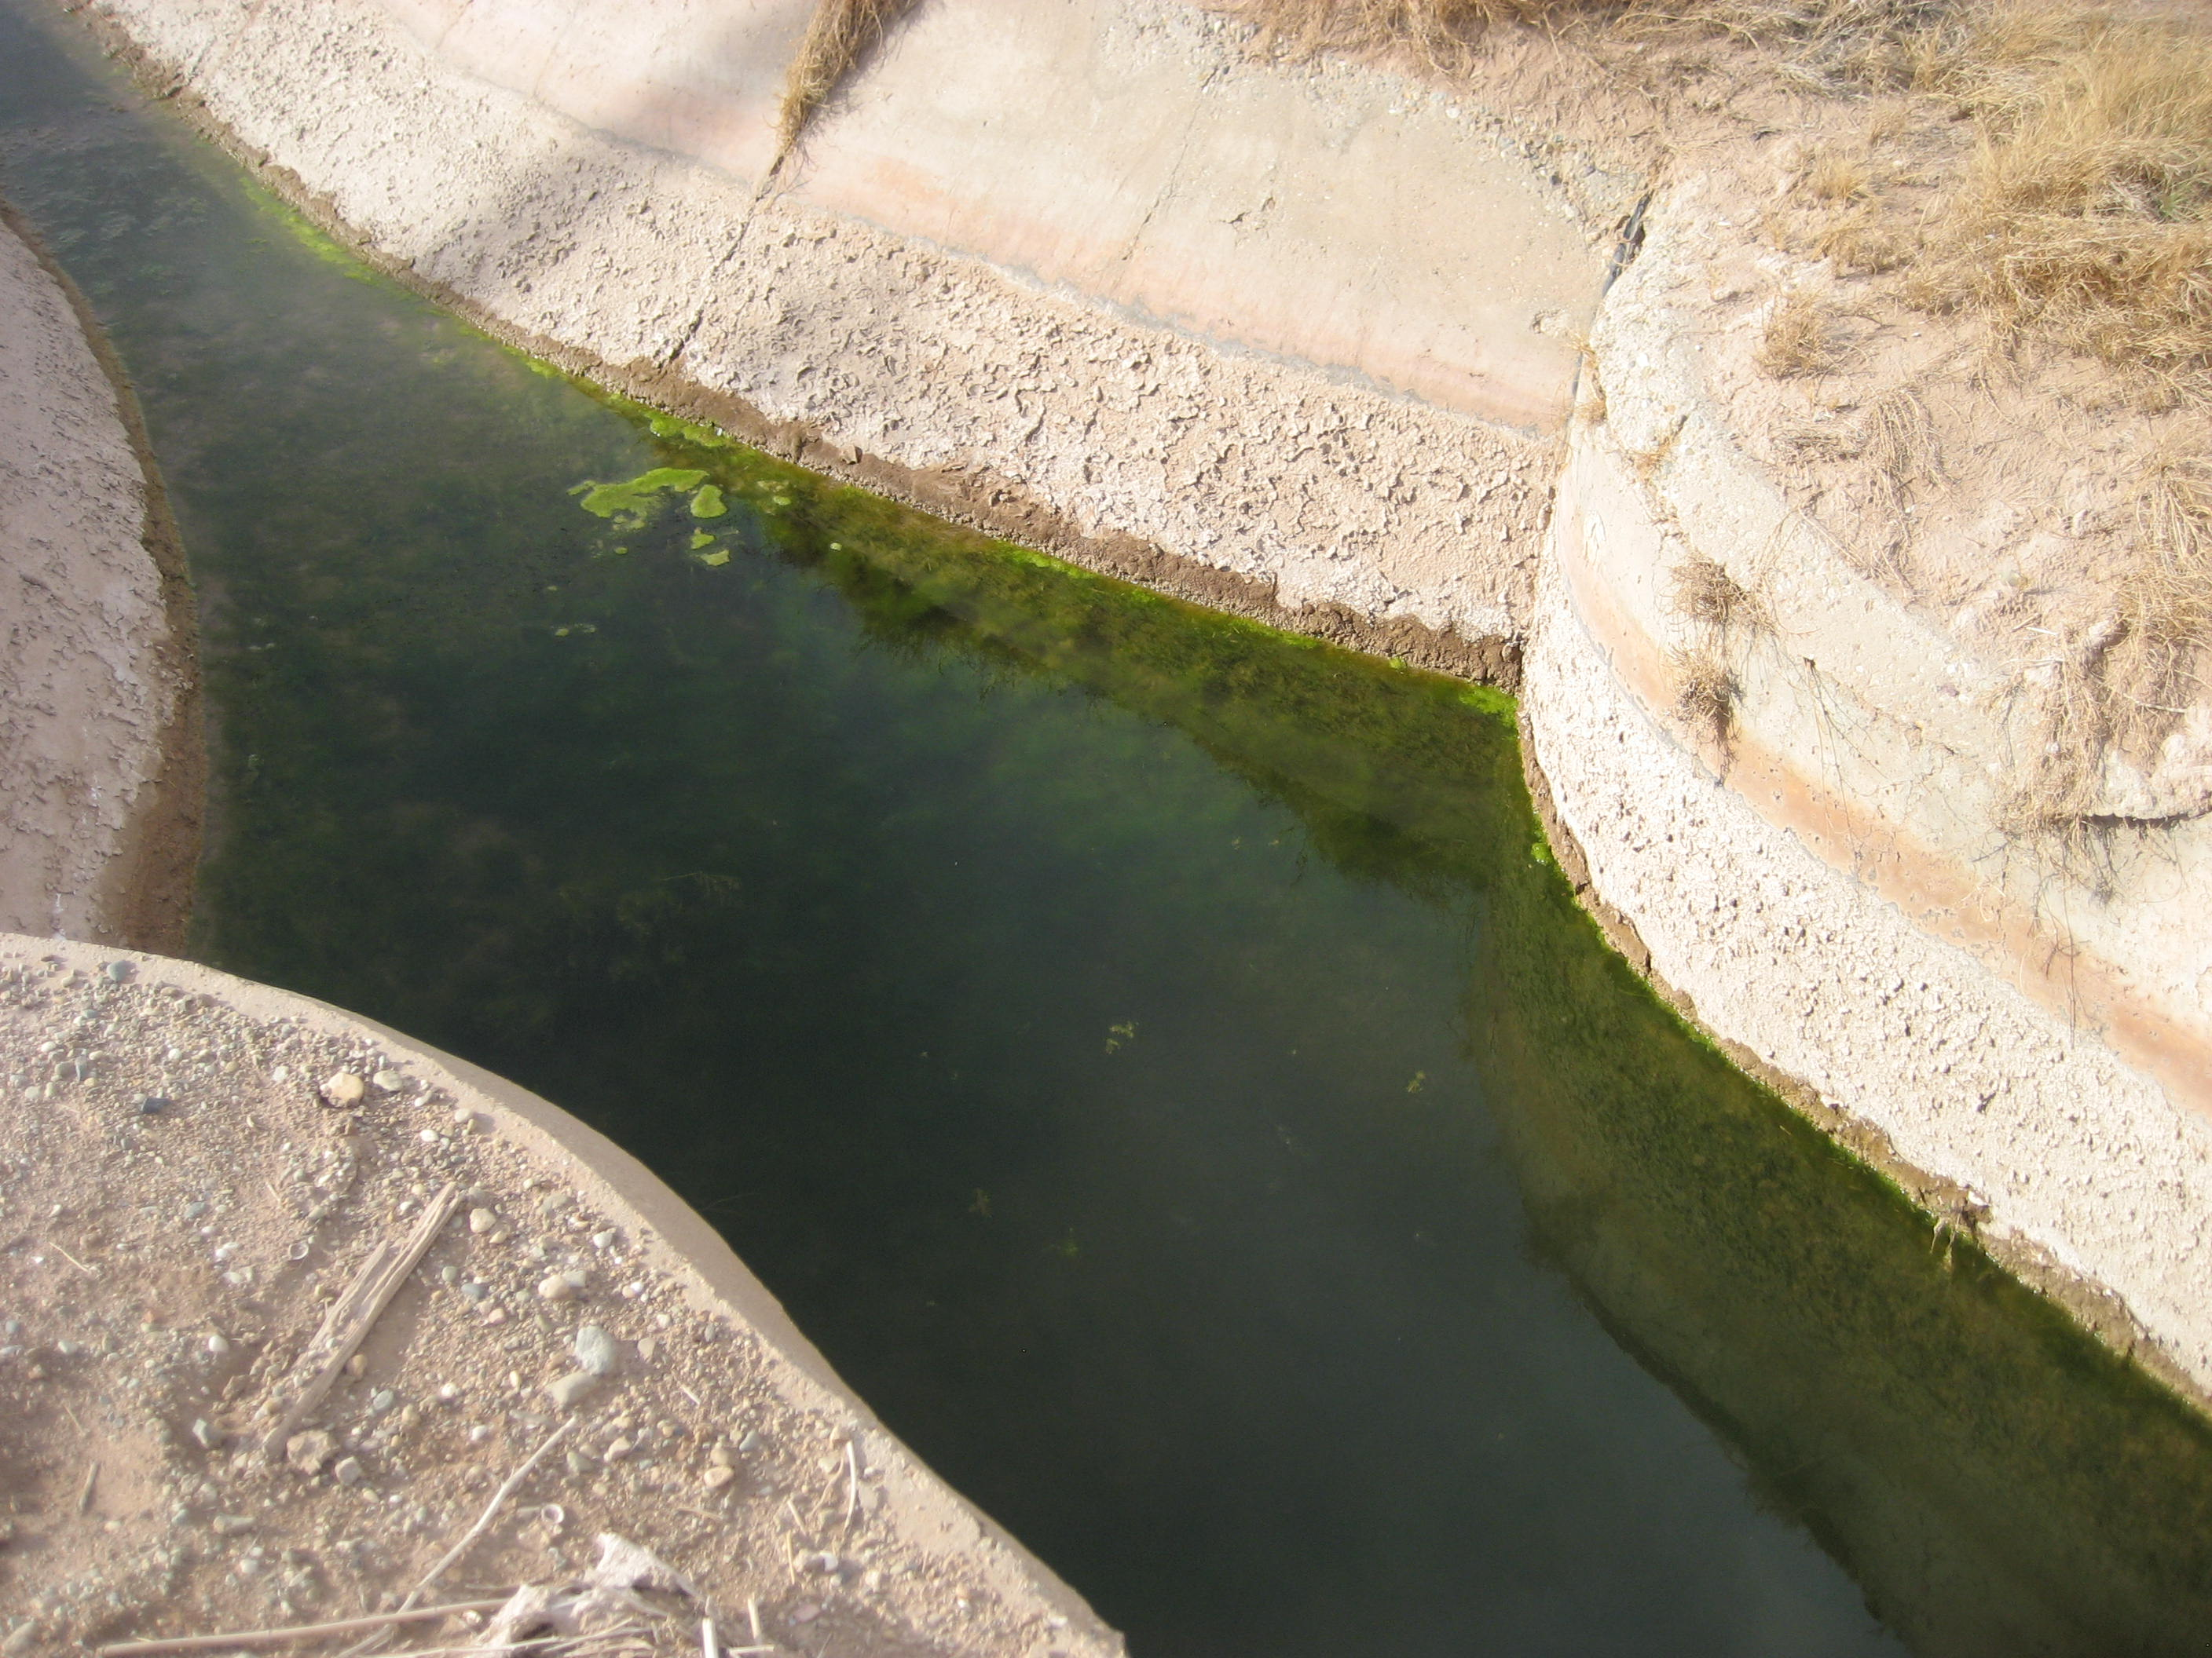
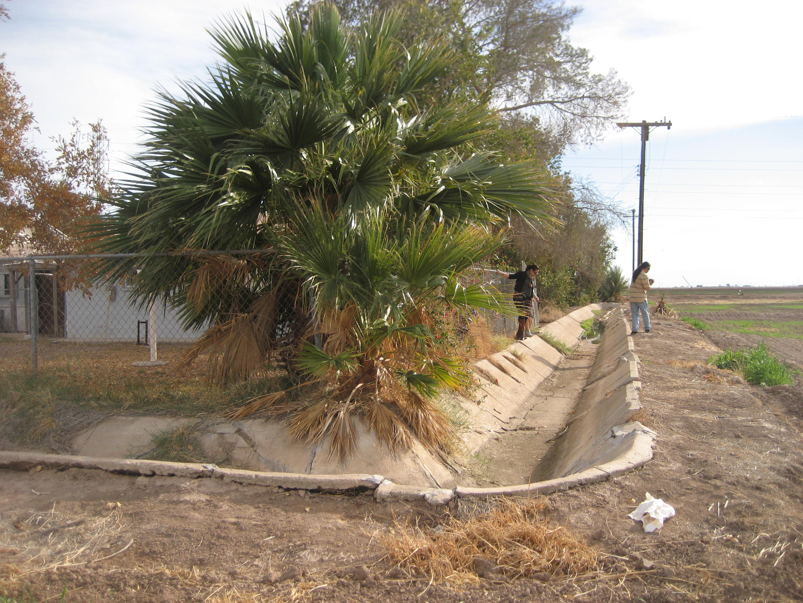
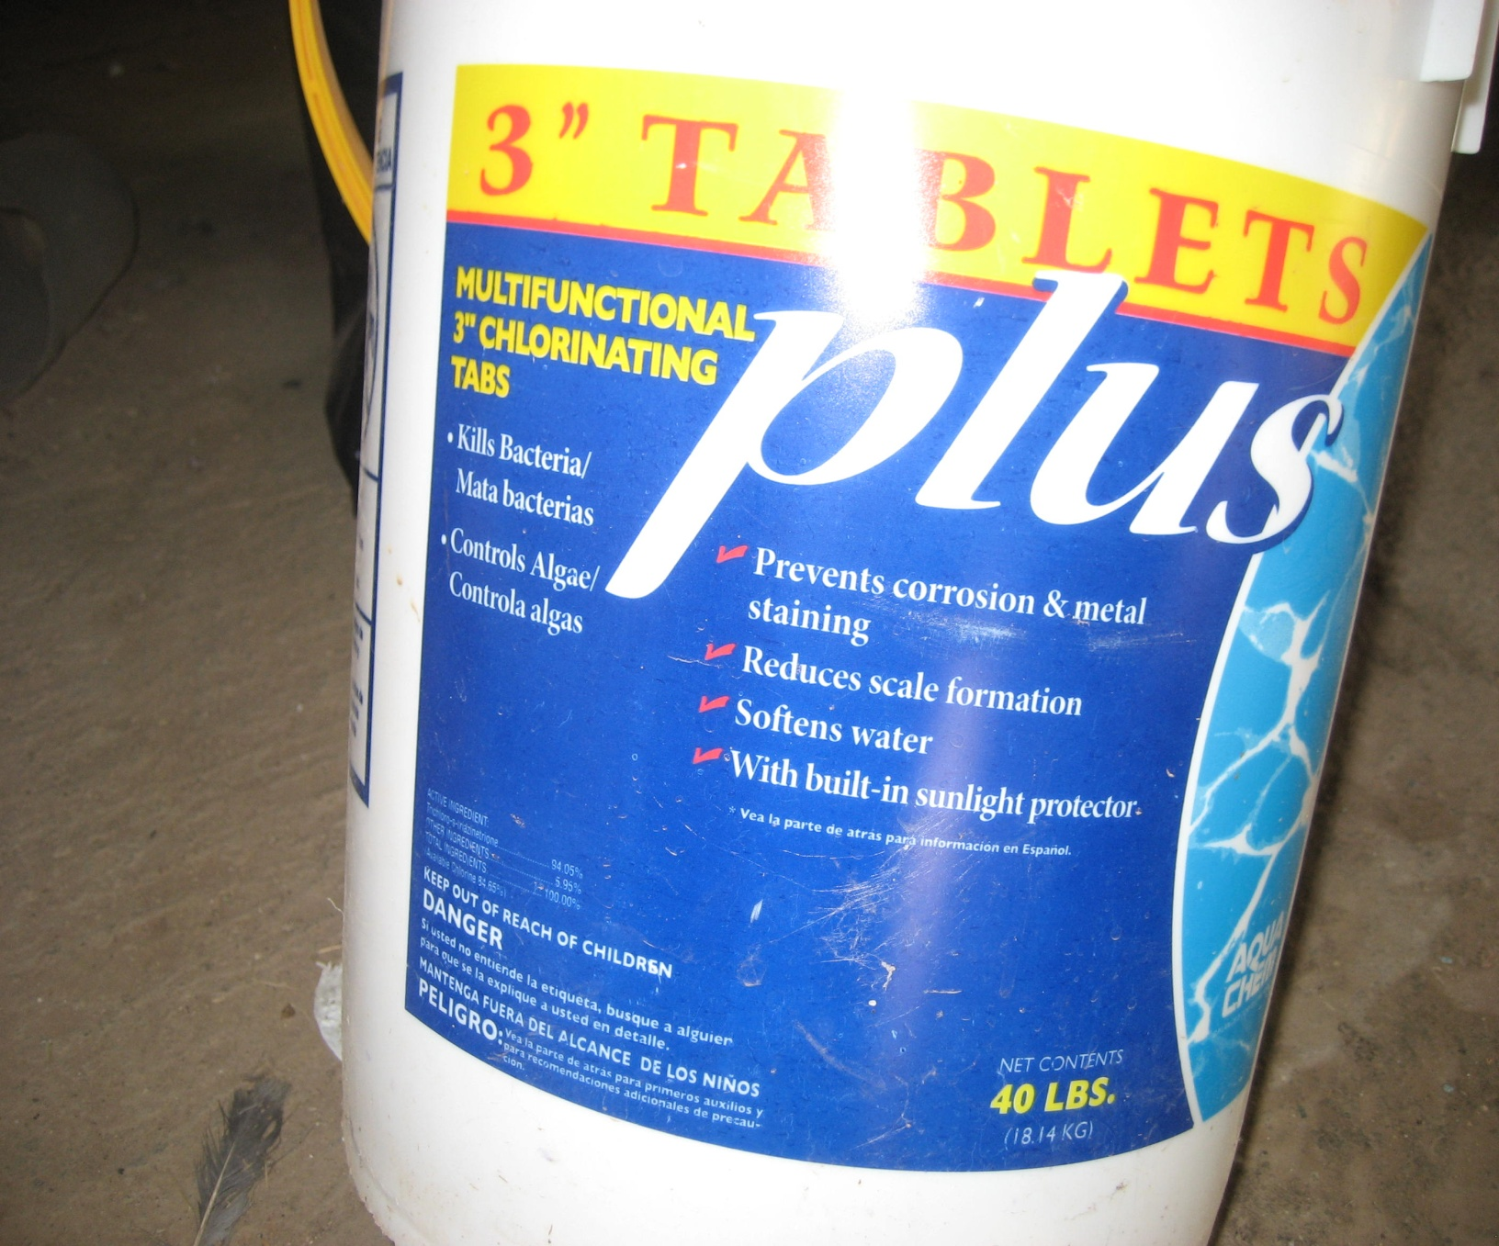
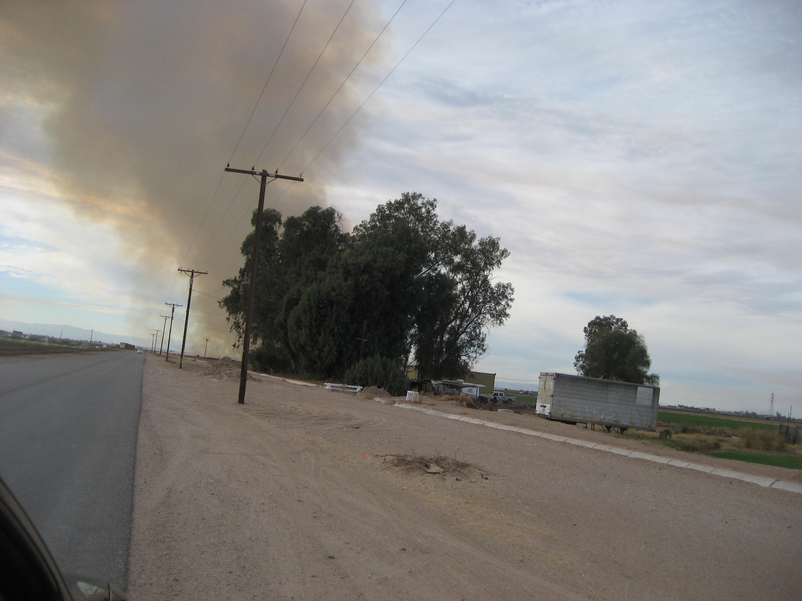
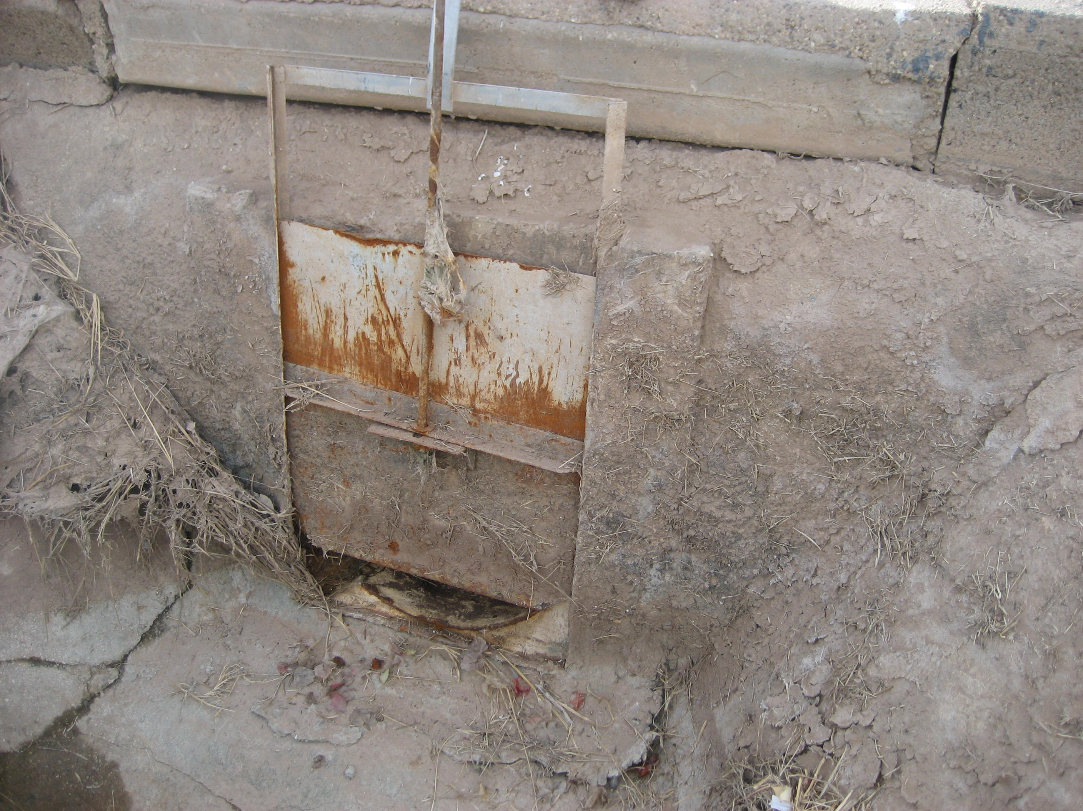
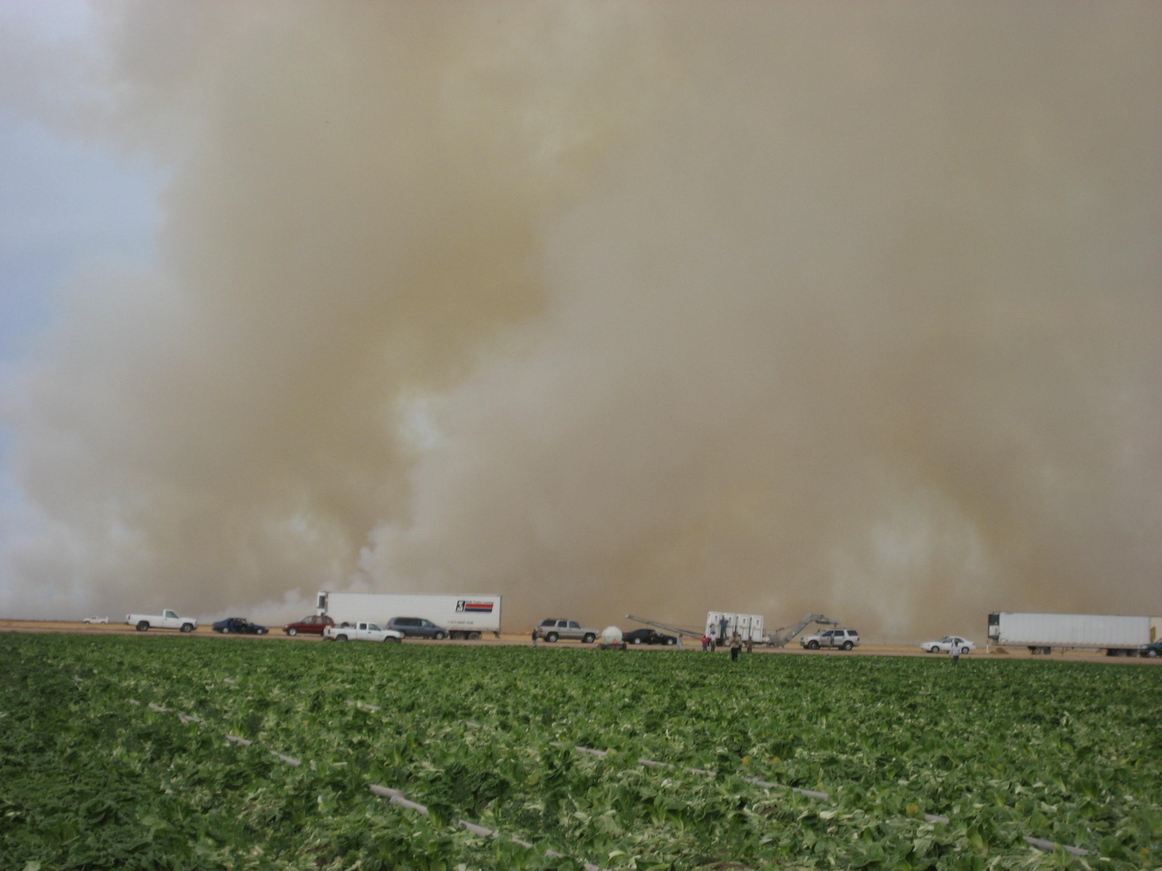
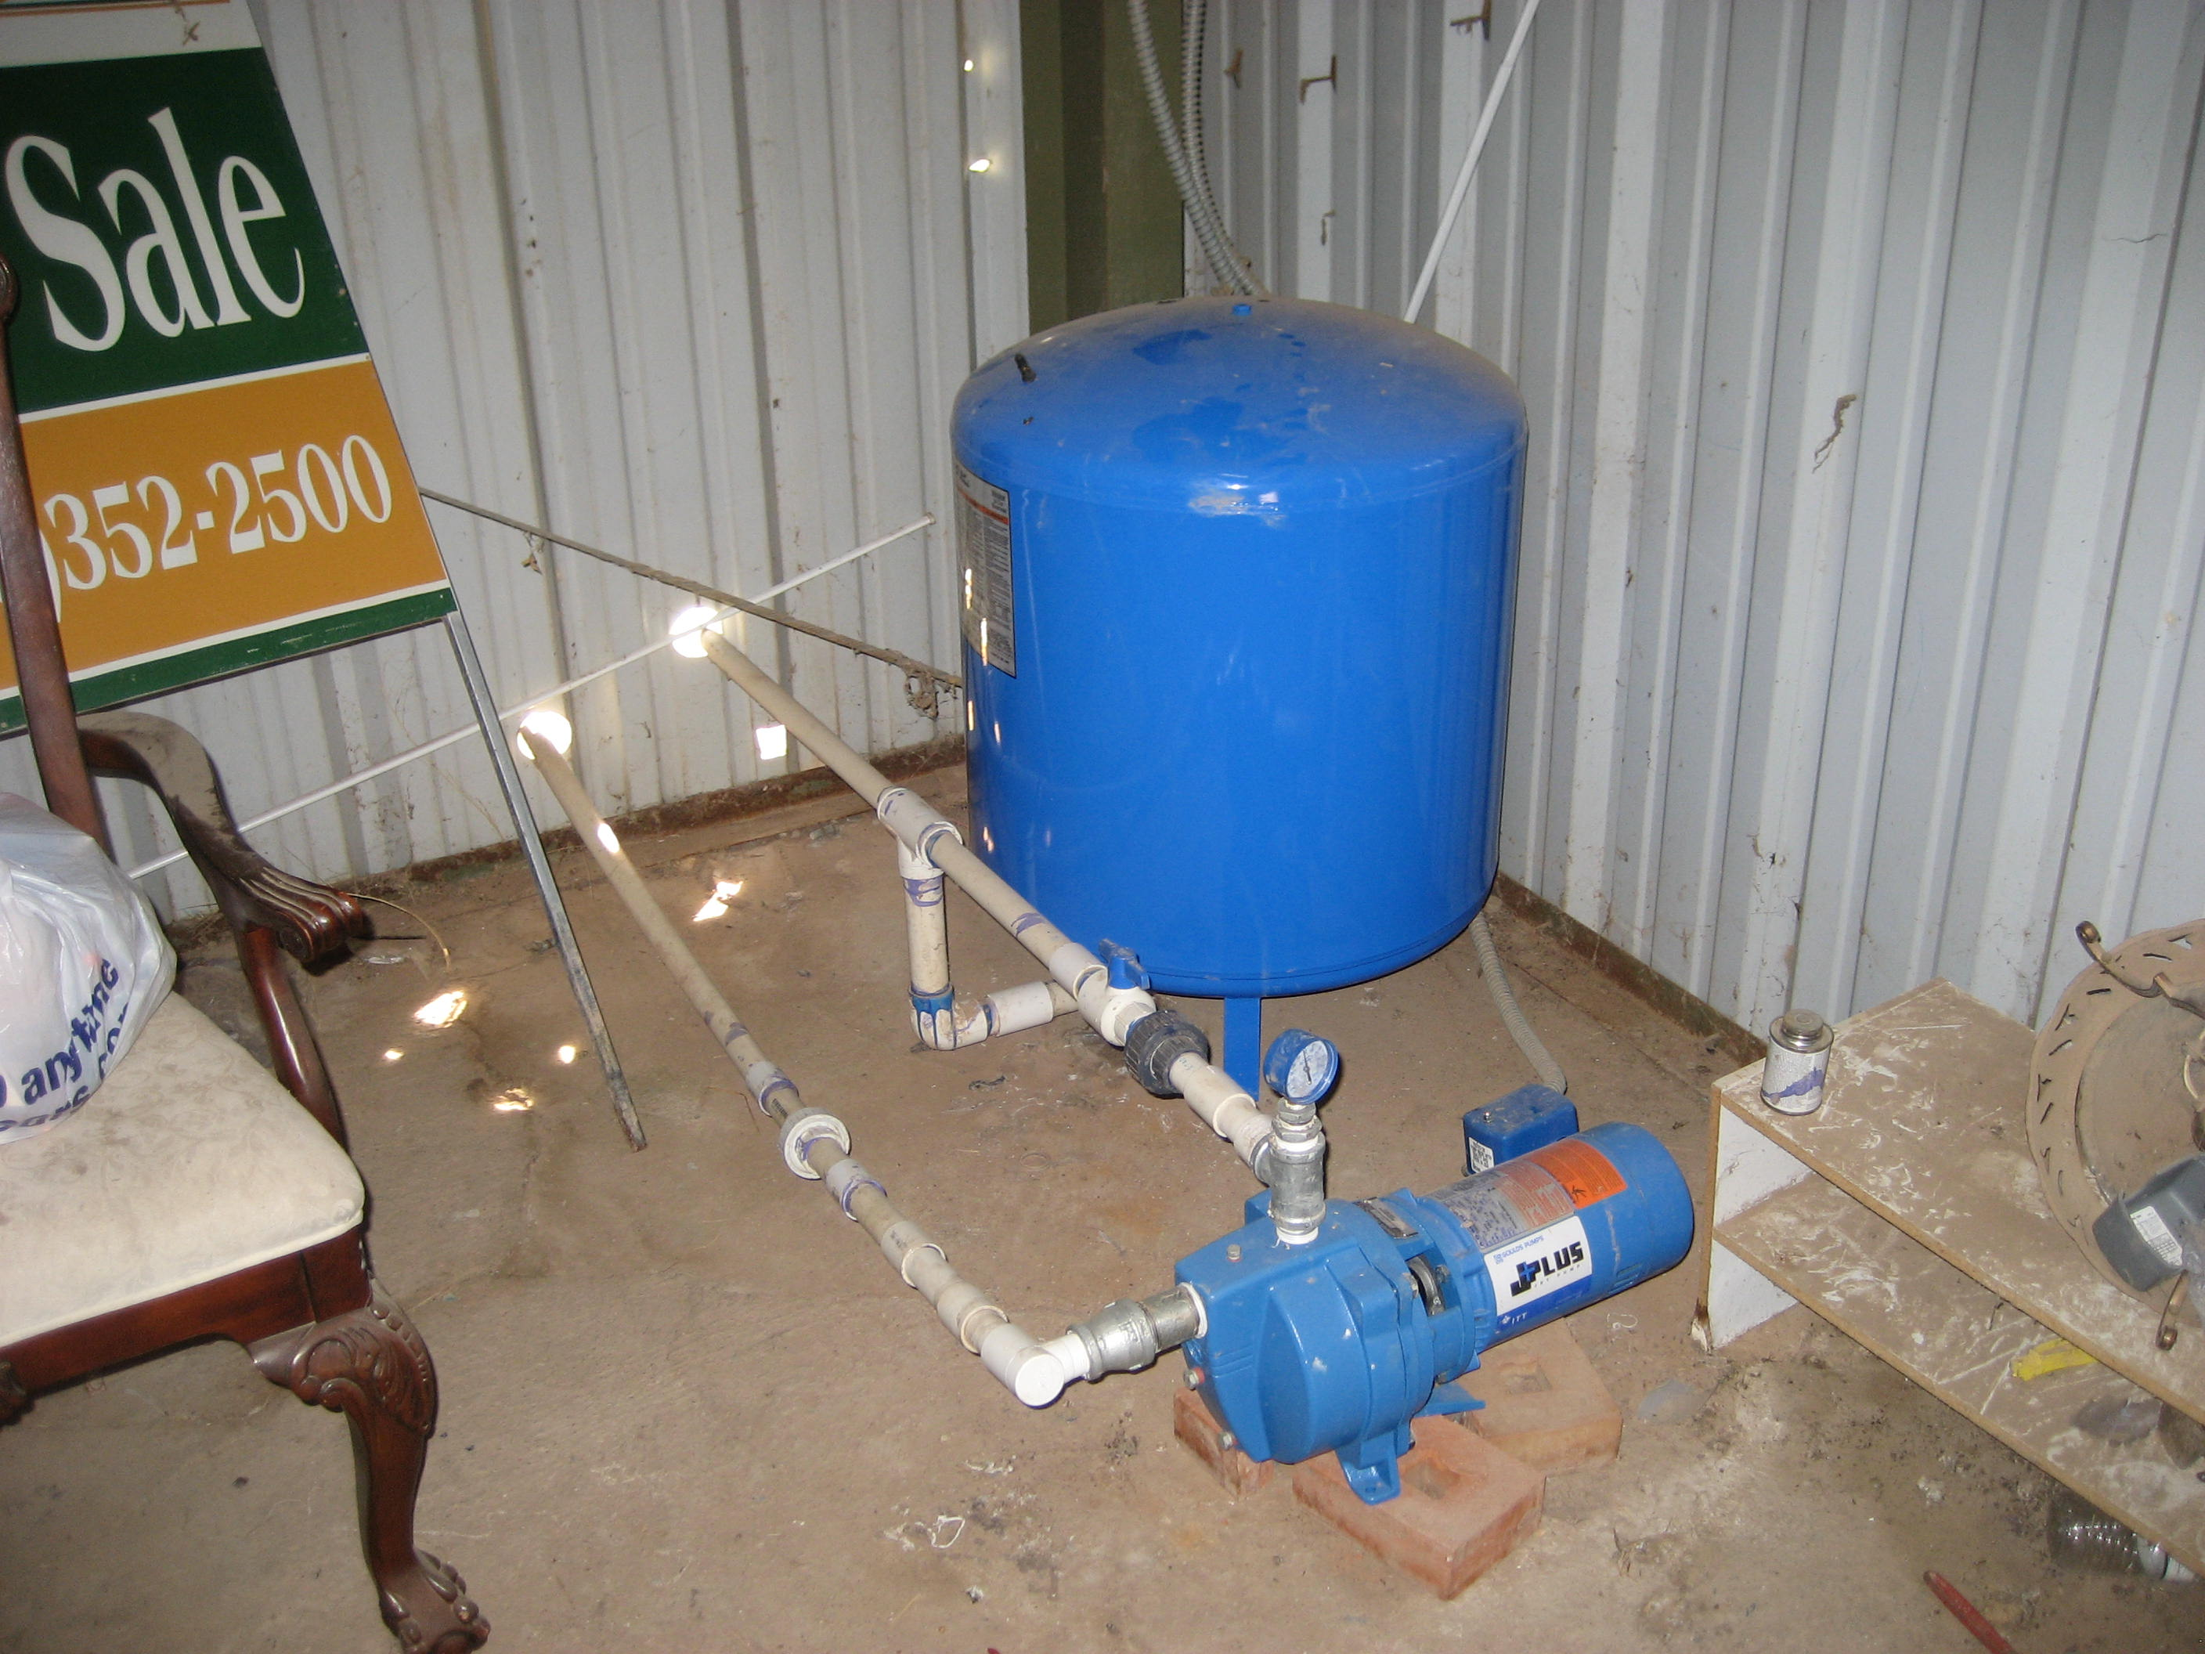




Water Quality and Environmental Health in Imperial County
Water is one of the Earth’s most valuable natural resources and access to clean water should be a basic human right.
Water Quality and Environmental Health Project
Clean Water is essential for:
Bathing
Laundry
Cooking
Drinking
What is Pollution?
Any harmful substance found in the:
Air
Soil
Water
Where does Pollution come from?
Indoor Sources
Outdoor Sources
Pollution harms the Environment and People
For more information about NLRC, visit www.csusm.edu/nlrc
For more information about CCV, visit
www.ccvhealth.org
Community Partners
Comite Civico del Valle

