Slide 1
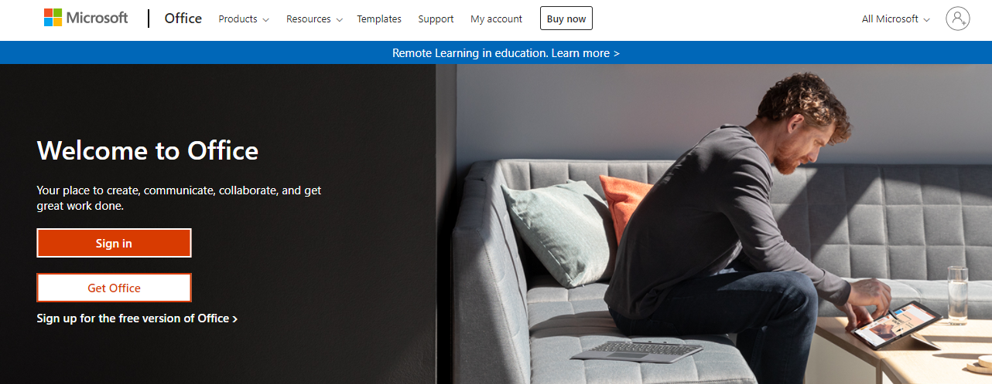
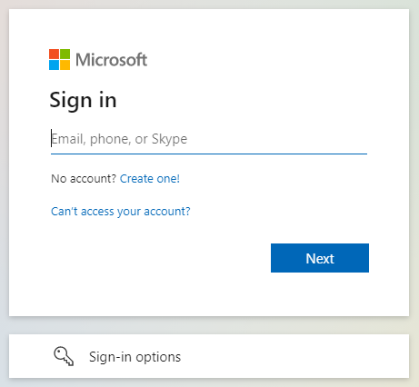
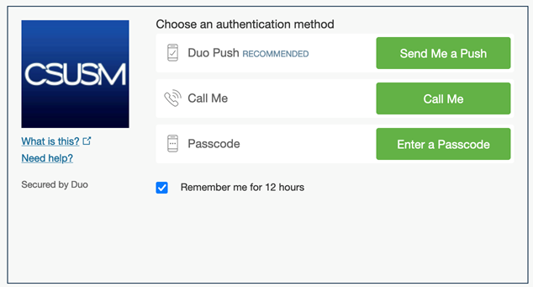
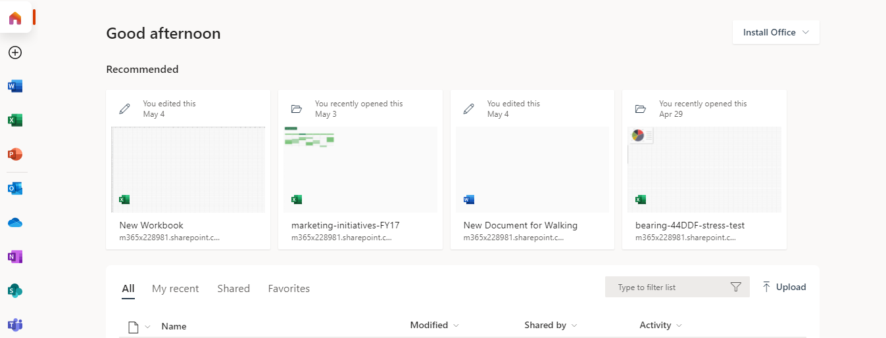
Log in to Outlook on the Web
Navigate to office.com.
Click Sign in.
From the list of applications that appears on the left-hand side of the Office landing page, click the Outlook icon.
Use your Organization email and password to sign in.
Next you will need to complete multi-factor authentication in Duo.

Slide 2


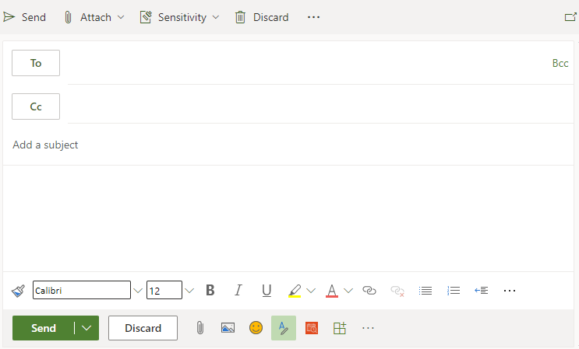

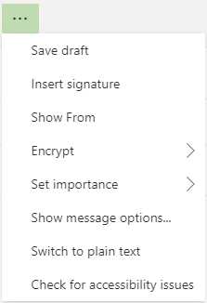

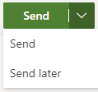
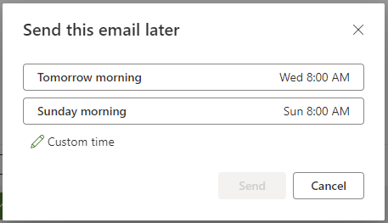
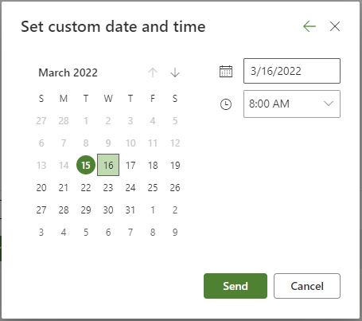
Composing an Email in Outlook on the Web
Click the Mail Icon in the left navigation pane.
Click New Message in the top left corner of your Email Window.
A New Message pane will open to the right of your inbox.
Clicking the Three-dot Ellipsis in the top toolbar will show additional
options.
To pop your email out into a separate window, click the pop-out icon directly above the Bcc icon.
To display the Bcc line, click Bcc to the far right of the To Field.
Once email is ready to send, click Send.
  To send your email later, click the down arrow within the send button and click Send Later.
  The Send this Email Later Dialog box will open with suggested times.
  To send at a time of your choosing, click Custom Time.
  Enter the desired date and time.
  Once complete, click Send.

Slide 3
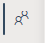
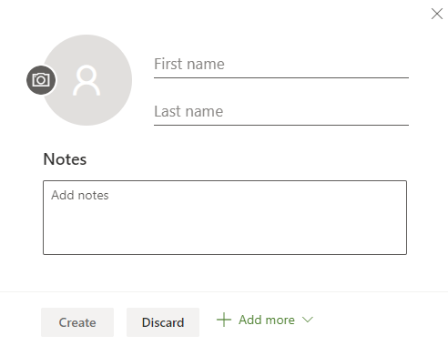

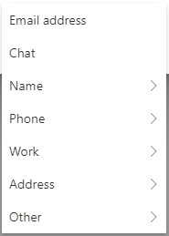
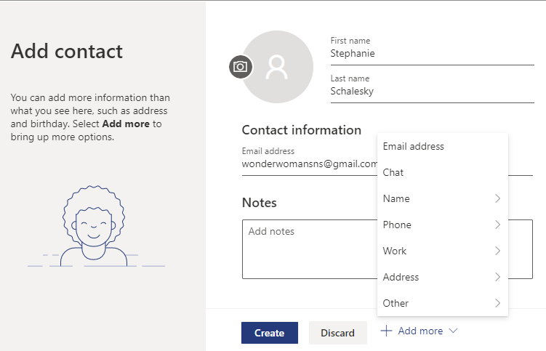
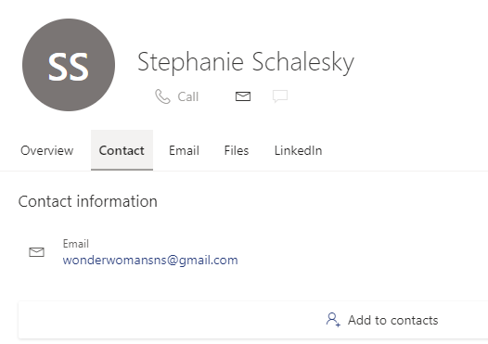
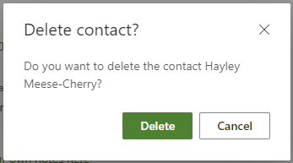
Managing Contacts in Outlook on the Web
To begin managing your contacts, click the Contacts Icon found in left pane.
Create a Contact
Click New Contact in the top left of your Contacts Window.
The Add Contact Dialog Box will open, allowing you to enter the first and in the details of your new contact.
Click + Add more at the bottom of your contact card, to add additional information.
Once complete, click Create
Note: When you add internal contacts, some of their information will autofilll
Add a Contact from email
On the email, click on the person’s information you wish to add in as a new contact.
Next, click on Contact. You will see a people icon with a plus sign and the words Add to contacts next to it. Click on it, and in the next pop-up window is where you will enter any additional information with the +Add more options.
Once you have entered all the information for this contact you wish to store, click Create. You can always go back in and edit contact information later if necessary.
Delete a Contact
Select the contact you’d like to delete.
Click Delete in the top toolbar.
When the confirmation box opens, click Delete.

Slide 4
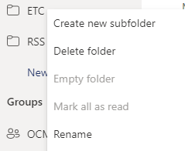
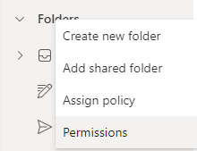


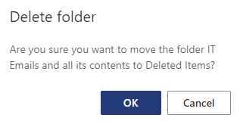

Folders in Outlook on the Web
Folders help to keep emails organized. There are default folders already set up (inbox, outbox, sent and drafts). Additional customized folders can be created and arranged as needed to simplify and prioritize content.
Creating a New Folder or Subfolder
There are a couple of ways to create a new folder. You can right-click on the Inbox folder, and type in the name of your new folder.
You can also click on New folder which is at the bottom of your folders list.
There may be times when content should be placed in a subfolder. To create a subfolder, right-click on the folder and click on Create new subfolder. Then type the name of the subfolder.
Note: You can move folders and subfolders by dragging and dropping them in a new location, or by right-clicking on the folder, from the menu options select Move. A pop-up list of all folders will come up. Choose the folder you want to move the content into and click Move.
Deleting and Renaming Folders
To delete a folder, right-click on the folder. Select Delete folder from the menu. Click OK to delete the folder and send all items to the Deleted Items folder.
To Rename a folder, right click on the folder and select Rename from the menu. Type in the new name for the folder.

Slide 5

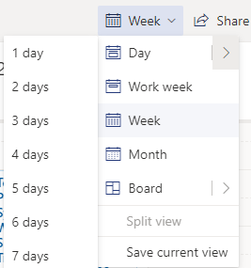




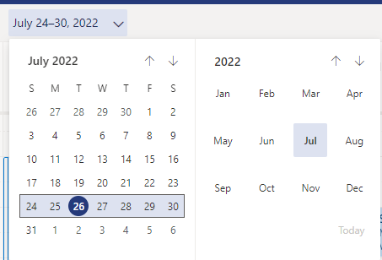
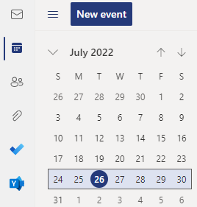
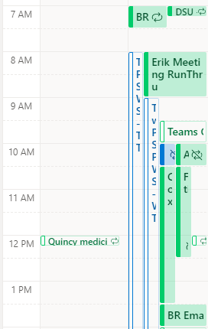

Calendar Views in Outlook on the Web
To access the calendar in Outlook on the Web, click on the calendar icon in the left navigation pane.
Changing the display
You can customize the calendar view by navigating to the upper right-hand area of the calendar page and clicking on the drop down for the current view. The default is a week, but you can set it to your preference here.
There are a few ways you can change the week you are viewing:
You can click on the arrow buttons next to Today in the upper left-hand corner to go forward and back.
You can click on the week you want to view on the calendar on the left side of the page.
You can click on the drop down on your current view and choose the week and month you want to view.
Viewing shared calendars
To view a shared calendar, click on the person’s calendar you wish to view. Their meetings will be color-coded and show side-by-side with your meetings on your calendar view.

Slide 6
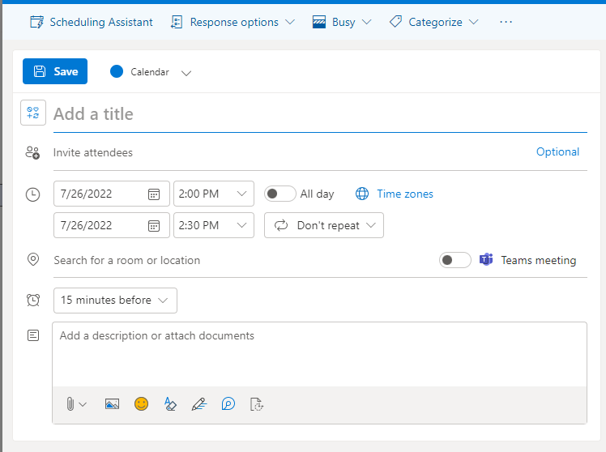

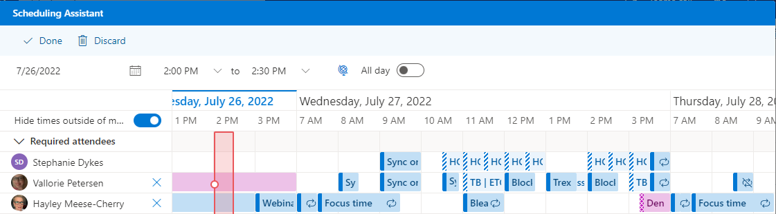
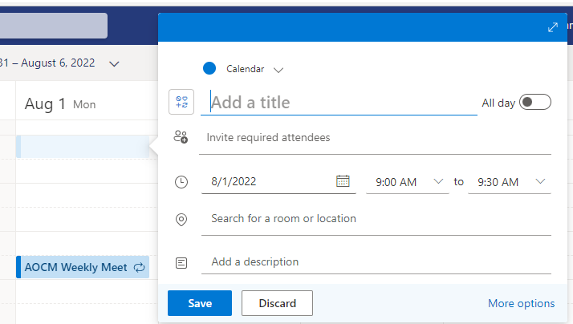
Scheduling Meetings and Appointments in Outlook on the Web
There are a couple of ways you can schedule appointments and meetings in your calendar view. You can click on New event in the upper left corner above the small calendar and it will bring up a new window for you to enter information.
Here you can enter a title, adjust the length of the meeting, invite attendees, and add in notes or documents for the meeting.
Use the toggle switch to set up a Teams meeting.
Use the Scheduling Assistant feature to view the calendars of internal attendees. This helps you set the best time for all to attend without having to go through declines and proposed new times from your participants and potentially need to reschedule the meeting.
To schedule an appointment, or non-Teams meeting, you can use the option listed above, or single-click on the calendar at any time in your calendar view. Adjust the time and/or date as needed. Use the toggle switch for an all-day event.
You can add a title, invite attendees, and add a location. If you want to make it a Teams meeting, or have additional add-ins, you can click More options and it will open the larger view with additional meeting options.

