Slide 1









What is OneDrive & Document Lifecycle
What is OneDrive?
OneDrive is a Microsoft cloud service that connects you to all your files. It lets you store and protect your files, share them with others, and get to them from anywhere on all your devices. OneDrive allows you to:
Upload and download files and folders
Access from any device, anytime and anywhere
Share files internally and externally
Collaborate real-time
Draft
Collaborate
Publish & Share
How To Guide
Video
Create files in OneDrive to start the draft process. Here you can share and collaborate with a few people or share externally.
Video
When you are ready to collaborate with others, move the file into Teams. You can share documents via link to others within your organization and can add external guests to your teams for easier external access.
Once the file has been finalized, files from Teams can be accessed in SharePoint so that they may be shared with others.

Slide 2
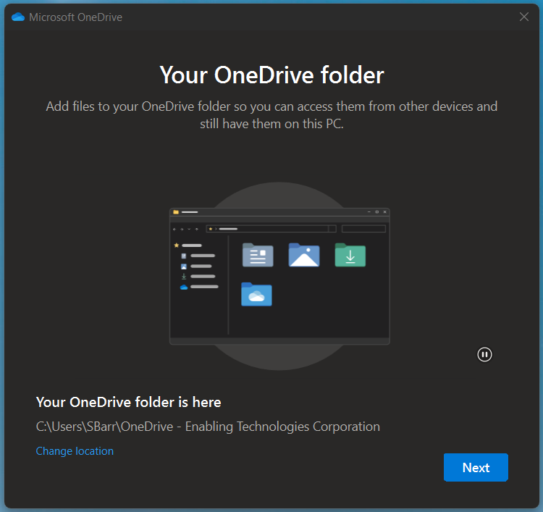
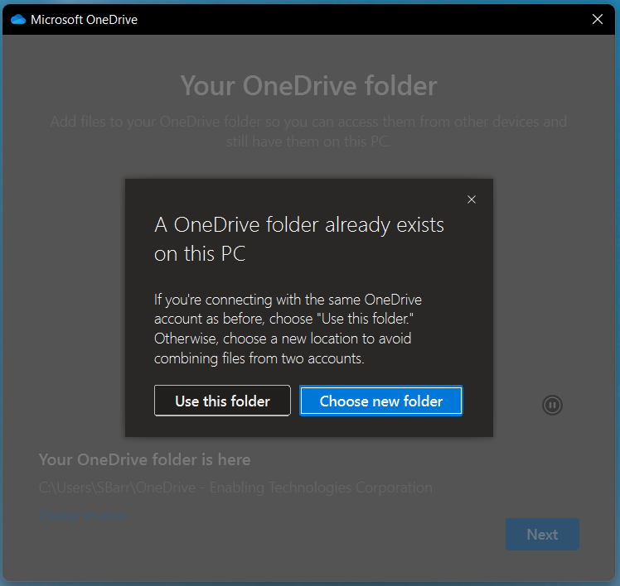
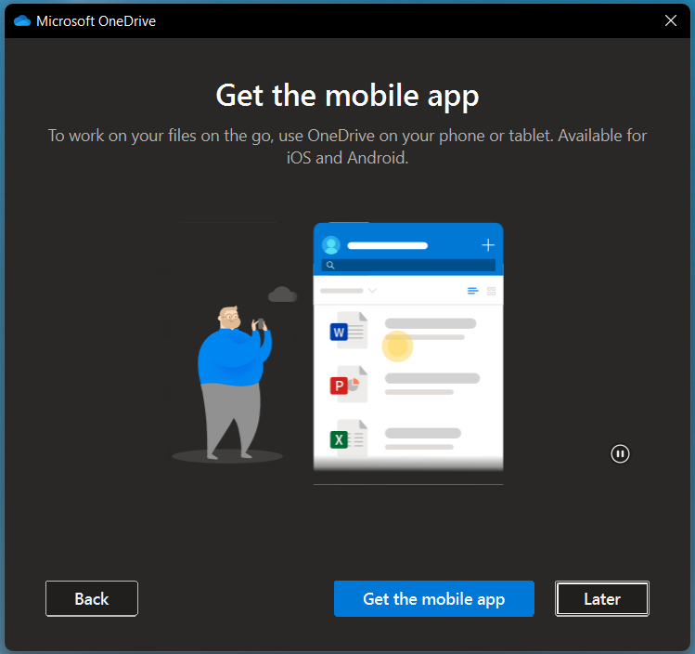
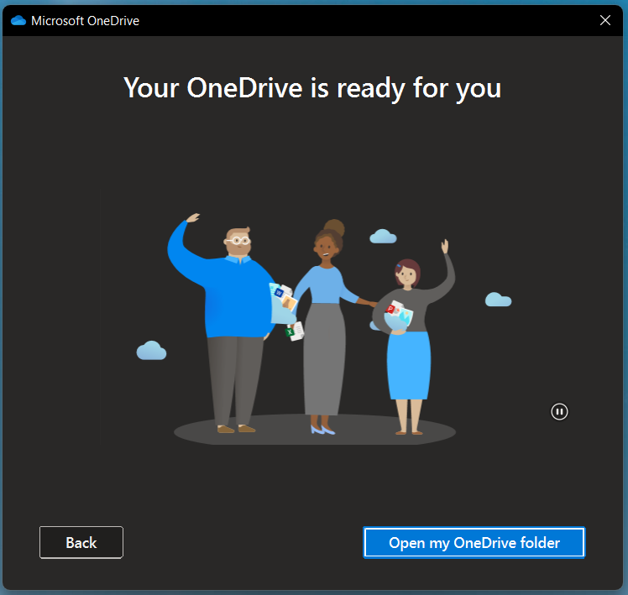
Update OneDrive Sync Account
Connect a New Sync Account to OneDrive (continued)
Your OneDrive folder will be located, click Next.
  NOTE: If a OneDrive folder is located on your device. OneDrive will prompt you to Choose a new folder or Use this folder. To ensure an optimal setup, please select Use this folder.
Continue the setup wizard by clicking Next. When prompted to download the mobile app, click Later.
Once your OneDrive setup is complete, click Open my OneDrive folder.

Slide 3
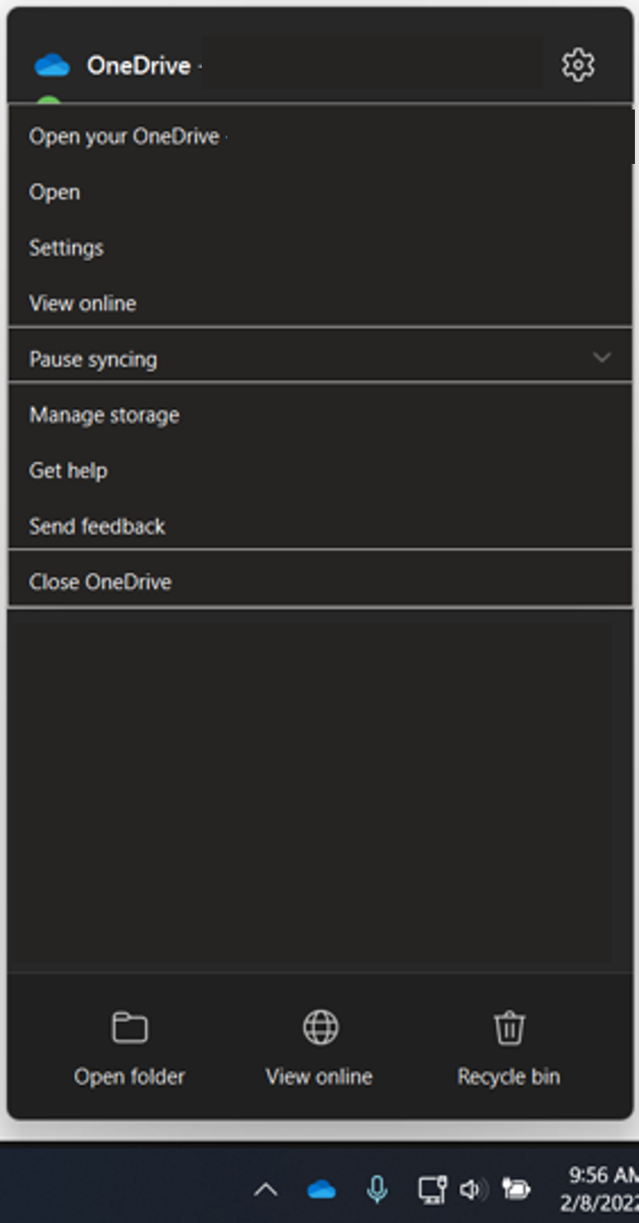
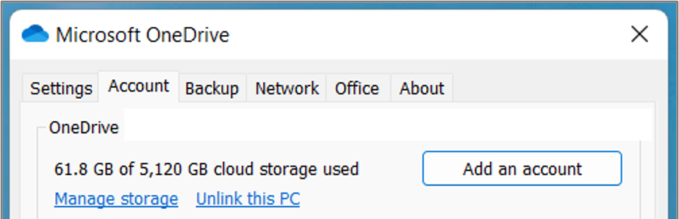
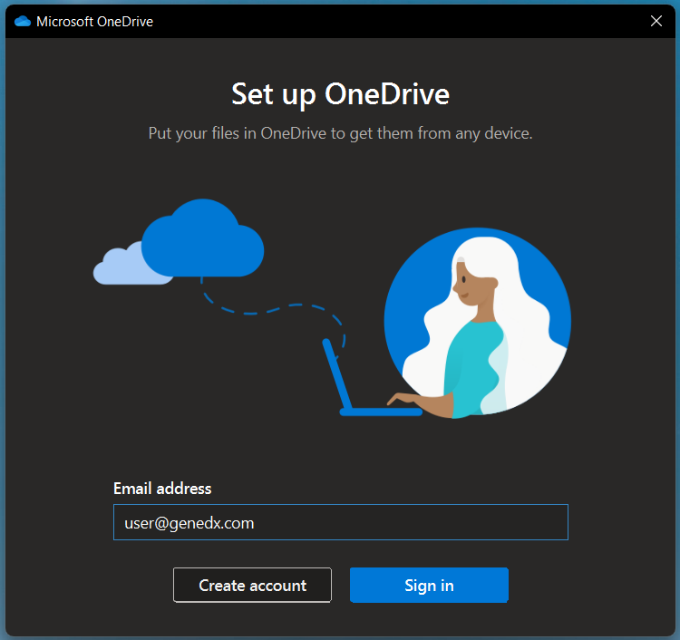
Update OneDrive Sync Account
Disconnect Sync Account from OneDrive
Right click the blue cloud icon in the lower right corner of the task bar on the desktop.
The OneDrive tray will display, and the menu will be open.
Click Settings.
A new window will appear, click the second tab labeled Account.
Locate the OneDrive account you would like to remove, click Unlink this PC.
This account will be signed out. This may take a few minutes to complete.
Connect a New Sync Account to OneDrive
After the account has been signed out successfully, a new window will appear prompting you to Set up OneDrive.
Enter the email of the new account you would like to sync to OneDrive and click Sign In. You may be prompted to enter your password.

Slide 4
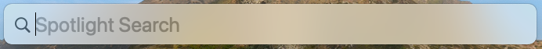
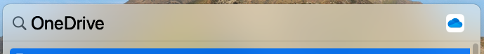
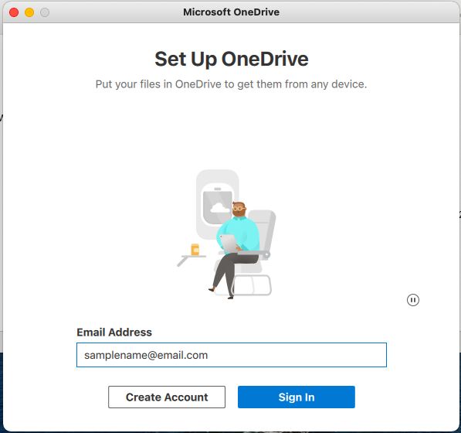
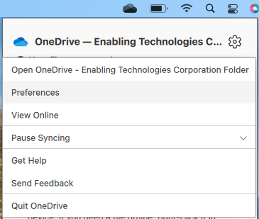
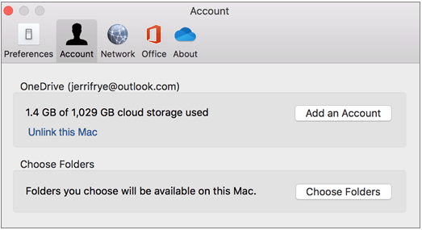
OneDrive Setup for Mac
If you have no accounts signed-in to OneDrive:
Press Command+Space on your keyboard to launch a Spotlight query. Next type OneDrive.
When the Microsoft OneDrive Dialog Box opens, enter your CSU San Marcos credentials and select Sign in to set up your account.
How To Guide
Video
If you already have a personal account signed-in to OneDrive:
Right-click the OneDrive icon in your menu bar, then select Preferences.
Next click the Account Tab, and then select Add an Account.
Video
When the Microsoft OneDrive Dialog Box opens, enter your CSU San Marcos credentials and select Sign in to set up your account.

Slide 5
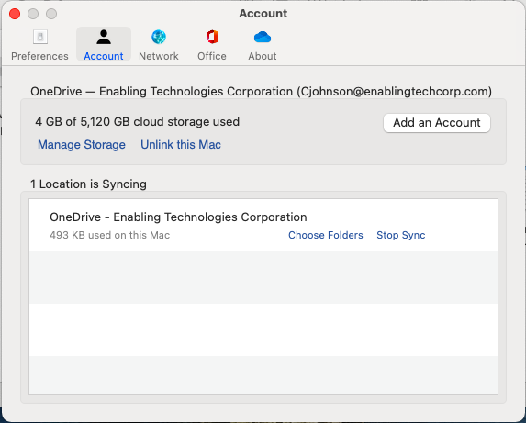
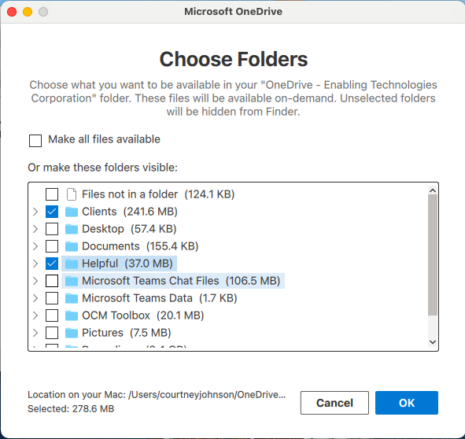
Sync OneDrive Files to Computer for Mac
You can sync all your OneDrive folders to your computer, or you can specify which folders you’d like to sync if you do not want to sync all your OneDrive folders.
Right-click the OneDrive icon in the top right corner of your computer window.
Next select Preferences.
In the Account Dialog Box, select the Account Tab and click Choose Folders.
When the Choose Folders Dialog Box, select Make All Files Available to sync all your OneDrive folders.
  If you only want to sync specific folders, select those folders in the
  Or Make These Folders Visible selection area.
Once you are complete, click OK.
How To Guide
Video
Video

Slide 6
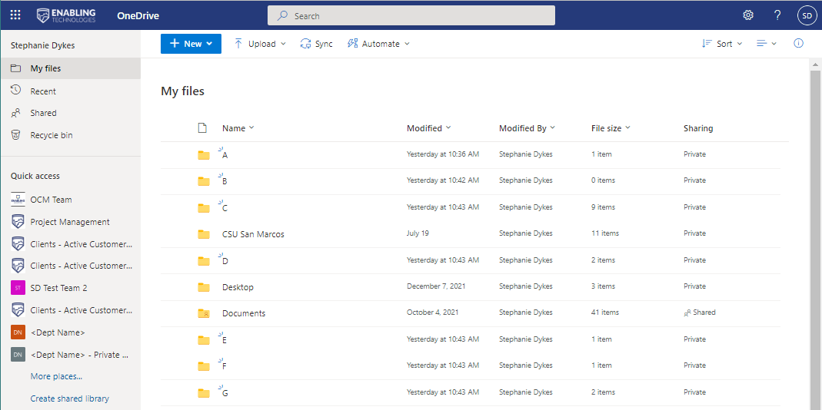
OneDrive Web Version Navigation
Upload File or Folder
Open Details Pane
Create New
Sync Files or Folders
App Launcher
Power Automate
Settings
Change Layout
Shared Libraries
Recent SharePoint Sites
File Navigation

Slide 7
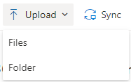
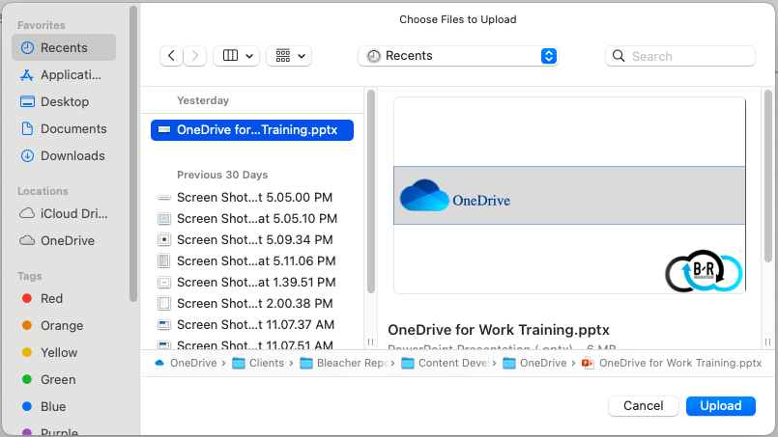
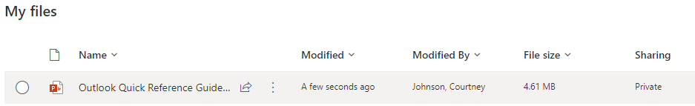
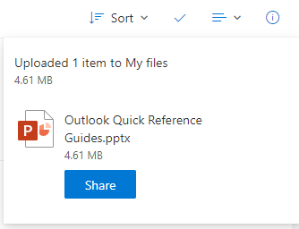
Uploading Files & Folders
Navigate to OneDrive Online and sign-in with your CSU San Marcos credentials.
You can Drag and Drop your files into your OneDrive Library.
- OR -
Click the Upload icon near the top of your OneDrive Window.
  You can select Files to upload file(s).
  Select Folder to upload a folder and its entire contents.
When you click either of these options to upload, the Choose Files to Upload dialog box will open.
Select the file(s) or folder(s) you would like to upload and click Upload in the bottom right corner.
You will also see in the top right corner that there is a dialog box that informs you the file/folder has been uploaded.
Your file or folder will now show in your My Files list.
How To Guide
Video
Video

Slide 8
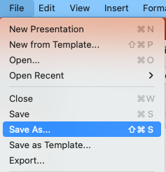

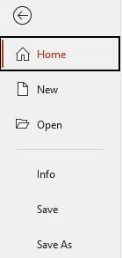
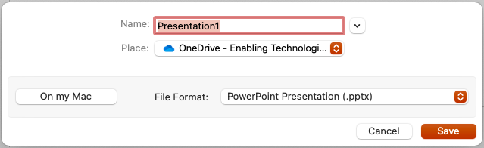
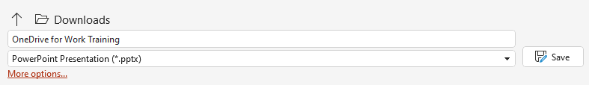
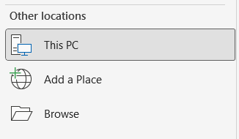
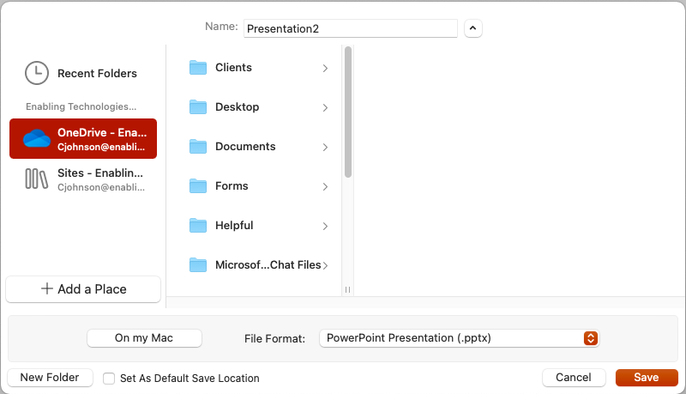
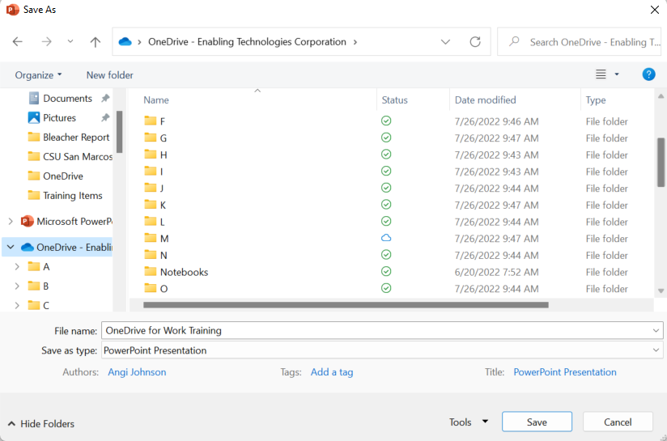
Save Files From Your Desktop
From any document within any of the Office Applications, click File and then choose Save As.
Once complete, click Save.
If autosave is enabled by your organization, documents will autosave in OneDrive after the initial save.
Mac:
Windows Device:
Next, select the location that you want to save the file to. If it does not show as OneDrive, use the More options right below the file type, or Browse to select OneDrive as the destination for the file.
When the Save Dialog Box opens, make sure that
OneDrive is the option within the Place selection area.
How To Guide
Video
If you do not see OneDrive there, click the down arrow next to the file name. In the Expanded Save Dialog Box, select OneDrive as the save area.
Video

Slide 9
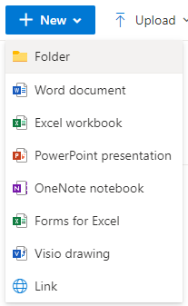


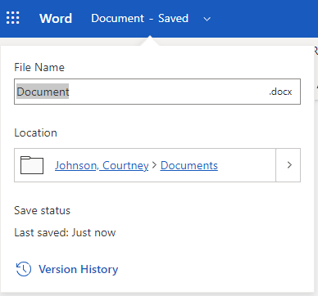
Create and Save Files from Web Browser
OneDrive on the Web allows the creation of a new file right from your OneDrive platform, instead of uploading from another source.
Navigate to the OneDrive library you wish to create your file in.
Select New from the top menu and choose the type of file you’d like to create.
The options available are:
  Word Document
  Excel Workbook
  PowerPoint Presentation
  OneNote Notebook
  Visio Drawing
When the file opens in your browser, you can work with your document by adding text, images, data, etc.
The new file will be automatically saved to your selected OneDrive library.
Once the document has been saved, click the down arrow next to the file name in the top left corner to rename.
How To Guide
Video
Video

Slide 10
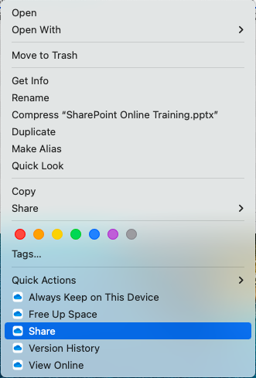
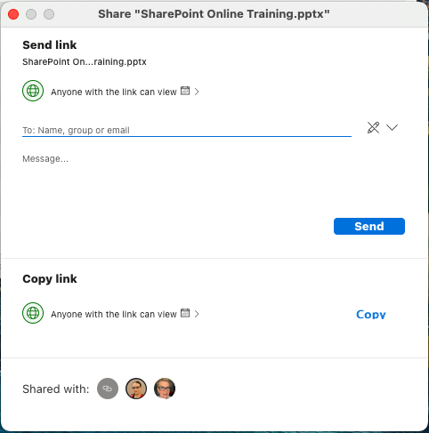
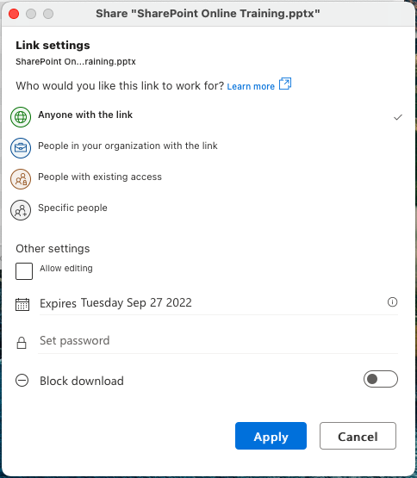
File Sharing & File Sharing Permissions From Your Desktop for Mac
Navigate to the document within your OneDrive App from your Desktop.
Right-click the document and select Share near the bottom of the menu.
When the Send Link Dialog Box opens, you can edit sharing permissions by clicking Anyone with the link can view.
  In the Link Settings, decide the permissions as well as editing rights, download blocking or set a password.
  Once complete, click Apply.
Back in the Share Link Dialog Box, you can send the link via email by clicking Send, or you can copy the link and paste in Teams Chat.
NOTE: This process requires the installation of the Monterrey OS from Mac.
How To Guide
Video
Video

Slide 11
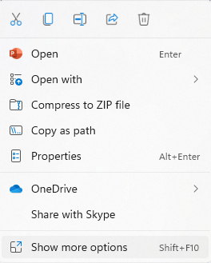
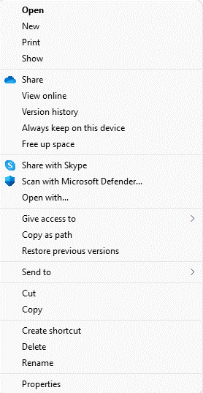
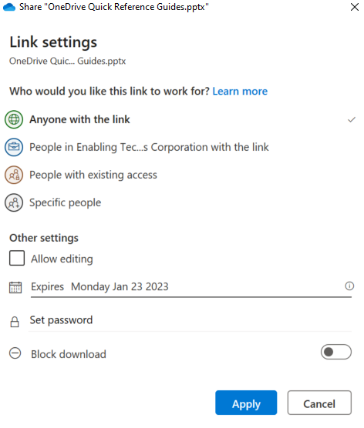
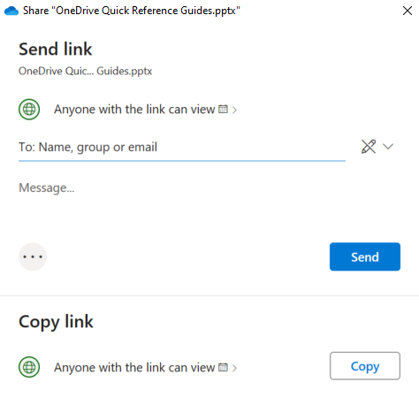
File Sharing & File Sharing Permissions From Your Desktop for Windows Device
Navigate to the document within your OneDrive App from your Desktop.
Right-click the document and select Show more options near the bottom of the menu. Next, click Share.
When the Send Link Dialog Box opens, you can edit sharing permissions by clicking Anyone with the link can view, or the drop down menu by the pencil.
  In the Link Settings, decide the permissions as well as editing rights, download blocking or set a password.
  Once complete, click Apply.
Back in the Share Link Dialog Box, you can send the link
via email by clicking Send, or you can copy the link by
clicking on Copy, and then paste in a chat or document.
How To Guide
Video
Video

Slide 12
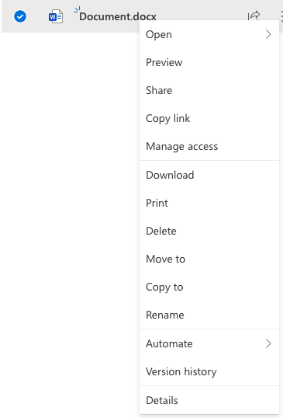
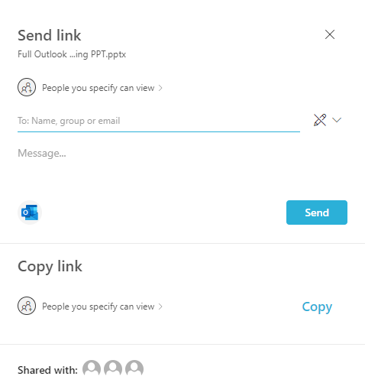
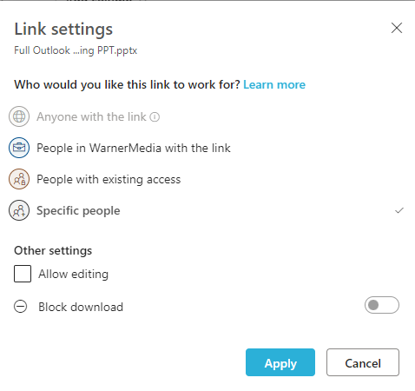
File Sharing & File Sharing Permissions From Your Web Browser
Navigate to the document within your OneDrive Online that you’d like to share.
Right-click the document and select Share near the top of the menu.
When the Send Link Dialog Box opens, you can edit sharing permissions by clicking People you specify can view.
  In the Link Settings, decide the permissions as well as editing rights or download blocking.
  Once complete, click Apply.
Back in the Share Link Dialog Box, you can send the link via email by clicking Send, or you can copy the link and paste in Teams Chat.
How To Guide
Video
Video

Slide 13

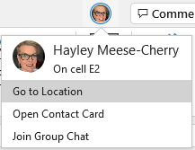

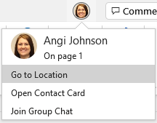

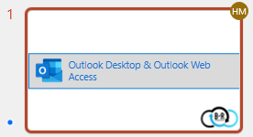
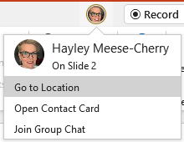
File Collaboration
Work with others on the same file (Word, PowerPoint, Excel) at the same time. Say goodbye to the check in/check out process with true, simultaneous co-authoring.
Co-authoring is available for documents stored in Teams, OneDrive, or SharePoint.
In OneDrive, all co-authors must have permission to access and edit the documents.
Navigate to, and open the document you are going to be working in. Begin editing!
The number of users currently working within the document will
appear in the upper right corner of the application.
In each document type, there will be indicators of where the other user is within the document.
  Excel: Within the Workbook, you will see a circle with their initials, indicating of where the other user is. You can also see where they are by clicking their photo in the top right corner of the application.
  Word: Within your document, there will be a line with the user’s initials/name. You can also click on their photo in the top right corner to see where they are.
  PowerPoint: Within your PowerPoint presentation, you will see a circle with the user’s initials/name on the slide they are current on. Clicking their photo in the top right will also show you their location.
How To Guide
Video
Video

Slide 14
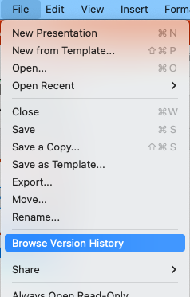
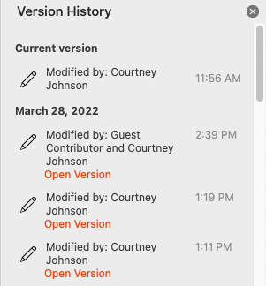
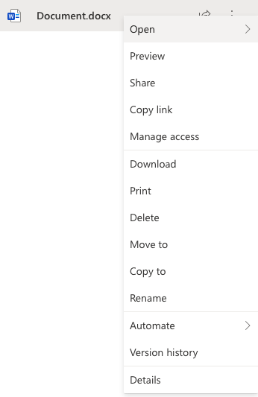
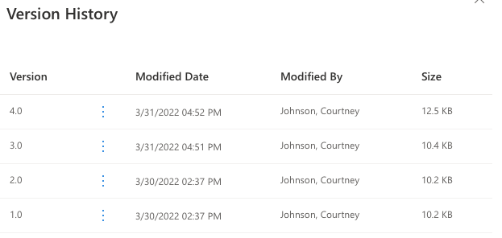
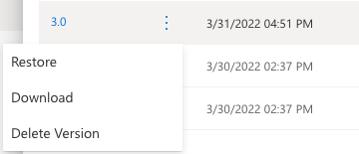
Version History & Managing Versions
From Desktop App on a Mac(Within Document):
Navigate to your Document saved within OneDrive.
In the top Menu Bar, click File, then Browse Version History.
The Version History Pane will open to the left of your desktop window.
Clicking Open Version will allow you to open and review the version.
Once the previous version is opened, you can Restore the file by clicking Restore near the top right corner of your document.
How To Guide
Video
From OneDrive Online:
Navigate to your OneDrive Online file.
Right-click on the document, and then click Version History.
The Version History Pane will open to the left of your window.
To open, click the Version Number.
Once the previous version is opened, you can Restore the file by clicking Restore near the top right corner of your document.
Clicking the Three-Dot Ellipsis gives the options to
Restore, Download or Delete.
Video

Slide 15
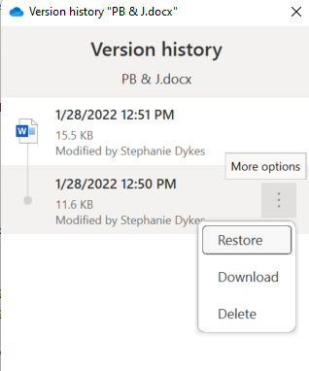
Version History & Managing Versions for Windows Devices
From Desktop App on a Windows Device:
Open your Files and navigate to your document saved within OneDrive.
Right click on the document, then click on Show more options.
Next you will click Version history.
The Version History Pane will open in another area within your desktop window.
How To Guide
Video
From within this pane, you will click on the three dot ellipses that appears when you hover over the document version that you want to act on.
Video
From there you can choose which action you want to take. Restore will restore the version you are on, you can place it into your downloaded files by clicking on Download, or you can click Delete to send that version to your Recycle Bin.

Slide 16
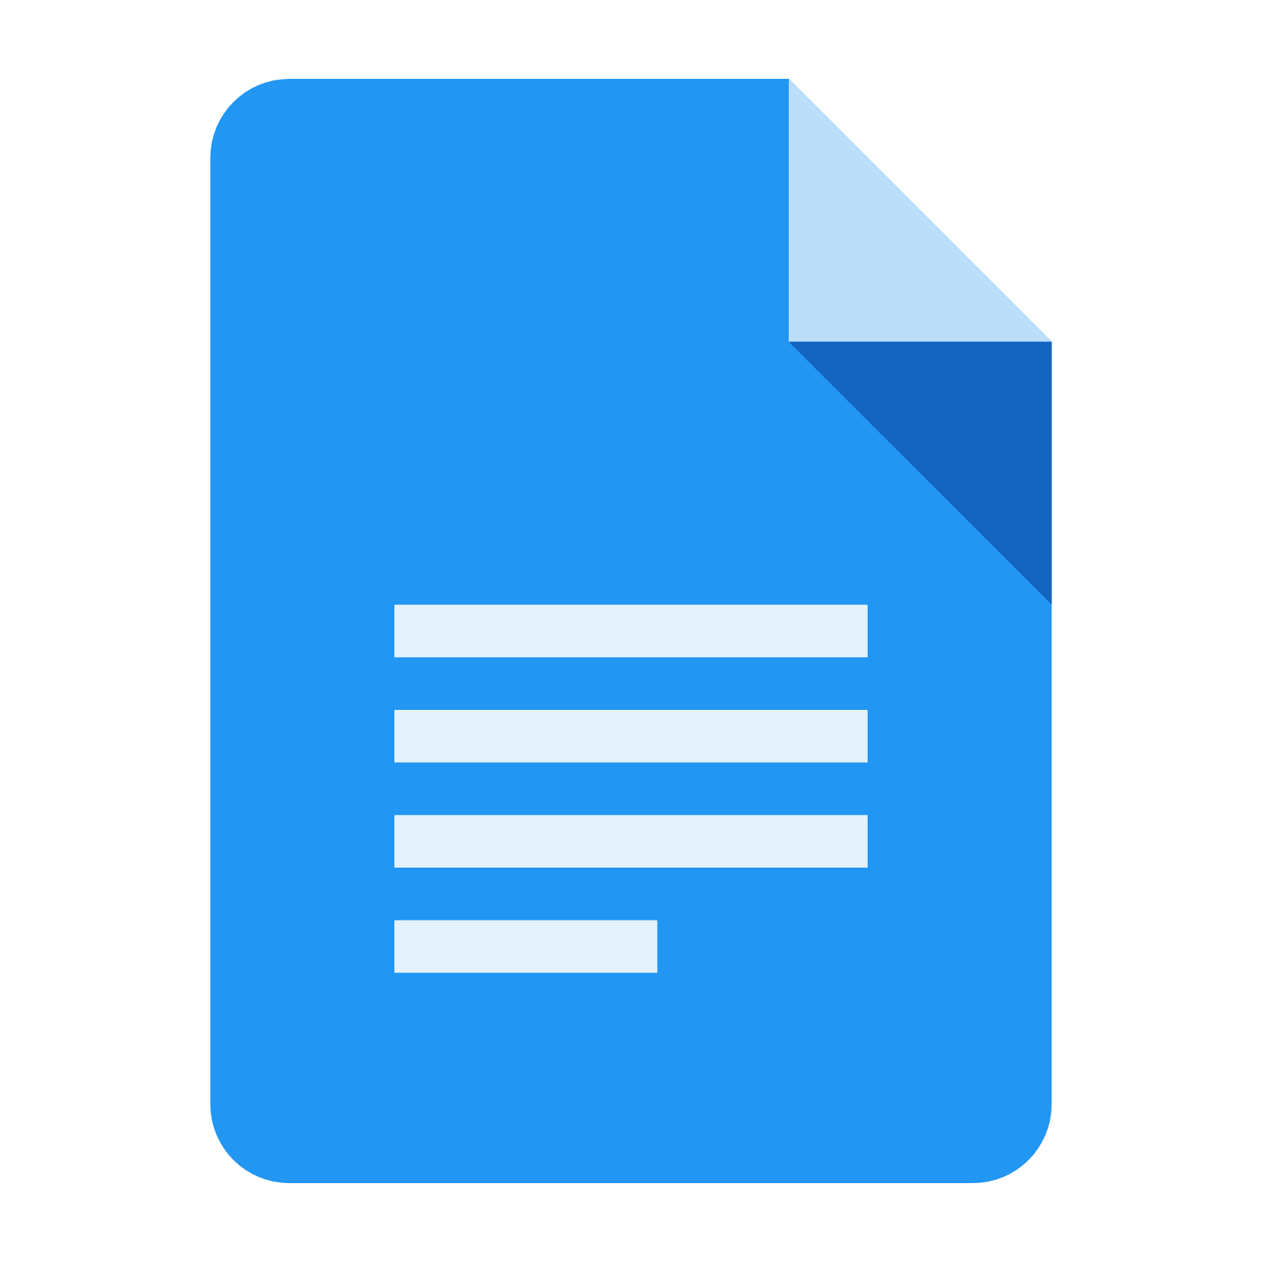
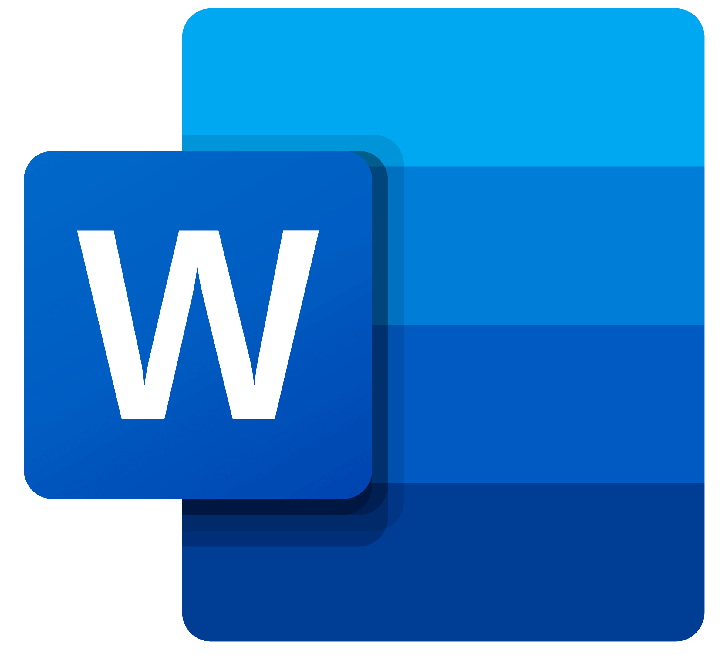
Microsoft Word vs. Google Docs
What are the differences between Microsoft Word and Google Docs? Both applications allow users to create documents, format text, insert tables, and allow files to be saved in multiple ways. There are some differences, however, and a few of them are outlined below.
 | Microsoft Word | Google Docs
Performance | Can run entirely offline Also has simplified version available online | Relies on internet connection or G-Suite Administrator must enable offline access
Features | Extensive menus full of features Ideal for research and writing Easy to use mail merge | Basic features Used for light writing Mail merge is time consuming and offers more room for human error
File Types | Can choose between multiple file types when saving the document 15 file documents currently available | Files are stored as one type Can download documents in seven file formats
Visualization | Useful visualization features such as page borders, background color and watermarks, etc. More templates available | Lacks advanced visualization features such as page border, background color, watermarking and comparing two versions of a document Less options for templates
Overall | Extra functionality and formatting power | Basic functionalities
Note: While you can use Microsoft Word online within a browser, if you want to get access to all the rich features available in Microsoft Word it is recommended to use the desktop application.

