Slide 1


Microsoft Outlook Mobile Application Features

Slide 2
Agenda
Getting Started
Adding Your Account
Notifications & Inbox View
Message Views & Actions
Calendar Views
Viewing an Event
Scheduling an Event
Settings

Slide 3
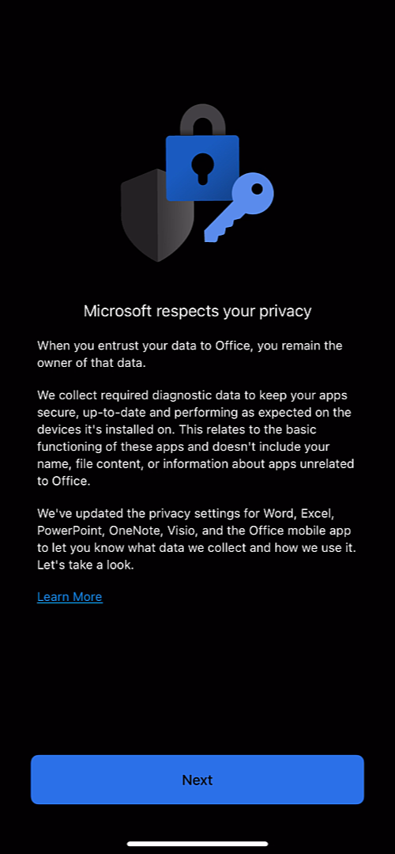
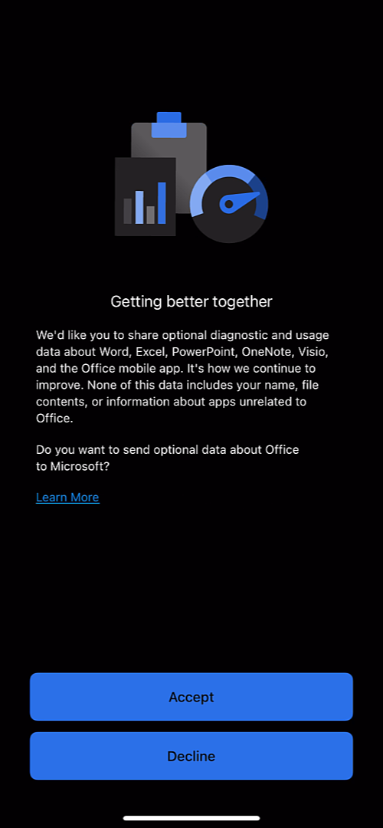
Outlook Mobile – Getting Started
When accessing any of the Office mobile applications for the first time, you will be prompted with information about privacy.
Accept or Decline to share optional data about Office to Microsoft.
Note: You will only be prompted with privacy information on the first Office mobile app you set up. Subsequent Office mobile apps will only prompt notification settings during set up .

Slide 4
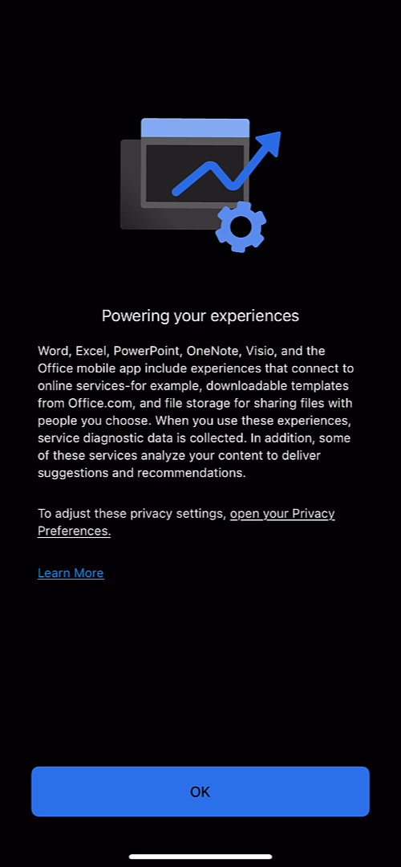
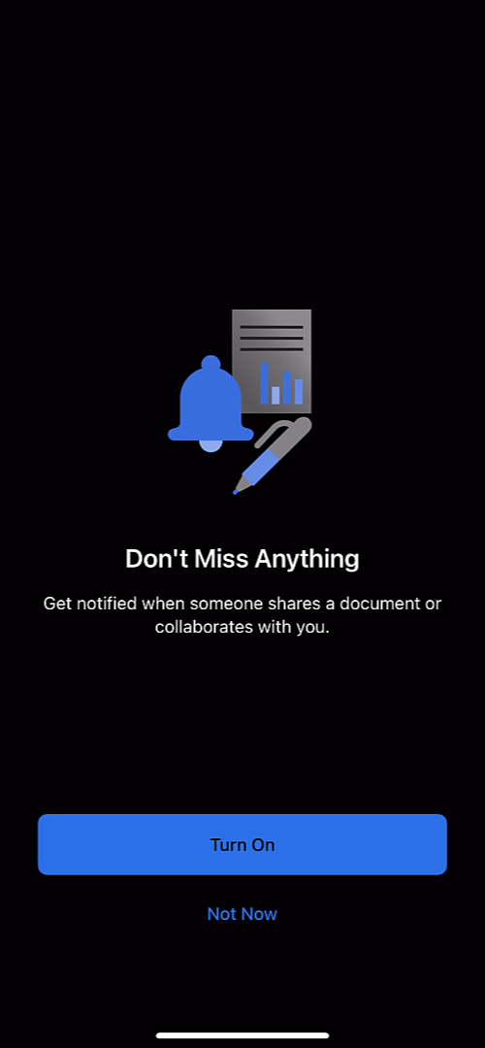
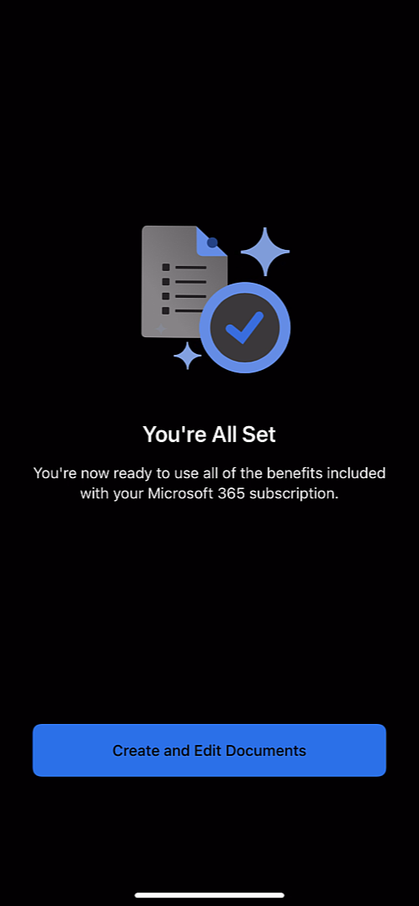
Outlook Mobile – Getting Started
If you decline to share optional data, additional information is provided about the default level of diagnostic data that is collected. A link to open your Privacy Preferences will be available to adjust these settings.
Reminder: Privacy Preferences are set at the account level, not per app.
Turn On notifications or select Not Now if you prefer to keep notifications disabled.

Slide 5
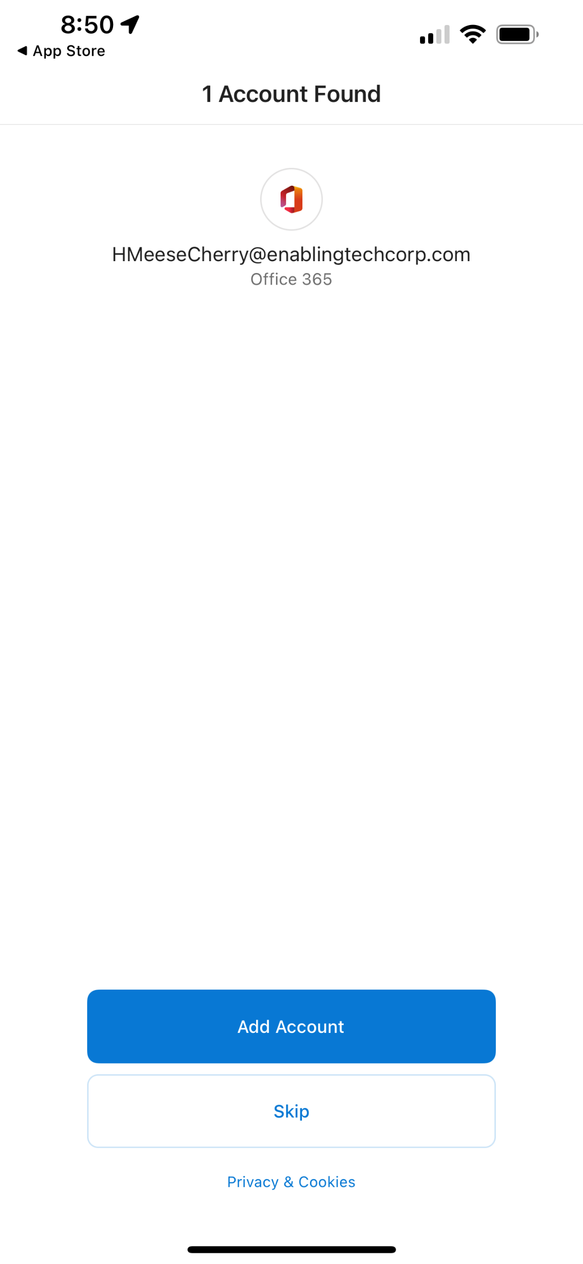
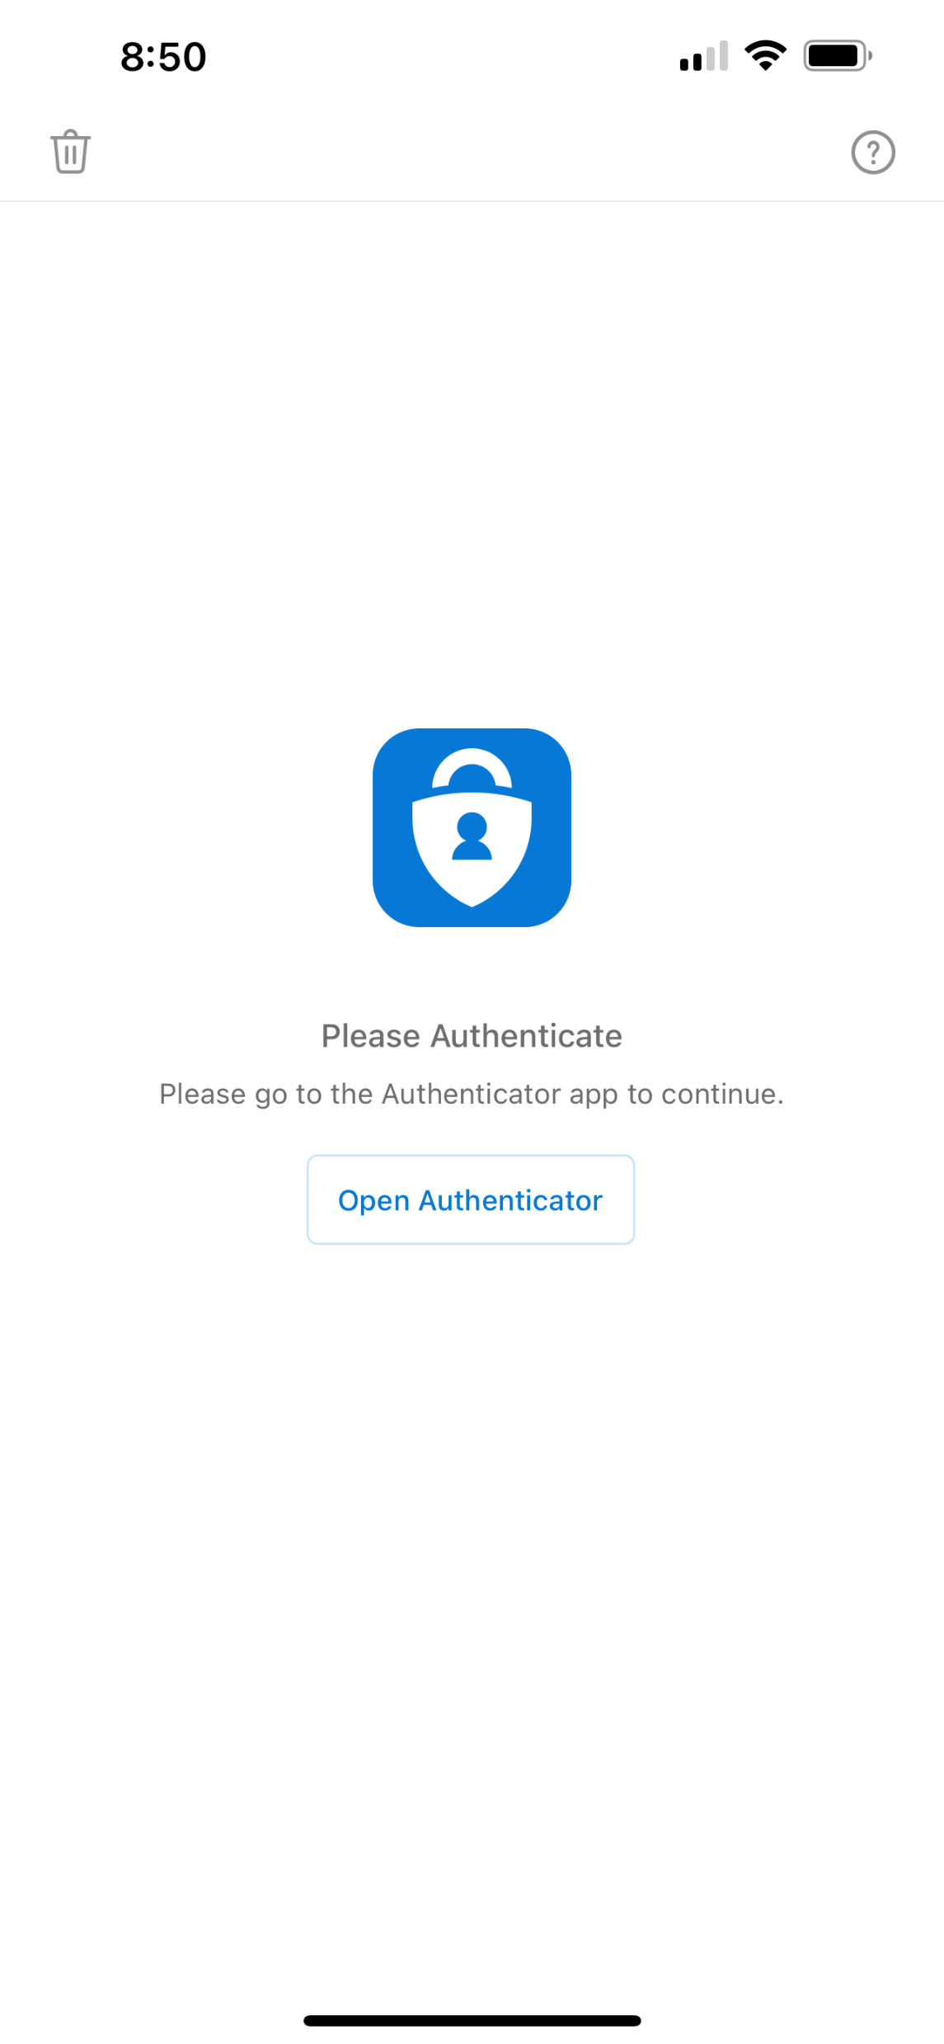
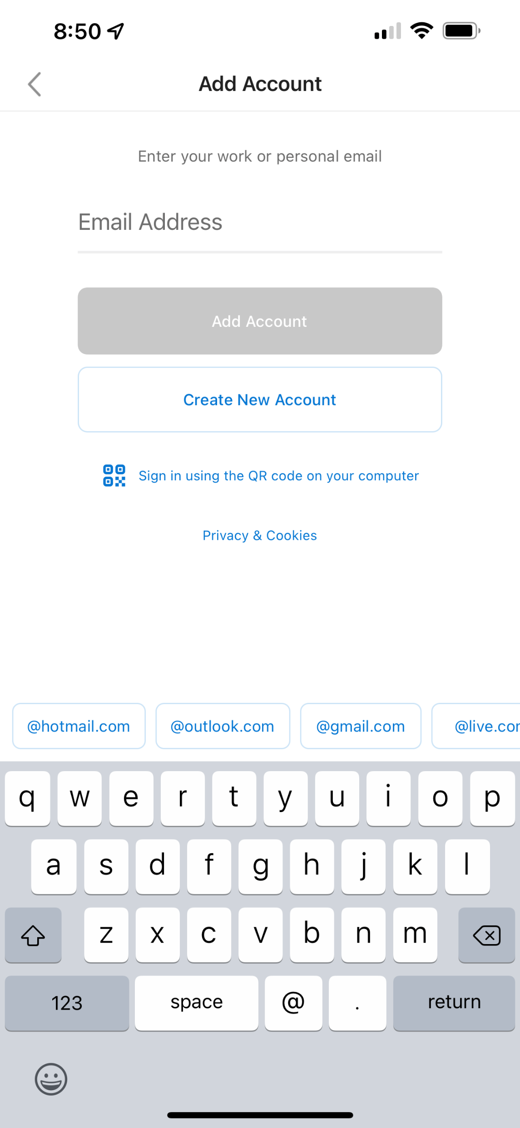
Outlook Mobile – Adding Your Account
If you are logged into your M365 account on any other device, Outlook will populate this account for you to sign in. Click Add Account to do this. If this is not an account you want to add, select Skip.
If you Skip on the first screen, you will be prompted to add other accounts. Enter the email address and follow the prompts.
If required, your device may prompt you for additional authentication, such as with Microsoft Authenticator.

Slide 6
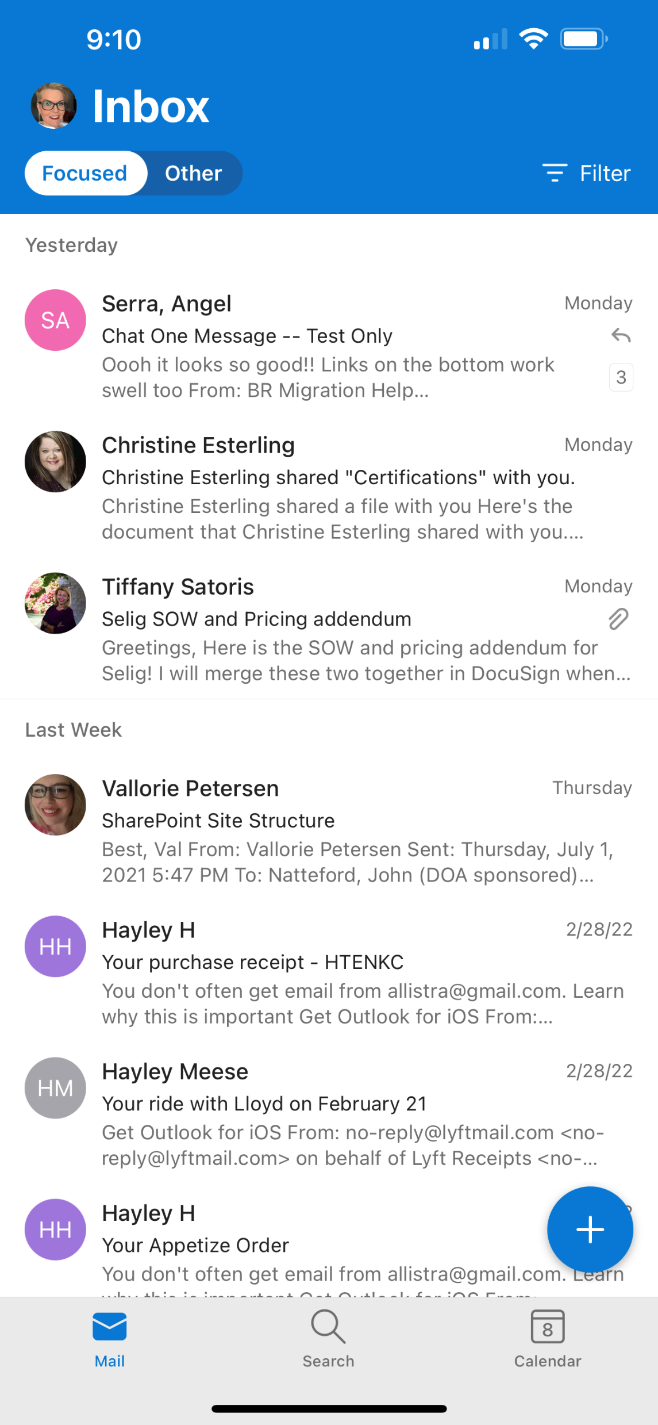
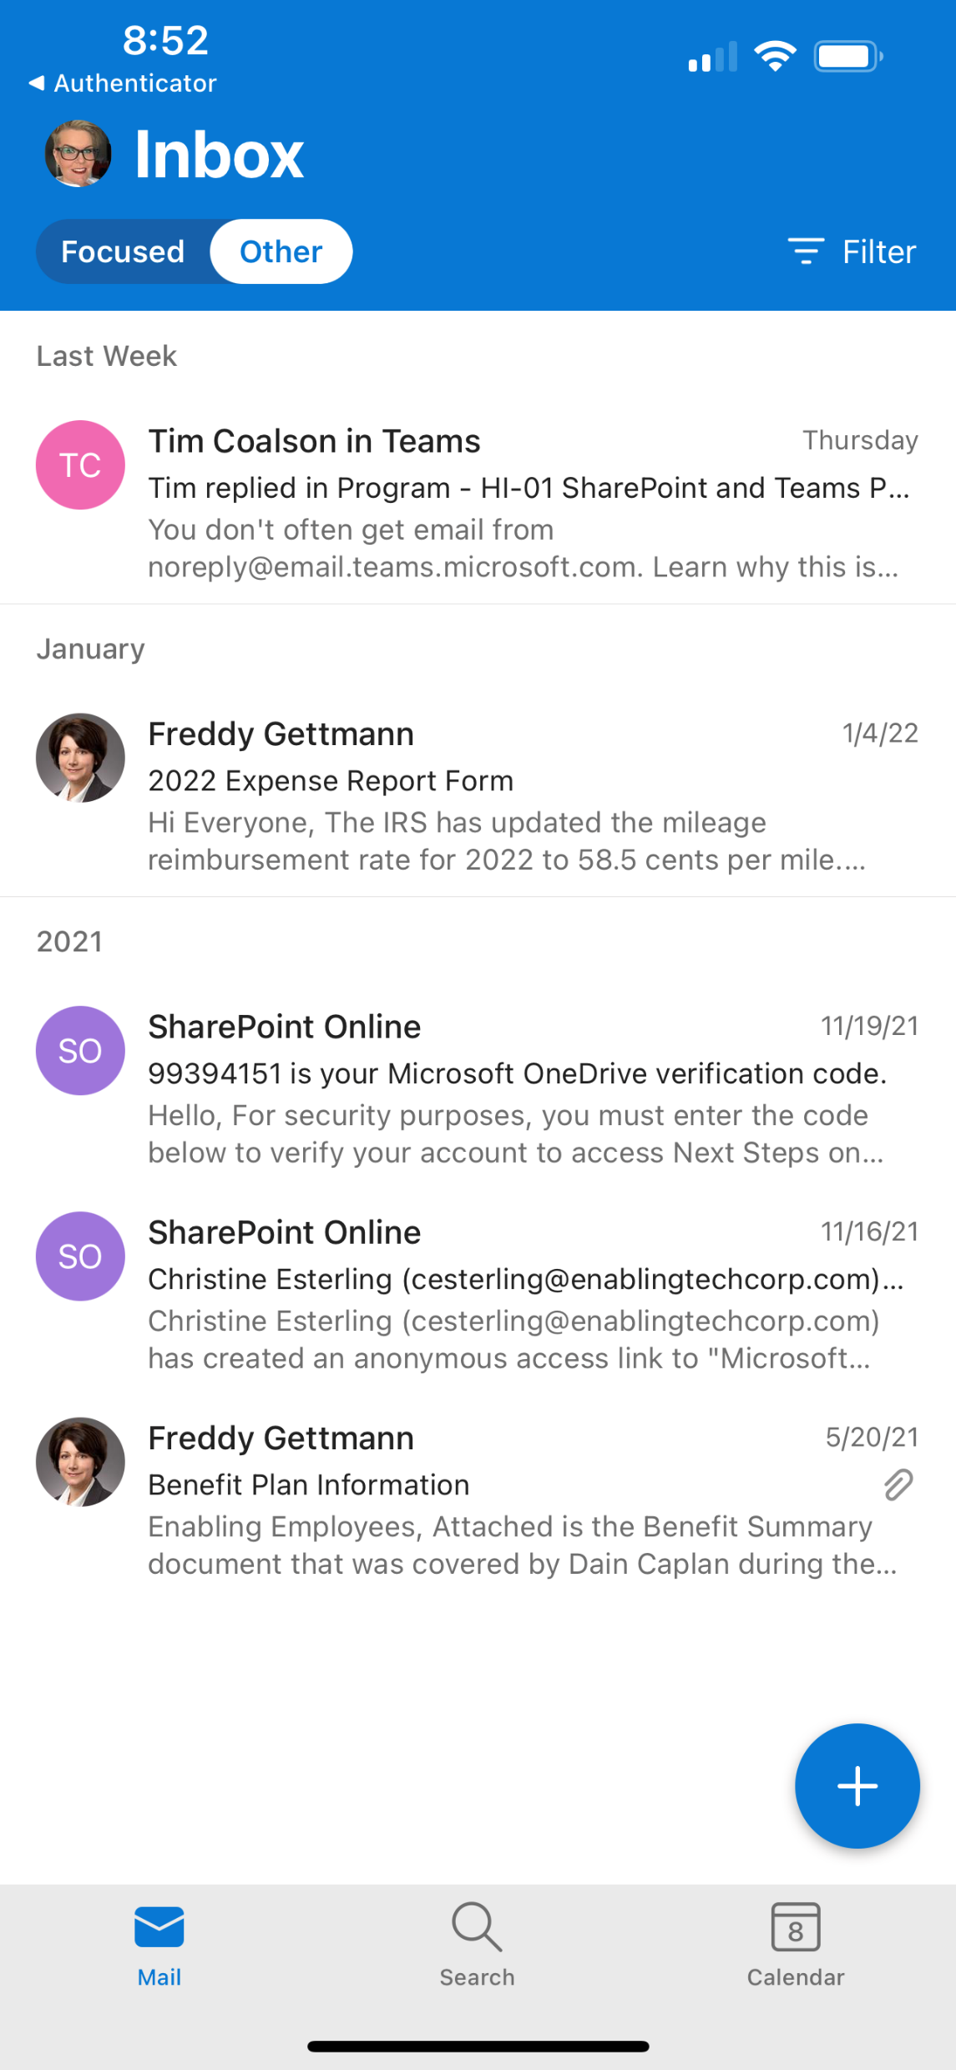
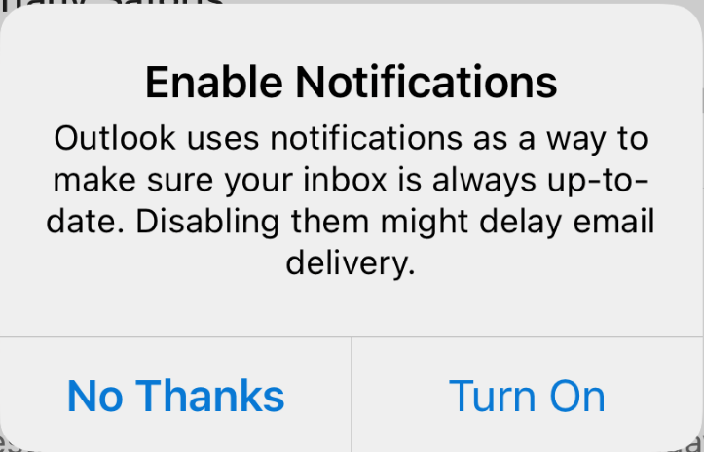
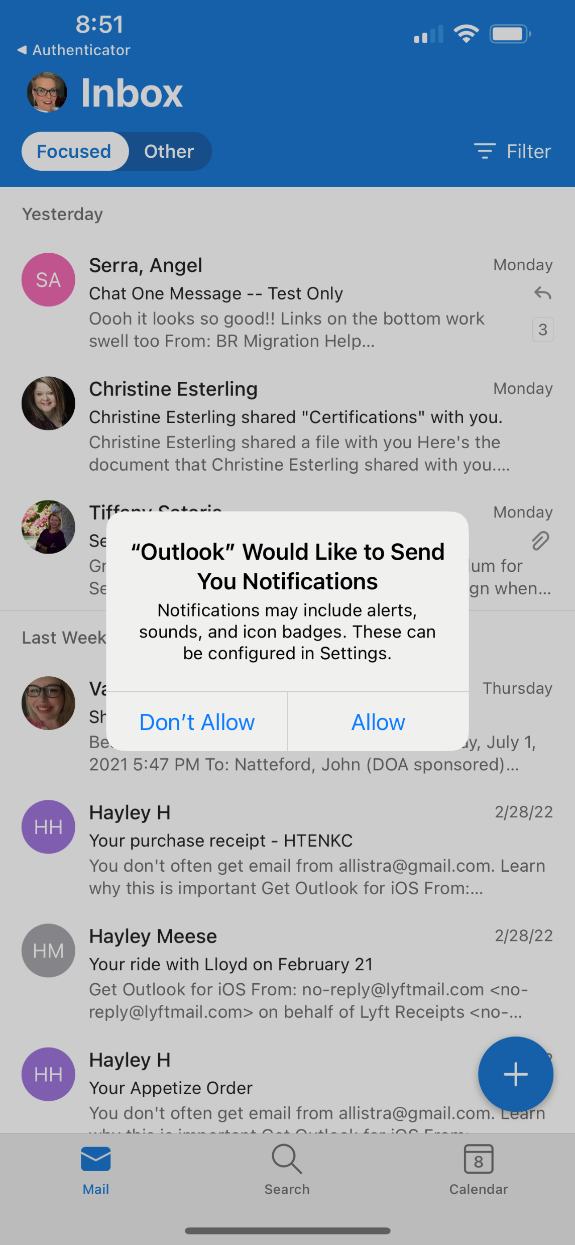
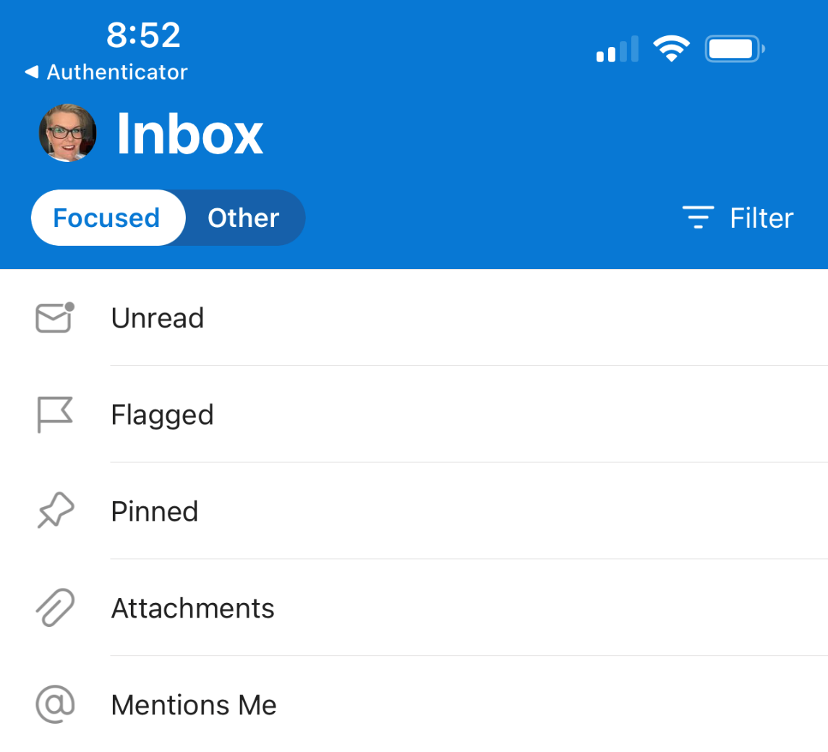
Outlook Mobile – Notification and Inbox View
When you have set up your account, Outlook will prompt you for permissions to enable and sent notifications.
Just like in your desktop app, you may turn on your Focused mailbox and move back and forth.
Focused shows you mail most likely to be important to you
Other is mail you are less likely to read
At the top of any view of your mailbox, you may select Filter to sort emails by Unread, Flagged, Pinned, or messages with attachments or @mentions
Click the + blue bubble to compose a new message
In the bottom tray, you can move between mail, search, and calendar features within the mobile app.

Slide 7
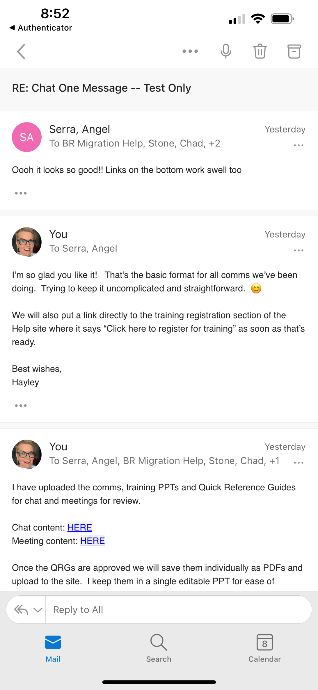
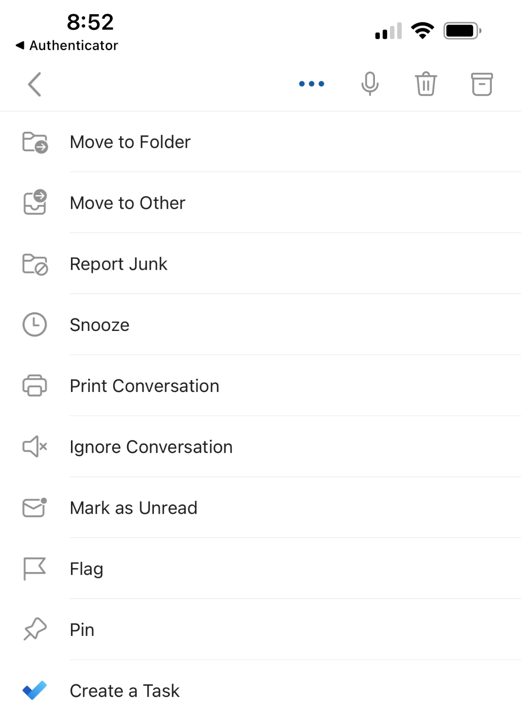
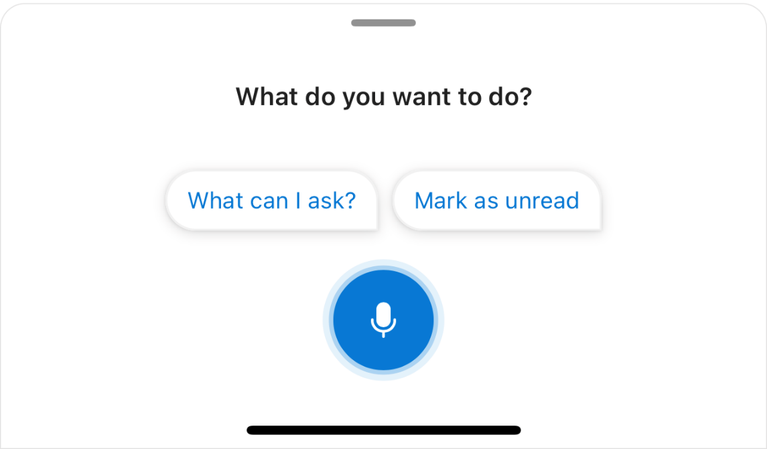
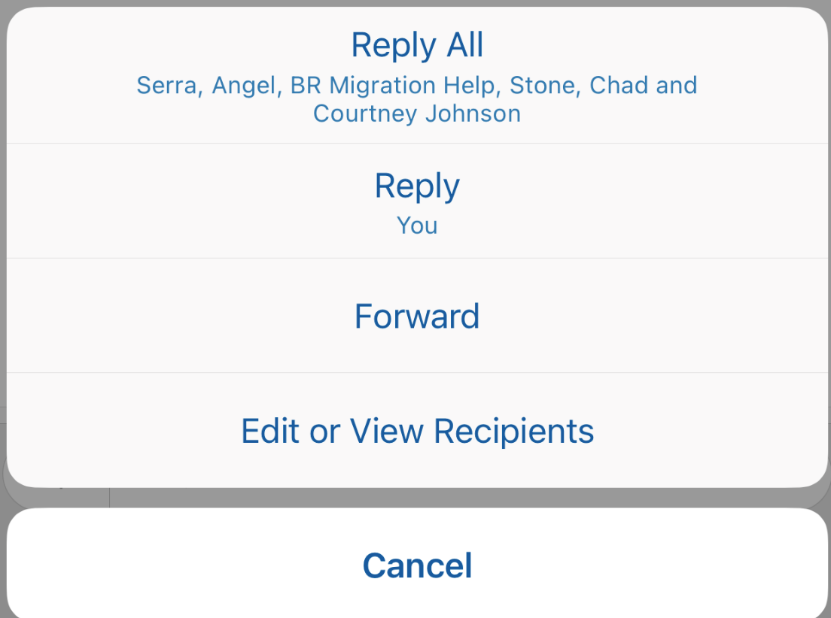
Outlook Mobile – Message Views & Actions
To read a message, click on it in your inbox. Here you will see all related messages within a thread. Scroll down to see older messages.
Select the “…” to get additional action options to move message to other folders, report as junk, mark as unread, or flag for later.
The Microphone icon allows you to voice commands after granting permission to access your device’s microphone.
The Trashcan deletes the message.
The FileBox icon archives your message, moving it to the Archive folder in all Outlook locations.
Click the drop-down next to Reply to All for additional message actions such as Reply All, Reply, Forward, or Edit or View Recipients

Slide 8
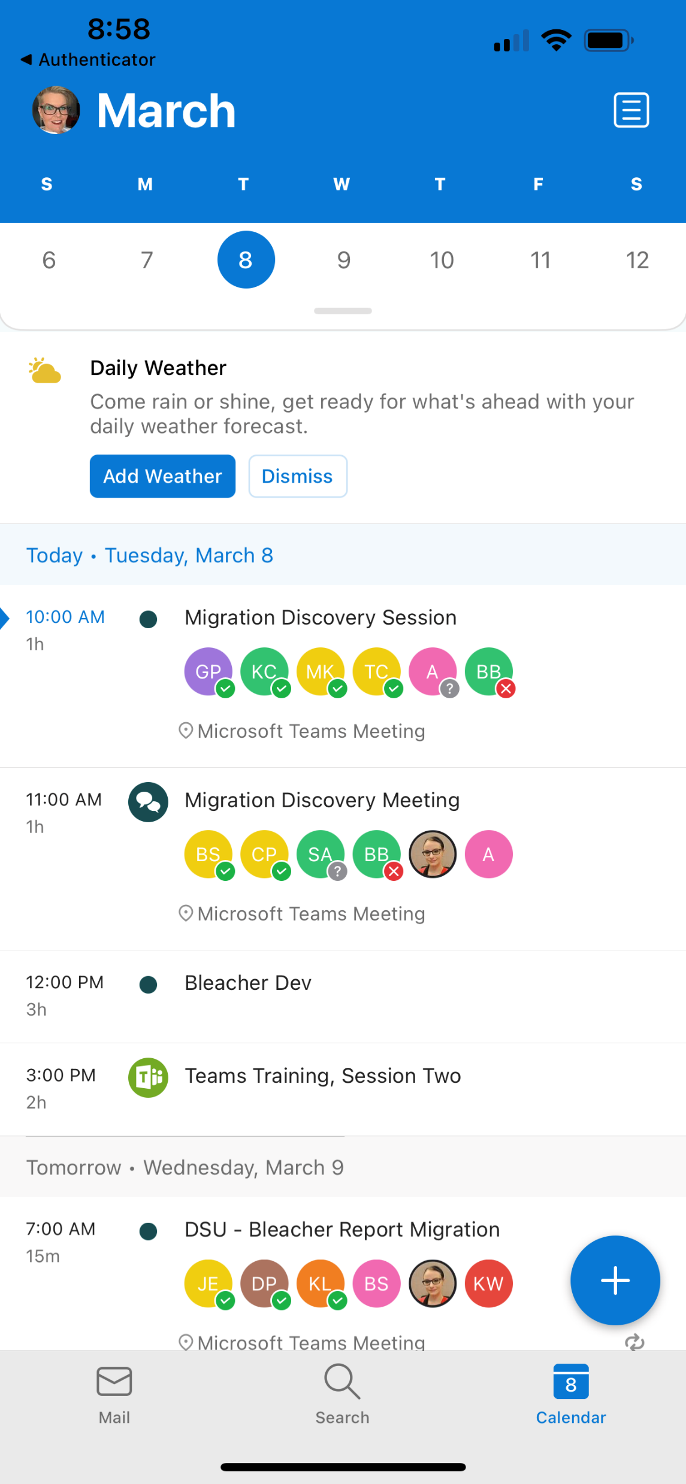
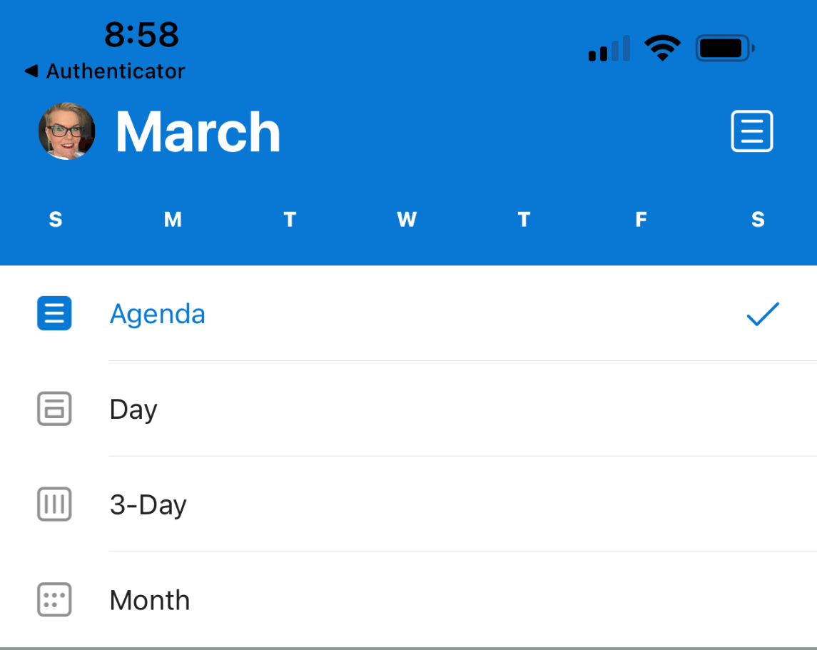
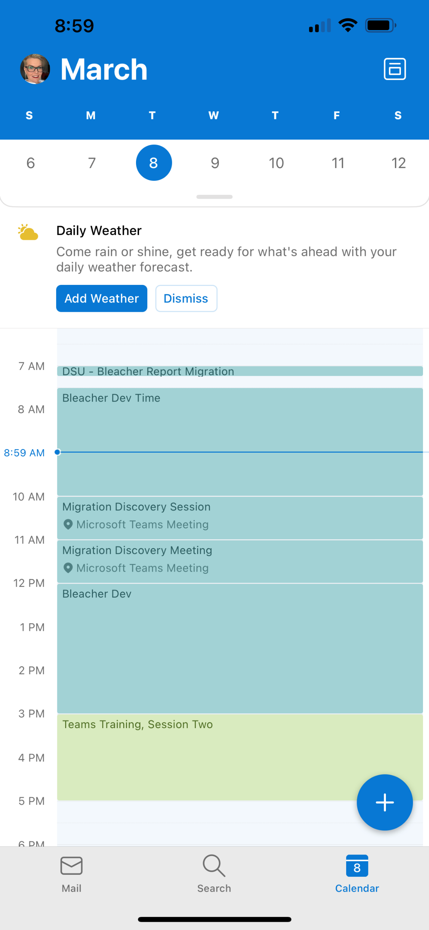
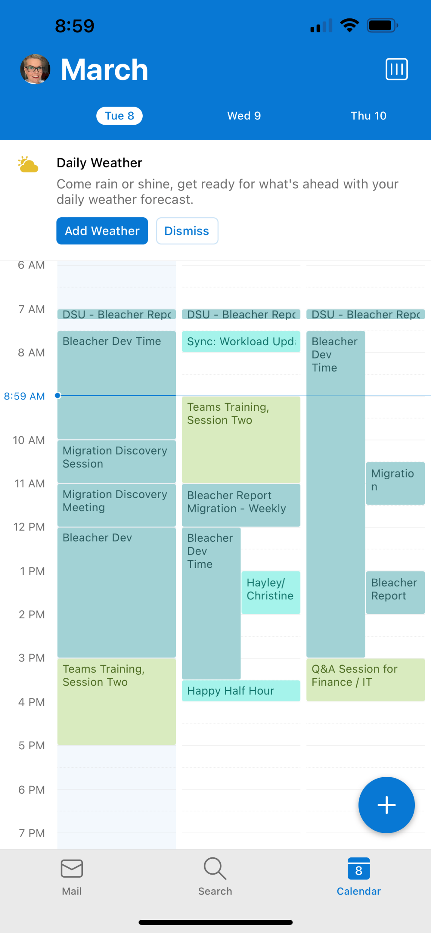
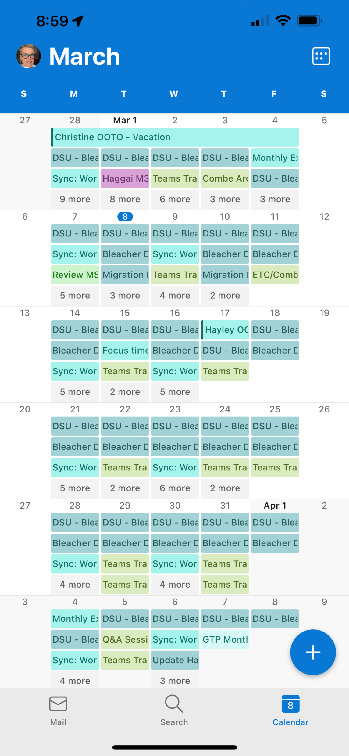
Outlook Mobile – Calendar Views
Your calendar will default to the Agenda view, with current day and the next event at the top, and you can scroll down to view subsequent days. You can also use the calendar at the top to click or scroll to future days or weeks.
Select the Filter icon to change your view to a single Day, 3-Days, or a Month at a time. Once you have selected a view, this will be reflected each time you open your calendar in the mobile app.

Slide 9
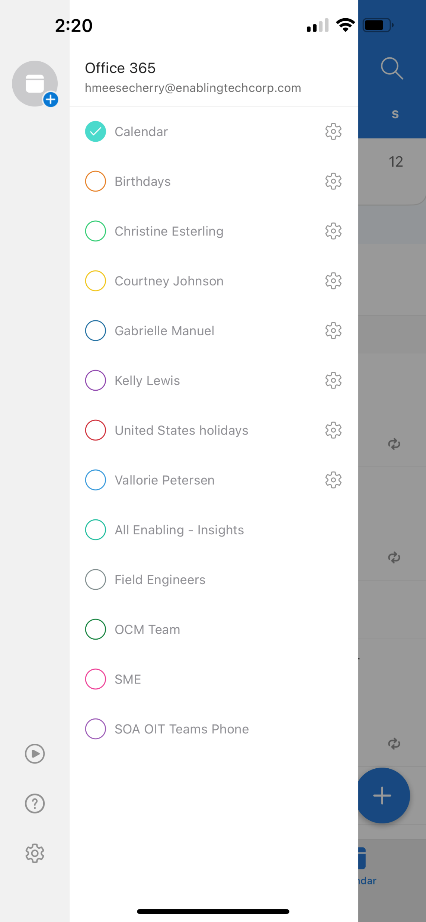
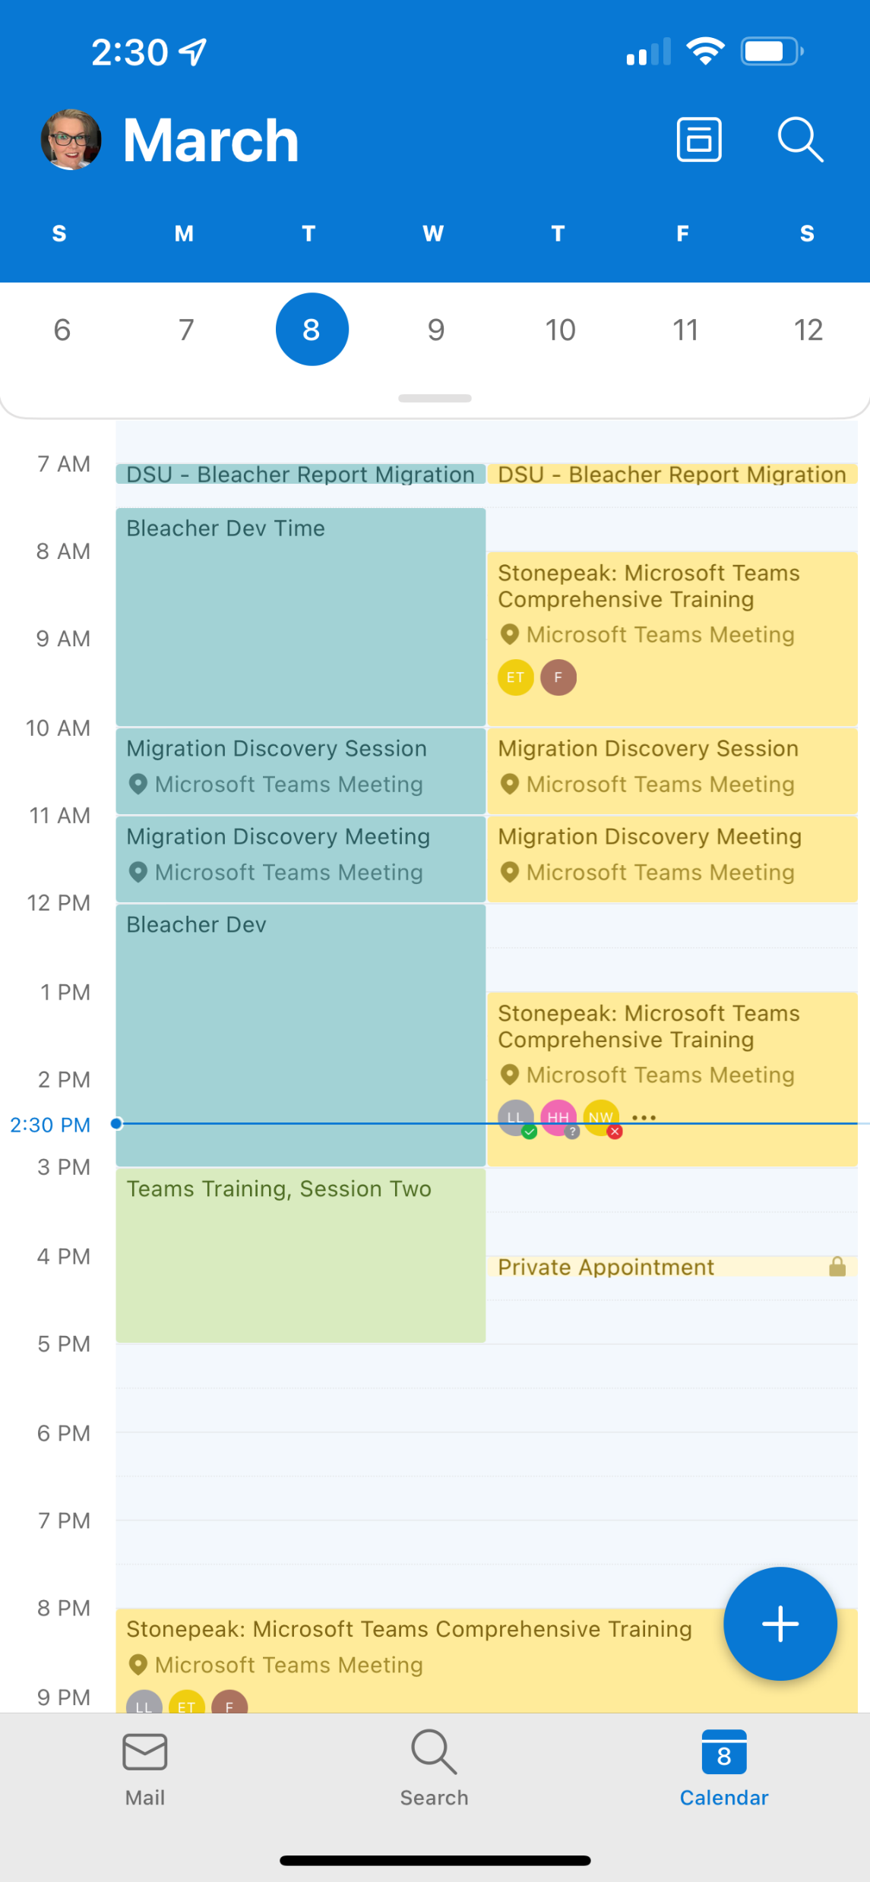
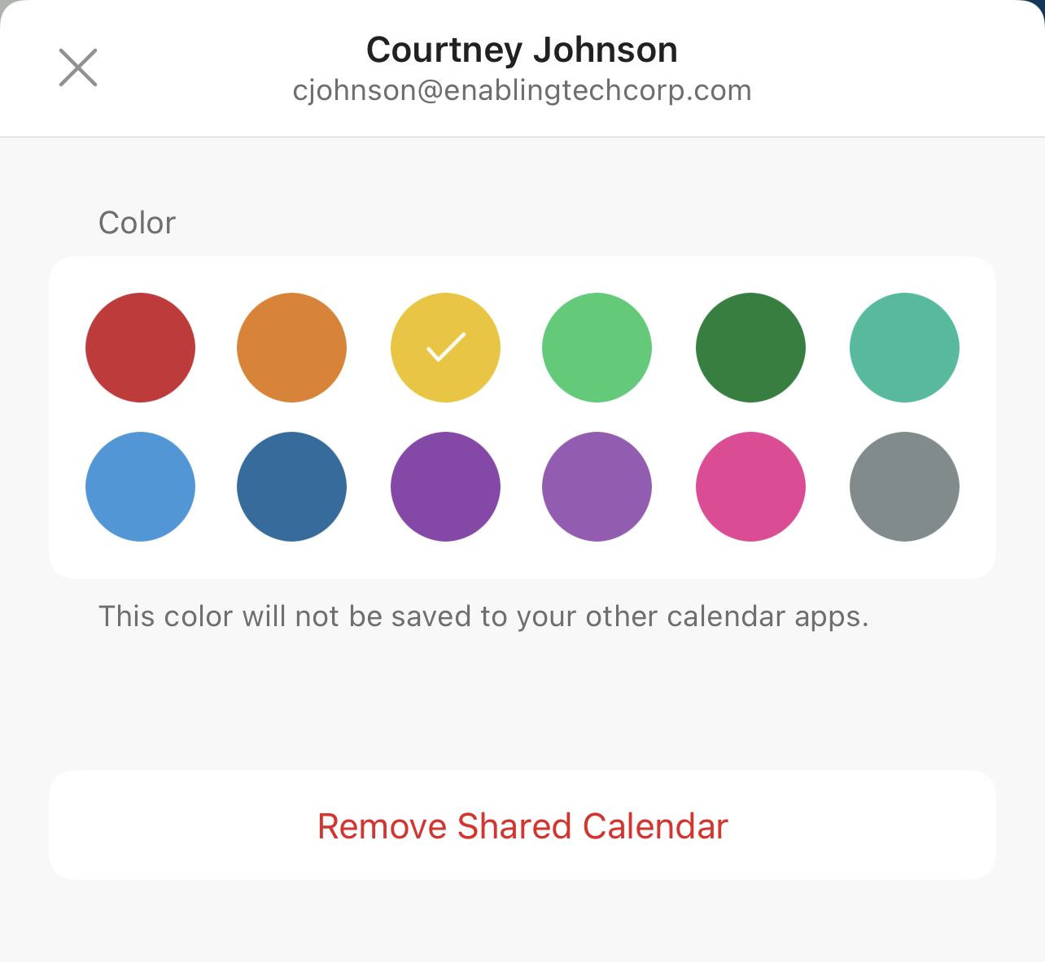
Outlook Mobile – Viewing Multiple Calendars
Your calendar is represented by the Calendar entry at the top. You may select other calendars to have those events integrated with yours. Events on other calendars will be designated with the color of the radio button on this page. You can change the assigned color by selecting the Gear icon next to the calendar name.
To view a calendar other than your own, or multiple calendars, navigate to the calendar view using the Calendar icon in the bottom tray, then click your M365 profile image in the top right corner.

Slide 10
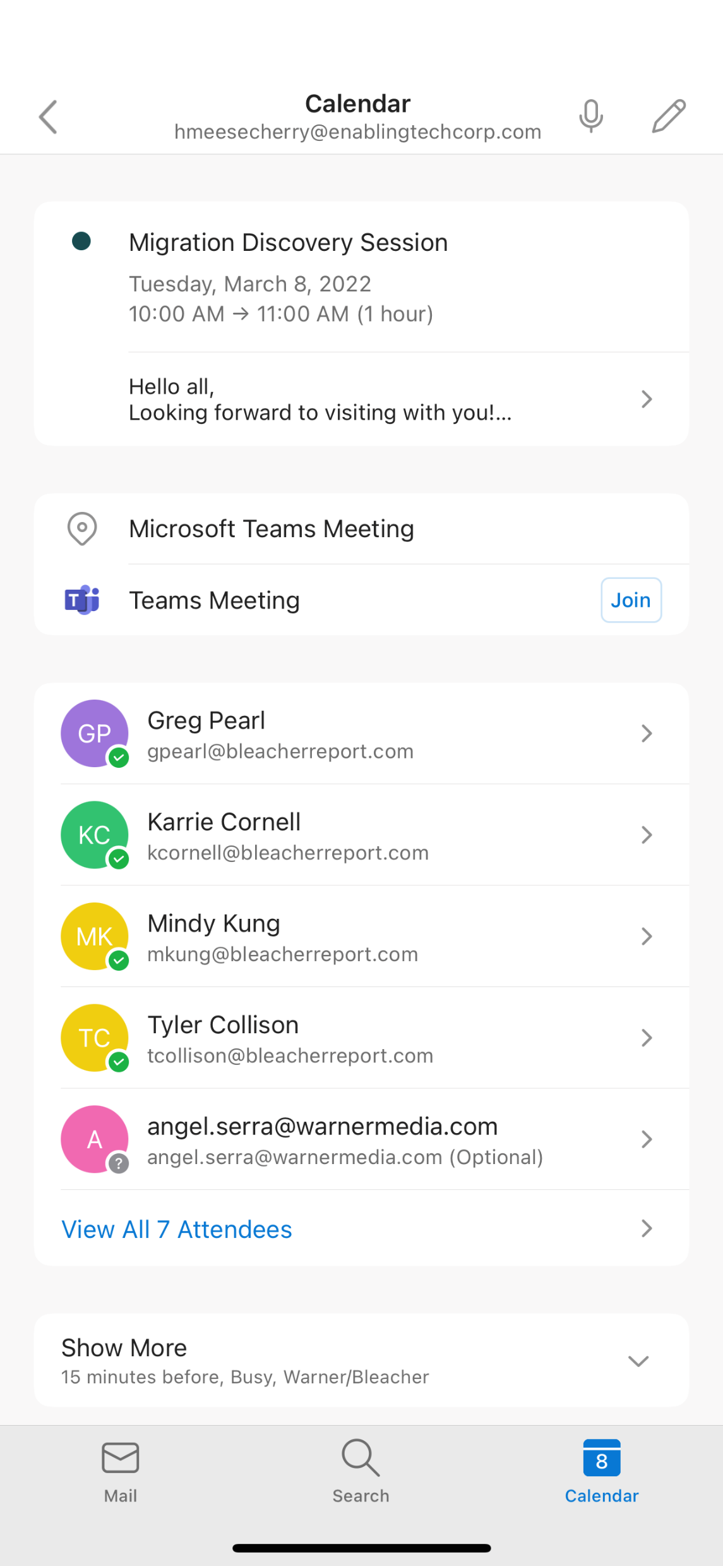
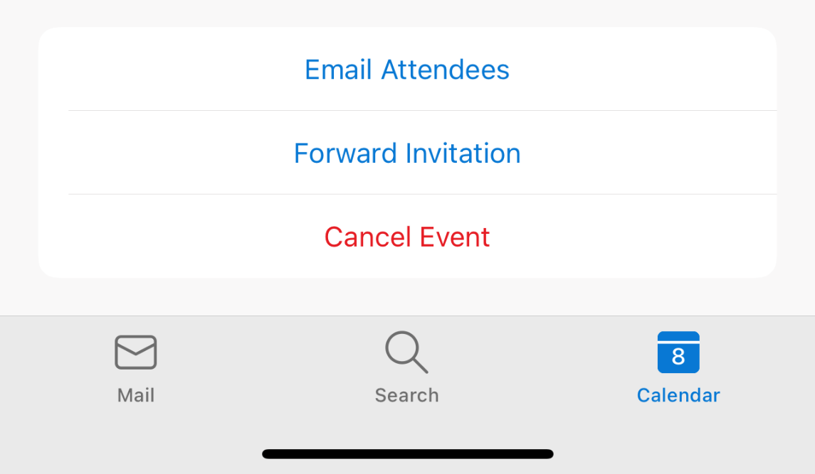
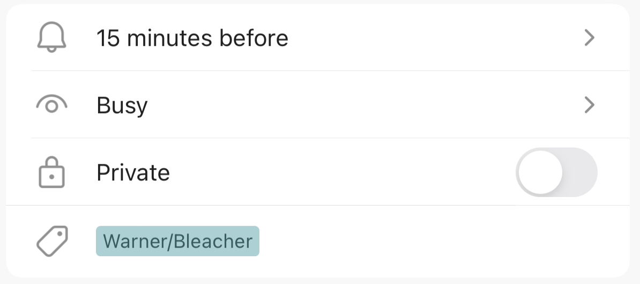
Outlook Mobile – Viewing an Event
To view the details of a calendar event, click on it, in any calendar view you are using.
Here you can see the event title and date and duration of the meeting.
Click to view the body of the invite
Click to join the meeting
View attendees, click the bottom link to see all attendees
Scroll down further for options to email attendees or forward or cancel the event
Show More allows you to change your reminder time, calendar show as, mark an event as private, and view any assigned Category.

Slide 11
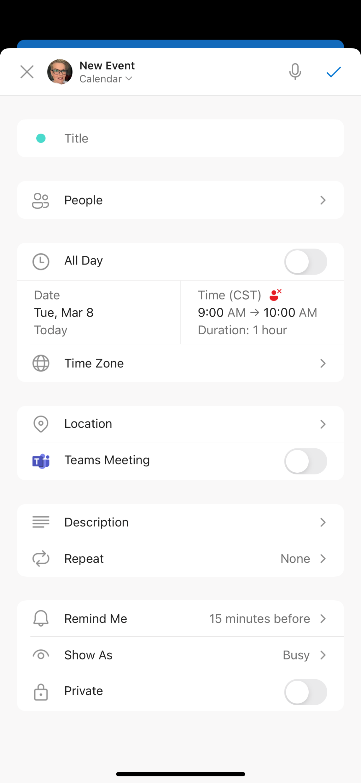
Outlook Mobile – Scheduling an Event
In the next screen, you may enter all needed information for your event:
Title
People (your attendees)
Date / Time / Time Zone
Location (toggle on Teams Meeting if needed)
Description (enter what you want in the body of the invite)
Repeat cadence if recurring meeting
Remind Me time
Show as on your calendar
Private Appointment
Click the Check icon in the top right corner to send the invite
To schedule a new event, click the “+” symbol in the bottom right corner of your calendar view.

Slide 12
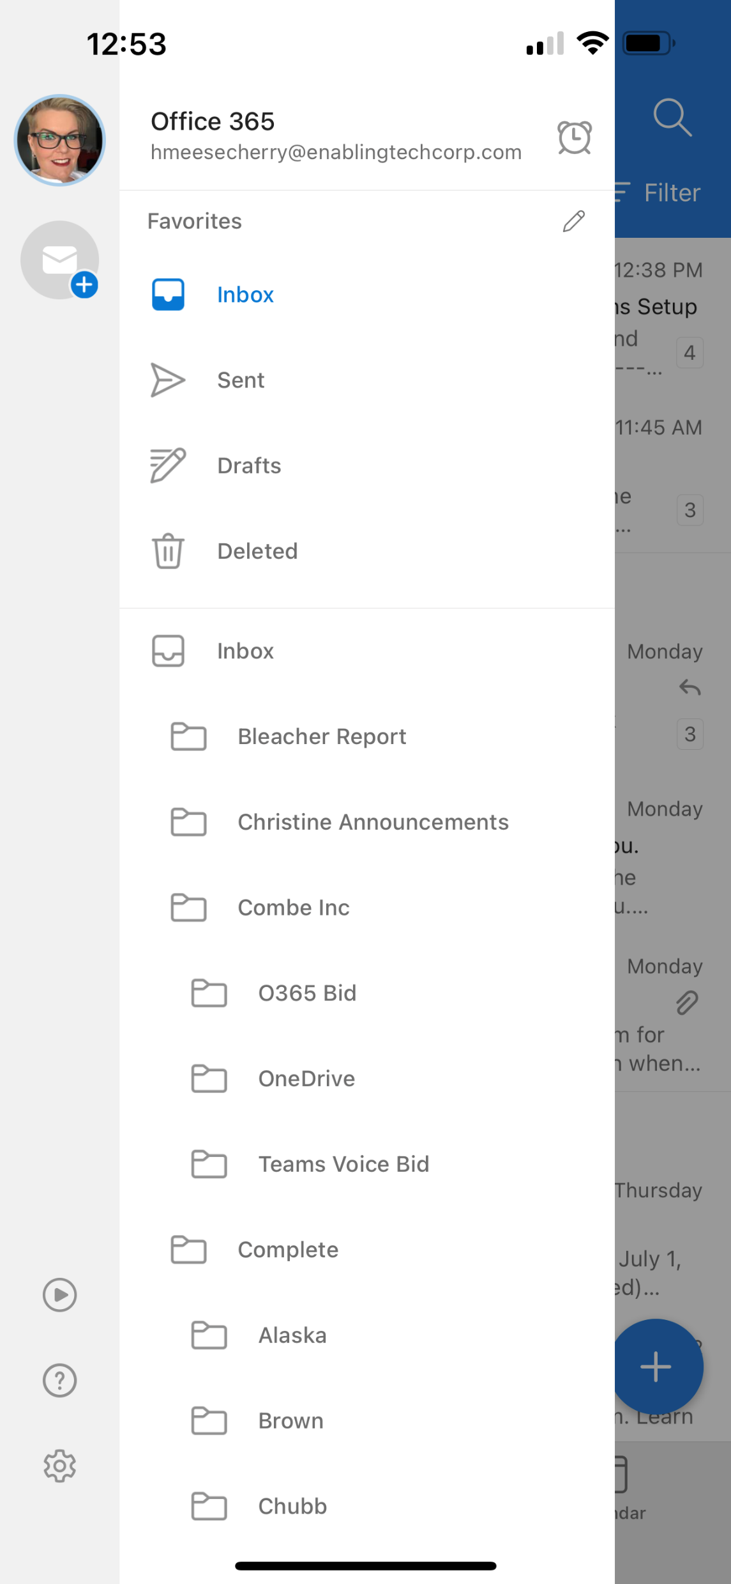
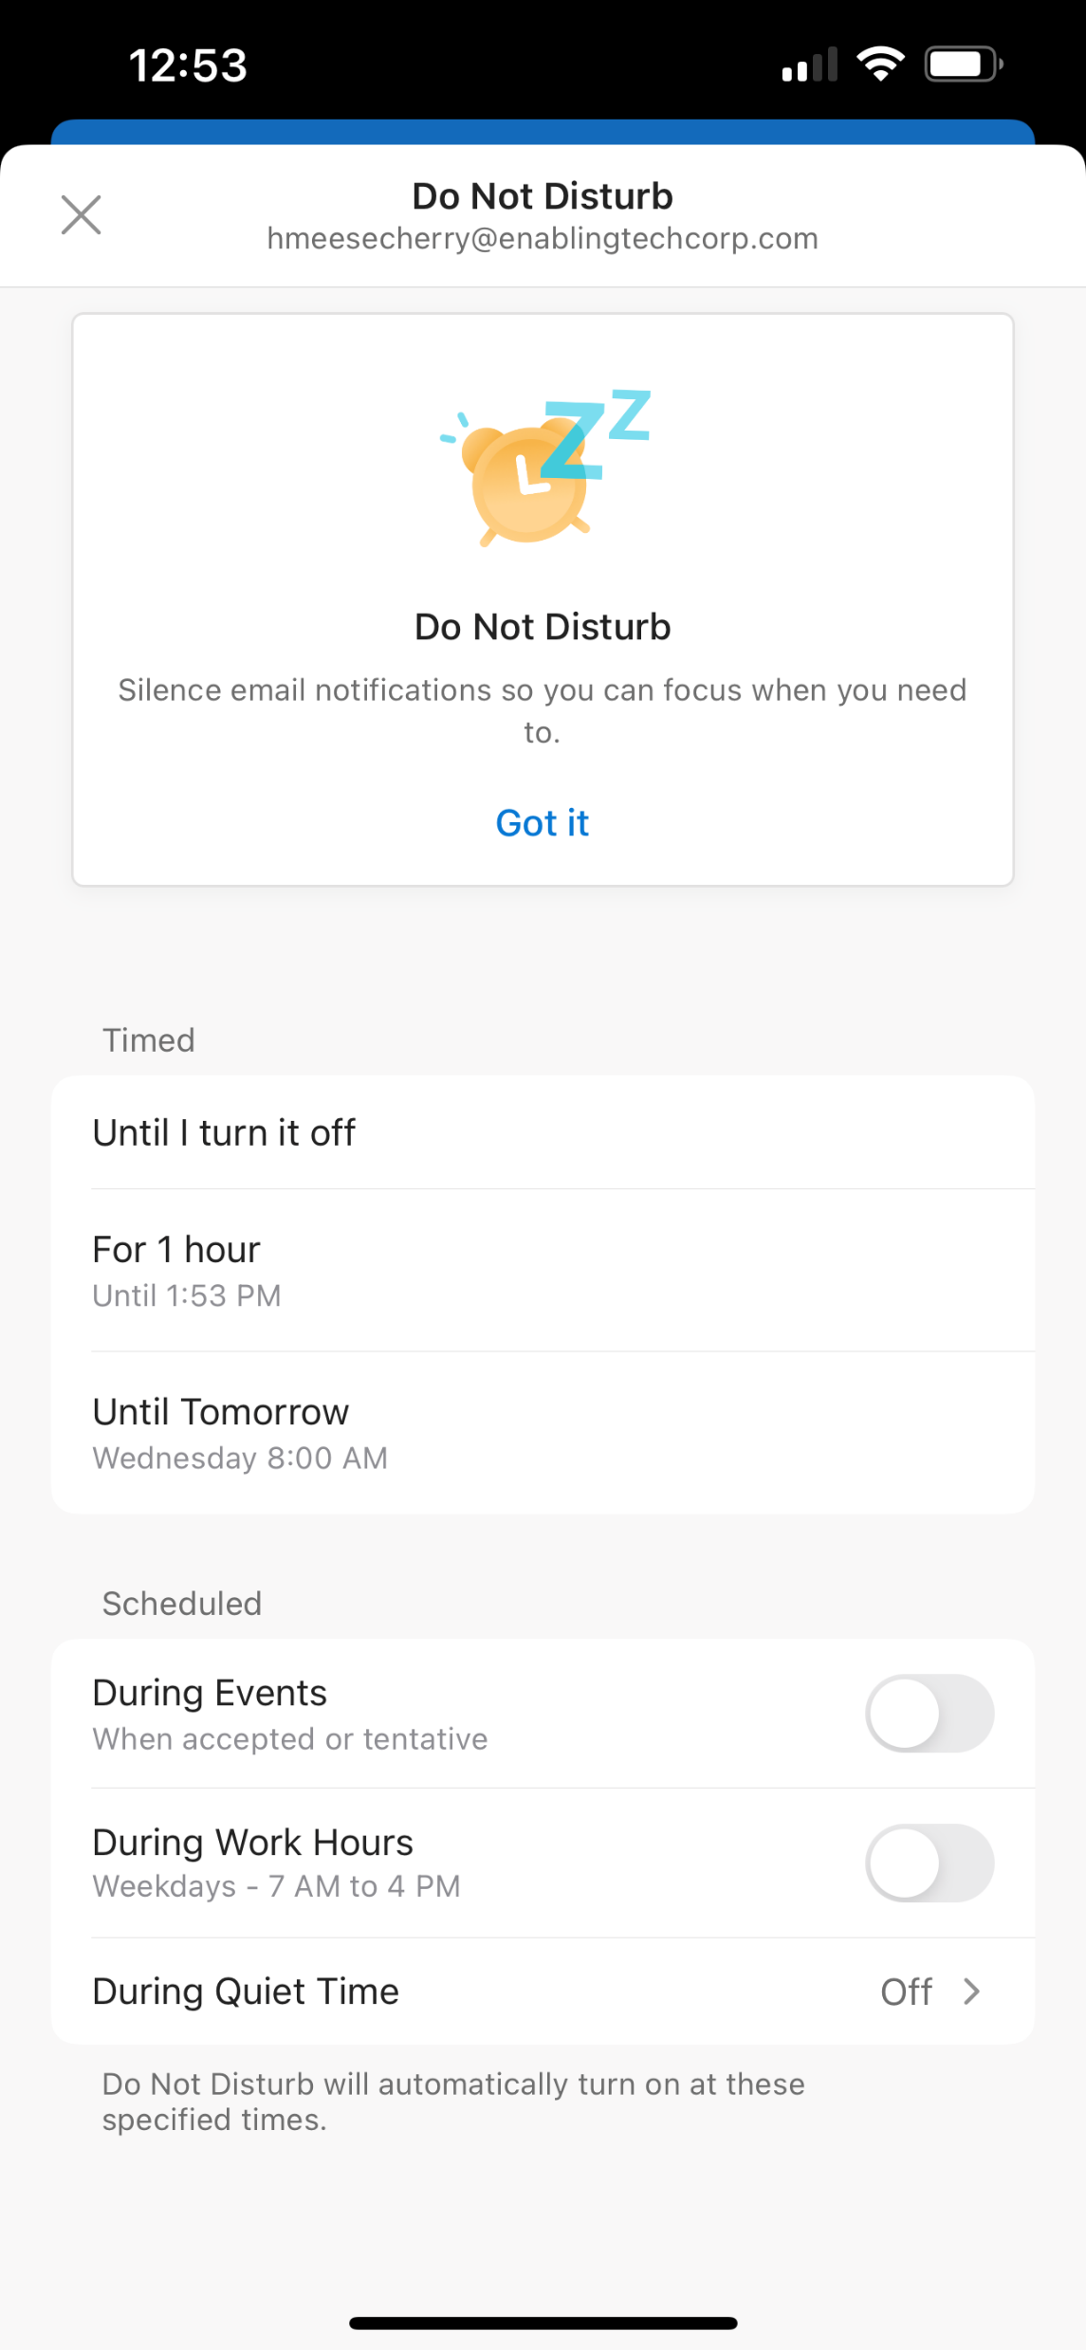


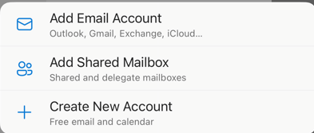



Outlook Mobile – Settings
To access settings, click on your M365 profile image in the top left corner
On the expanded menu, you can navigate between your email folders.
Additionally, if you decide to add additional email accounts, you can navigate between those accounts or add a new one along the left column
The Play button allows you to have Outlook read your emails to you
Help provides help and feedback options along with troubleshooting assistance and information about the app
Look for the Gear icon to access full Settings

Slide 13
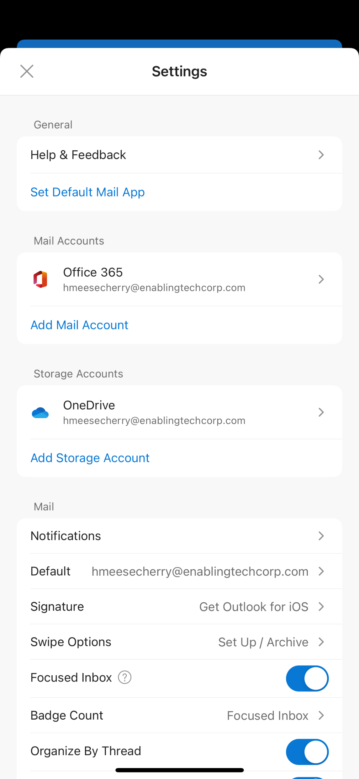
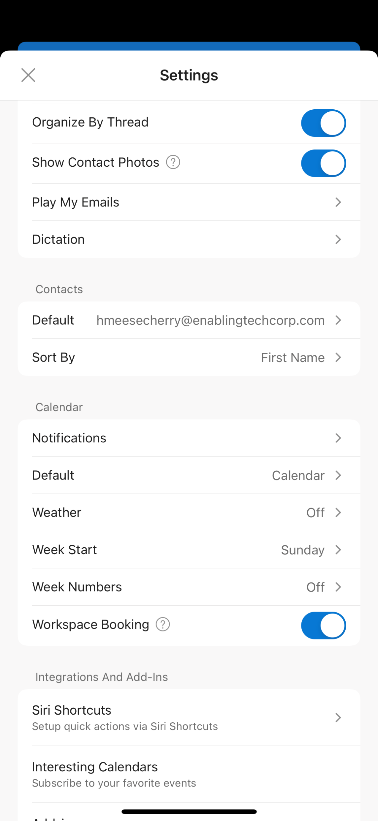
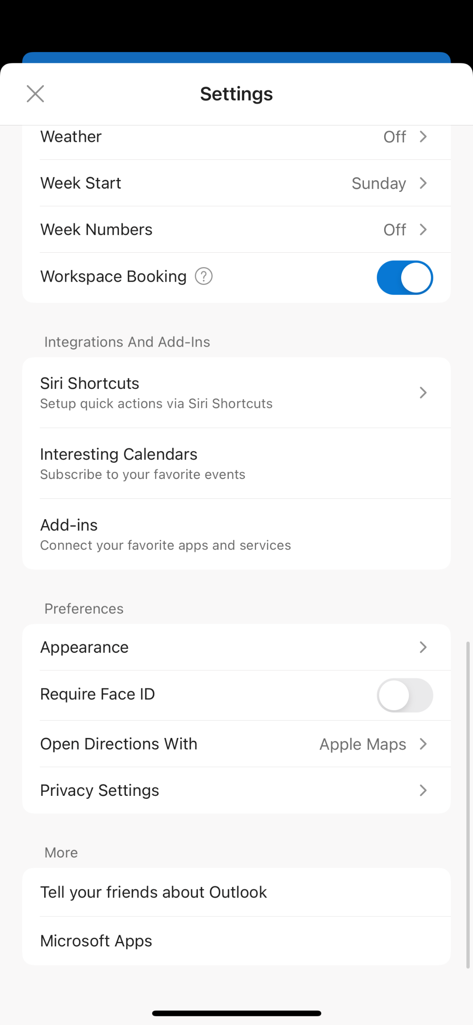
Outlook Mobile – Settings
Settings provides you with many options to customize your Outlook mobile experience, including:
Adding additional mail accounts
Accessing or adding storage accounts such as OneDrive
Setting up email notifications, signatures, organization preferences
Calendar settings such as notifications, weather forecast incorporations, or weekly start (Sunday or Monday)
Add-ins and integrations
Preferences for overall appearance, Face ID, and privacy settings

Slide 14
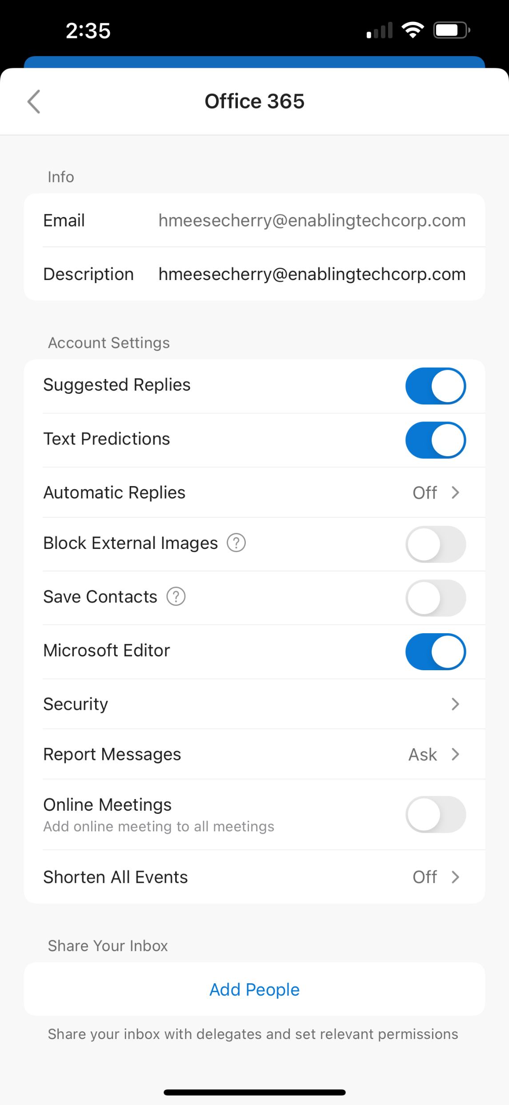
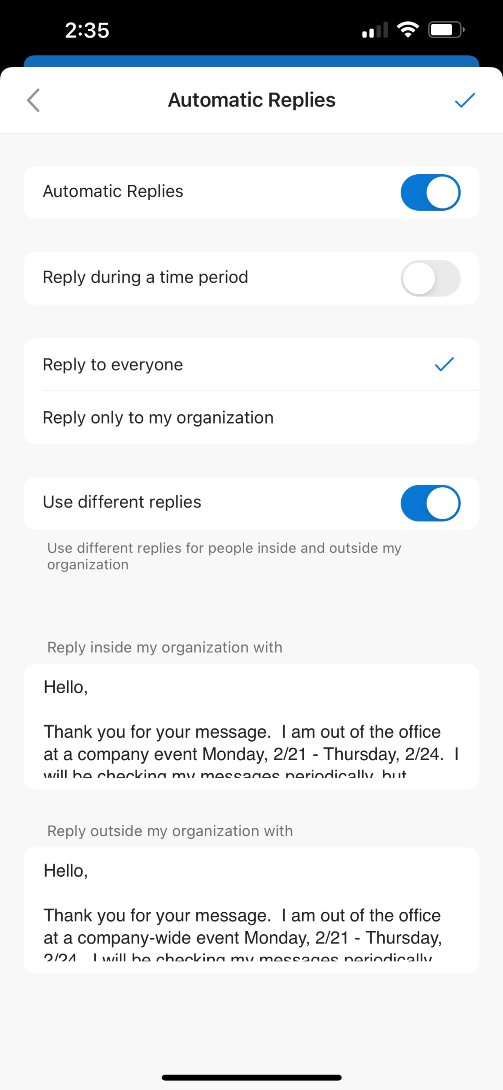
Outlook Mobile – Setting Out of Office
To set up Out of Office in the mobile app, select the impacted email account from the Mail Accounts section of Settings.
Click on Automatic Replies
Toggle on the Automatic Replies switch
You can set separate Automatic Replies for everyone or for those within your organization.
Enter the appropriate text in the boxes at the bottom
Select the Check icon in the top right to save your changes

Slide 15
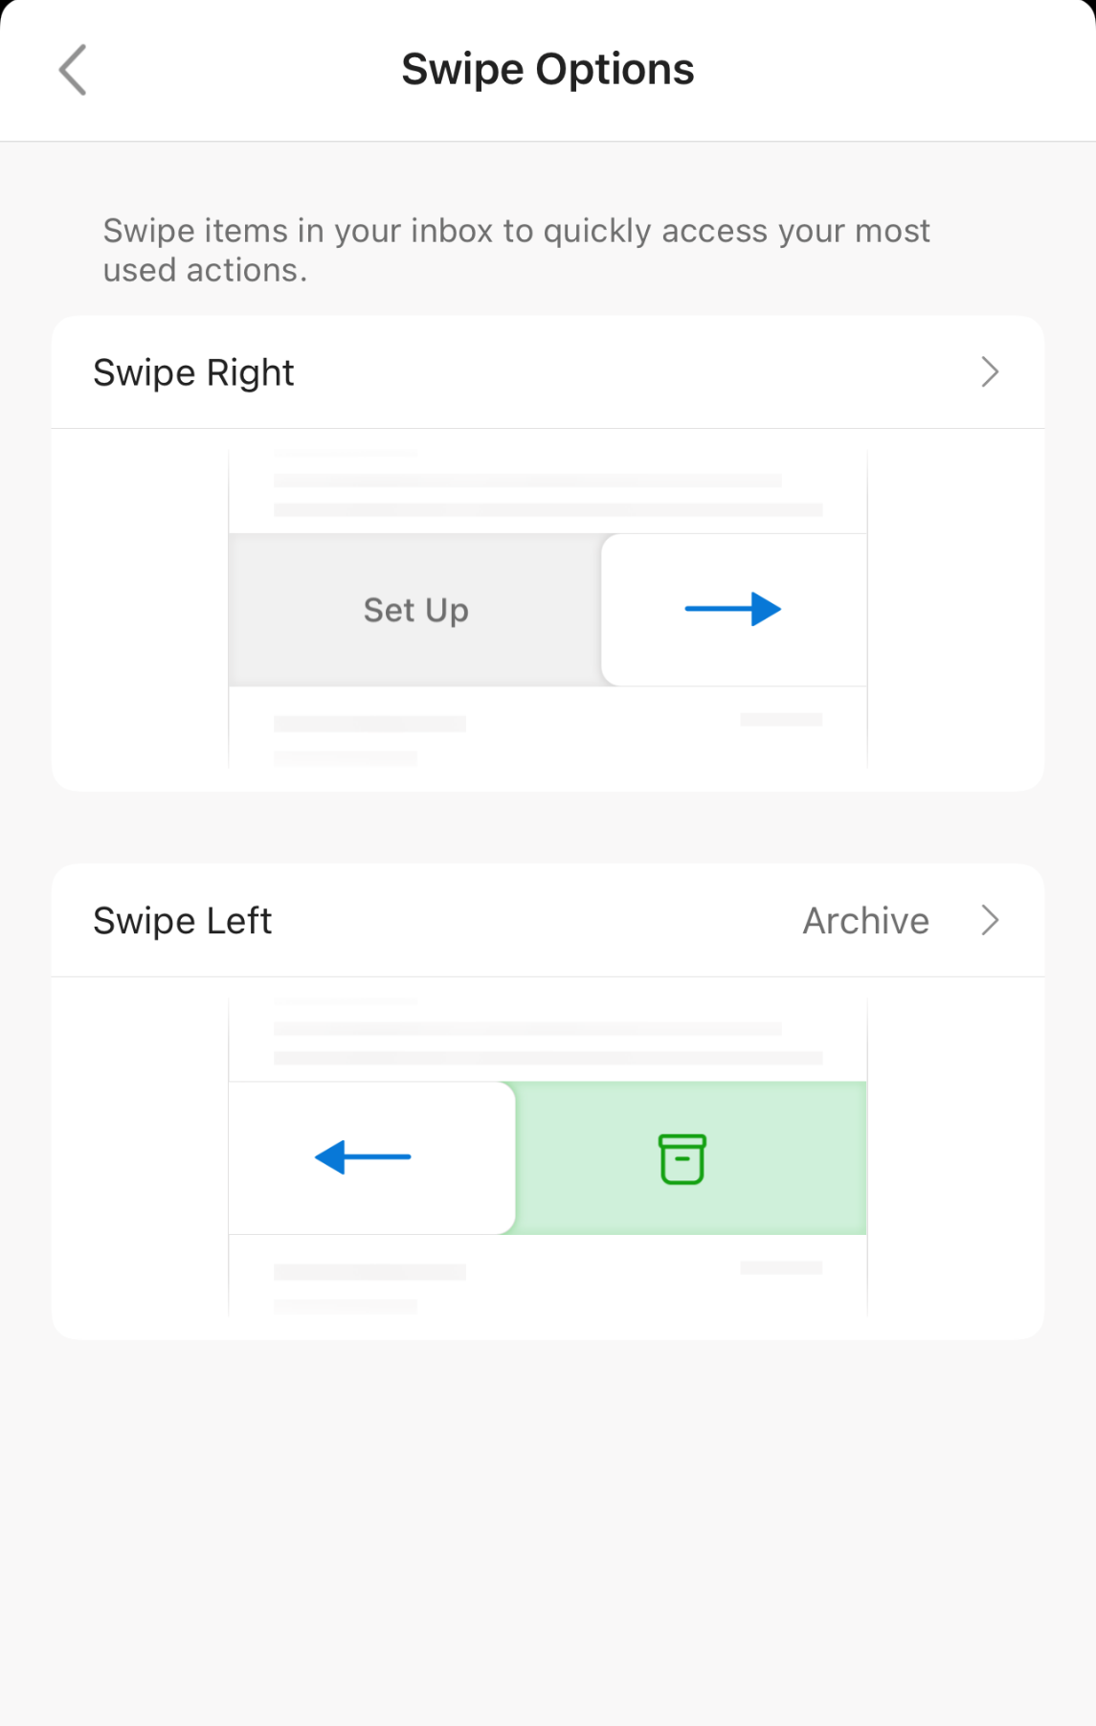
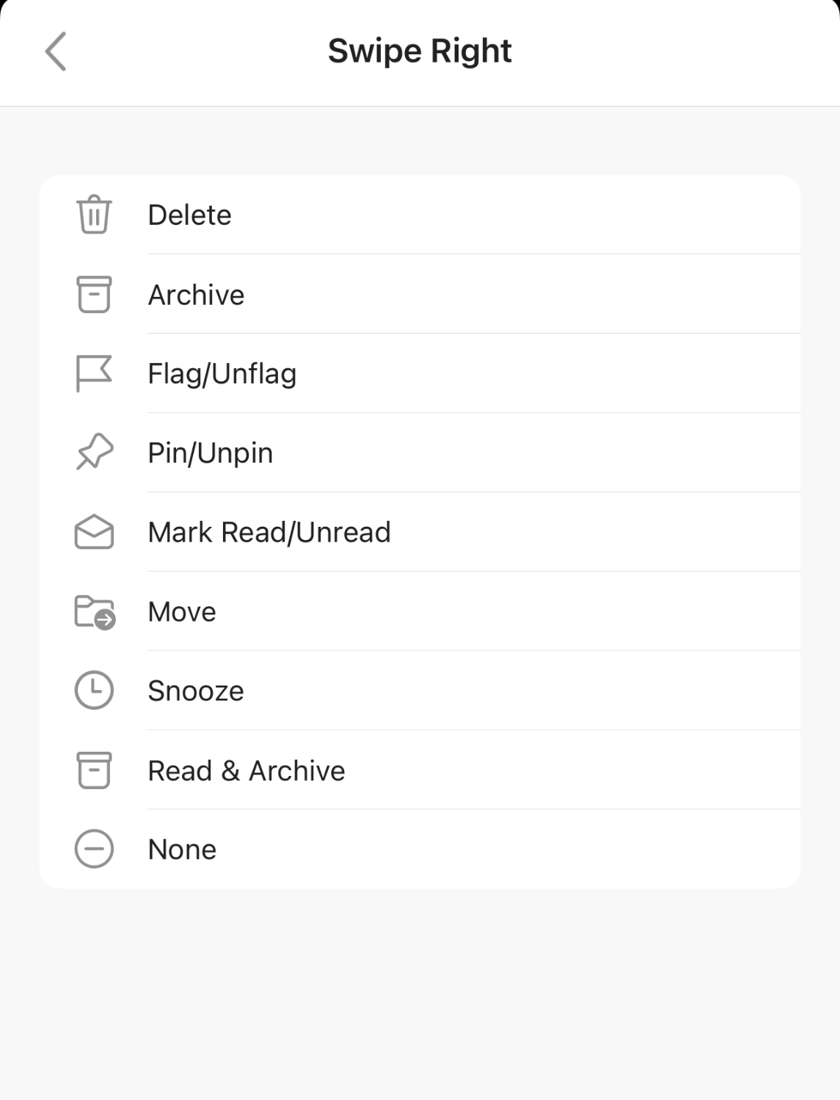
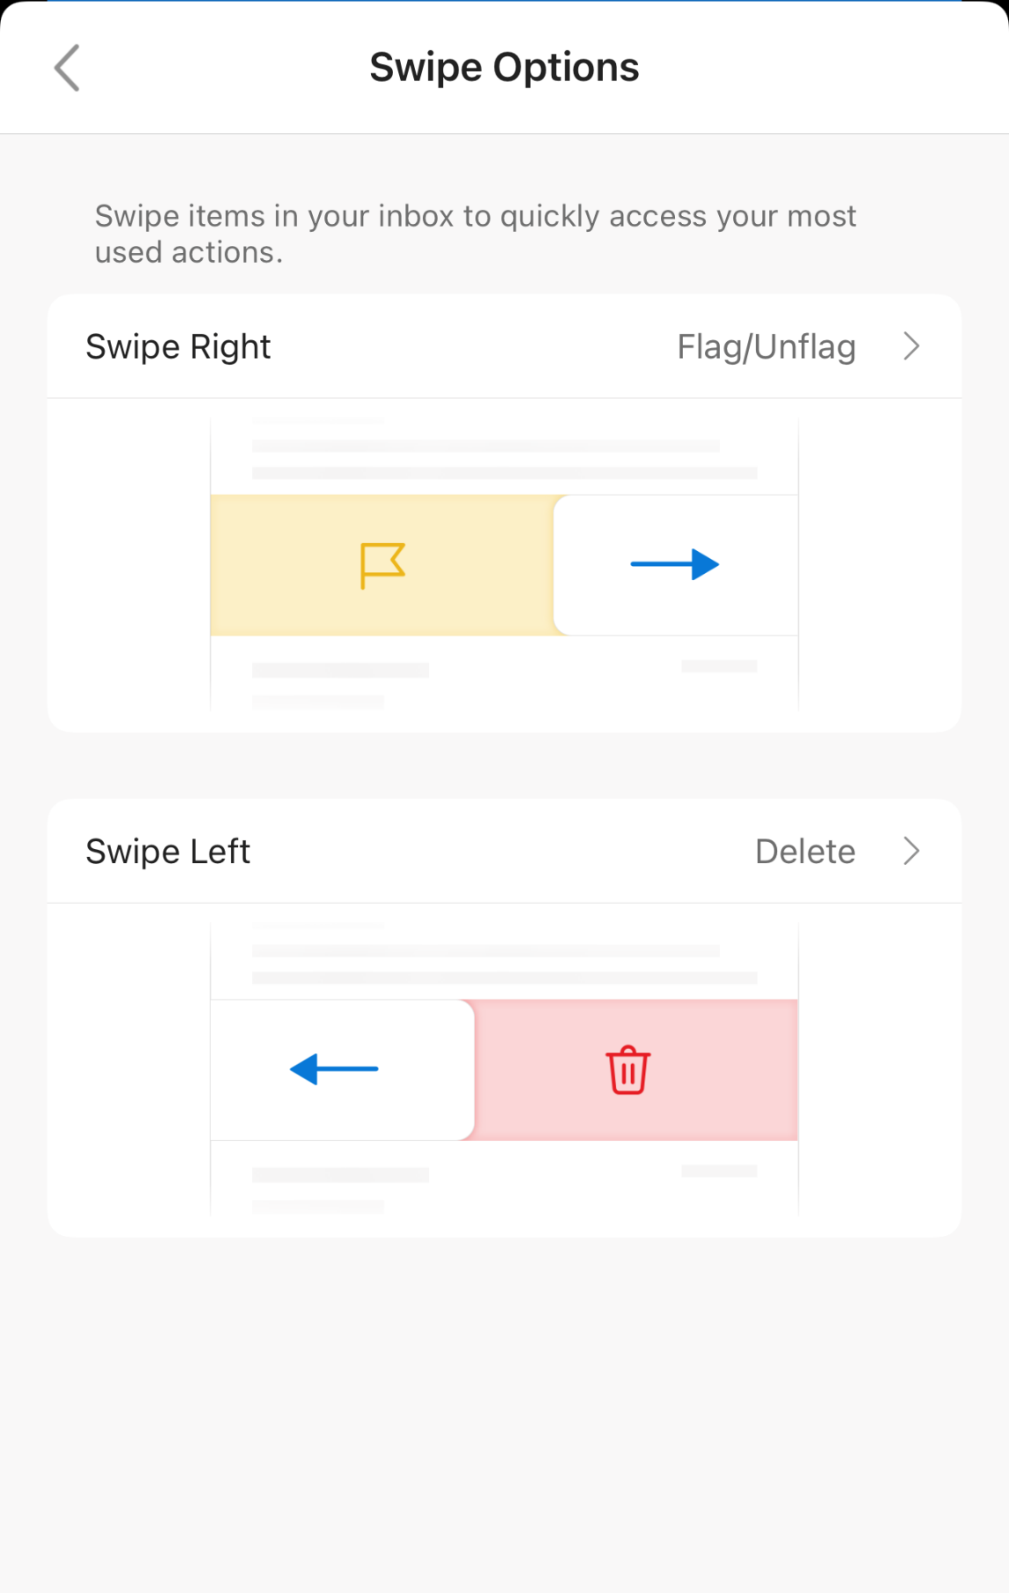
Outlook Mobile – Swipe Preferences
When viewing your inbox, you can swipe left or right on a message for a specific action to take place. In the Settings menu, you can define the actions associated with left and right swiping.
After selecting Swipe Options, you may select an assignment for Swipe Right and Swipe Left. Click the > carrot to see the definitions
Once you have defined your swipe actions, Outlook will provide a text and visual confirmation of your settings. No need to save, just click the ← arrow to return to settings.

Slide 16
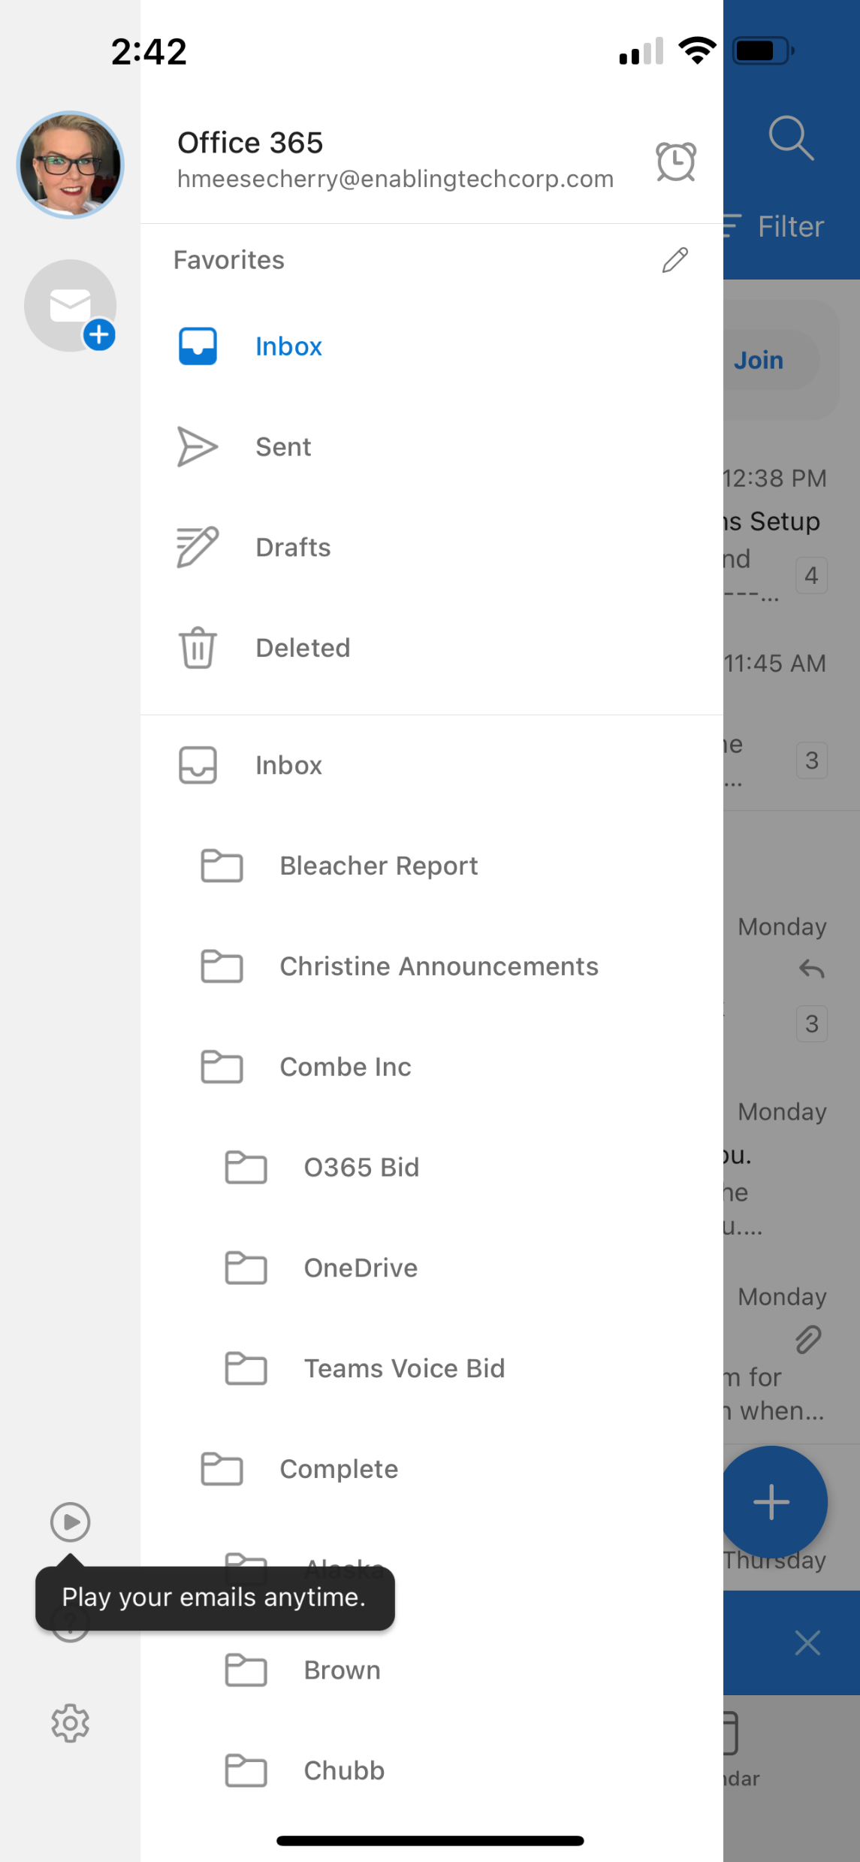
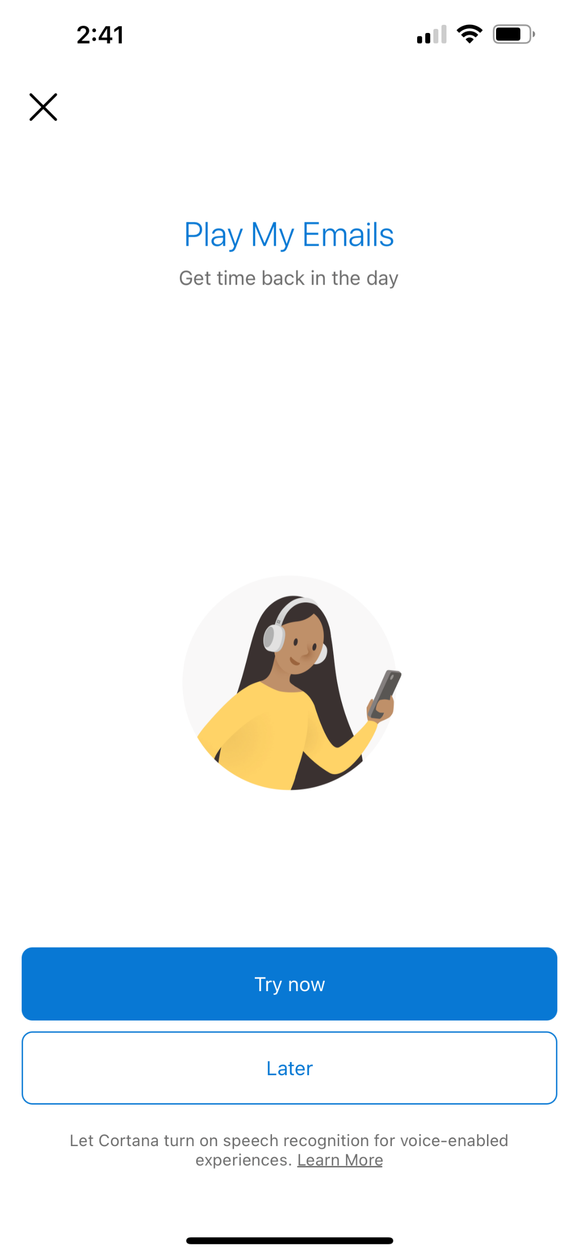
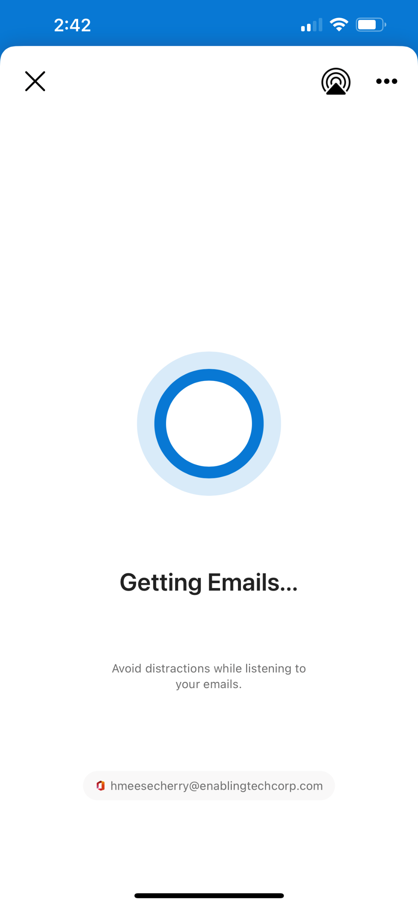
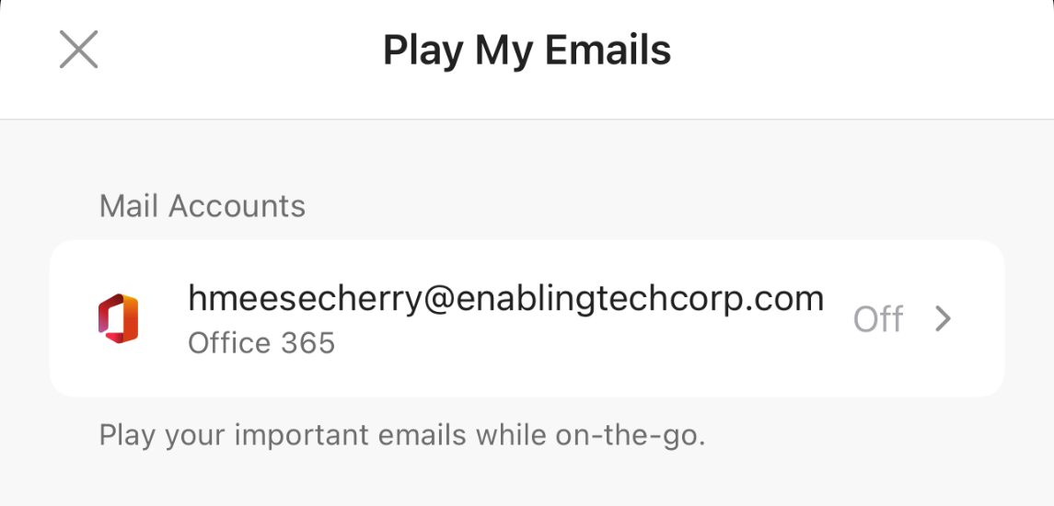
Outlook Mobile – Cortana Read Me Option
To save time, you can have Outlook read your unread messages out loud to you.
Enable this feature by clicking on your M365 profile image then the Play button
Select the impacted account
On the next screen, toggle on the switch for Play my Emails
The following page allows you to continue with set up or try it out later

