Slide 1




EMPLOYEE FEE WAIVER BENEFIT PROGRAM

Slide 2





TUITION FEE WAIVER & REDUCTION PROGRAM
The Employee Fee Waiver Program allows eligible California State University (CSU) employees to enroll in CSU courses at reduced rates. Participants are encouraged to take advantage of this opportunity to enhance skills related to their current role or to prepare for career advancement aligned with University needs. Courses must be taken for credit; the program does not apply to Open University, Professional Development Center, or Special Session courses offered through Extended Learning.
In addition, eligible CSU employees may transfer their fee waiver benefit to a spouse, domestic partner or dependent child.

Slide 3

EMPLOYEE CATEGORY/ELIGIBILITY
Unit 1: Physicians (All Unit Members)
Units 2, 5, 7, & 9: CSUEU
Unit 4: Academic Professionals
Unit 6: Skilled Trades
Full-Time employees (permanent, temporary & probationary) and part-time permanent employees

Slide 4

EMPLOYEE CATEGORY/ELIGIBILITY
Unit 8: Public Safety
C99: Confidential
E99: Excluded
M98: Executive
Full-time or part-time permanent employees and full-time probationary employees (does not apply to temporary)

Slide 5

EMPLOYEE CATEGORY/ELIGIBILITY
Unit 3 Faculty
Tenured and probationary faculty unit employees, and temporary faculty with (3) year appointments.
Coaches must have at least 6 years of full-time equivalent service in the department
FERP eligible during semesters/quarters when they are actively employed

Slide 6

EMPLOYEE CATEGORY/ELIGIBILITY
M80: Management Personnel Plan (MPP)
Full-time employees (includes temporary)
Notes:
Part-time MPP employees are NOT eligible.

Slide 7

DEPENDENT FEE WAIVER
Spouse
Dependent Child
Domestic Partner
Must be matriculated towards a degree or attainment of a teaching credential in the CSU
Courses must be for credit towards completion of that degree or teaching credential
Must meet established in-state residency requirements or pay non-resident tuition charges
Notes:
Eligible employees may transfer their fee waiver to a spouse, dependent child or registered domestic partner.

Slide 8

DEPENDENT FEE WAIVER
Bargaining Unit: Unit 1/Physicians Unit 10 | Dependent child age limit is 23
Bargaining Unit: CSUEU (2,5,7 &9) Unit 3/Faculty Unit 4/Academic Professionals Unit 6/Skilled Trades Unit 8/Public Safety C99/Confidential; MPP; Executives | Dependent child age limit is 25
DOMESTIC PARTNER | Eligibility is the same for health benefits (registered with the State of California)
If both parents are employees and eligible to transfer their fee waiver benefit to a dependent child, each employee may transfer the benefit
May enroll at any CSU campus
Notes:
Fee Waiver may be transferred to only one person at a time, regardless of whether that individual uses the full entitlement of 2 courses or 6 units (maximum).
If both parents are employees of a CSU University and eligible to transfer their fee waiver benefit to a dependent child, each employee may transfer the benefit.

Slide 9

EMPLOYEE FEE WAIVER COURSES
WORK RELATED
  To improve/enhance skills related to current role
CAREER DEVELOPMENT PLAN
  Employees must complete all forms required for regular admission and matriculation at CSU

Slide 10

EMPLOYEE FEE WAIVER COURSES
A maximum of two (2) courses or six units per semester/term
Only state-funded courses may be taken under the fee waiver program
Self-support programs are not eligible for fee waiver (Extended Learning courses are self-supporting)

Slide 11
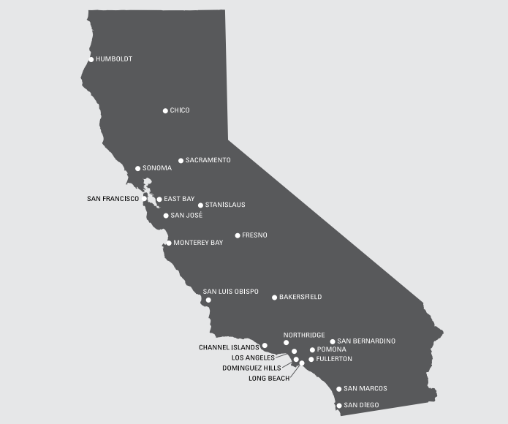
EMPLOYEE FEE WAIVER COURSES
Normal academic standards must be maintained in order to continue in the fee waiver program
May be used at any CSU campus
Release time may be taken for one (1) on-campus fee waiver course, if class is during normal work hours – please refer to your appropriate bargaining unit contract
Courses taken in addition to fee waiver courses, the employee must pay the difference in fees at a regular rate

Slide 12
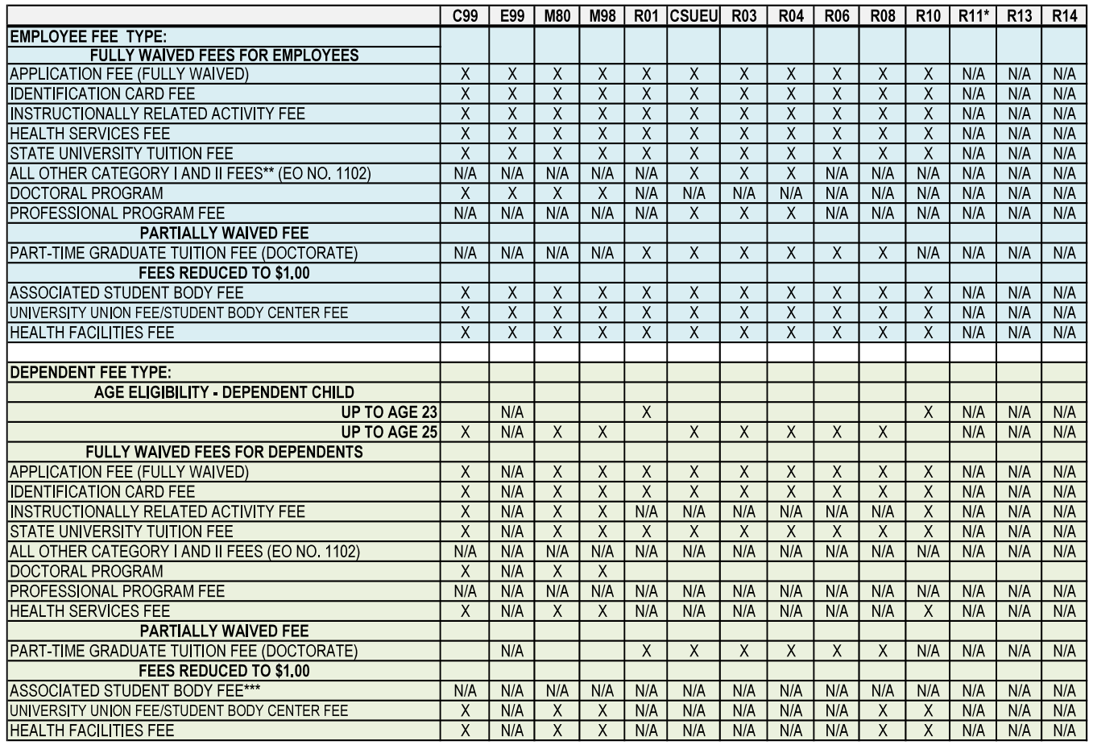
FEE WAIVER TABLE

Slide 13
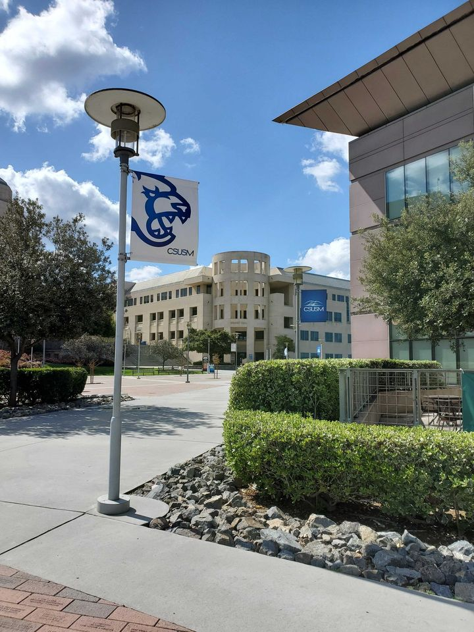
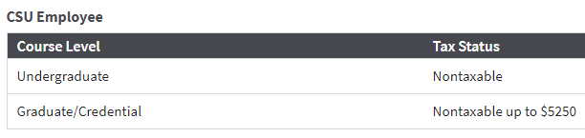
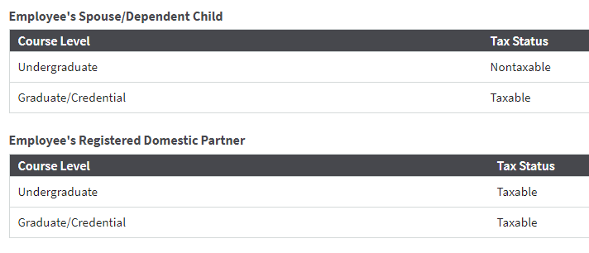
TAX FREE OR TAXABLE BENEFITS
Fees waived may be considered imputed taxable income based on eligible participant and course level.
Taxes withheld from the employee’s paycheck in the month the imputed income is reported.
Imputed taxable income will be included on the employee’s W-2 form.
Imputed taxable income is subject to the following:
Federal = 22% Social Security = 6.2%
State = 6.6% Medicare = 1.45%

Slide 14

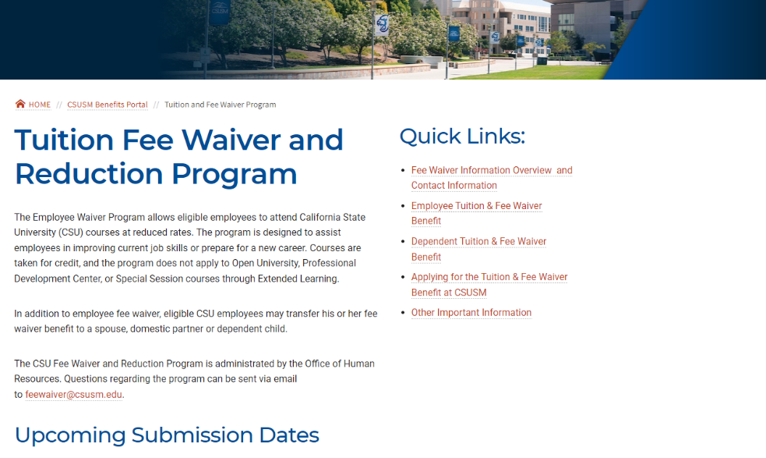
FEE WAIVER PROCESS
Submit your completed fee waiver forms to OHR by the dates published on the Tuition Fee Waiver website:
Tuition Fee Waiver and Reduction Program

Slide 15





FEE WAIVER PROCESS
CHECK BARGAINING UNIT CONTRACT
http://www.calstate.edu/HR/
CHOOSE FEE WAIVER OPTION
Work Related
Career Development
Dependent Fee Waiver
SELECT CLASSES
COMPLETE FEE WAIVER FORMS AND OBTAIN REQUIRED SIGNATURES
All forms can be found on the HR website
https://www.csusm.edu/hr/benefits/fee_waiver/index.html
Notes:
If you are attending a CSU other than CSUSM you will want to pay attention their deadline dates and submit your forms timely to meet important deadlines.
A request to participate in the fee waiver program is required for each new semester you wish to participate, this is applicable to employee use as well as transferring the benefit to an eligible dependent.

Slide 16

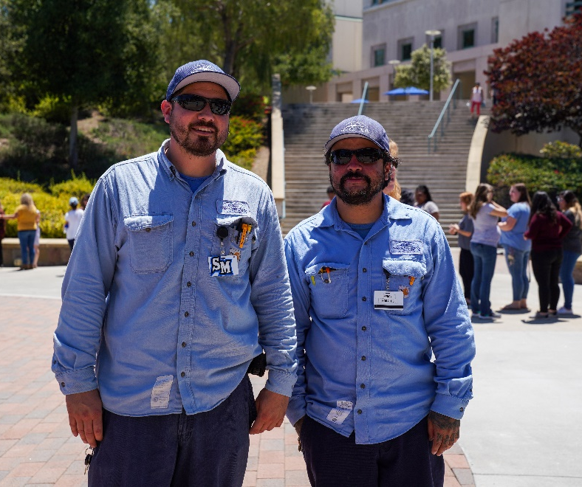


HELPFUL LINKS
Tuition Fee Waiver & Reduction Program
Employee Tuition and Fee Waiver Benefit
Application to the CSU
Student Financial Services
FORMS
  Career Development Plan
  CSU Application Fee Reimbursement Request
  Dependent Fee Waiver Application
  Employee Fee Waiver Application
  Employee Fee Waiver Application – Work Related
  All Fee Waiver forms are available via Adobe Sign

Slide 17



HR FEE WAIVER QUESTIONS
feewaiver@csusm.edu
STUDENT FINANCIAL SERVICES
CONTACT US
sfs@csusm.edu
OFFICE OF ADMISSIONS
apply@csusm.edu
OFFICE OF THE REGISTRAR
registrar@csusm.edu

Slide 18

THANK
YOU

