Slide 1
RACE THEMED PARTIES
Issues of Cultural Appropriation
Presented By
Arturo E. Ocampo
Associate Vice President
For Diversity, Educational Equity,
Inclusion and Ombuds
CSU San Marcos

Slide 2

Defining Cultural Appropriation
In its broadest sense cultural appropriation is:
The adoption or taking of specific elements, (such as ideas, symbols, artifacts, images, art, rituals, icons, behavior, music, styles) of one culture by another culture.

Slide 3
DEFINING CULTURAL APPROPRIATION
There are four types of cultural appropriation according to Richard A. Rogers,* they include:
1. Cultural Exchange – Reciprocal Exchange
2. Cultural Dominance – Imposing the dominant culture on a subordinate
culture
3. Cultural Exploitation – Taking of subordinate culture for benefit of dominant
culture
4. Transculturation – Development of cultural hybrids
* See R. Rogers, From Cultural Exchange to Transculturation: A Review and Reconceptualization of Cultural Appropriation,
Communication Theory 16 (2006).
Notes:
1 equal footing – not all cultural appropriation is “bad” from a social justice point of view.
2. Culture is forced onto subordinate culture, often occurs in colonization. Also looks at how subordinate culture accepts (involuntarily accepts or doesn’t accept dominant culture).
3. Benefit to dominant culture is not always financial, could be psychological, could be maintenance of status quo, etc.
4. New cultural practice, symbol, product, etc created through interaction of two or more cultures. New product no longer identifiable or exactly the same as an artifact of influencing cultures.
Each of these forms of cultural appropriation have some overlap and sometimes evolve from one another, so no clear distinctions, just a framework to help us understand different forms of appropriation. Whether the appropriation under items 1 and 4 is considered harmful or bad depends on the context in which the appropriation occurs and the possible consequences of the appropriation.
Understanding each of these helps us in our analysis when people respond for example by saying if its ok for china to appropriate Mcdonalds its ok for me to appropriate black culture. Even in the appropriation of black culture some appropriations may be more offensive or harmful than others.

Slide 4
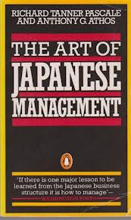
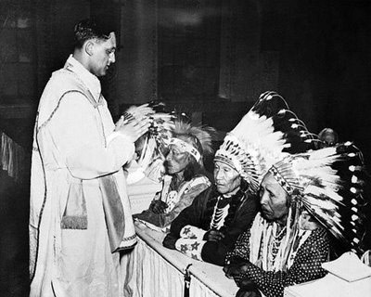
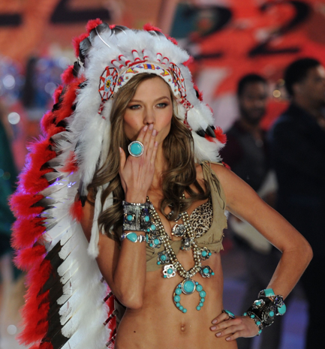
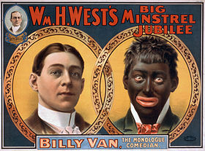
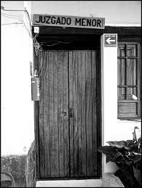
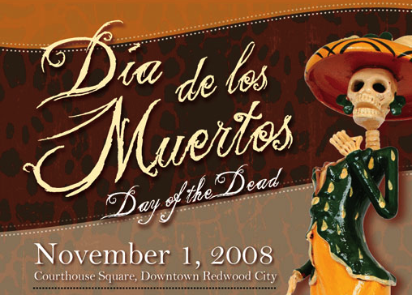
Types of Cultural
Appropriation
1. Cultural Exchange ……….
2. Cultural Dominance …………………………….... Indian Boarding Schools
and forced assimilation.
3. Cultural Exploitation……… …………..
Victoria Secret
Indian Princes Blackface
4. Transculturation …………………………………………………………
From “juzgado” to “hoosegow”
Notes:
These are examples of the types of cultural appropriation. Other examples include under #1 products such as the tomatoes, Chocolate being introduced to Europe and certain diseases being introduced to the Americas, the early colonists learning democratic principles from American Indians; white settlers in California learning new techniques on how to mine for gold from Mexican-Californios; under #2 forcing the language of the colonizer onto the colonized, forcing a political system onto a conquered country, American Black Slaves adopting Christian religions; under #3 the use of indigenous folk music by Western musicians without compensation, the physical removal of cultural objects (e.g., to museums) without permission, the use of cultural or religious items such as the Bindi, or new age spiritualists taking religious cultural practices from other cultures and rebranding it for consumers.
Ziff and Rao (1997) identified four concerns expressed about acts of cultural
appropriation by dominant from subordinate cultures (i.e., cultural exploitation).
* The first concern is cultural degradation.
* The second concern is the preservation of cultural elements.
* The third concern is deprivation of material advantage:Cultural products, either of the past or of living cultures, are being ‘‘wrongfully
exploited for financial gain’’
* The fourth concern isthe failure to recognize sovereign
claims.
#4 you often see transculturation in music (Jazz, Ska, Mariachi, Salsa), in dance, in food; religion and religious practices (Haitian Voudu, the Virgen de Guadalupe); and in language, (language of southwest, bronco, calaboose, chaps, desperado, mustang, lariat,etc)
Some refer to the negative or harmful types of cultural appropriation (most often #2 and #3 above) as “cultural mis-appropriation”
See R. Rogers (2008), supra.

Slide 5
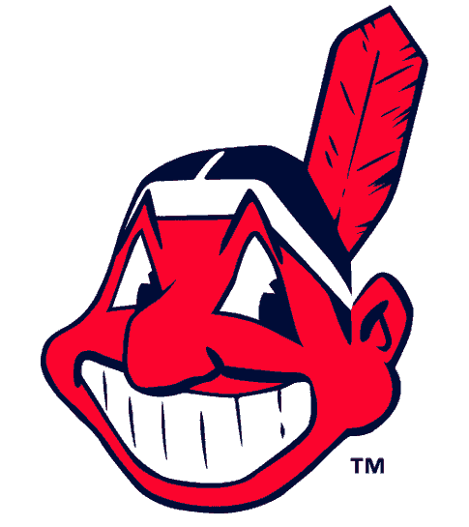
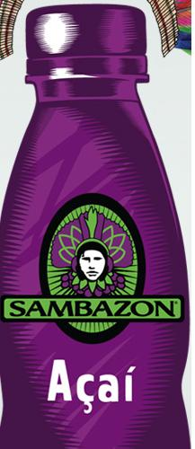
Cultural Exploitation
Cultural exploitation is:
The appropriation of elements of a subordinated culture by a dominant culture without substantive reciprocity, permission, compensation, understanding, or appreciation*. There is often a prior history of discrimination or some form of marginalization. Often the appropriation serves, intentionally or unintentionally, to perpetuate the subordinate position of the appropriated culture.
* See R. Rogers, From Cultural Exchange to Transculturation: A Review and Reconceptualization of Cultural Appropriation, Communication Theory 16 (2006).
Notes:
Historical context and social positionality are important in determining when or to what degree CA is innappropriate. Where the cultures have unequal power and one has oppressed or marginalized the other. Is there for example a difference between taking elements of french culture and taking elements of Native American Culture when designing an item of clothing
Other examples Bindi, music, herbal medicines and practices, taco bell, Navajo designs, and Indian art kopepelli, Katchina dolls,
Exploitation - concerns of cultural degradation, when culture is depicted inaccurately and distorted it can have corrosive effects on the distorted culture. By doing so non=natives claim authority to define what native americans really are, distorting not only non-native but also native understanding of native american cultures
Also concern preservation of cultural elements. Cultural symbols, rituals, and artifacts can begin to lose their original meaning. The need to preserve the integrity of an already marginalized culture, ex NA many lost their language. Ex of distortion of spiritual practices by New Age followers. Preservation also include the conern re the actual taking of cultural object. Artifacts taken from natives and placed in museums,
Deprivation of material advantage – when for example a herbal cure is taken or indegnous music, or a navajo rug , which is then marketed and sold for a profit with no compensation to the originating culture. Bruce springsteen able to sue and stop republican appropriation of of Born in the USA, but the laws don’t protect indigenous groups from allowing the appropraition of Kachina dolls or the imagery of Kokopelli the flute player. All of the above also occurs when appropraition takes the form of commodification.
Pocahontas, the taking by itself is not CA its that its done in unequal footing, done without permission and compensation and it is then used in a way to justify oppressive behavior past or present.

Slide 6
Cultural Dominance
Cultural Dominance is:
The use of elements of a dominant culture by members of a subordinated culture in a context in which the dominant culture has been imposed onto the subordinated culture, including appropriations that enact resistance.

Slide 7
Stereotypes
Stereotypes are important to understand as they are often used in cultural appropriation
A stereotype is a an exaggerated or distorted generalization about an entire category of people that does not acknowledge individual variation. Stereotypes form the basis for prejudice and discrimination. They generally involve members of one group that deny access to opportunities and rewards that are available to that group.

Slide 8
Cultural Exploitation and Race Themed Parties
Race themed parties can be a form of cultural Exploitation.
Serves to maintain the status quo through justification and perpetuation of negative stereotypes, can cause cultural degradation, and commodifies a culture.
See G. Garcia et al., When Parties Become Racialized: Deconstructing Racially Themed Parties, Journal of Student Affairs Research and Practice 48 (1) 5-21 (2011)

Slide 9
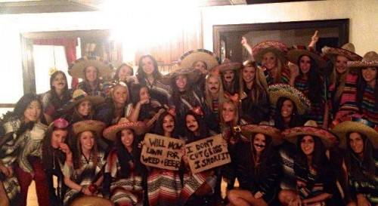
Penn State Mexican Party
October 2012: The photograph below depicts the members of the Chi Omega sorority at Penn State hosting a Mexican themed party . The signs read “will mow lawn for weed & beer” and “I don’t cut grass I smoke it”.

Slide 10
Student Response at Penn State
“The Mexican American Student Association is disappointed in the attire chosen by this sorority. It in no way represents our culture. Not only have they chosen to stereotype our culture with serapes and sombreros, but the insinuation about drug usage makes this image more offensive. Our country is plagued by a drug war that has led to the death of an estimated 50,000 people, which is nothing to be joked about.”

Slide 11
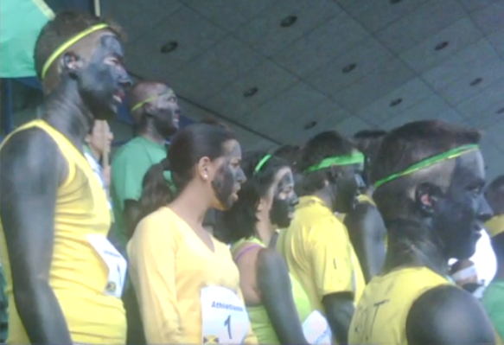
Cultural Exploitation
Business School Jamaican Skit
Students at Hautes Etudes Commerciales (2011), were filmed “wearing black makeup [and] chant[ing] with mock Jamaican accents about smoking marijuana”…part of a skit in honor of Jamaican Olympian Usain Bolt. A spokesperson explained that Francophone Canadians were unaware of the racial history behind blackface.

Slide 12
Response to Jamaican Skit
“[Being black] is not a costume that you put on… This is not just about a few bad apples. This is about a greater problem about what we think about, how we value, how we understand, how we discuss — if we discuss — black history, culture and contribution.”

Slide 13
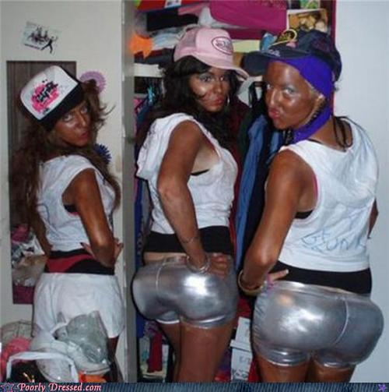
Compton Cookout UCSD
Invitees were urged to wear chains, don cheap clothes and speak loudly with a limited vocabulary. Female participants were encouraged to be “ghetto chicks” and “chicken, coolaide and of course watermelon,” would be served.

Slide 14
Student Response to Compton Cookout
"It's not cool," black UCSD junior Theresa Richards said of the party. "It's disheartening and it's hurtful, and I'm appalled that we're having to talk about it in this day and age.”
“I’m not saying that they don’t have the right to freedom of speech, but where’s my right to be protected from that?” …“I am a student in your class, and I have to sit next to these racist kids. What kind of college is this?

Slide 15
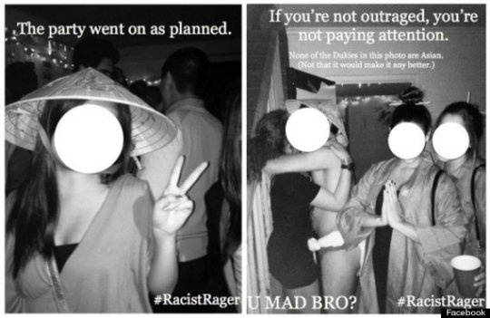
Duke University-Asia Prime Party
The Kappa Sigma Fraternity threw a party that they named "Asia Prime.” The invite read: "Herro Nice Duke Peopre" in a misspelling intended to convey an East Asian accent.
Photos from the party show students dressed in traditional Asian garments such as conical sedge hats and sumo wrestler attire.

Slide 16
Asia Prime Student Response
"We are protesting the culture of acceptance at these kinds of things," Ting-Ting Zhou, president of the Asian Students Association, told the Chronicle. "The administration does nothing.”
Notes:
Common concern - Students looking for validation, for support, confirmation that they are welcome and respected.

Slide 17
Identifying Events of Cultural Exploitation
So how do I know the difference between Cultural Exploitation and other non offensive types of Cultural Appropriation?
Or the difference between cultural mis-appropriation and cultural appreciation?
What are the markers or red flags that one should be aware of to avoid culturally insensitive conduct or activities?

Slide 18
Identifying Events of Cultural Exploitation
Ask the following questions:
Is there a history of discrimination or oppression, of the subordinate group? (Black face v. White chicks, why context is important).
Is there a power differential between cultural groups involved?
Does the event perpetuate negative stereotypes of the subordinate group?
Is the culture being erroneously depicted (cultural degradation).*
Is the subordinate culture being “mined’ and “shipped home” for consumption? Is commodification occurring? (See Wallace & Malm, 1984).
Intent to harm or mock is not determinative, context could be consideration.
Is a cultural/racial group offended or likely to be offended? (We don’t have the right to tell someone when they should or shouldn’t be offended)
* Appropriation “can have corrosive effects on the integrity of an exploited culture because the appropriative conduct can erroneously depict the
heritage from which it is drawn.” When a culture is distorted “tears can appear in the fabric of a group's cultural identity.” Ziff & Rao, 1997, p.9)
Notes:
History - There has been no history of whiteface as a mechanism for denigrating the intelligence of whites, whereas blackface served precisely that purpose. “White Chicks” or blacks putting on “white face” conjures up no painful memories, and is so devoid of the historical ‘umph’ of blackface, that to consider it in the same category as minstrelsy is simply an error in rational thinking. Black stereotypes were then used to justify the unequal treatment of African Americans (see Tim Wise, Majoring in Minstrelsy). This of course is not to say that White Chicks, did not display a stereotype, it clearly displayed the sexist “dumb blonde” stereotype that involves a sexist stereotype and involves male privilege more than it does racial privilege.
Power - Major point, power implicates privilege, example of Bindi - Selena gomez = Her usage of the Bindi was a fashion statement that symbolizes how she is bold, cool, and fashionable. However when an Indian/Hindu woman in the US wears a Bindi as part of her religious/cultural practice it becomes a mark of her otherness, her failure to assimilate. We have seen this with how black women with cornrows have been discriminated in the workplace and told the style is unattractive, or unprofessional yet when white females wear cornrows it’s a beauty fashion statement and is more accepted. This differential treatment reminds folks that they are not priviliged and serves to remind them of their subordinate position.
* Stereotypes – also Major point, perpetuation of stereotypes of marginalized groups is a major problem and causes more harm than most realize. See the Thomas Theorem.
Stereotypes must also be viewed in conjunction with issues of power and privilege. A stereotype of a marginalized group is more harmful than a stereotype of the dominant group.
Intent – Intent not to offend is not a defense, we must look at the impact of the behavior. In limited instances the educational purpose to use a stereotype may be appropriate, for example some comedians use stereotypes to highlight the ignorance or harm of stereotypes and prejudice, for others the stereotype is simply used to make fun of the “other”. The difference between Dunham vs Chappelle (satire)
Offended – Sometimes it helps to think how substituting another group sounds. What if folks threw a concentration camp party? What if we changed the name of the resdskins football team to the Japs or the Jews, or instead of the Chief tomahawk mascot we changed it to the Black Sambo mascot.
Also important to understand that we all see the world through different lenses so what I see as offensive may be completeley invisible to another. Lived experiences inform our daily realitie s- ex of Blacks followed in stores, asians as perpetual foreigners, white student didn’t realize that asians often told “my you speak english so well”. Don’t be so quick to say you are too sensitive it invalidates the daily reality they experience as a person who is gay, a person with a disability, of color, or some form of “otherness”.

Slide 19
WHY ARE RACIALLY THEMED PARTIES HARMFUL?
  Reinforces and Perpetuates negative stereotypes.*
  Dehumanizes and Invalidates the appropriated culture by reducing entire groups of people to a caricature.
  Allows for commodification and cultural degradation of the culture.
  Creates a hostile and unwelcoming educational environment (legal liability).
  Can also negatively impact the appropriators (future employers or grad programs may discover their participation in these events via the internet)
  Adds to micro-aggressions experienced by members of subordinate groups** -This impacts learning
* Research shows exposure to American Indian mascots increased stereotyping of other minority groups. (See Prieto, Okazaki, Goldstien and Kirschener. 2010).
** Racial micro-aggressions are the brief and everyday slights, insults, indignities and denigrating messages sent to people of color by well-intentioned people who are unaware of the hidden messages being communicated (D.W. Sue, Micro-aggressions in Everyday Life, Wiley Pub. 2010). Research shows that chronic micro-aggressions results in “painful psychological stress responses” and “feelings of anger, disgust, distress, and a diminished sense of belonging on their respective campuses”(W.A. Smith et al. 2007 p. 573)
Notes:
*
Hostile environment - Offensive behavior severe or pervasive

Slide 20
Microaggressions*
** Data going back to the 80s suggests that there are thousands of instances of ethno-violence (ranging from assaults, to graffiti, to racial slurs) directed towards students of color each year. A study at the University of California-San Diego in the 90s found that over 80% of white students admitted to having seen or heard racial slurs or acts of race-based discrimination aimed at students of color. And a 2004 survey at the University of Virginia found that 40% of all black students at the school had been the target of a direct racial slur, while 91% had either experienced or witnessed an act of racial discrimination or intolerance since coming to the college.
* Racial microaggressions are the brief and everyday slights, insults, indignities and denigrating messages sent to people of color by well-intentioned people who are unaware of the hidden messages being communicated (D.W. Sue, Microaggressions in Everyday Life, Wiley Pub. 2010).

Slide 21
WHY SHOULD WE CARE ABOUT RACE THEMED PARTIES?
As an institution of higher learning we need to be concerned with all students sense of safety, validation, inclusion and integration into the University as this impacts learning.
As a social justice institution we need to address social inequities. We need to model that which we preach.
We need to ensure our students graduate with the skills to be competitive in a diverse and global workplace/society.
The potential legal liability from claims of hostile work/education environment. Hostile Environment v. Free Speech.
Our reputation will impact our ability to recruit employees and students whose diversity is needed to ensure academic excellence.
Notes:
Severe or pervasive
Legal obligation to take corrective action.

