Slide 1
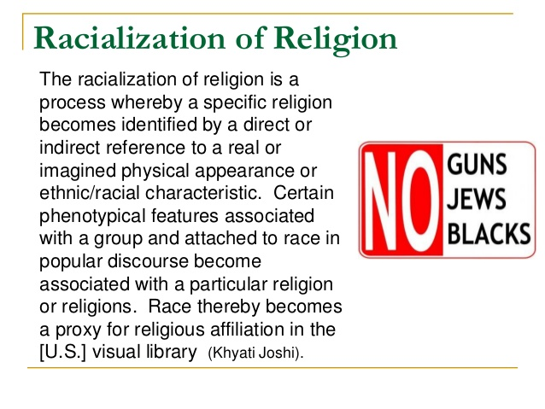

Slide 2
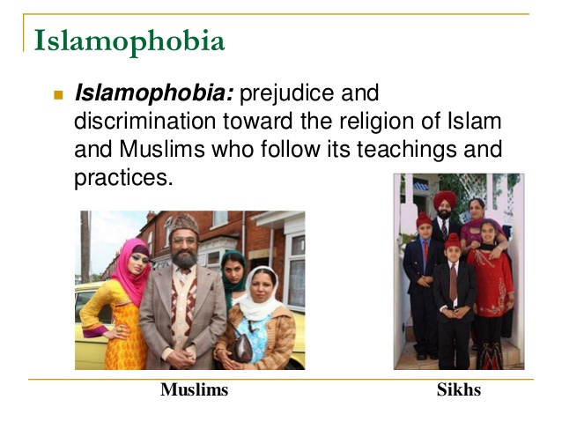

Slide 3
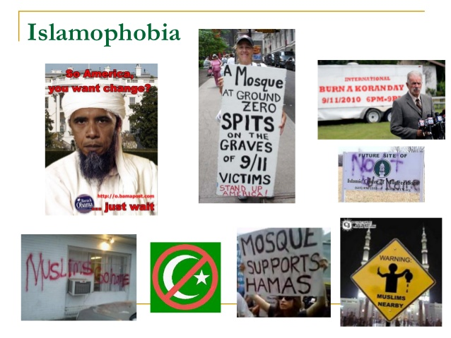

Slide 4
Supporting Religious Pluralism
Educate yourself about world religions and the history of religion & religious oppression in the United States & other countries throughout the world.
Educate yourself to the need & experiences of people from many religious /spiritual backgrounds as well as those who do not ascribe to “mainstream” religions. Listen without defensiveness. Do not attempt to change their perspectives – these are their experiences, beliefs, and meanings that they have made and therefore, are not up for debate.

Slide 5
Supporting Religious Pluralism
Put yourself in the shoes of religious minorities and those who do not ascribe to “mainstream” religions, especially during major Christian holiday seasons. Attempt to experience those seasons from their perspectives. What do you perceive?
Attend events of faith practices other than your own.
Beware of the generalizations you make about religious groups as well as those who do not practice “mainstream” religions. Assume that there are people from a wide-range of belief systems in your workplace, school, and so forth.

Slide 6
Supporting Religious Pluralism
Monitor media, politicians, and organizations to assess their level of sensitivity to belief inclusion.
Encourage belief inclusion in your workplace, in your political representatives, in your school, in your social networks, and at home.
As we learn more about other people and their beliefs, customs, and consciousness maybe we will experience a more just, equitable, and peaceful world.

