Slide 1
Judaism, Islam, And Other Expressions of Religious Pluralism
Contemporary Context

Slide 2
Introduction
The U.S. is rightly described as the “world’s most religiously diverse nation”
  Hundreds of religious groups and thousands of religious communities & churches
Each American religious group has political objectives
  Each exercises political influence
Part of this pluralism includes those reject formal and/or organized religion
  Nones; organized secular and atheist orgs
Divide smaller religious movements into three groups
  Judaism & Islam; separatist religious traditions; & non-separatist religious traditions

Slide 3
Judaism & Politics
Jews are the most successful members of minority groups in the U.S.
  Rank high on every aggregate socioeconomic measure, including income, educational attainment, and professional status
  Moved into positions of prominence in business, law, higher education, journalism, entertainment, and politics
Constitute less than 2% of the U.S. population
  Jewish voting strength makes it largest impact only in cities and states where their numbers are concentrated
  Some cases, Jewish influence is enhanced by broad support by Christians – such as support for Israel

Slide 4
Judaism & Politics
Jewish Americans have an impact on American politics beyond what their small numbers suggest
  Openness to involvement in politics, substantial financial contributions to politicians & political candidates, willingness to get organized for political causes & candidates
Religious Jews fall into one of three major groupings
  Reform (41%); Conservative (29%), Orthodox (18%)
  Most Jews are secular or live a secular life; up to 1/3rd of Reform Jews have left
    High interfaith marriages among Reform & Conservative Jews
    However, Orthodox communities are steadily growing
  All Jews voice strong opposition to govt interaction with religion

Slide 5
Judaism & Politics
Most Jews have a well-deserved reputation for political liberalism
  78% for Obama in 2008; 69% for Obama in 2012;
  Serve as Democratic leaders & active in liberal interest groups
  Support for minority rights is a hallmark of Jewish politics
    Secularized ethic rooted in historic religious Judaism
Exercise political power through a host of robust orgs; political pluralism
  American Jewish Committee is a liberal org; though Orthodox and ultra-Orthodox often oppose liberal social policies & sometimes vote Republican
  Support for Israel is a cause for numerous liberal Jews – politics of Zionism

Slide 6
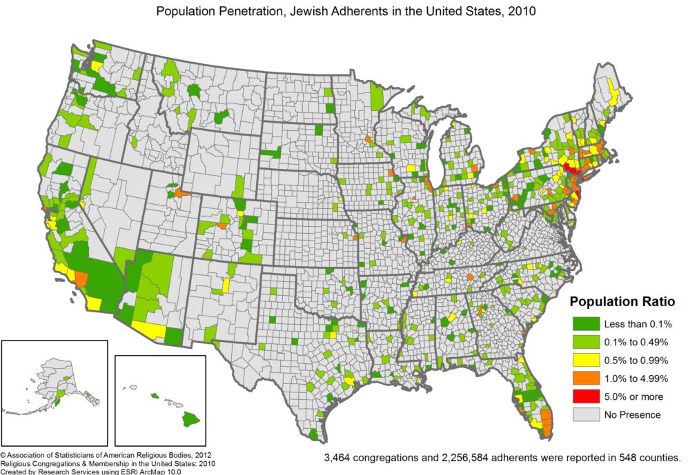

Slide 7
Islam & Politics
Islam received a great deal of media attention since the 9/11 attacks
  Population is estimated between 3 and 7 million; though difficult to estimate
  1% of the population, though number is growing rapidly
  More than 2,100 mosques and Islamic religious centers
Authors posit that Muslim Americans are on the low end of in terms of income and educational attainment
  I disagree given the research
Remarkable ethnic diversity – does limit their ability to organize effectively

Slide 8
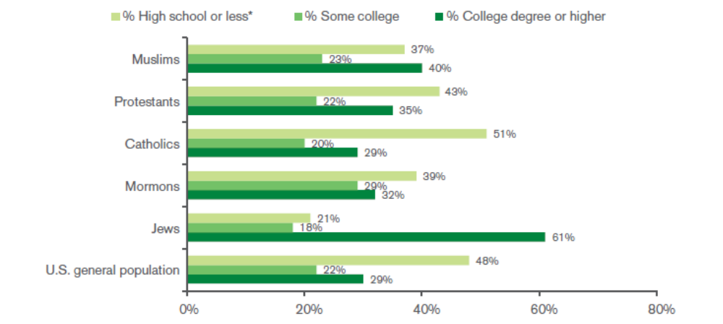
High rates of college education among Muslims

Slide 9
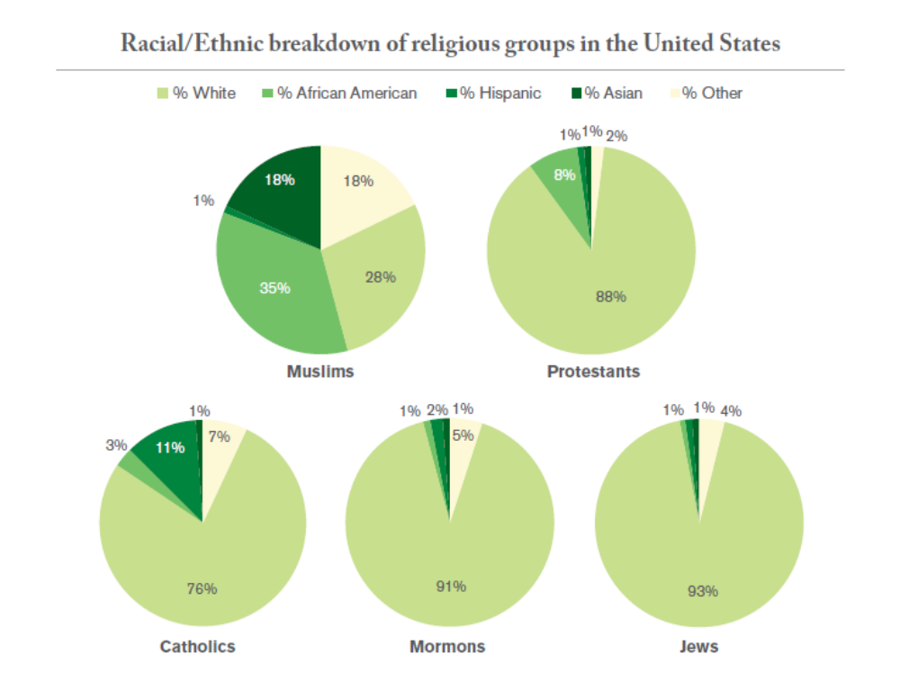
Muslim Americans are Diverse

Slide 10
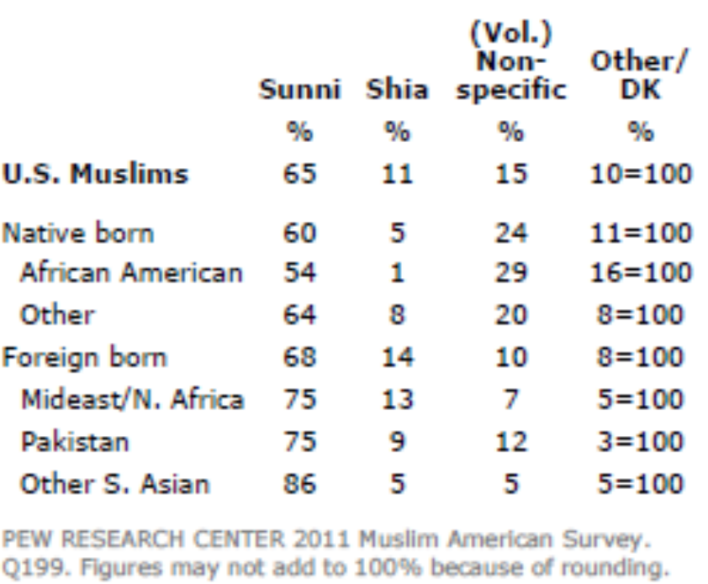
Islam & Politics
65% report to be Sunni
  Arab & South Asian Americans
11% report to be Shi’a
  Iranian & some Pakistani Americans
15% report to be Non-specific
  Those who admonish any label (~Islamists)
10% report Other/Don’t Know
  African Americans transitioning from the Nation of Islam

Slide 11
Islam & Politics
65% of Muslim Americans are foreign born
  Yet 70% are citizens; most immigrant Muslims naturalize
Muslim Americans are generally geographically dispersed throughout the U.S.
  Highest absolute number of Muslim Americans are in California, followed by New York, Illinois, Michigan
  Northern California (bay area) may be home to the highest absolute # of Muslims
Most densely populated area is Dearborn, MI
  Considered the heart of Muslim and Arab America
  Immigrants from the Middle East brought over by Henry Ford to work at the Ford Motor Company

Slide 12
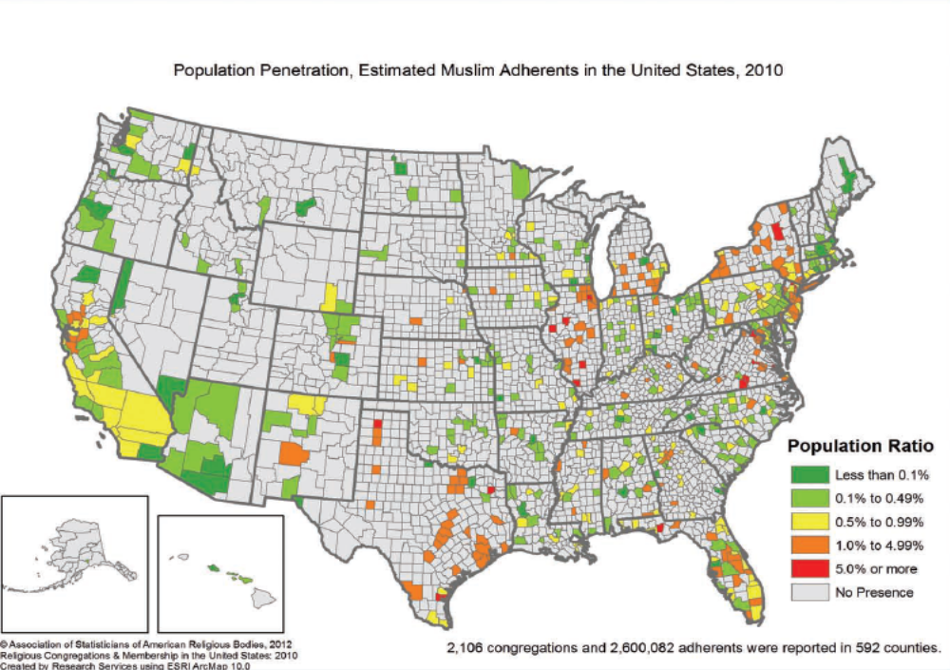

Slide 13
Islam & Politics
Muslim American groups primarily focus on protecting civil liberties & rights
  MPAC, CAIR, AMA
The 9/11 attacks have changed the political dynamics for Muslim Americans
  Threat = Mobilization; collective Muslim political muscle
Religious Muslim Americans voted for Bush in the 2000 election
  However, they voted against Bush in the 2004 election
Muslim Americans voted in high levels for Obama in the 2008 & 2012 elections
  Some argue though that this was a default choice

Slide 14
Islam & Politics
Ideologically & socially conservative
  Though an alliance with Evangelical conservatives is highly unlikely
Foreign policy concerns are still ethno-nationalist in nature
  Strong, universal support among Muslims for the Palestinian cause
Political leverage will remain limited
  Lack of knowledge about Islam: Most American have little to no knowledge of what Islam is, its pillars and what Muslims do
  Unfavorability towards Islam: See Muslims as dangerous, violent and hateful fanatics
  Continuing attempts to commit terror by Muslim extremists against American targets
  Mass Media Portrayals of Arabs, Islam and Muslims: Arab & Muslim stereotypes overlap in movies

Slide 15
Separatist Religions
Separatist: religious communities that set stricter moral boundaries for their members than do mainstream religions
  Separate members of the religious group from the larger society to a degree
Two types of separatist groups:
  Religious traditions whose members share a common history or ethnic origin
    Amish are a good example; practice political disengagement
  Groups with no such “built-in” basis for unity; substitute some other foundation to fashion a tightly bound community

Slide 16
Separatist Religions
New religious movements, or “cults”
  Cult has a prejudicial meaning as it is always used in a negative way
  New religious movement or unconventional religion
Often headed by a charismatic leader that people are willing to follow
  Often shun politics, but can come into conflict with the state
  Branch Davidian community in Waco, TX; FLDS communities in Utah & Arizona
  Unification Church (moonies), Christian Identity movement
Other small religions
  Wiccans, Native American religious traditions; Fellowship of Metropolitan Community Churches

Slide 17
LDS (Mormons) & Politics
Mormons are major players in modern religion and politics
  Size and steady growth in church membership; 1.7%-2% of the total U.S. population
Unconventional religious group overcoming tremendous disadvantages
  Early days, Mormons has no political influence
There is debate about where Mormons fit in the rest of the Christian tradition
  Impeded efforts for Mormons to reach across religious barriers for political purposes
History of the Mormon church is intensely political

Slide 18
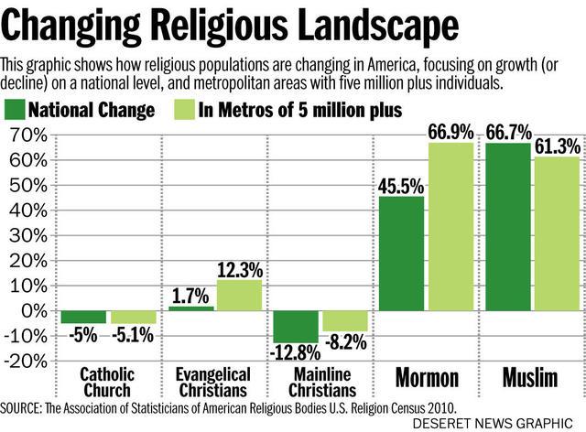

Slide 19
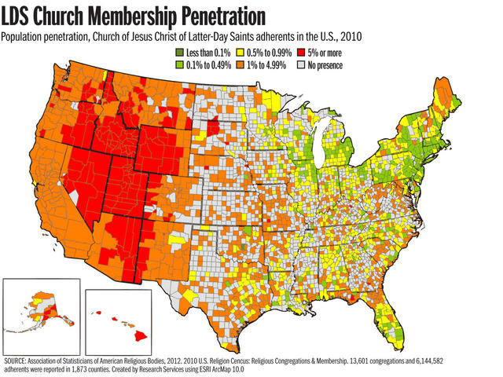

Slide 20
LDS (Mormons) & Politics
  Founded by Joseph Smith in 1830. Latter-Day Prophet
  Book or Mormon explains the history of a tribal branch of Israelites who came the Americans. Tribe was visited by Jesus Christ & were eventually destroyed because its members failed to follow God’s will
  Holy Trinity – maintain that they are separate entities & not three-in-one; baptism for the dead; celestial marriage; doctrine of polygamy
These theological differences led to clashes with other Christian denominations
  Led to Mormons leaving the U.S. for the Utah Territory
  State of Deseret applied 3 times; rejected each time

Slide 21
LDS (Mormons) & Politics
Woodruff Manifesto in 1890 outlawing polygamy after the U.S. Congress disincorporated the Mormon Church
  Major turning point for Mormon involvement in politics
  Slowly incorporated into the political system; Mormon’s People Party
Socially conservative & strong identification with the Republican Party
  Typically middle-class, well-educated, overwhelmingly white
Politically active & often work behind the scenes on certain issues
Romney candidacies for Presidency changed Evangelical views on Mormons in politics
  Received 80% of the evangelical vote in 2012

Slide 22
Jehovah Witnesses
Witnesses practice political disengagement in modern politics
  Were key in a number of legal victories about state infringement in religion & religious freedom
Founded by Charles Russell in 1870
  Intensive evangelism & communal ethics have led to steady growth
  Unusually integrated racially and ethnically
Witness theology contends that though Christ is the son of God, Christ in not God
  End of the world, there will be 144,000 disciples who will be glorified with God
  The end of the world is so near, that there is no time for politics or government

