Slide 1
Thinking through Christian Privilege
Before class…….
Have students read Schlosser, Lewis (2002) Christian Privilege: Breaking a Sacred Taboo, Journal of Multicultural Counseling and Development 31(1).
Have students complete the Christian Privilege Checklist

Slide 2

Multiple Ways of Knowing & Thinking
Fish are the last to see or even feel the water around them because it is so pervasive, so taken for granted, so “normal.”
So too is privilege for those who have it.
Those who do not have it function marginally outside of the water, and from that vantage point, can understand & perceive the unearned socially-granted privileges of the dominant group(s).

Slide 3
Privilege . . . .
A special right, benefit, favor, advantage, or immunity granted or available only to a particular person or group.
  Granted not earned
In this case, Christian status or background grants this unearned benefit.

Slide 4
Christian Privilege . . . .
Not monothetic
Not a binary (i.e., you either have it or you don’t)
A continuum or hierarchy based on:
  Historical factors
  Numbers of Adherents
  Degrees of Social Power (Blumenfeld)

Slide 5
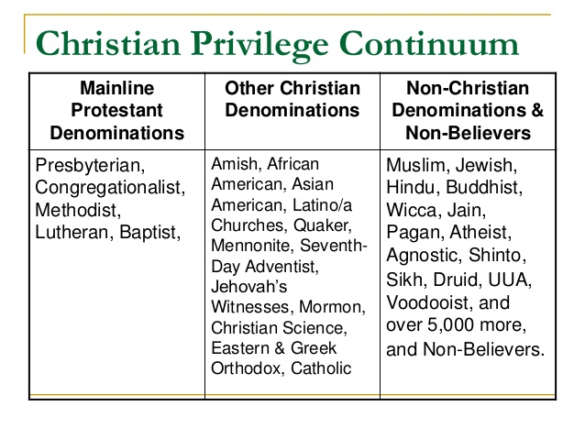

Slide 6
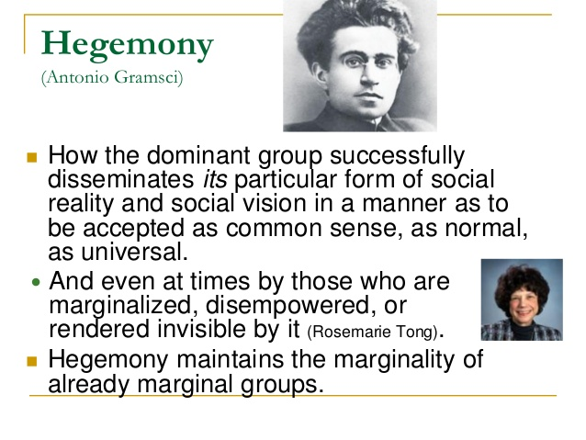

Slide 7

Christian Hegemony is . . . .
A system of advantages bestowed on Christians.
It is the institutionalization of a Christian norm or standard, which establishes and perpetuates the notion that all people should be Christian thereby privileging Christians and Christianity, & excluding the needs, concerns, ethnic/religious cultural practices, & life experiences of people who are not Christian.
Can be overt or subtle

Slide 8
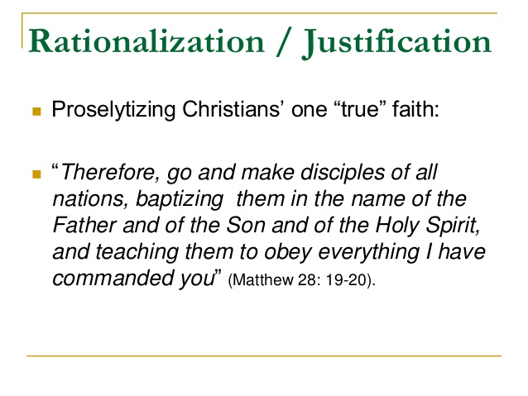

Slide 9


Slide 10
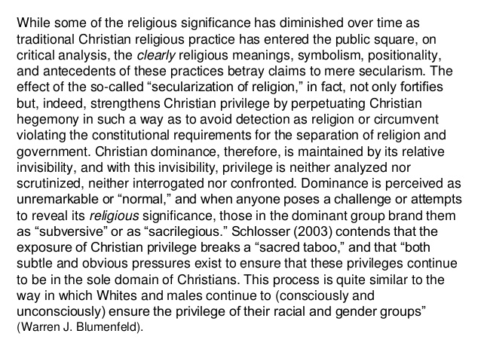

Slide 11
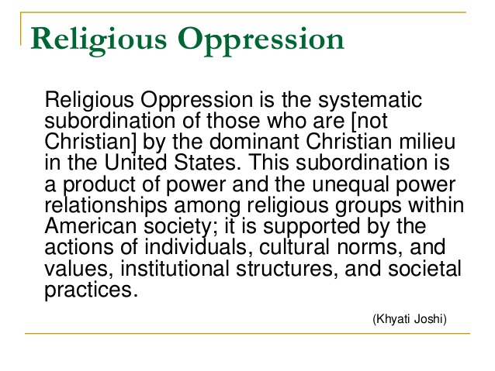

Slide 12
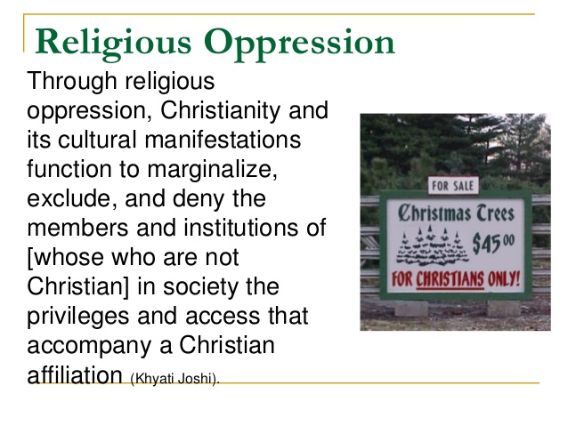

Slide 13
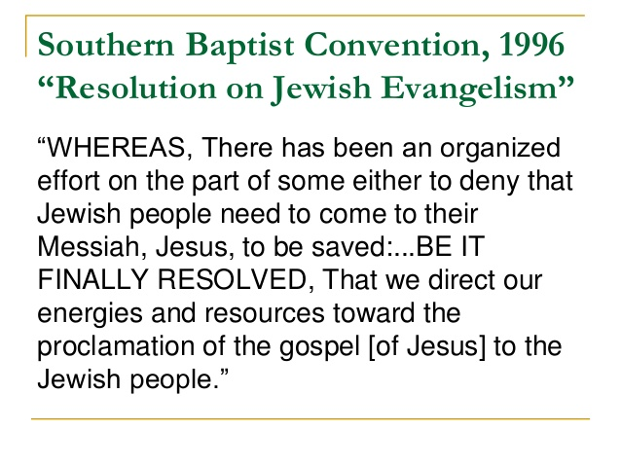

Slide 14
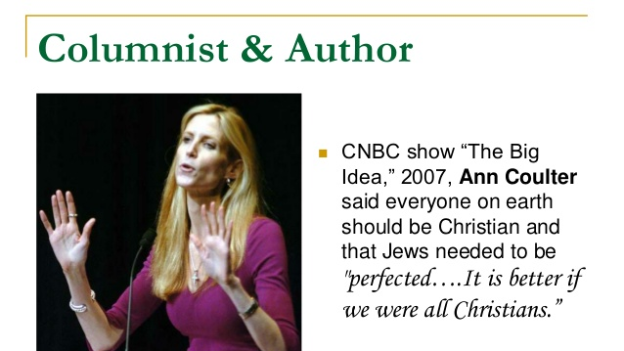

Slide 15
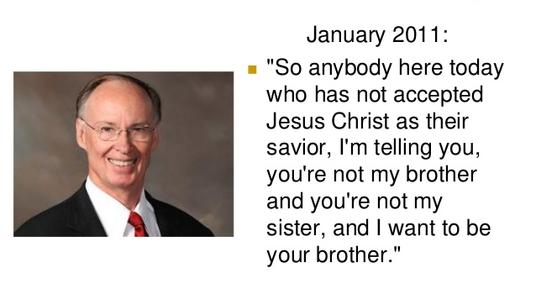

Slide 16
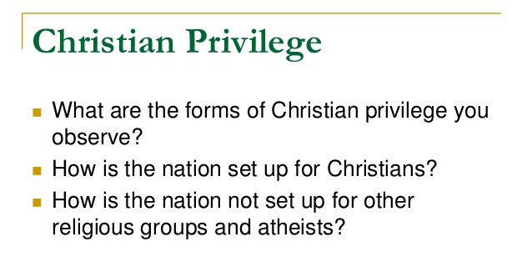

Slide 17
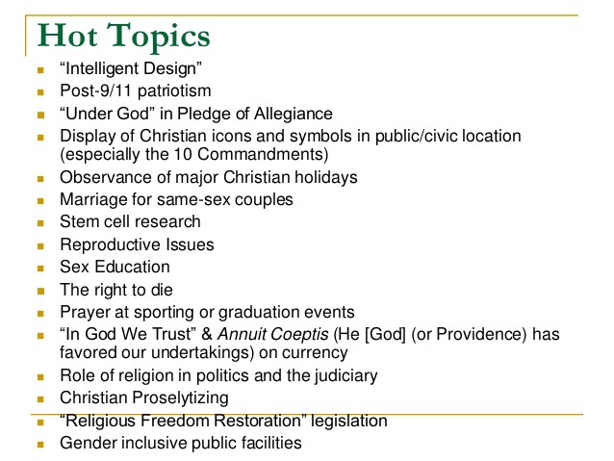

Slide 18
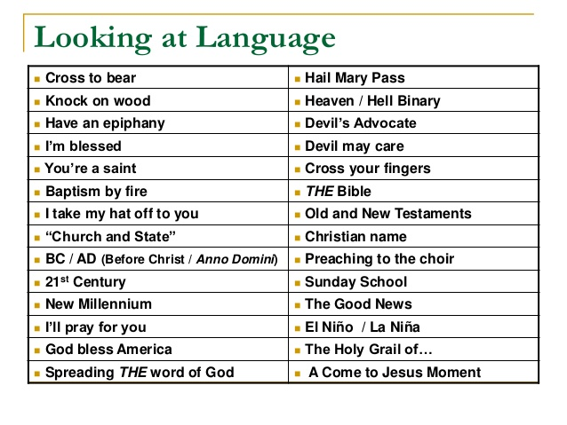

Slide 19
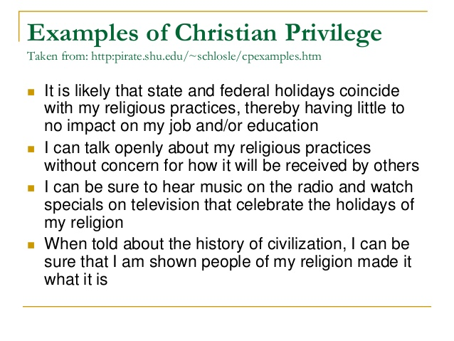

Slide 20
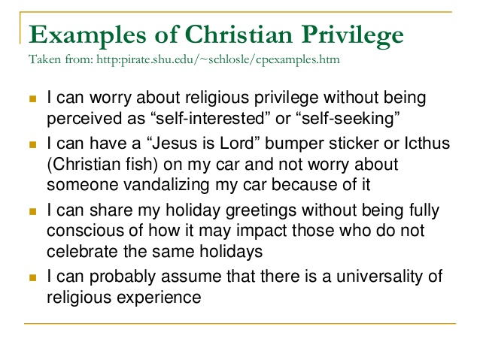

Slide 21
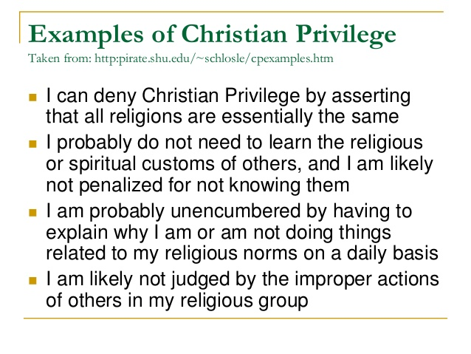

Slide 22
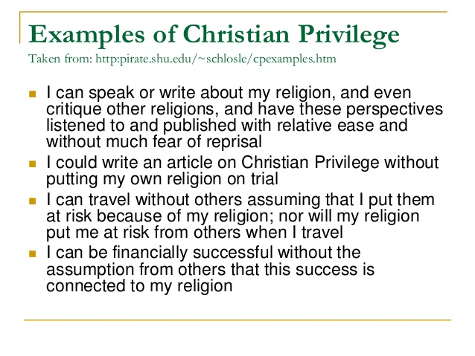

Slide 23
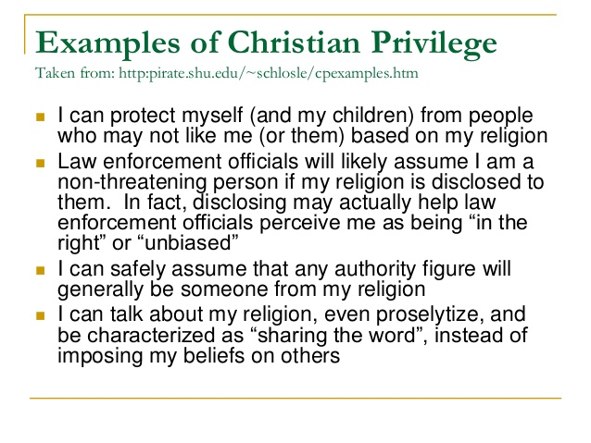

Slide 24
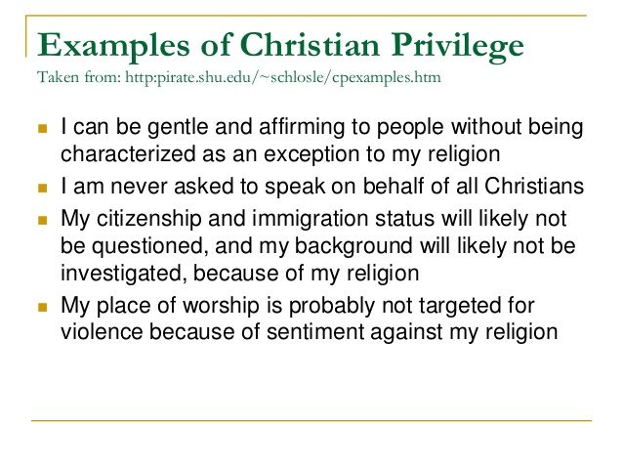

Slide 25
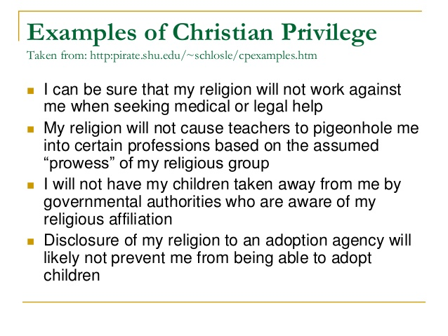

Slide 26
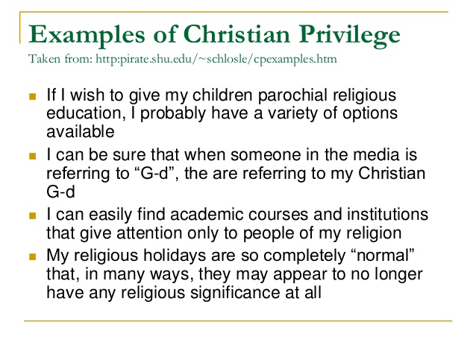

Slide 27
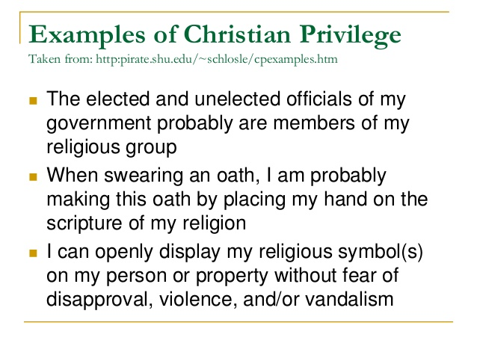

Slide 28
Supporting Religious Pluralism
Educate yourself about world religions and the history of religion & religious oppression in the United States & other countries throughout the world.
Educate yourself to the need & experiences of people from many religious /spiritual backgrounds as well as those who do not ascribe to “mainstream” religions. Listen without defensiveness. Do not attempt to change their perspectives – these are their experiences, beliefs, and meanings that they have made and therefore, are not up for debate.

Slide 29
Supporting Religious Pluralism
Put yourself in the shoes of religious minorities and those who do not ascribe to “mainstream” religions, especially during major Christian holiday seasons. Attempt to experience those seasons from their perspectives. What do you perceive?
Attend events of faith practices other than your own.
Beware of the generalizations you make about religious groups as well as those who do not practice “mainstream” religions. Assume that there are people from a wide-range of belief systems in your workplace, school, and so forth.

Slide 30
Supporting Religious Pluralism
Monitor media, politicians, and organizations to assess their level of sensitivity to belief inclusion.
Encourage belief inclusion in your workplace, in your political representatives, in your school, in your social networks, and at home.
As we learn more about other people and their beliefs, customs, and consciousness maybe we will experience a more just, equitable, and peaceful world.

