Slide 1
Open University:
Summer Enrollment Process

Slide 2
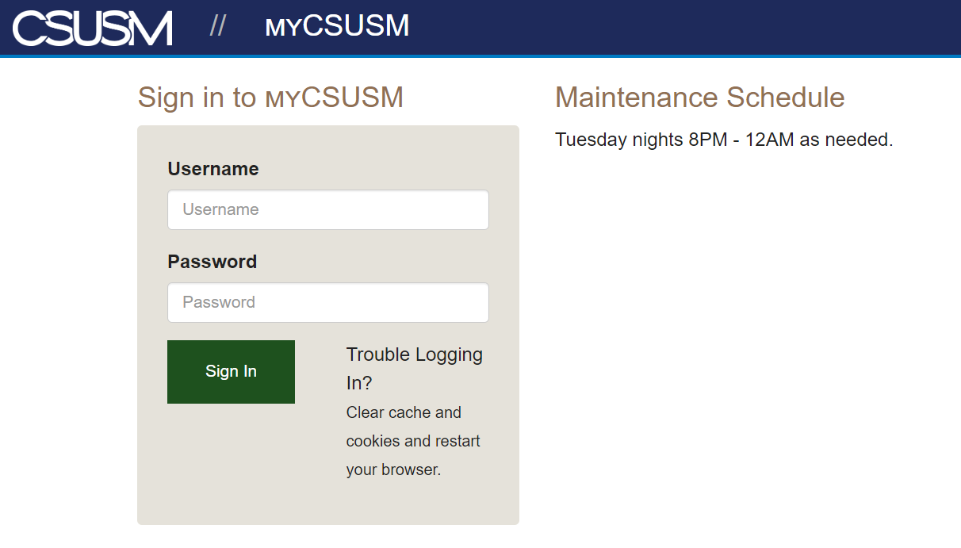
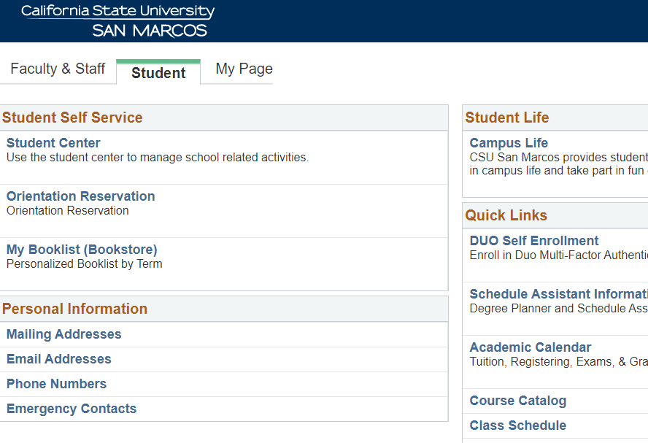
My CSUSM: Student Center
Log onto
https://my.csusm.edu/
Click
Student Center

Slide 3
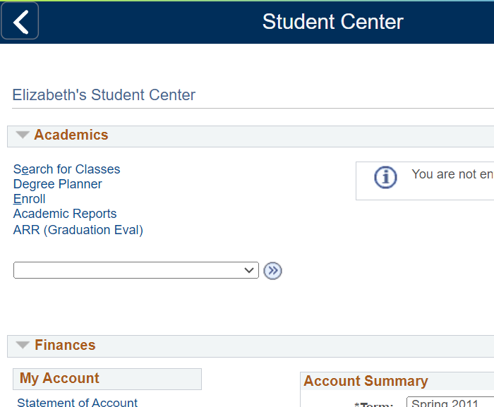
Student Center
Click Enroll

Slide 4
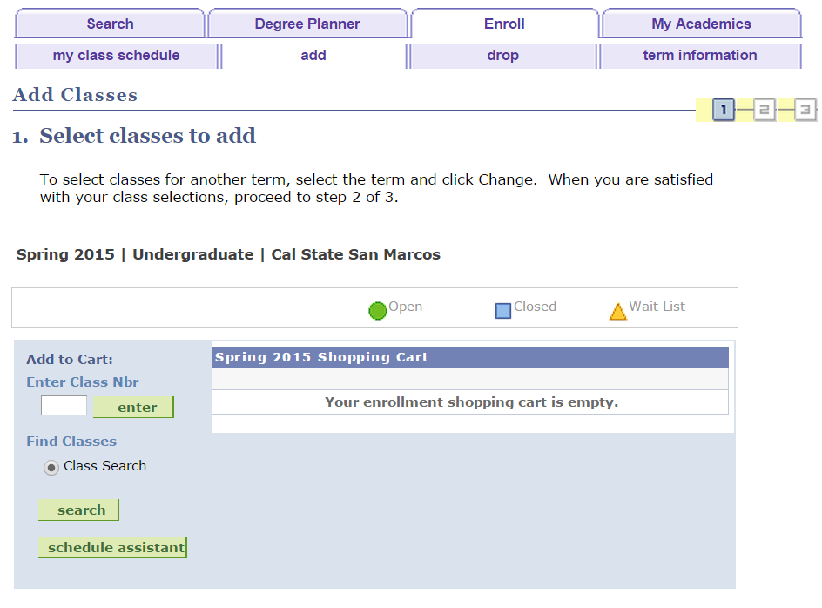
From the enroll tab:
Searching to enroll
You can use the green ‘search’ button since it will allow you to ‘select’ courses directly from the schedule.
Click ‘search’ to Begin

Slide 5
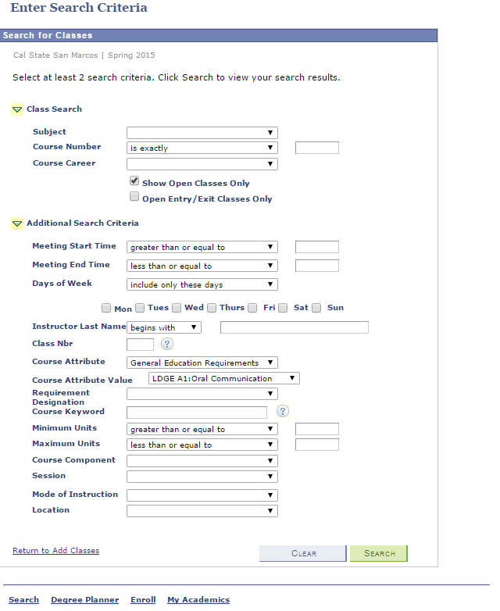
Searching by GE requirement &
Searching by Mode of Instruction
Search for a major course by choosing the Subject
Course Career =Undergraduate Now click on search button below
This student is searching for the A1 requirement by clicking on the Additional Search Criteria arrow
Course Attribute: ‘General Education Requirements’;
Course Attribute Value: ‘LDGE A1: Oral Communication’
Or for a major course choose the Class Subject at top to perform your search
You can also try and search a particular course by mode of instruction such as on-line, in person. But be aware that it is often not possible to find all courses in the mode you prefer!

Slide 6
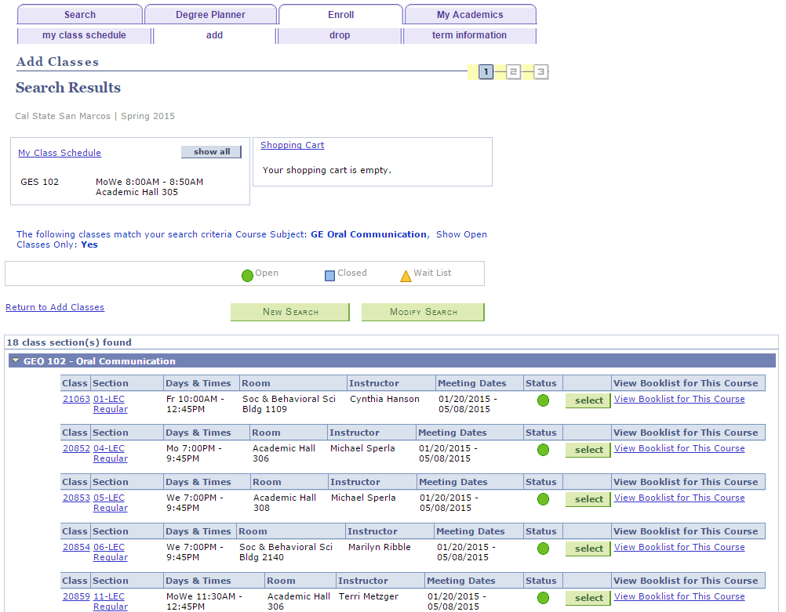
Select A Class
To continue enrollment click ‘select’

Slide 7
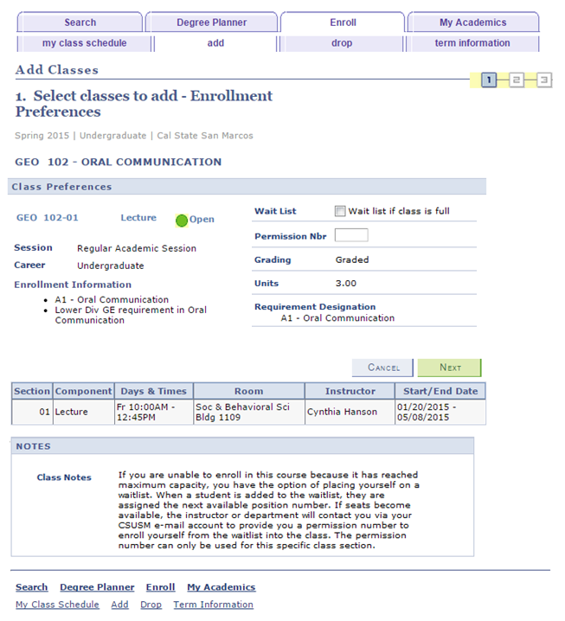
Completing Enrollment
Check the waitlist box only if the course is currently full and you wish to be added to the waitlist, then finish the enrollment steps to be placed on the course waitlist.
Class ‘NOTES’ will have special information for the term and should be reviewed.
If the class requires Instructor Consent or is added during the add/drop period you will add the Permission Nbr here.
Continue the enrollment process, click ‘NEXT’.
Notes:
Like the use of colors that match the button! ☺

Slide 8
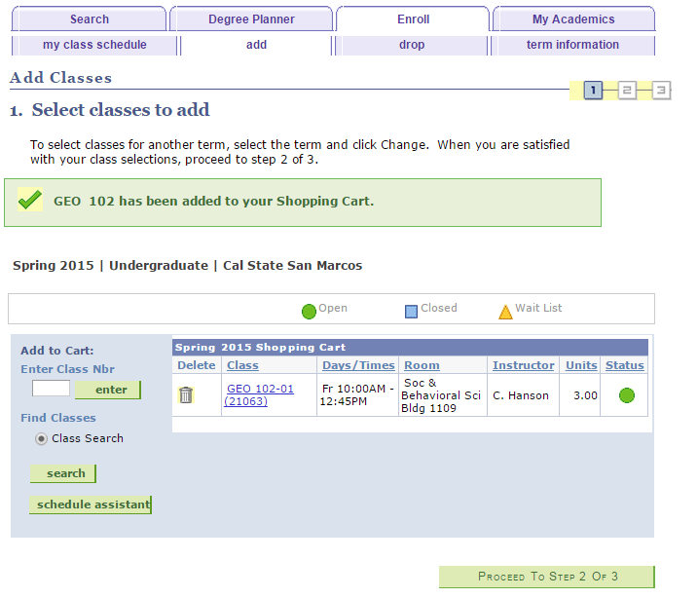

Class moved to Shopping cart….
Click ‘Proceed to Step 2 of 3’ for EACH class
Just because a course is in your shopping cart it DOES NOT mean you are enrolled!
Continue the enrollment process.
Notes:
Very good!

Slide 9
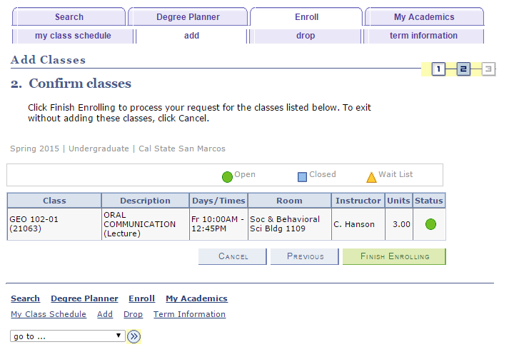
FINISH ENROLLING….
Click ‘FINISH ENROLLING’

Slide 10

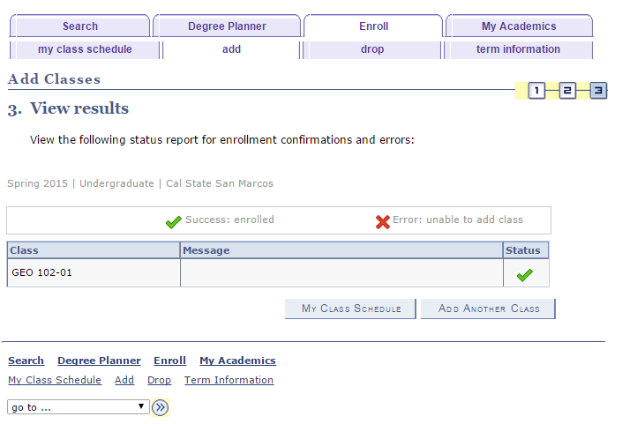
You ONLY Have the class when you see a
Repeat the enrollment process for each course you wish to enroll in by clicking on the ‘Add Another Class’ button otherwise click on ‘My Class Schedule’.
Congratulations you successfully Enrolled!!!

Slide 11
From the enroll tab:
You can also enroll by entering the 5-Digit class number and then finishing the enrollment steps.
Enrolling directly into class
Type in ‘Class Number’ here, and click the ‘enter’ button

Slide 12
Extended Learning Courses
Always check with Financial Aid before enrolling into a course designated as “EL” (Extended Learning)
EL courses have a different cost structure associated with them.

Slide 13

Have QUESTIONS
Open University Registration: elregistration@csusm.edu
General Information: el@csusm.edu

