Slide 1





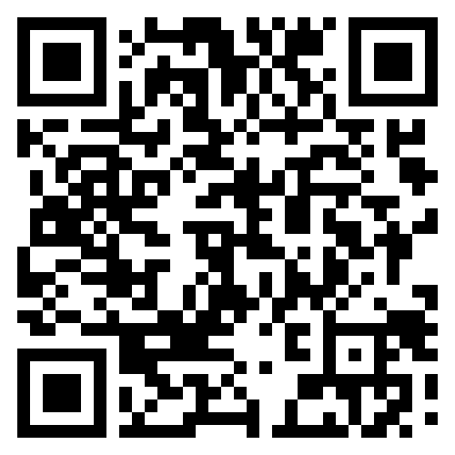

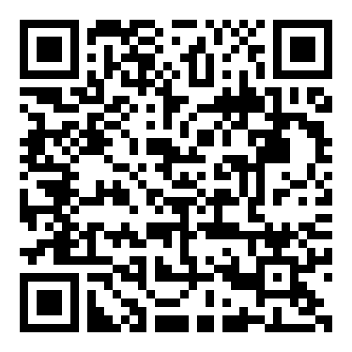
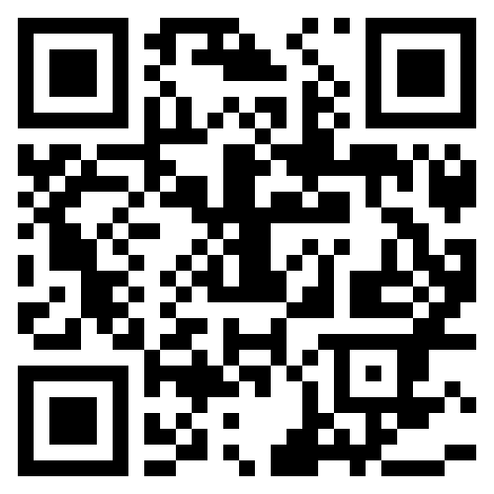


Information for
Child & Adolescent Development Majors
Child & Adolescent Development (CHAD) Program at CSUSM
The CHAD major in the Psychology Department focuses on the scientific study of developmental processes that occur from conception through the end of adolescence.
CHAD classes focus on research in developmental science.
CHAD graduates receive an excellent foundation for subsequent careers working with children, adolescents, and their families in various fields.
Major Requirements
Required Core Courses (15 units)
PSYC 331 | Infancy & Childhood
PSYC 349 | Adolescence: Theories & Research
CHAD 370 | Risk & Resiliency in Childhood/Adolescence
CHAD 491 | Children, Adolescents, & Social Policy
Laboratory Course (CHAD 496 or PSYC 395)
Upper Division Requirements (18 units)
Select 1 course to fulfill each of the clusters:
Cluster A | Atypical Child & Adolescent Development
Cluster B | Contexts of Child & Adolescent Development
Cluster C | Understanding Others
Cluster D | Intrapersonal Development
Cluster E | Research/Working with Children & Adolescents
Elective | CHAD 496, PSYC 395, or any Cluster A-E course not already taken
Lower Division Requirements (15 units)
PSYC 100 | Introduction to Psychology
PSYC 210 | Child Growth & Development
PSYC 215 | Child, Family, & Community
PSYC 220 | Introduction to Statistics in Psychology
PSYC 230 | Research Methods in Psychology
Breadth Requirement (3 units)
Select an upper-division Social Science (DD designated) course outside of the major and in a discipline other than Child & Adolescent Development or Psychological Science. This course may be used to meet the UDGE DD requirement.
Minimum Grade of “C”
You must earn a grade of “C” or higher in every course
in order to count it toward the major.
If you earn a “C-” or lower, you will have to repeat
the course.
Language Proficiency (0-9 units)
This requirement can be met in one of eight ways. See CHAD Major Worksheet on website.
Transfer Students!
Will your transfer courses meet the lower-division requirements for the major?
For articulation with community colleges, visit www.assist.org
Background Check Requirement
CHAD 496 will take place at a setting that requires background checks including: (1) fingerprinting and background check through LIVESCAN, (2) Tuberculosis test, (3) Proof of MMR immunity, (4), Tdap immunization, (5) Flu shot. This process must be completed no later than 6 weeks before the start of the semester in which a student enrolls in CHAD 496.
Setting Yourself Up for Success
Plan to spend at least 8 hours per week for each 3-unit course. For a full load of 5 classes, this is a minimum of 40 hours per week devoted to school. Consider taking 4 classes for school-work-life balance and staying on track to graduate by taking courses in summer sessions.
Stay connected and gain assistance by visiting your professors’ office hours, get assistance with statistics or research by visiting PARL, and get involved in university and department activities.
Helpful Resources
CHAD
Website
Psychology
Website
PARL
Website
Student Services & Resources Website
@csusm_psyc

