Slide 1

Axiom How To
Q3 Overview & Reports
University Budget Office – Last Revised 4/17/2025

Slide 2

Agenda
Q3 Overview
Forecasting
Axiom Reports
Using Axiom to Reconcile
Demo
Q&A welcome throughout
Please don’t be shy!
Notes:
Q&A Throughout, participation is encouraged, please don’t be shy!
You are encouraged to log into Axiom now, if you haven’t already, and follow along

Slide 3

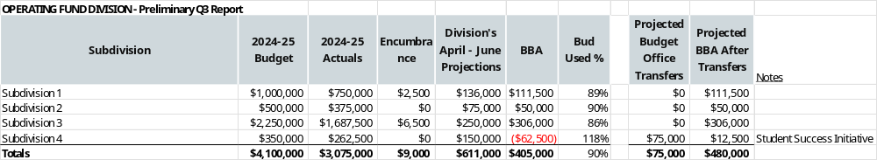
Q3 Report Overview – General Guidelines
Budget Office complies preliminary report and shares results with Divisions
Compiled with Axiom IYF Data – Please update projections
Used to ensure adequate funds available for remainder of year
Estimates year-end carryforward
Notes:
CSU policy dictates that budget reviews occur during the fiscal year that compare budgeted and actual revenues and expenditures and take action to resolve any discrepancies. These reviews must be documented and occur at least once per quarter.
The Q3 Reforecast will provide a review of Q1 through Q3 budget and actuals (9-months) and a forecast of remaining year activity (3-months). Q3 report is compiled using Axiom data for the Operating Fund. For other funds, the Q3 forecast will be compiled using a pro-rata portion of the forecast from mid-year.
For this portion of the training, we are going to focus on the Q3 process for the Operating Fund.
The Budget Office will compile a preliminary Q3 reforecast using Axiom and share results with divisions.
At the bottom of this slide is an example of the preliminary report looks like.
Budget , actuals, encumbrance, and projection, and BBA data was pulled from Axiom at the end of Q3
We added a column for projected transfers from the Budget Office. These are anticipated transfers for centrally held funds. We added notes to the right for any transfers indicated here. Please look these over and let us know if any changes are needed to the transfers section.
Divisions will have an opportunity to update projections in Axiom after report is shared.
The Budget Office suggests making updates to projections in Axiom if subdivision projections vary from current Axiom projections by 5% or $20,000 (whichever is greater)
Information will be used to ensure adequate funds are available for the remainder of the fiscal year and to estimate year-end carryforward

Slide 4

Q3 Overview – Centrally Held Funds
Project Expenses
Do NOT project transfers
Note in Axiom comments section if this creates a deficit
Notes:
Please project expenses for relevant centrally held funds.
Do not project transfers of centrally held funds from the Budget Office to your division / subdivision. If projected actuals cause a deficit because funds have not yet been transferred to your department / division, please make a note in the Axiom comments section.

Slide 5

Q3 Overview – Payroll / Compensation
Include compensation increases in projections
  GSI / IRPs / reclasses, promotions, etc.
Positive pay salary projections should NOT include June earnings
HR Actuals Report can be used for payroll analysis
Notes:
Compensation increases (IRP's, reclasses, promotions, GSI, etc.) should be included in your projections.
Positive Pay salary projections should not include June earnings. Positive pay is overtime, student assistants, special consultants, etc. December – May earnings should be projected, as they will be paid in January – June. June positive pay will be paid in July using the 2025/26 Budget. The HR Actuals Report can be used for payroll analysis. The Budget Office can assist with any additional payroll analysis, if needed.

Slide 6

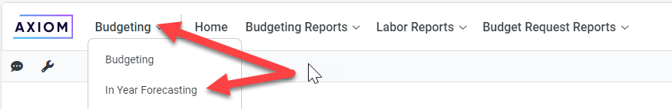
Log in from edge browser:
IYF Home Page (axiom.cloud) or https://csusm.axiom.cloud/
Forecasting –
Update frequently for best results
Navigate to In Year Forecasting:
Notes:
Q3 updates need to be completed in the Axiom In-Year-Forecasting model
This can be done as frequently as desired
We recommend updating forecasts monthly to maintain accuracy and reduce workload at midyear and other reporting periods

Slide 7
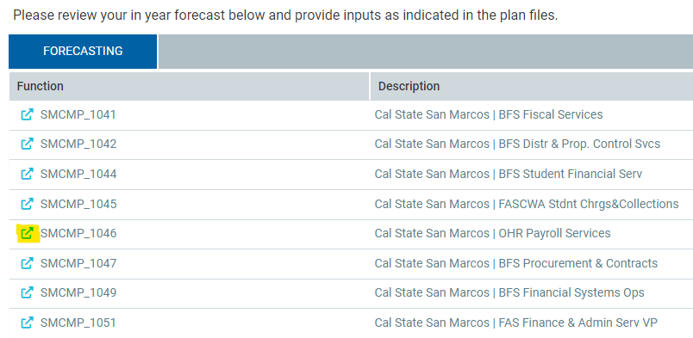
Select a department by clicking on the arrow in front of the department number:
Notes:
Here’s a quick review of how to navigate in In-Year-Forecasting

Slide 8
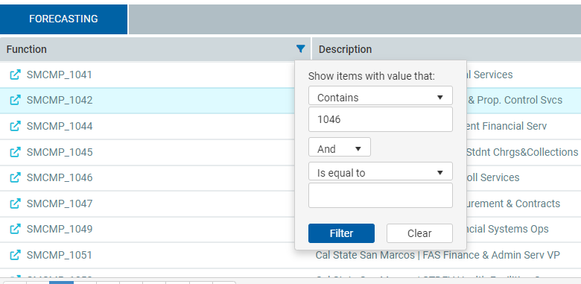
To search for a department, click the filter icon, select “Contains” in the first dropdown and enter the department number:

Slide 9
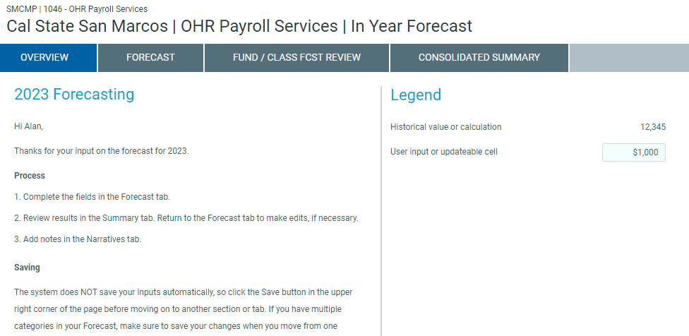
Select the Forecast tab:

Slide 10
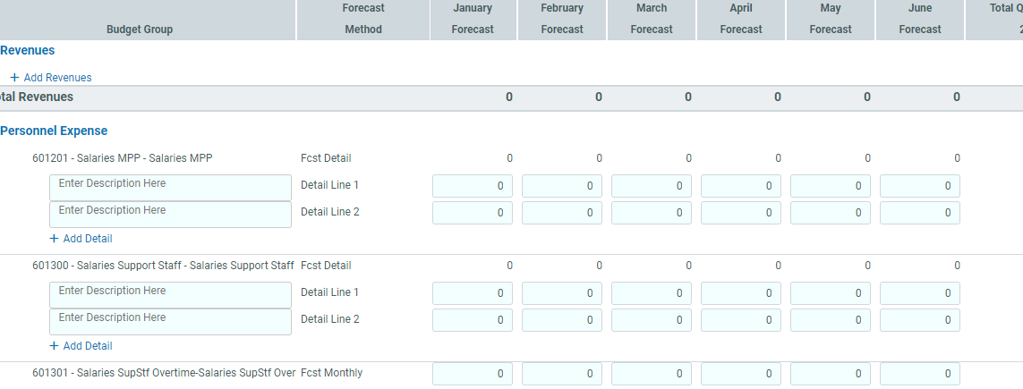
Enter the projected expenses for each account listed for remaining months:
Notes:
The Forecast tab has many columns including the past 2 years of actual expenses, current budget, year to date actual expenses,
actual expenses by month to date, projected expenses by month, encumbrance, budget balance available and comments.
Navigate to the right to see the empty cells where projected expenses by month can be entered for the remaining months in the fiscal year and enter the projected expenses for each account listed
Only months that have not been closed will have editable fields. Once a month is closed, that month’s prior forecast is replaced with Actuals.
Accounts such as “601201 – Salaries MPP” use a Forecast Method called “Fcst Detail” and can have additional detail lines entered as shown in the example above. Entering additional information in these lines is not required by the Budget Office for reporting purposes.
For accounts such as “601301 – Overtime,” only a total monthly amount can be entered.
To add detail under an account with this capability click “+ Detail”
A limitation to the use of detail lines is they will not carry forward to the next fiscal year, so if you take the time to add individual employee salaries, for example, understand that you will need to repeat those steps for the new year to continue using those lines.
Accounts can be universally modified to include the “add detail” functionality at the start of a fiscal year only. Please notify the Budget Office if you would like this added to specific account(s) before year end so we can modify it moving forward.
When entering projections, please split projected expenses between remaining months as relevant, do not enter an expense total into June, for example, unless you plan to spend all remaining funds in that month. Since actuals replace forecasts each month, leaving a large amount as forecasted can negatively skew available balances as expenses post to actuals.

Slide 11
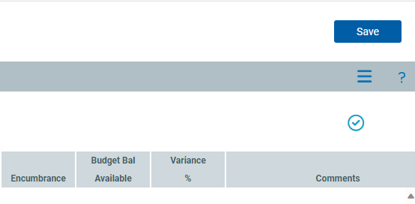


To save your projections, click Save in the upper right corner.
Tip: We encourage users to save their work periodically while in Axiom, as the system may time-out.

Slide 12

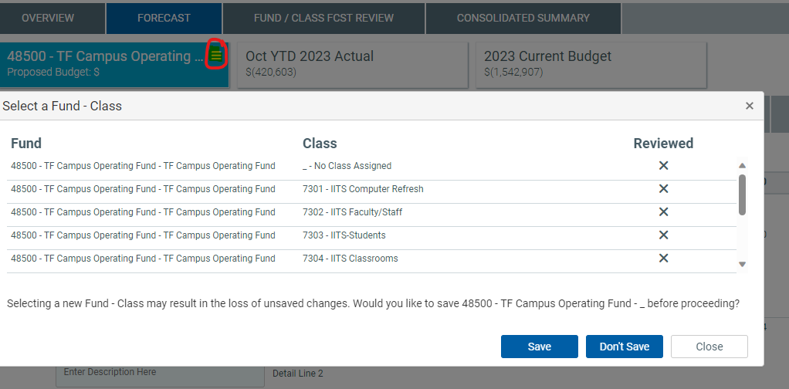
Additional Steps are needed for Departments with Class Codes:
Notes:
If your department uses class codes, forecasts can be entered by clicking on the burger icon by the fund in the upper left corner as shown.
Select the class code you would like to view and click either:
<save> (to save data entered in prior screen) or
<don’t save> (to discard changes made to prior screen) to navigate to forecast screen for that class code
clicking <close> will not select a class code, you will be returned to the forecast screen for “no class code assigned.”
Projections for each class code will need to be entered on the relevant class code page.
Note which class code you’re working in, Axiom will not display this info.
Data Warehouse Note:
When pulling data for your department be sure to display class codes as well so you can see budget and actuals for “no class assigned” as well as any active class codes.
If class codes are used, Axiom will separate actuals in the forecasting screens, and you won’t see the same totals as in Data Warehouse.
You will need to run an Axiom report to view combined totals.

Slide 13

Axiom Reports
Synced with Data Warehouse
Summarize forecasting data
View class code totals
Download and save/email to others
Customizable
Notes:
This brings us to Axiom Reports!
Axiom Reports pull in synched data from Data Warehouse and summarize it with your projections for convenience and accessibility
They allow you to view class code totals and export to Excel for additional analysis and sharing with others
These reports can be customized - the Budget Office can create unique reports to fit your needs
Examples of some existing custom reports we’ve created:
Student Health
Athletics
reports pull in fee revenue data as well as actuals and historical data for convenient analysis in one place
Division Non-Discretionary fees to track received fee revenue
Centrally held funds by Division for Division heads to view approved funds held Centrally by the Budget Office
There are also canned reports available for all users in the Intelligence Center. We hope that after exploring some of the available reports, you’ll be as excited about them as we are!

Slide 14
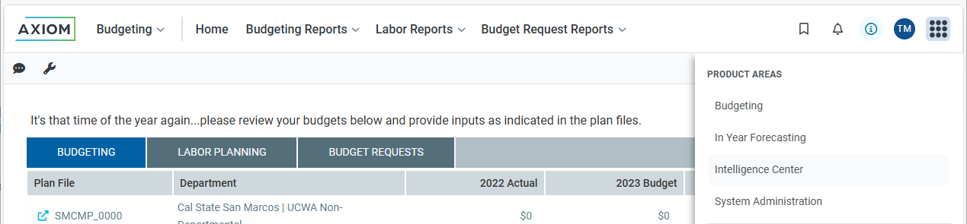
Axiom Reporting
Log in from Edge Browser: https://csusm.axiom.cloud/
Navigate to Intelligence Center:
Notes:
To navigate to available Axiom Reports

Slide 15
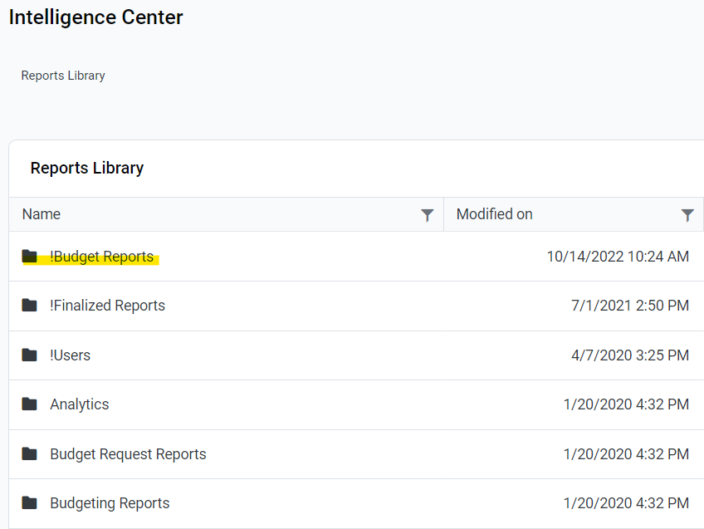
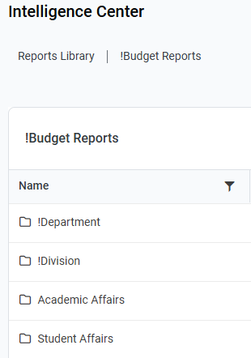
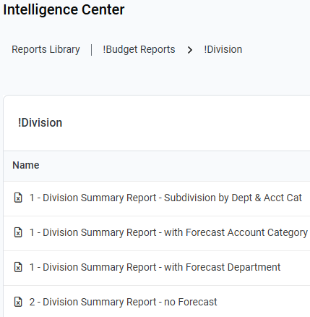
From the Intelligence Center, double click on the Budget report that you would like to use in the “!Budget Reports” menu:
Notes:
Go through the rest of these slides then come back here to do a live demo
Double click on the report that you would like to use. The report will open in Excel. The default Axiom spreadsheet will also open.
Please note that the report may open up behind the default spreadsheet.
Starts with 1: Includes forecast
Starts with 2: Does not include forecast
There really is no need for a "no Forecast" report except for when the new FY has not been set up yet. The forecast reports error out in that situation. Some rely on the Axiom reports for monthly recs, these reports will run even before the FY is set up in Axiom. Thus, the no forecast reports that don't error out.

Slide 16
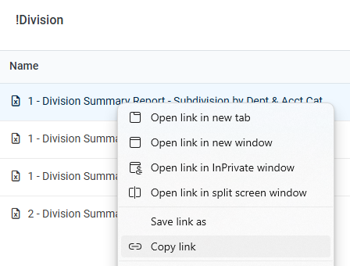
Create a bookmark in Edge for quick access to reports you use often:
Tip: Right click on Report and select “copy link” to create bookmark in Edge
Bookmark a “dummy” page in Edge and edit bookmark, replacing it with the copied link
Notes:
Saving a bookmark in Edge will allow you to bypass going to the intelligence center and searching for your report

Slide 17
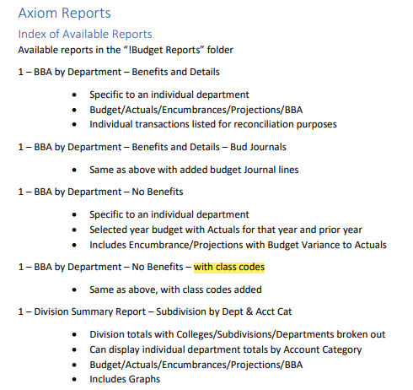
Tip: An index of Axiom Reports describing what each offers can be found in the User Guide on the Budget web page
Click Here for User Guide
Notes:
Axiom reports are intended to provide reporting data to you and your division/department as often as needed.
The index in the Axiom User Guide on the budget web page provides a summary of what’s included in each report
We encourage you to utilize these reports frequently and let us know if there’s a tweak we can make so they better suit your needs.
For instance, the BBA by Dept (no benefits) report highlighted above has been modified to include class codes. We hope this is a helpful addition –

Slide 18
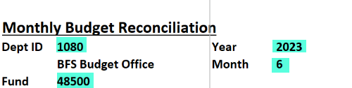
Once you’ve selected a report:
Select the criteria you wish to view and Click <F9> to refresh the data in the report.
Example (from “BBA by Department – no Forecast” report):
Notes:
Axiom reports are intended to provide reporting data to you and your division/department as needed.
Upon selecting a report, fill out your specific division/dept info as well as dates for your desired report, and click <F9> to refresh your report

Slide 19
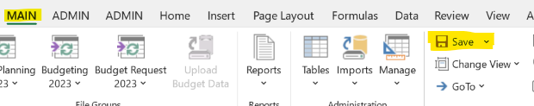
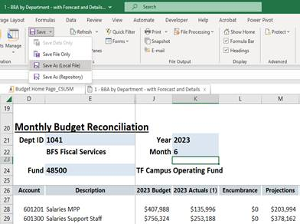
Save report in Excel:
Click down arrow next to Save menu
Save As:
Local File
Notes:
To save a populated report in Excel, from the Main menu, Click the down arrow next to <save> and select “Save As (Local File)”
You can then share/email this report as you would any other Excel file

Slide 20

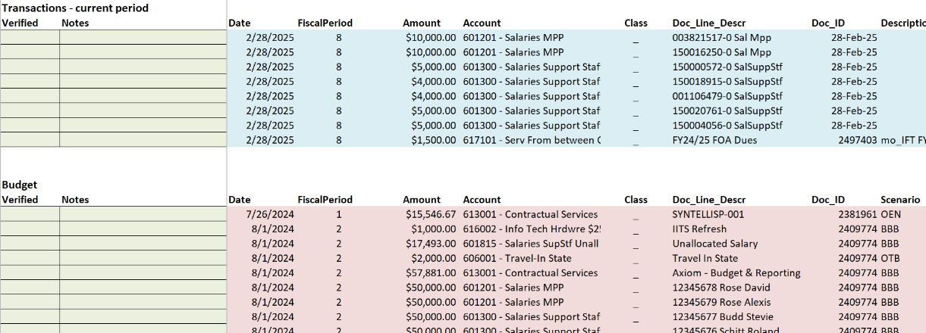
Reconciling using an Axiom Report
Notes:
You can use Axiom to reconcile monthly transactions:
Several department reports include a reconciliation section at the bottom of the report
Journal Lines for reconciling are pulled directly from DW
Save report to local file as shown in the previous slide and use to reconcile
If a variation of this report would be more useful for you (example: you would prefer to see all transactions year-to-date) let us know and we can customize it for you

Slide 21

Help Resources
Budget Office –
Assistance with Axiom use, permissions, and access
budget@csusm.edu
Axiom User Guide
Axiom Training Resources
FSO –
Assistance with Axiom permissions and access
fso@csusm.edu
IITS –
Assistance with system downloads for initial access
Contact for “Admin password required” error
helpdesk@csusm.edu
(760) 750-4790

Slide 22


