Slide 1

Axiom How To
In Year Forecasting
University Budget Office – Last Revised 12/11/24

Slide 2
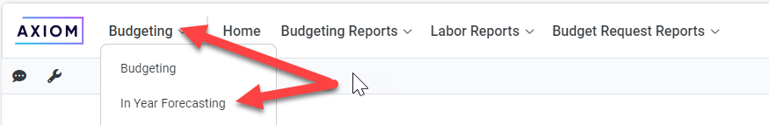
Log in:
IYF Home Page (axiom.cloud) or https://csusm.axiom.cloud/
Navigate to In Year Forecasting:

Slide 3
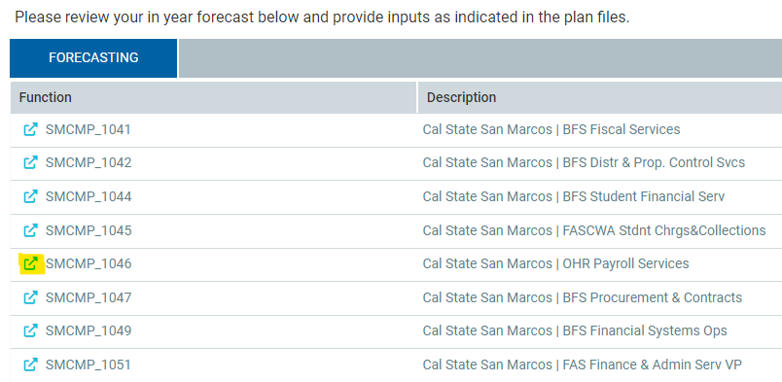
Select a department by clicking on the arrow in front of the department number:

Slide 4
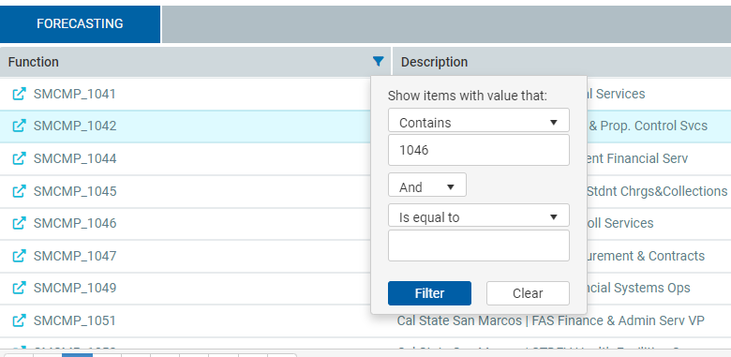
To search for a department, click the filter icon, select “Contains” in the first dropdown and enter the department number:

Slide 5
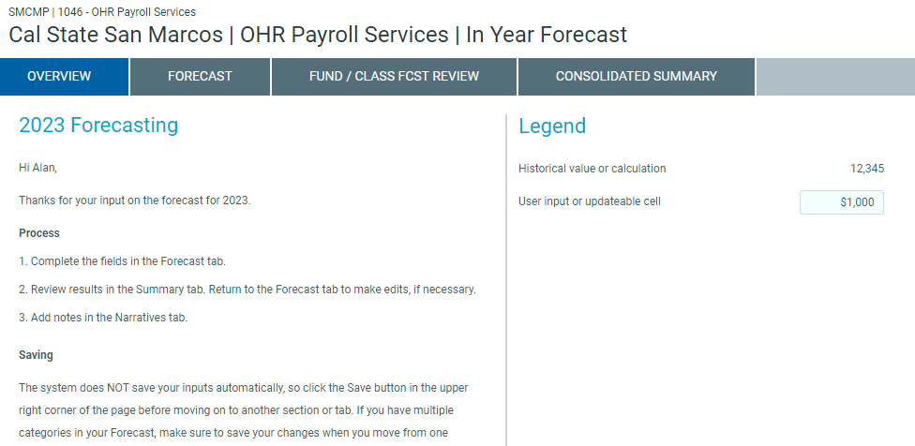
Select the Forecast tab:

Slide 6
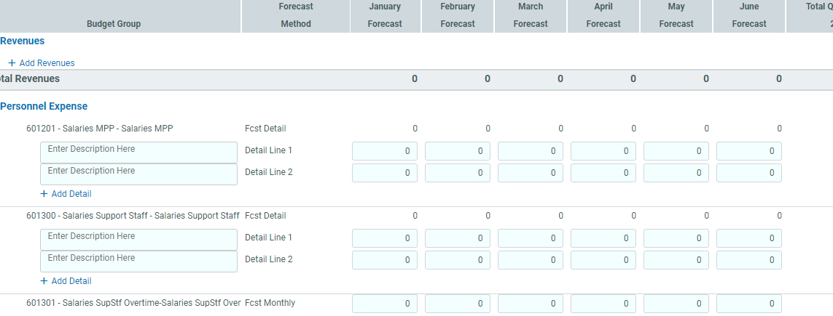
Enter the projected expenses for each account listed for January through June:
Notes:
The Forecast tab has many columns including the past 2 years of actual expenses, current budget, year to date actual expenses,
actual expenses by month to date, projected expenses by month, encumbrance, budget balance available and comments.
You will need to navigate to the right to see the empty cells where projected expenses by month can be entered for January through June.
Then, enter the projected expenses for each account listed for January through June.
Accounts such as “601201 – Salaries MPP” use a Forecast Method called “Fcst Detail” and can have additional detail lines entered as shown in the example above. Entering additional information in these lines is not required by the Budget Office for reporting purposes.
For accounts such as “601301 – Overtime,” only a total monthly amount can be entered.
Note: Please split the projected expenses between January – June as relevant, do not enter all expenses into June, unless you plan to spend all remaining funds in the
month of June.

Slide 7
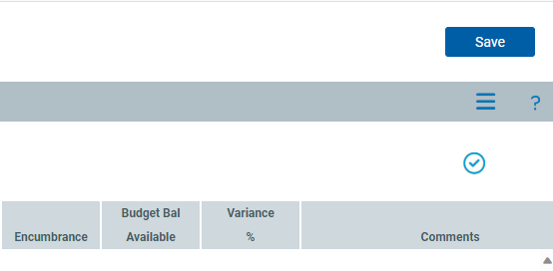

After completing the department’s expenditure projects, click Save in the upper right corner.
Tip: We encourage users to save their work periodically while in Axiom, as the system may time-out.

Slide 8
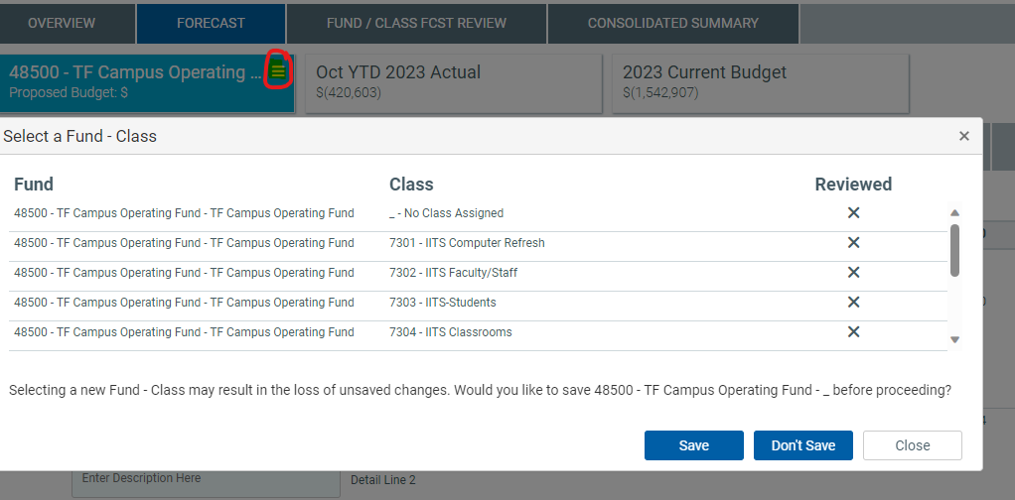
Additional Steps for Departments with Class Codes:
Notes:
If the department uses class codes, data for other class codes can be viewed by clicking on the burger icon by the fund in the upper left corner as shown.
Select the class code you would like to view and click either:
<save> (to save data entered in prior screen) or
<don’t save> (to discard changes made to prior screen) to navigate to forecast screen for that class code
<close> will not select a class code, you will still see a forecast screen for “no class code assigned.”
Projections for each class code will need to be entered on the relevant class code page.
Note which class code you’re working in, Axiom will not display this info.
Data Warehouse Note:
When pulling data for your department be sure to display class codes as well so you can see budget and actuals for “no class assigned” as well as any active class codes.
If class codes are used, Axiom will separate actuals in the forecasting screens, and you won’t see the same totals as in Data Warehouse.
You will be able to run a report in Axiom that combines the totals.

Slide 9
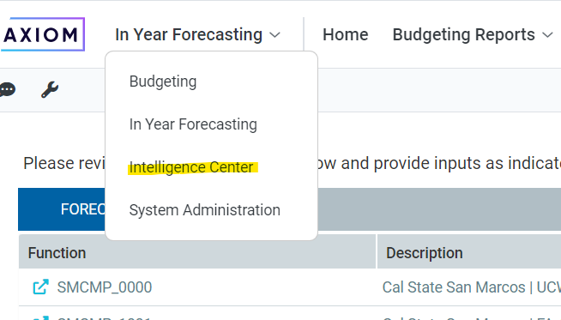
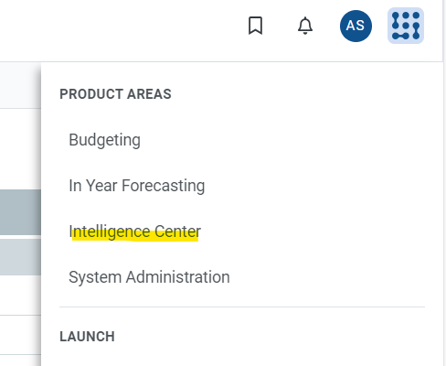
Running a report in Axiom:
Select Intelligence Center from dropdown menu or navigation matrix (waffle)
Notes:
Running an Axiom report will allow you to view total expenditures for a department, combining class codes with “no class code assigned.”
Reports that may be useful for mid-year can be found in the Budget Reports folder.

Slide 10
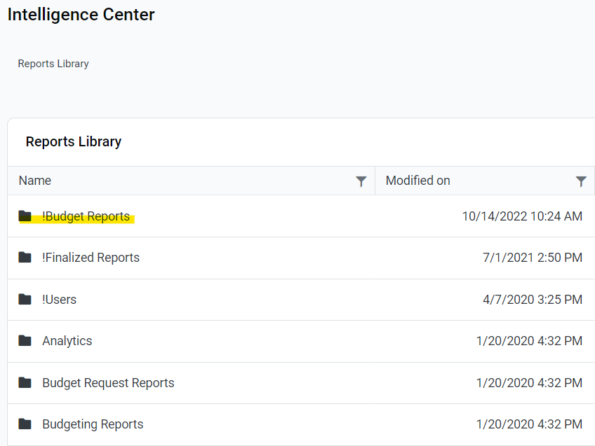
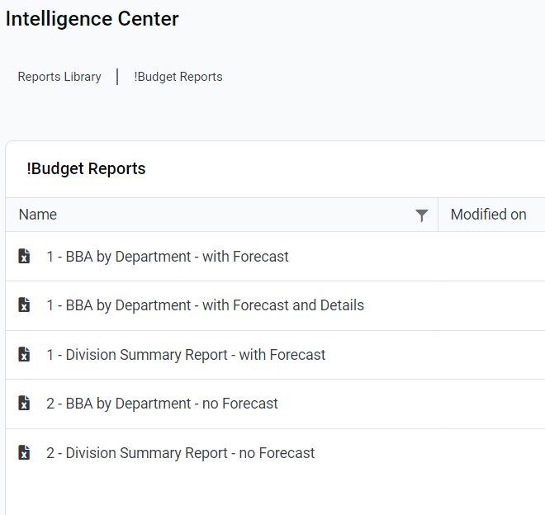
From the Intelligence Center, double click on the Budget report that you would like to use in the “!Budget Reports” menu:
Tip: An index of Axiom Reports describing what each offers can be found in the User Guide on the Budget web page
Notes:
Double click on the report that you would like to use. The report will open in Excel. The default Axiom spreadsheet will also open.
Please note that the report may open up behind the default spreadsheet.

Slide 11
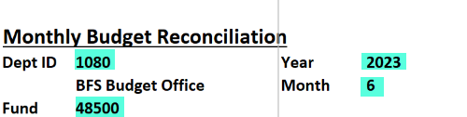
Select the department criteria you wish to view and Click <F9> to refresh the data in the report.
Example (from “BBA by Department – no Forecast” report):
Notes:
Axiom reports are intended to provide reporting data to you and your division/department as needed.
You do not need to export these reports and submit them to the Budget Office as a part of your mid-year package – we can run the reports through Axiom once your projections are completed.

Slide 12
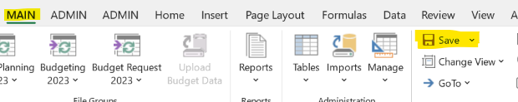
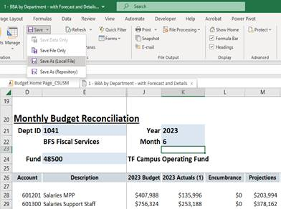
Save report in Excel:
Click down arrow next to Save menu
Save As:
Local File
Notes:
To save a populated report in Excel, from the Main menu, Click the down arrow next to <save> and select “Save As (Local File)”
You can then share/email this report as you would any other Excel file

Slide 13
Help Resources
Budget Office –
Assistance with Axiom use, permissions, and access
budget@csusm.edu
Budget Web Page ←(filler-update link to Axiom training guide)
FSO –
Assistance with Axiom permissions and access
fso@csusm.edu
IITS –
Assistance with system downloads for initial access
Contact for “Admin password required” error
helpdesk@csusm.edu
(760) 750-4790

